Slide 1
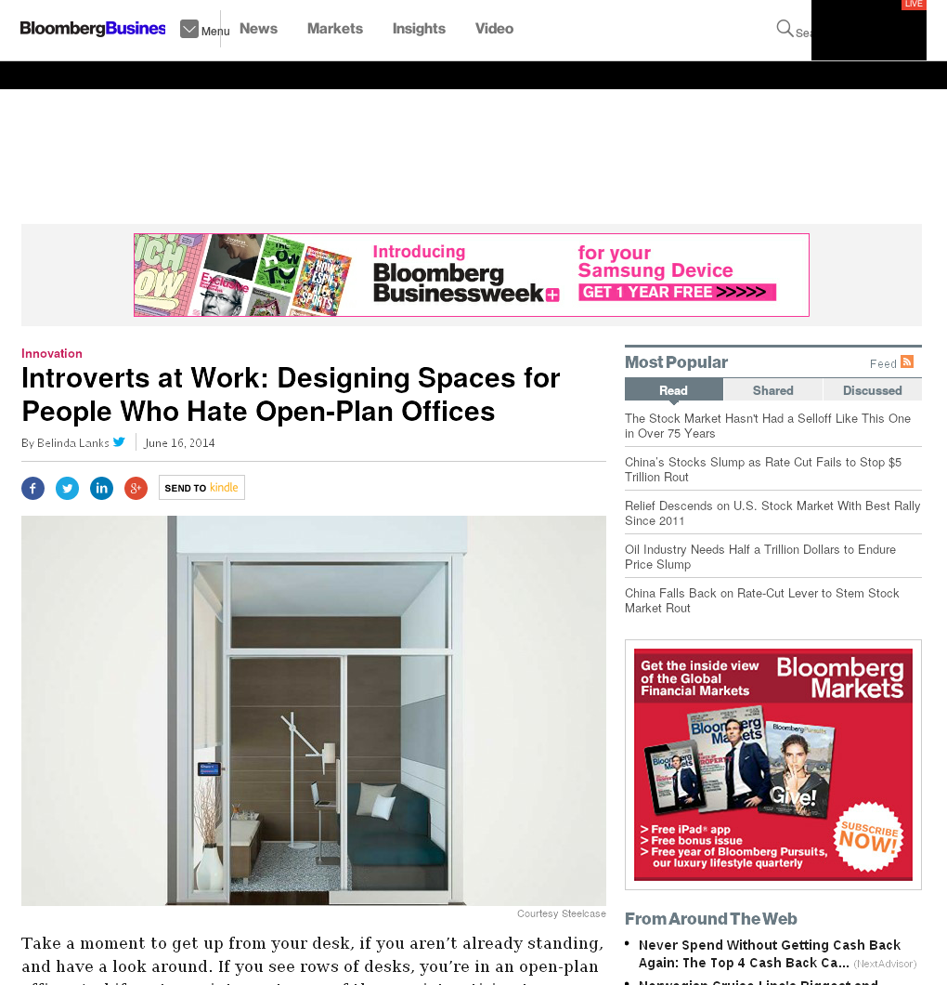

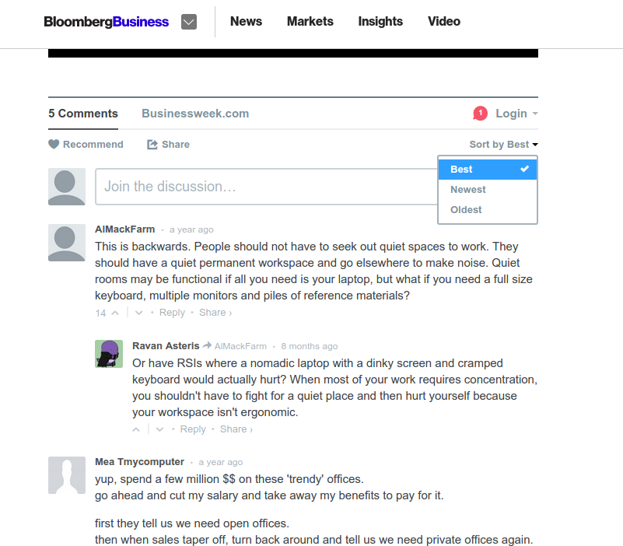


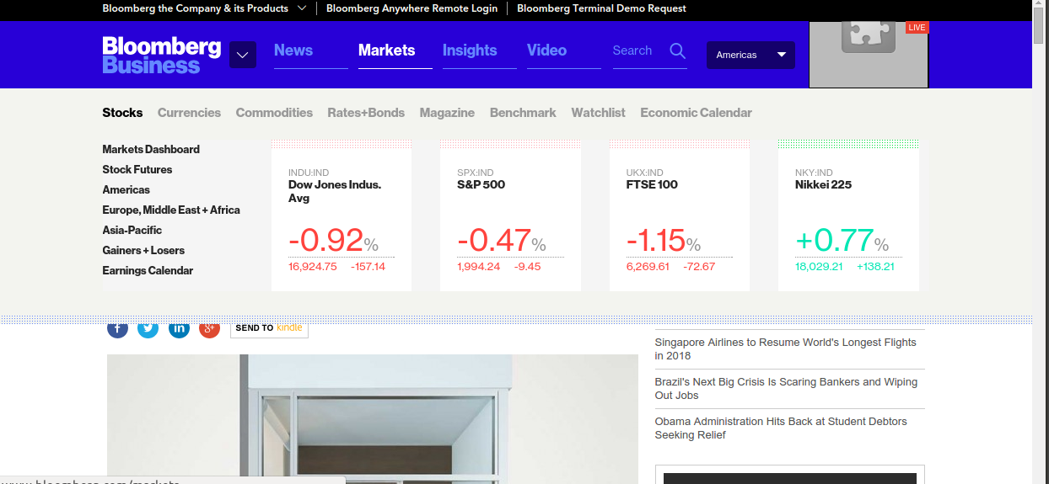
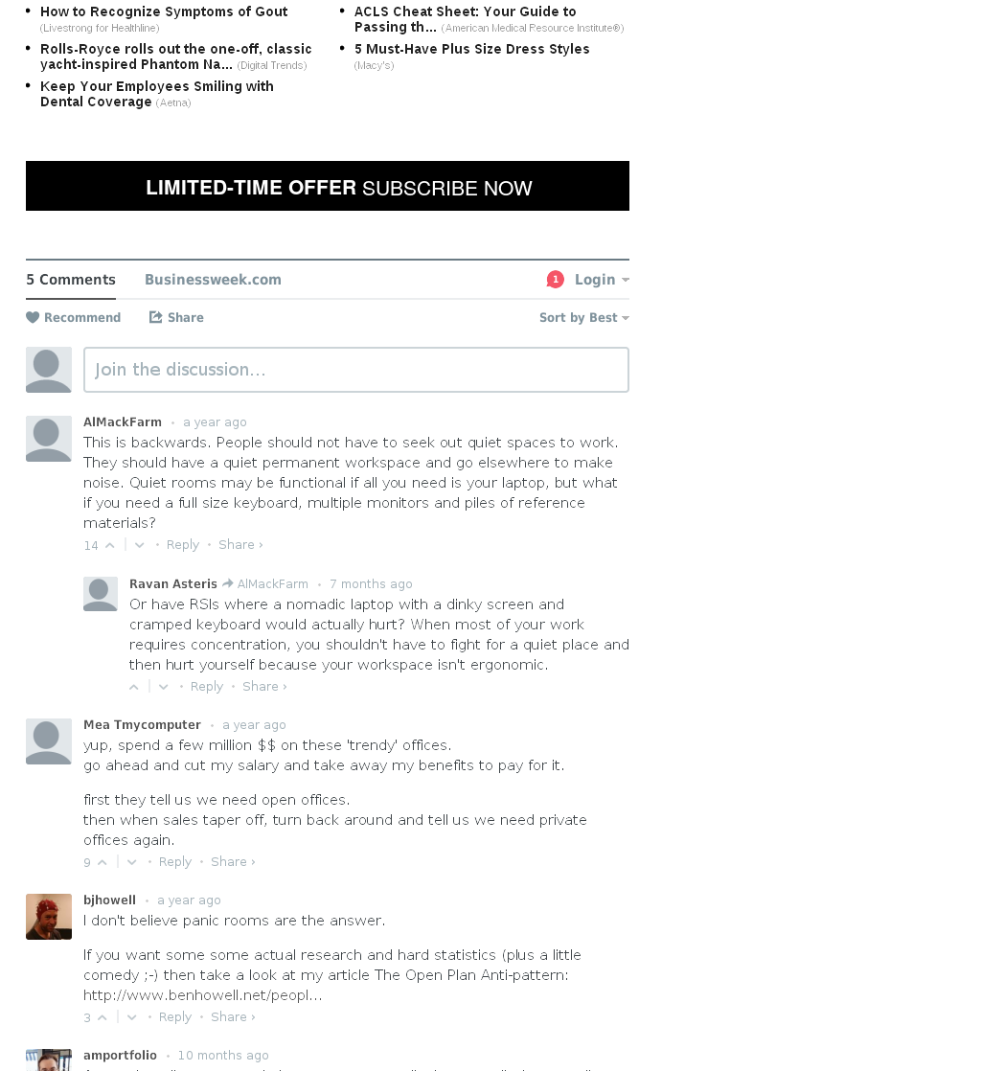
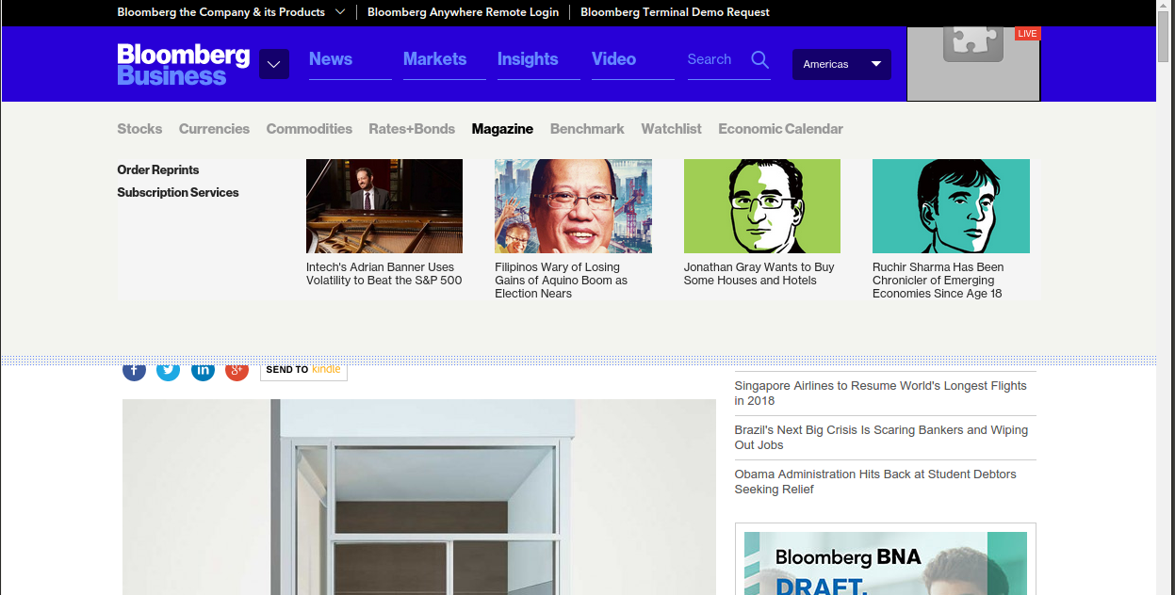
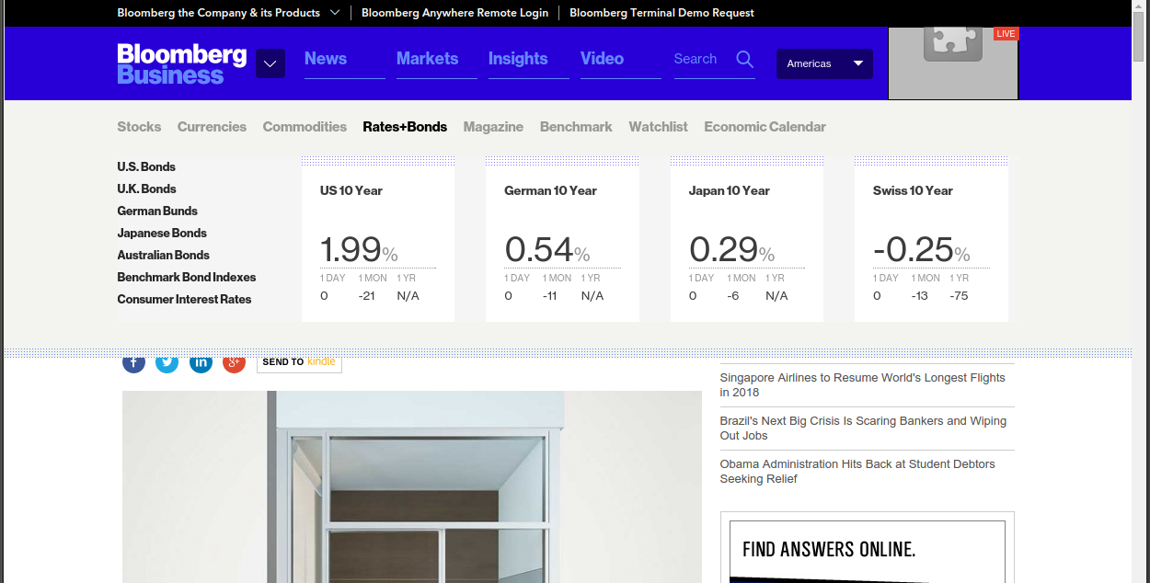
onMouseOver P
onClick Ps
s₀
mouseOver
click
click
s₁
mouseOver
s₂
http://www.bloomberg.com/bw/articles/2014-06-16/open-plan-offices-for-people-who-hate-open-plan-offices

