Slide 1
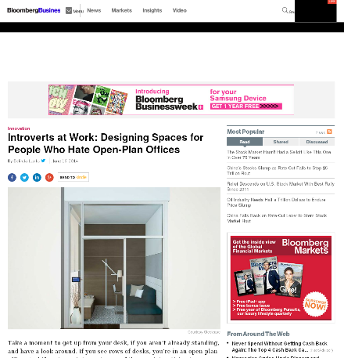


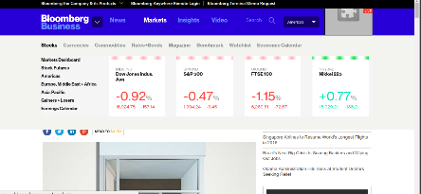

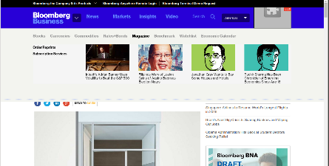
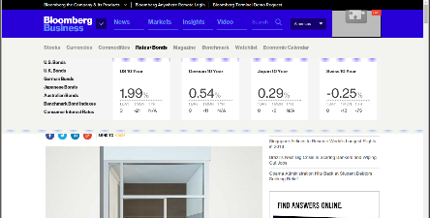
s₀
s₀
mouseOver
V_{a}
s₁
mouseOver
V_{b}
V_{c}
V_{d}
s₂
http://www.bloomberg.com/bw/articles/2014-06-16/open-plan-offices-for-people-who-hate-open-plan-offices

