Slide 1
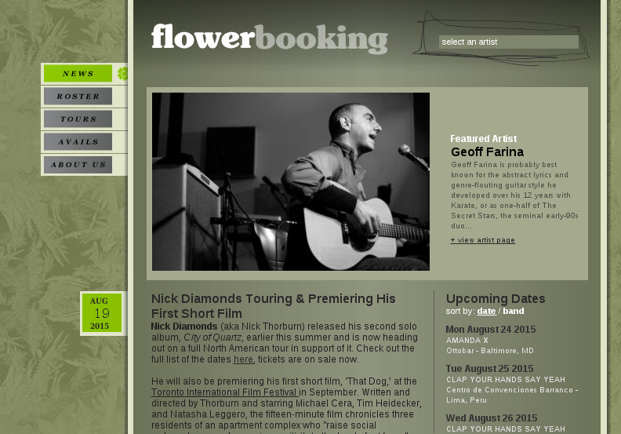




URI-R
a
s0
onclick
onclick
b
c
s1
onclick
onclick
d
c
s2

Slide 2

URI-R
a
s0
onclick
onclick
b
c
s1
onclick
onclick
d
c
s2
Client-side
States

Slide 3
URI-R
a
s0
onclick
onclick
b
c
s1
onclick
onclick
d
c
s2
Client-side State levels

Slide 4
URI-R
a
Non-terminating client-side state
s0
onclick
onclick
b
c
s1
onclick
onclick
d
c
s2

Slide 5
URI-R
a
Terminating client-side state
s0
onclick
onclick
b
c
s1
onclick
onclick
d
c
s2

Slide 6
URI-R
a
s0
onclick
onclick
b
c
s1
onclick
onclick
d
c
s2
onclick
terminates, despite having an interaction because no new embedded resource is required
c
c
c

Slide 7
URI-R
a
s0
onclick
onclick
b
c
s1
onclick
onclick
d
c
s2
c
a
Deferred Representation s0 of URI-R
b
Non-terminating descendent
(s Є S)
c
Terminating descendent
(s Є S)
d
Final states
(f Є F)

