Slide 1

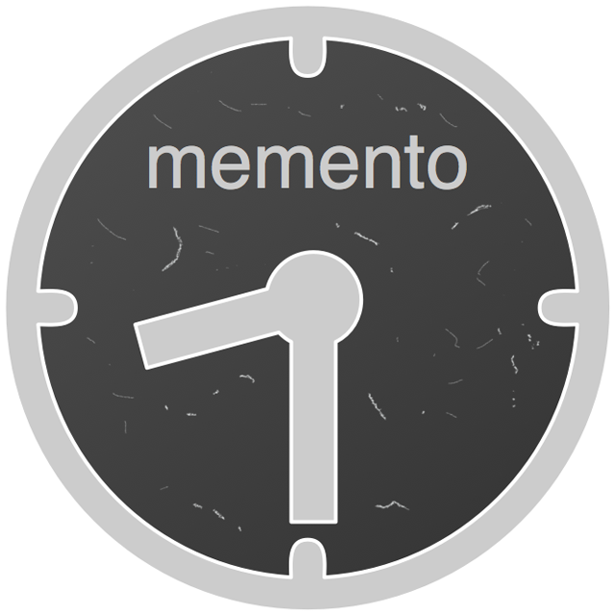
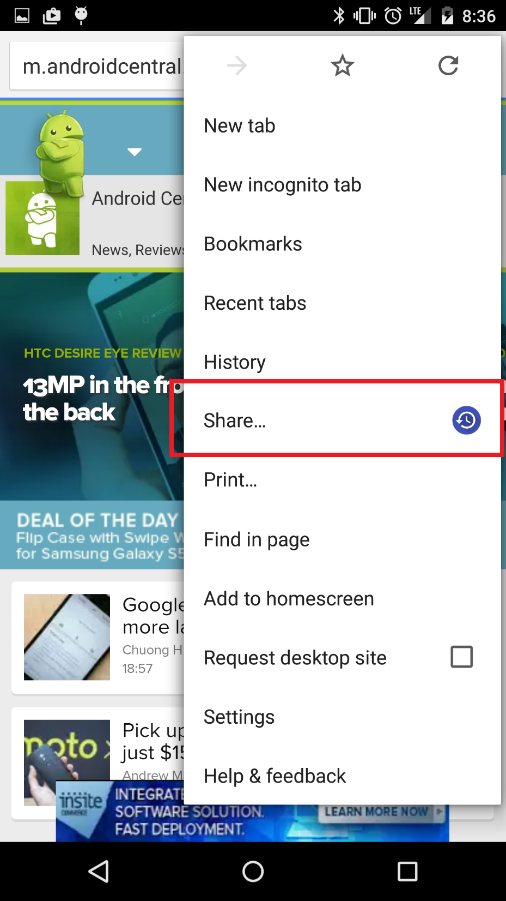
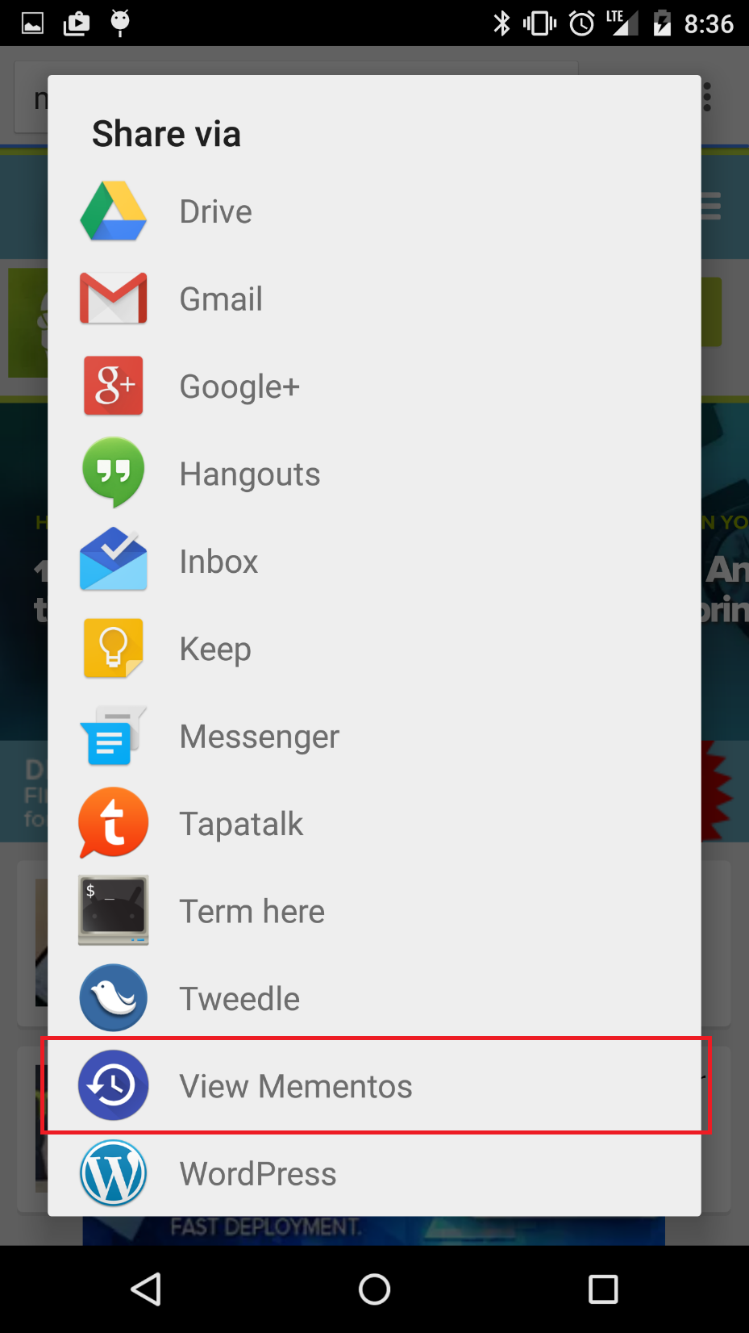
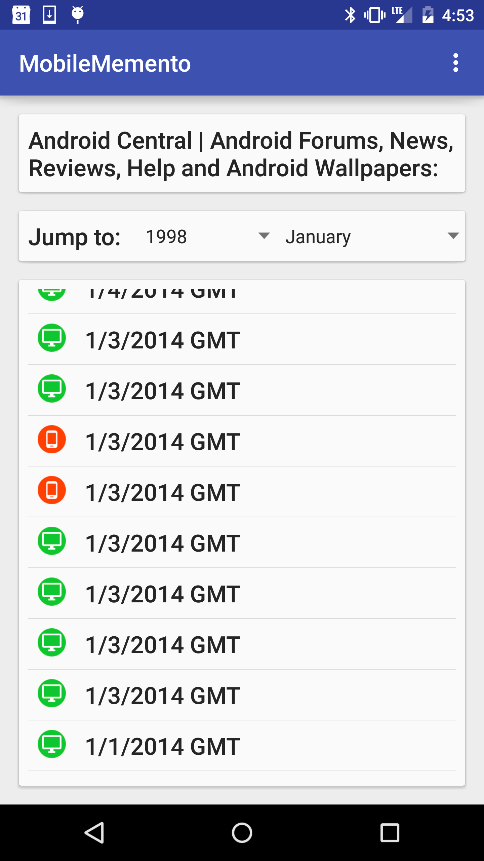
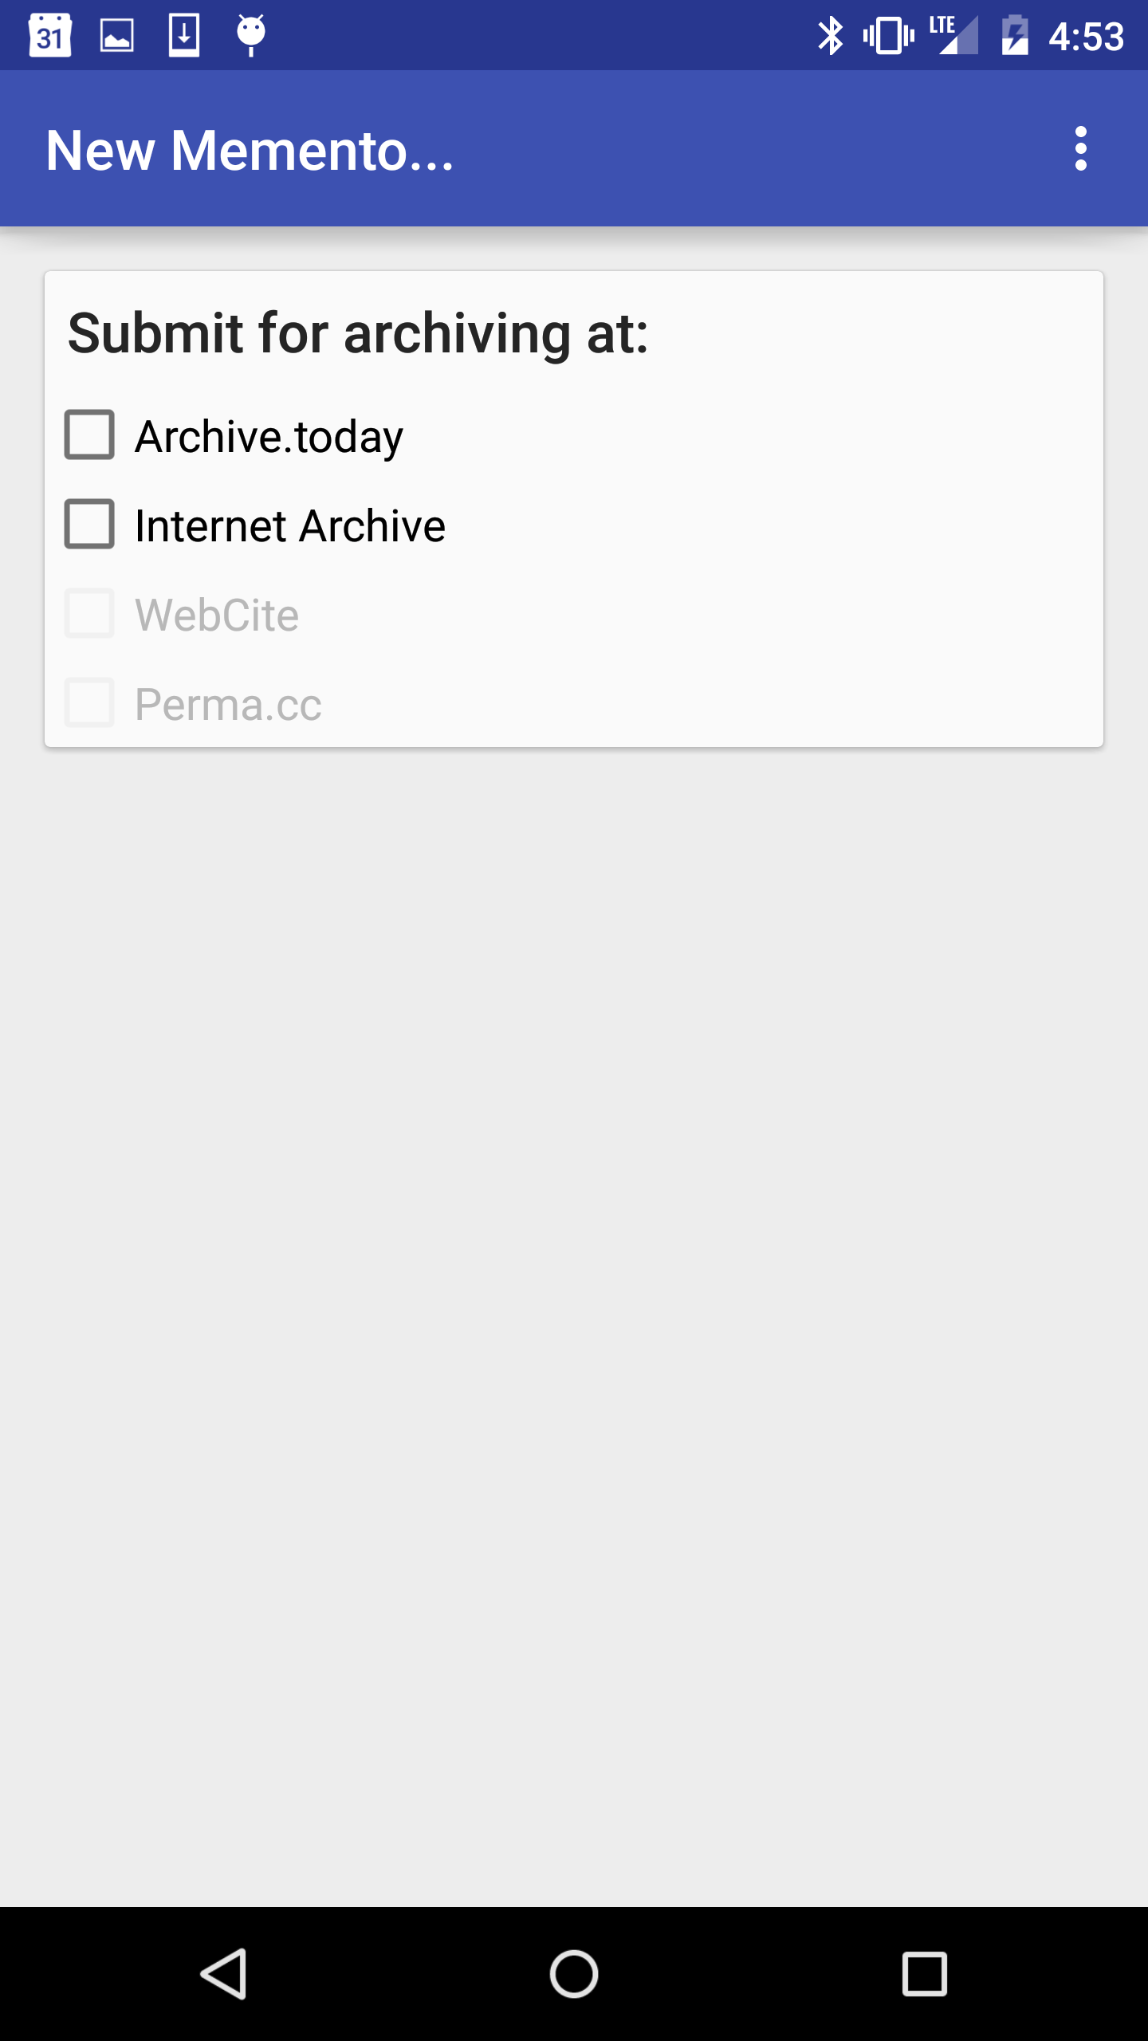
Mobile Mink: Merging Mobile and
Desktop Archived Webs
Wesley Jordan, Mat Kelly, Justin F. Brunelle, Laura Vobrak,
Michele C. Weigle, Michael L. Nelson
Navigate to a URI-R
Select the “share” menu, and Mobile Mink discovers mobile or desktop versions of the resource.
Ask for an aggregated TimeMap,
Giving the user a TimeMap of merged URI-Ms from the desktop and mobile webs.
Note that the TimeMap is merged, providing a way to easily select mobile or desktop mementos.
Mobile Mink allows users to request the Internet Archive's Save Page Now or Archive.today create a memento of both the desktop and mobile resources with a single click, helping to increase the archival coverage of the mobile web.
Purpose and Contributions
Mobile Mink extends the desktop browser version of Mink. Mobile Mink discovers mobile and desktop URIs and provides the user an aggregated TimeMap of both mobile and desktop mementos. Mobile Mink also allows users to submit mobile and desktop URIs
for archiving at the Internet Archive and Archive.today. Mobile Mink helps increase the archival coverage of the growing mobile web.
Mobile Mink helps merge the mobile and desktop webs in the archives, increasing archival coverage of the mobile web through end user curation. End users are offered the feature of pushing URI-Rs of mobile sites into page-at-a-time archival services (Archive.today and the Internet Archive's Save Page Now services) and presents the TimeMap of both the mobile and desktop URI-Ms in an aggregate TimeMap.
This work takes a step toward increasing the archival coverage of the mobile web (which is often unarchivable by automatic crawlers since they do not use a mobile user-agent).
Acknowledgements and References
This work supported in part by the NEH HK-50181. This work was performed as part of Wesley Jordan’s mentorship at The MITRE Corporation. The author’s affiliation with The MITRE Corporation is provided for identification purposes only, and is not intended to convey or imply MITRE’s concurrence with, or support for, the positions, opinions or viewpoints expressed by the author.
A. Jindal, C. Crutchfield, S. Goel, R. Kolluri, and R. Jain. The mobile web is structurally different. In INFOCOM Workshops 2008, IEEE, pages 1–6, 2008.
M. Kelly, J. F. Brunelle, M. C. Weigle, and M. L. Nelson. A method for identifying dynamic representations in the archives. D-Lib Magazine, 19(11/12), November/December 2013.
M. Kelly, M. L. Nelson, and M. C. Weigle. Mink: Integrating the Live and Archived Web Viewing Experience Using Web Browsers and Memento . In DL ’14, September 2014.
A. Rossi. Fixing Broken Links on the Internet. https://blog.archive.org/2013/10/25/fixing-broken-links/, 2013.
F. McCown, M. Yarbrough, and K. Enlow. Tools for discovering and archiving the mobile web. D-Lib Magazine, 21(3/4), March/April 2015.
R. Schneider and F. McCown. First Steps in Archiving the Mobile Web: Automated Discovery of Mobile Websites. In JCDL ’13, pages 53–56, 2013.
H. Van de Sompel, M. L. Nelson, R. Sanderson, L. L. Balakireva, S. Ainsworth, and H. Shankar. Memento: Time Travel for the Web. Technical Report ArXiv:0911.1112, 2009.
B. V. Wakode, D. N. Choudhari, and V. M. Thakare. Accessing Web Content on Mobile Devices: Relevance, State of the Art and Future Direction. International Journal of Computer Science & Applications (TIJCSA), 1(4):16–21, 2012.

