Slide 1

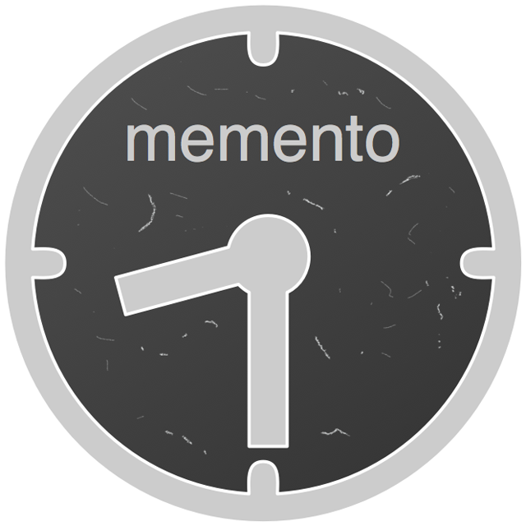
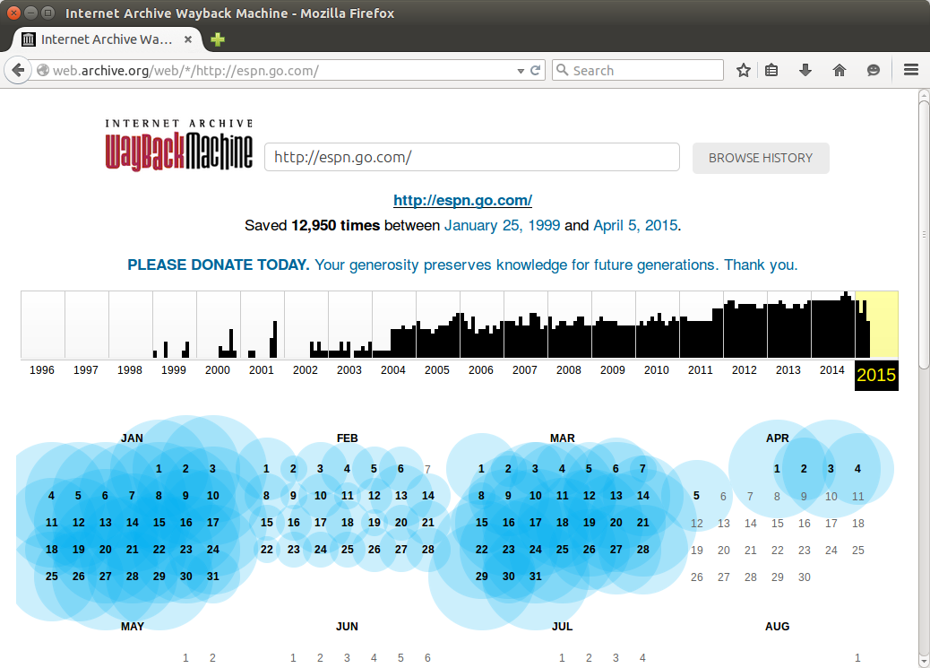
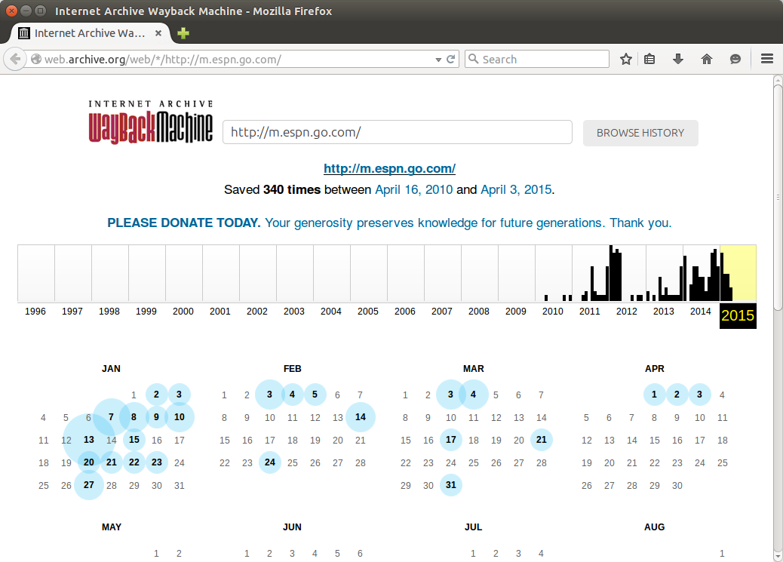
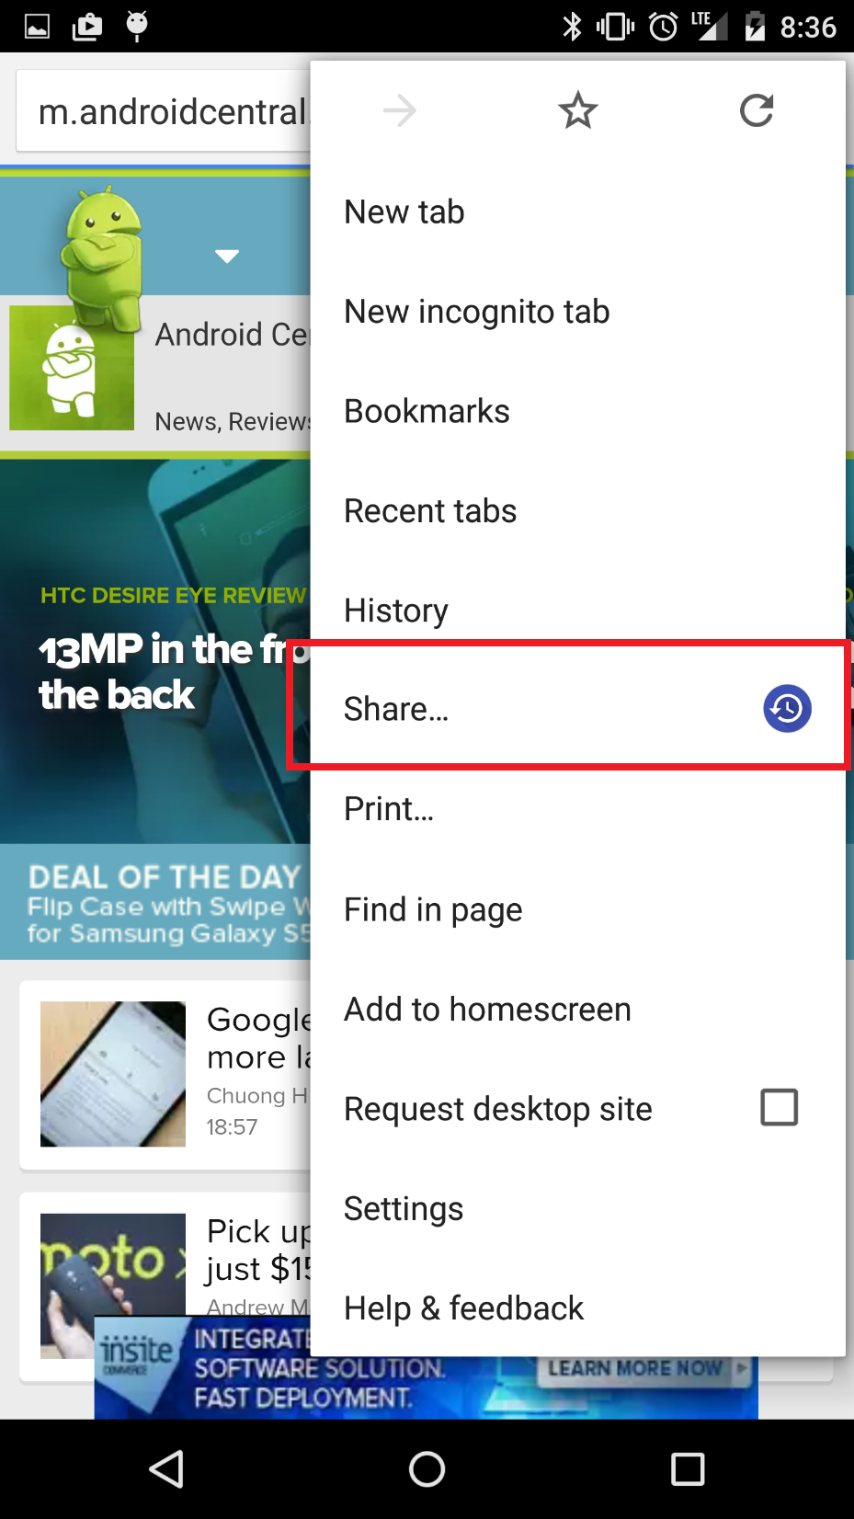
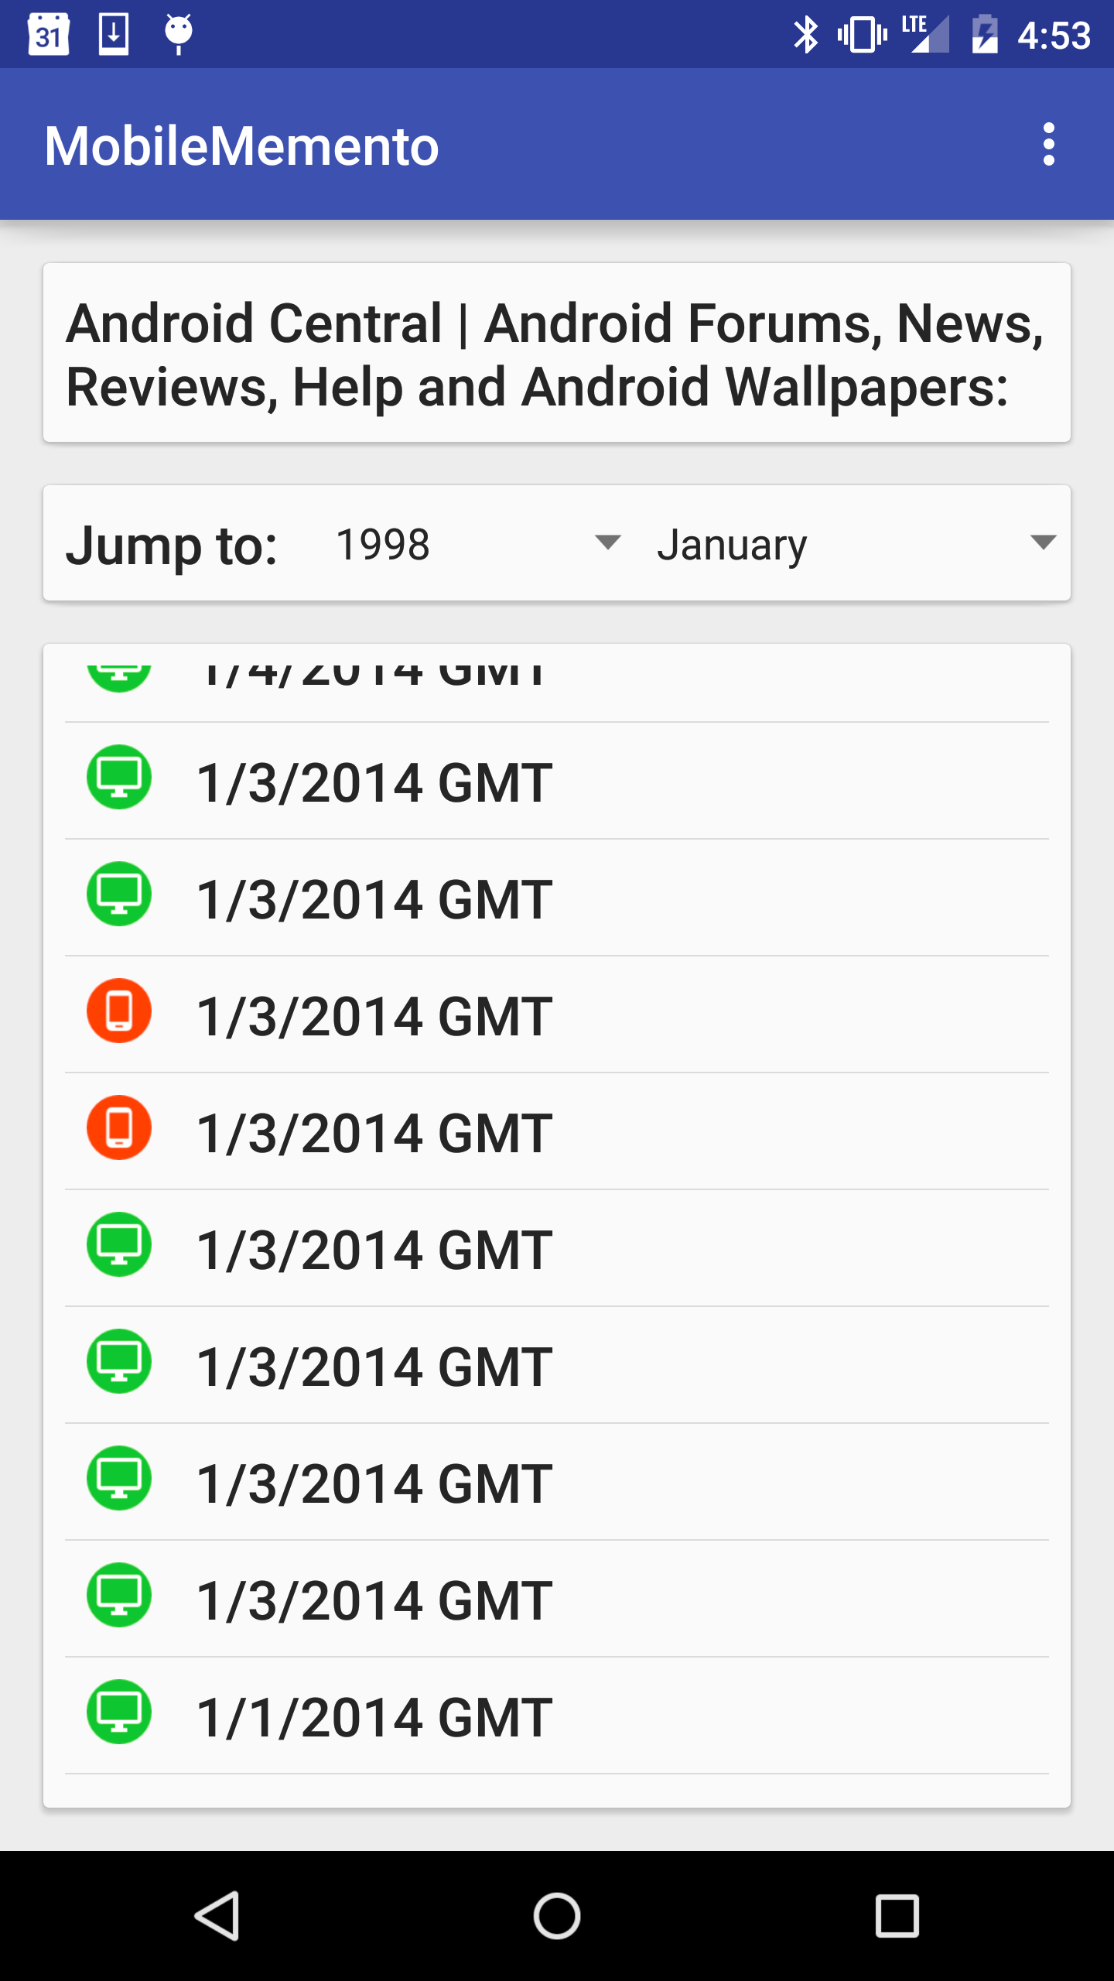
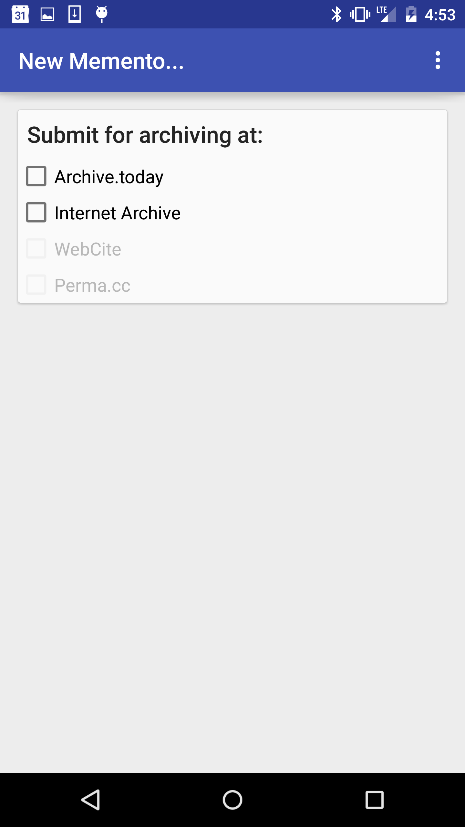
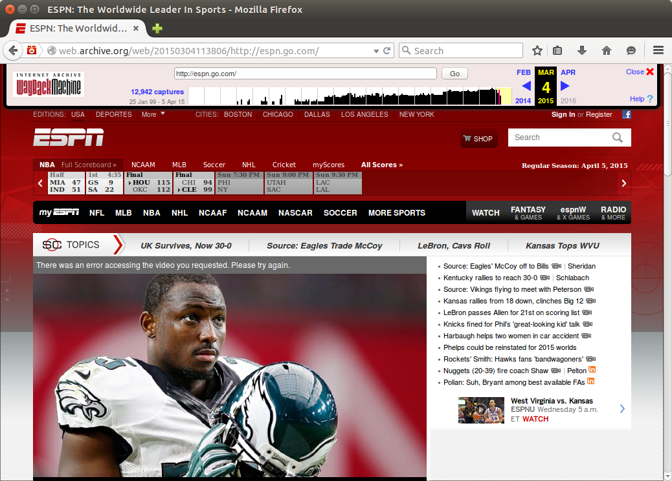
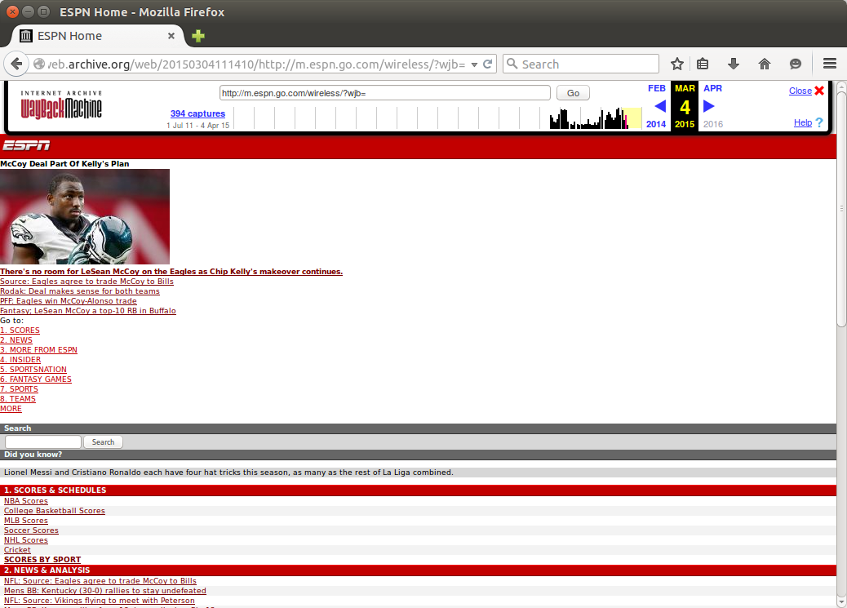

Mobile Mink: Merging Mobile and
Desktop Archived Webs
Wesley Jordan, Mat Kelly, Justin F. Brunelle,
Laura Vobrak, Michele C. Weigle, Michael L. Nelson
Desktop and Mobile Webs differ
(even in the archives)
MobileMink extends Mink
Desktop and mobile URI-Rs can differ. Same information, different TimeMaps.
http://espn.go.com/
http://m.espn.go.com/
Browse to a URI-R
Potential content-negotiation from user-agent
accessed from the “Share” menu
Discovers mobile and desktop URI-Rs
Uses Memento to get all available TimeMaps
Provides integrated TimeMap
Offers users ability to submit mobile and desktop URI-Rs to archives
Increases coverage of mobile URI-Rs in the archives
Desktop URIs are much more prevalent than their mobile counterparts in the archives due to factors such as user-agent of archival crawlers.
Mobile URIs are not as populated in the archives, even though the representations are different than their desktop counterparts.
More about...
Acknowledgements
downloading MobileMink: http://bitly.com/MobileMink/ (?)
how MobileMink works: upcoming blog post...
using Mink in your desktop browser: http://...
This work supported in part by the NEH HK-50181. This work was performed as part of Wesley Jordan’s mentorship at The MITRE Corporation. The author’s affiliation with The MITRE Corporation is provided for identification purposes only, and is not intended to convey or imply MITRE’s concurrence with, or support for, the positions, opinions or viewpoints expressed by the author.

