Slide 1

Evaluating the SiteStory Transactional Web Archive With the ApacheBench Tool
Justin F. Brunelle
Michael L. Nelson
Lyudmila Balakireva
Robert Sanderson
Herbert Van de Sompel

Slide 2
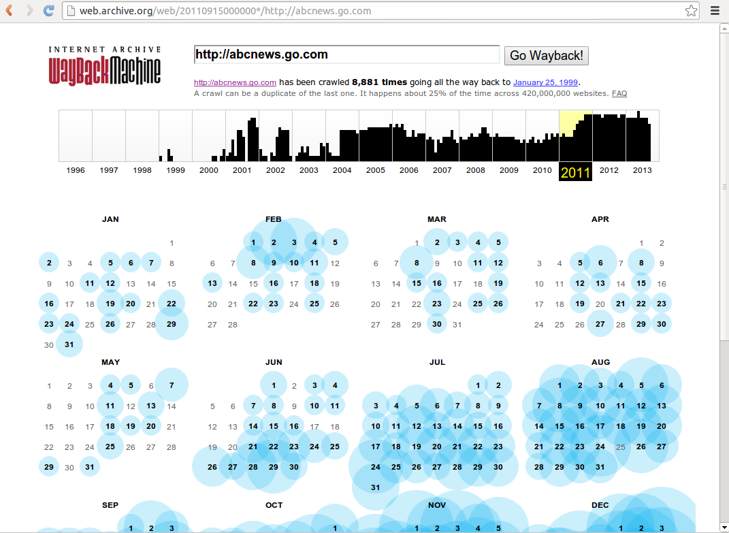
Notes:
Soundtrack:
The Internet Archive got smart about crawling ABC News in July of 2011. But before that, there are large gaps in mementos captured. We will take Jan 12, 2011 as our first observation date. There are three days without corresponding mementos before we arrive at our second observation date of Jan 16, 2011.

Slide 3


Slide 4


Slide 5
Problem
People view ABC News all the time
No mementos for “all the time”
Missed stories
Solution: Transactional Archiving!

Slide 6
Agenda
SiteStory
Experiment Design
Benchmark Results
Conclusions
Traditional Archiving

Slide 7
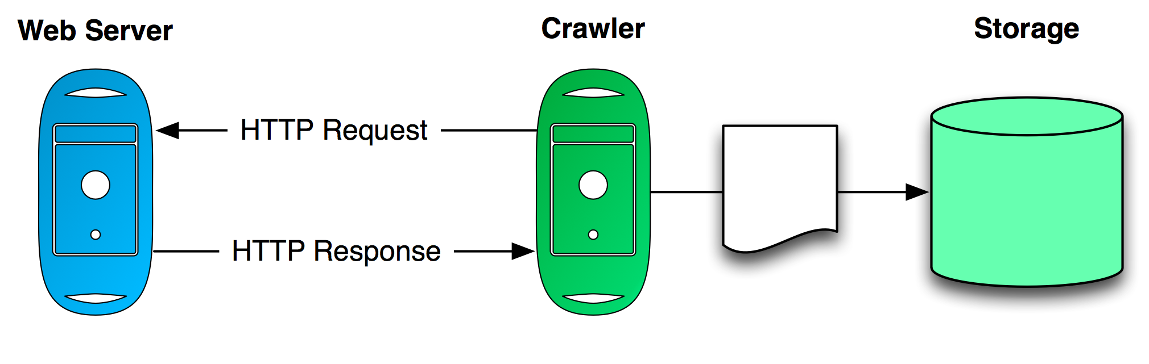
Traditional Web Archiving
Active crawling
Heritrix

Slide 8
Issues with Traditional Web Archiving
Request can be rejected (robots.txt, user-agent, IP)
Can be deceived (geo-location, user-agent)
Can be trapped (crawl my calendar!)
Resource-intense (bandwidth)
Recrawl vs. change-rate

Slide 9
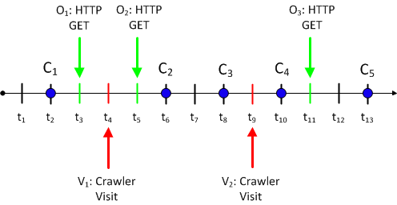
Missed Updates
Notes:
Updates are the blue dotes. We miss update C2 and C4. Does it matter that we miss C2? (Tree falls in the woods…). It definitely matters if we miss C4 with the crawler.

Slide 10
Agenda
SiteStory
Experiment Design
Benchmark Results
Conclusions
Traditional Archiving

Slide 11
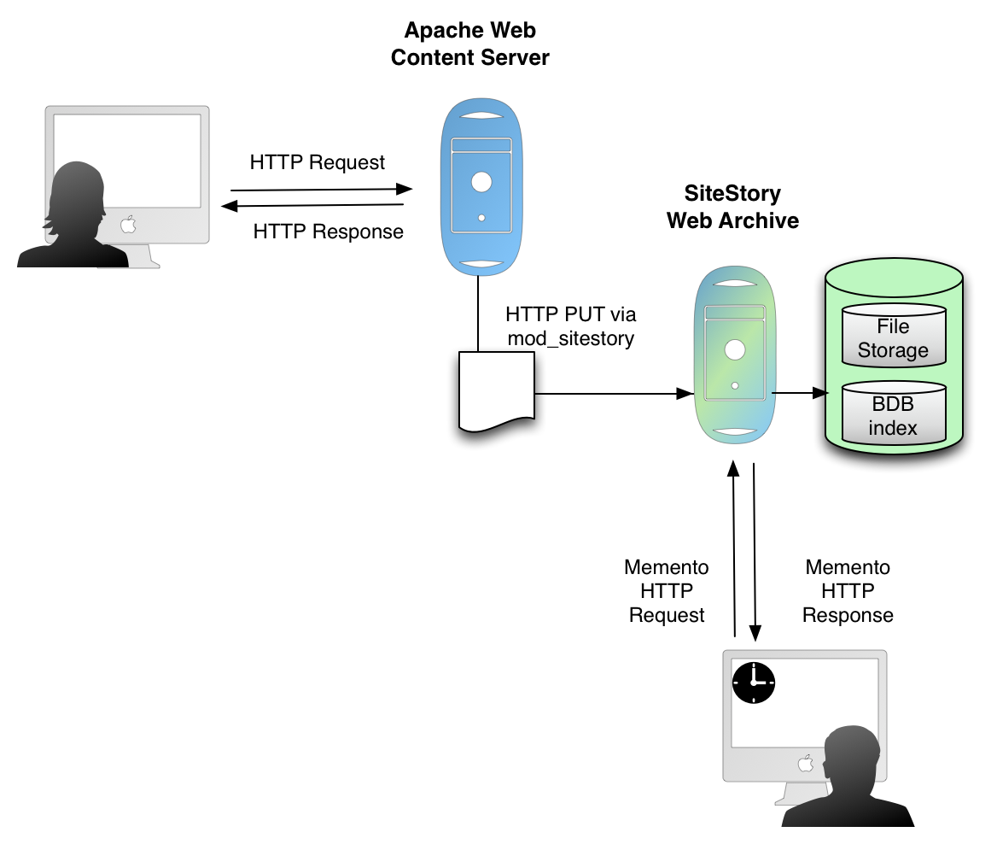
Notes:
Describe sitestory here: archives on servers based on http gets, stored in a memento-complient archive, etc. etc.

Slide 12
Now we have them all
Notes:
Updates are the blue dotes. With SiteStory, we get all the updates except C2

Slide 13
Agenda
SiteStory
Experiment Design
Benchmark Results
Conclusions
Traditional Archiving

Slide 14
Benchmark with ab
ApacheBench: ab
-n [Number of Connections]
-c [Concurrency]
Benchmarked with SiteStory on & off
Notes:
ApacheBench is a tool to benchmark apache servers. Takes number of connections and concurrency of those connections as parameters. We benchmarked an apache server with sitestory both on and off. This measured the server’s ability to deliver content over a network.

Slide 15

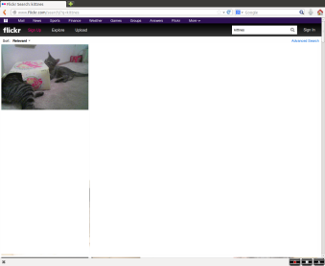
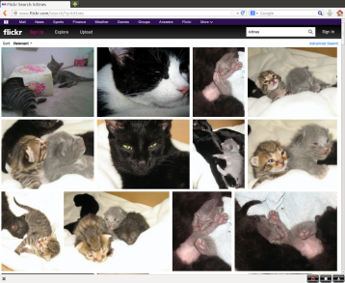







Benchmark with wget
x99
,
,…,
megalodon.lanl.gov
TWA@AWS
ws-dl-03.cs.odu.edu
Notes:
For the wget tests, we created 100 resources with 0-99 embedded images. These were PHP pages that also included the current datetime. We executed wget –p for each of them and timed the total round-trip time. We also executed this with sitestory on and off. This measured the performance of the server when a resource was constantly changing and also has many embedded resources.

Slide 16
Agenda
SiteStory
Experiment Design
Benchmark Results
Conclusions
Traditional Archiving
Notes:
We set up an experiment on a local LAN between two networked machines.

Slide 17
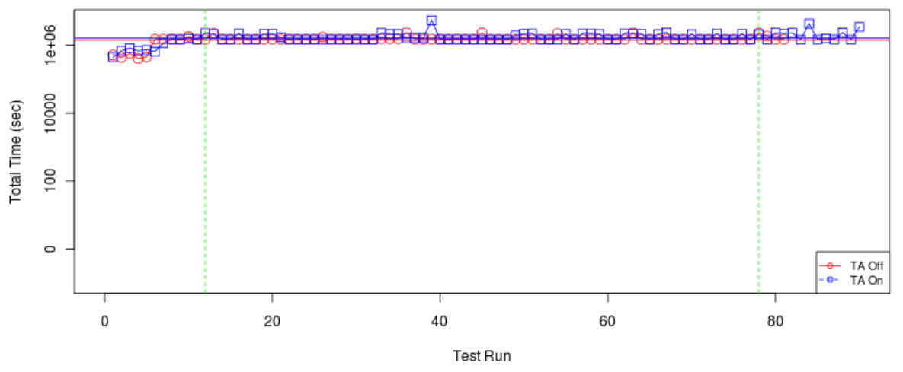
Testing LAN with ab
Notes:
The server’s ability to return content is not impacted be SiteStory running based on the ab tests.

Slide 18
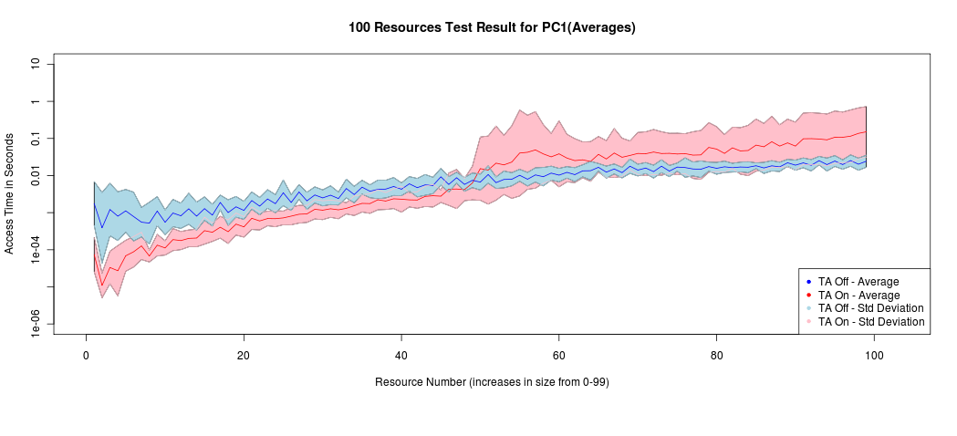
Benchmark with wget (unburdened)
Notes:
The wget tests show that (as expected) more embedded resources creates a longer round-trip time. SiteStory runs slower with the increased files, and worsens as compared to when sitestory is off as more embedded resources are present. In these graphs, the middle line is the average over about 100 tests, and the filled in area is the standard deviation. However, we were using an unburdened server.
The dip in the beginning of the graph can be attributed to a cold start – the difference is in the order of milliseconds.

Slide 19
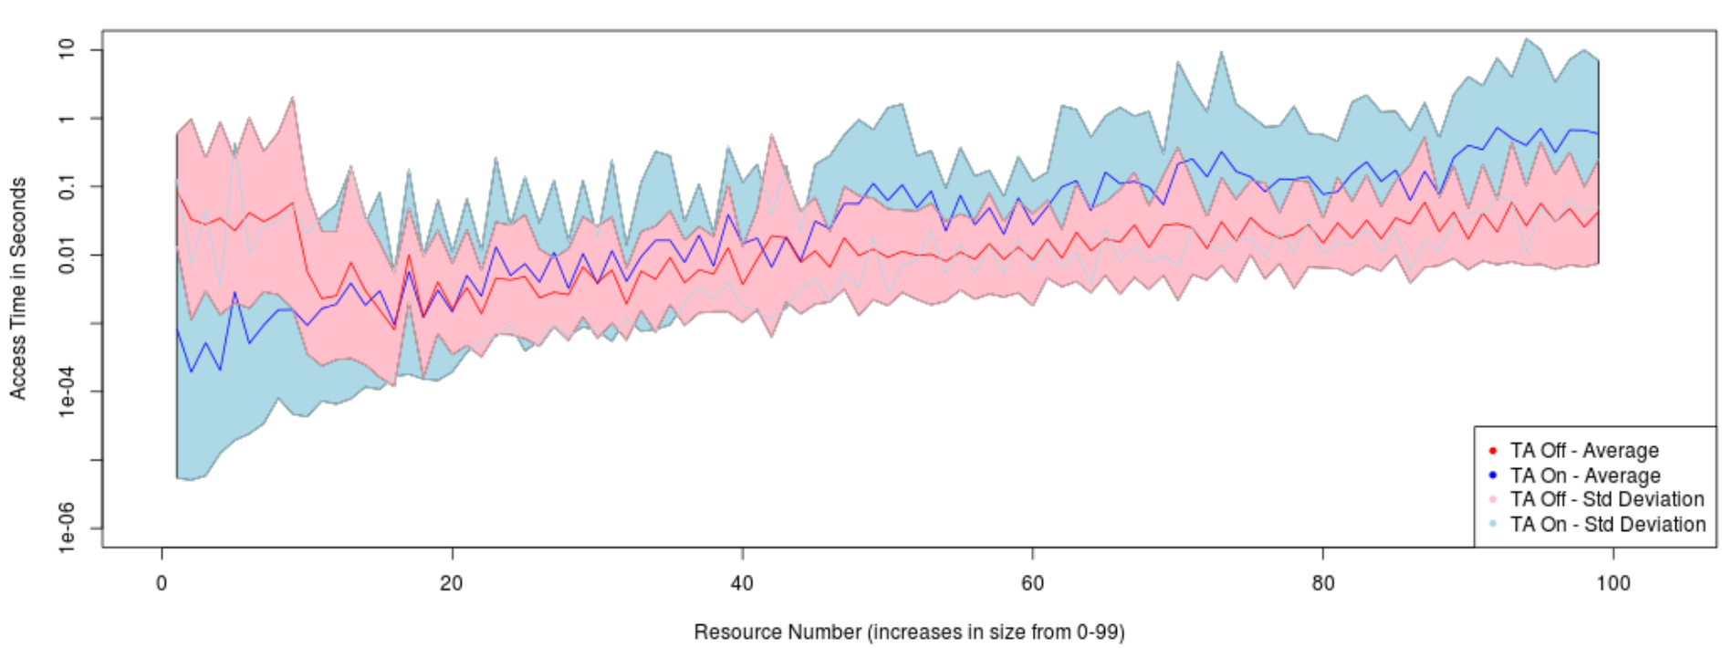
Benchmark with wget (burdened)
Notes:
We burdened the server by simulating user access to pages hosted by the server. The resulting statistics show that the burden creates higher variance, as expected, but the sitestory

Slide 20
Results
Negligible difference SiteStory On vs Off
Limited to local LAN
Performance over WAN?

Slide 21
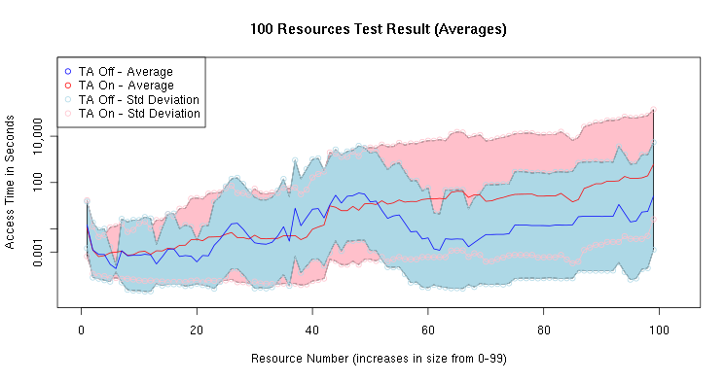
Testbed Performance
Notes:
The testbed has higher variance and poorer performance because of the longer network delays. (between ODU and LANL)

Slide 22
SiteStory Testbed
We have a SiteStory Web Archive installed for you!
Install and configure mod_sitestory
Send an email containing:
Your contact info
Web server IP address
Server domain name used
Happy Sitestory’ing!
mailto: SiteStory-Testbed@googlegroups.com

Slide 23
Agenda
SiteStory
Experiment Design
Benchmark Results
Conclusions
Traditional Archiving

Slide 24
Results
Distributed: Higher variance
Increased delay due to network
On vs. Off Comparison still comparable

Slide 25
Conclusions
Small performance difference
Viable solution without crippling service
http://mementoweb.github.io/SiteStory/

Slide 26
Backups

Slide 27
Sample ab output
$ ab -n 10 -c 2 "http://www.cs.odu.edu/"
This is ApacheBench, Version 2.3 <$Revision: 655654 $>
…
Server Software: Apache/2.2.17
Server Hostname: www.cs.odu.edu
Server Port: 80
Document Path: /
Document Length: 62289 bytes
Concurrency Level: 2
Time taken for tests: 0.213 seconds
Complete requests: 10
Failed requests: 0
Write errors: 0
Total transferred: 624810 bytes
HTML transferred: 622890 bytes
Requests per second: 47.01 [#/sec] (mean)
Time per request: 42.540 [ms] (mean)
Time per request: 21.270 [ms] (mean, across all concurrent requests)
Transfer rate: 2868.66 [Kbytes/sec] received
…
Connection Times (ms)
min mean[+/-sd] median max
Connect: 0 1 0.0 1 1
Processing: 27 41 10.8 45 62
Waiting: 3 3 0.4 4 4
Total: 27 41 10.8 45 63
Percentage of the requests served within a certain time (ms)
50% 45
66% 46
75% 46
80% 46
90% 63
95% 63
98% 63
99% 63
100% 63 (longest request)

