Slide 1
pgr week
Style

Slide 2
intended learning outcomes
design research that produces rigorous results
locate, appraise, and summarise relevant literature
write a clear and concise research paper
present a persuasive presentation on the research paper
proofread and referee

Slide 3
seven simple suggestions
The following material is based on “How to write a great research paper” talk by Simon Peyton-Jones
Make a written note of anything you don’t expect

Slide 4
#1: Don’t wait - write!

Slide 5
writing papers model 1
idea
research
write paper

Slide 6
writing papers model 2
idea
research
write paper
idea
write paper
research

Slide 7
writing papers model 2
idea
write paper
research
writing is doing research - not just reporting research
forces us to be clear / focused
articulates what we don’t understand
opens the way to collaborate with others

Slide 8
do not be intimidated
fallacy - you need to have a fantastic idea before you can write a paper
write a paper / give a talk on
any idea
no matter how poor you initially think the idea to be
Notes:
writing the paper is how you develop the idea in the first place
it usually turns out to be more interesting and challenging than you first thought

Slide 9
#2: Identify your key idea

Slide 10
convey a useful / reusable idea
you want to infect the mind of your reader with your idea
papers last longer (are more reusable) than programs
ideas are only useful if they are communicated

Slide 11
the idea
each paper should have one clear, sharp idea
you may not know it when you start but must by the time you finish
if you have lots of ideas, write separate papers

Slide 12
is the idea “audible”
many papers have good ideas but don’t necessarily state them clearly
be sure that the reader is in no doubt:
“The main idea of this paper is …”
“In this section, we present the main contribution of this paper.”

Slide 13
#3: Tell a story

Slide 14
narrative flow
Imagine explaining at a whiteboard:
What is the problem?
Why is it interesting?
Is it unsolved?
Idea
Details of how idea works
Compare idea to other’s works
I wish I knew how to solve that!
I see how that works! Ingenious!

Slide 15
structure
Title (1000 readers)
Abstract (<12 sentences, 100 readers)
Introduction (1 page, 100 readers)
The problem (1 page, 10 readers)
Idea (2 pages, 10 readers)
The details (5 pages, 3 readers)
Related work (1-2 pages, 10 readers)
Conclusions / future work (½ page)

Slide 16
structure
A strong structure helps clarify the role of each part of the writing
For example, a related work section should only describe past work and not include any new material
Structure helps avoid repetition
e.g., stating the number of human subjects several times
Being clear that this information needs to go into a “methods” section reduces this type of repetition
Similarly, if you discover repetition, it could be due to poor structure

Slide 17
#4: Nail your contributions

Slide 18
molehills not mountains
“Computer programs often have bugs [1]. It’s important to eliminate these bugs [2,3]. Many researchers have tried [4-9]. It’s really very important”
“Consider this program, which has an interesting bug … we will show an automatic method for identifying and removing such bugs”
yawn!
cool!

Slide 19
state your contributions
write the list of contributions in introduction
the list of contributions drives the whole paper
specifically link contributions to sections

Slide 20
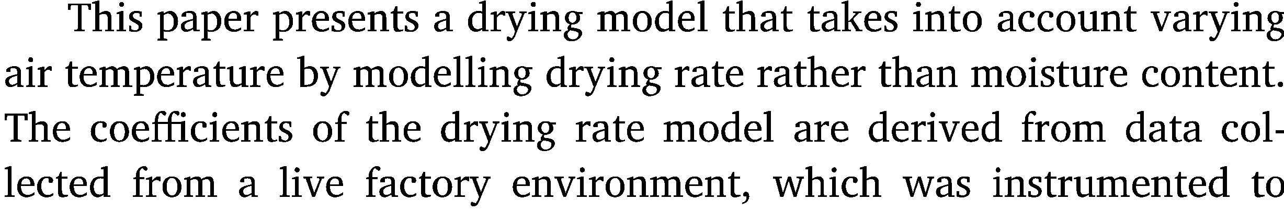
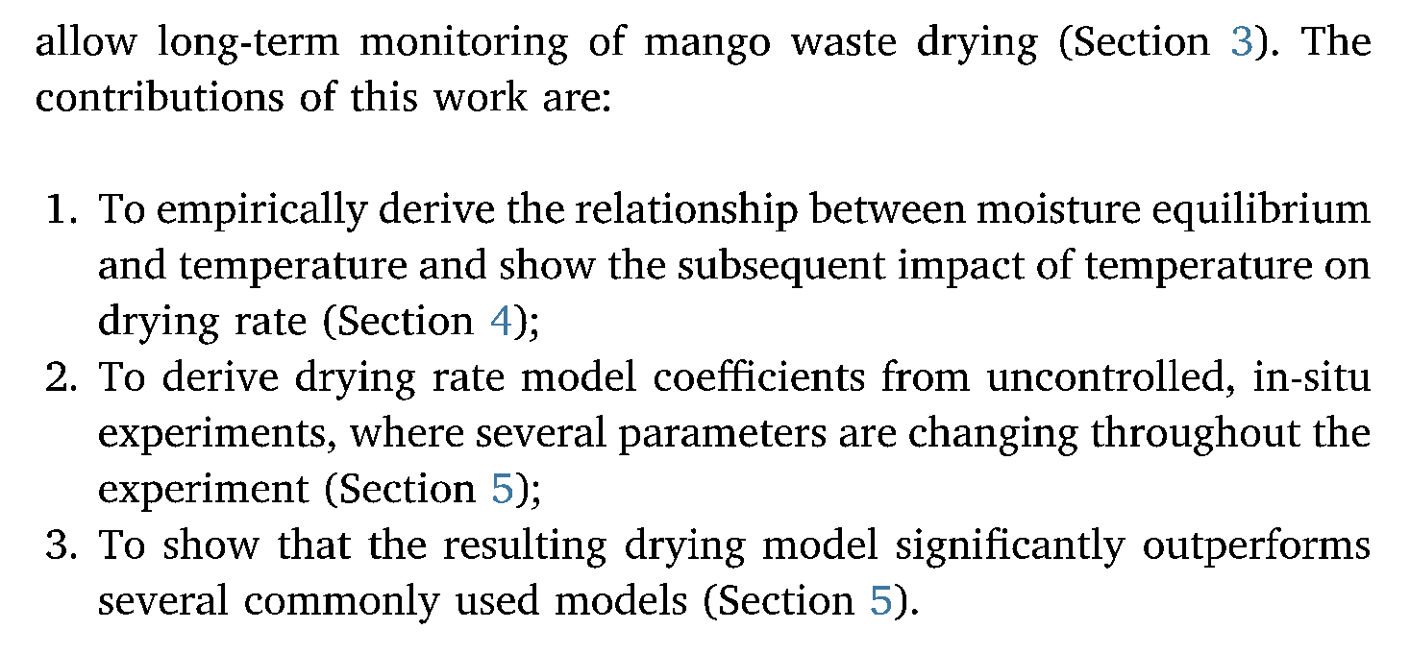
state your contributions

Slide 21
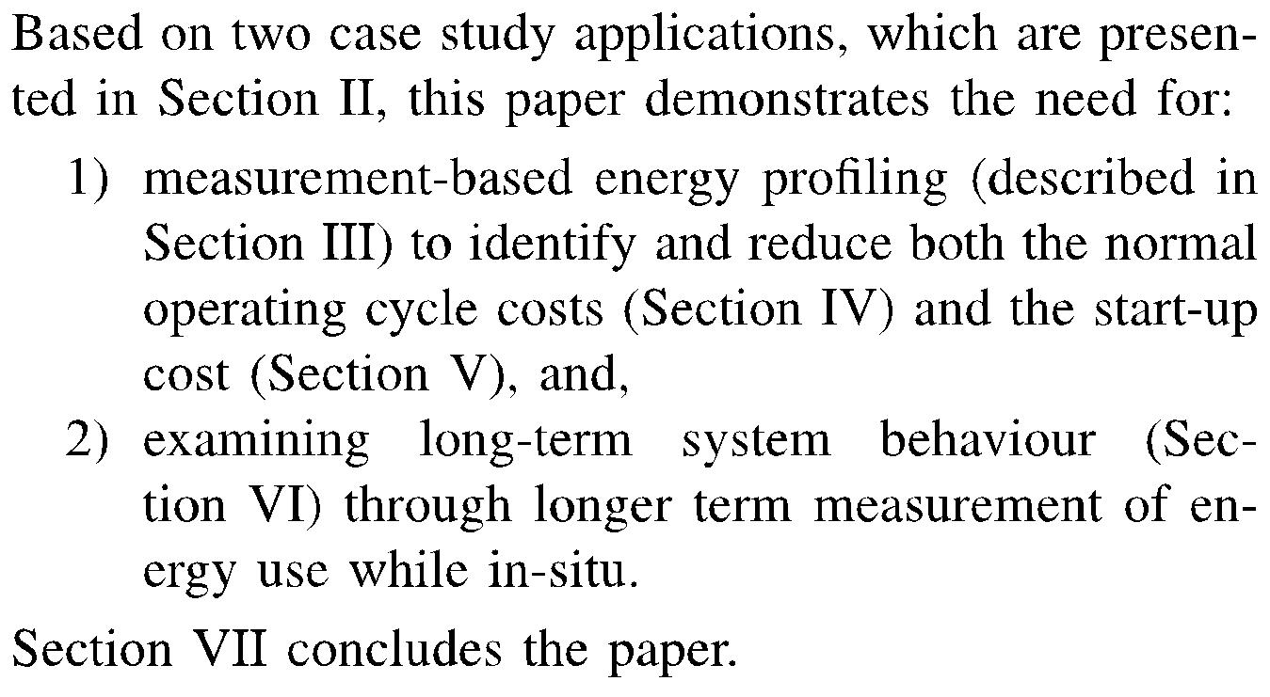

Slide 22
evidence
your intro makes claims
the body contains evidence to support each claim
evidence can be: theorem / proofs, experimental results, case studies, or even argumentation

Slide 23
contributions should be refutable
NO! | YES!
We describe the WizWoz system. It’s really cool! | We give the syntax and semantics of a language that supports concurrent processes (section 3). Its innovative features are ...
We study its properties. | We prove that the type system is sound and that type checking is decidable (section 4)
We have used WizWoz in practice. | We have built a GUI toolkit in WizWoz and used it to implement a text editor (section 5). The result is half the length of the Java version.

Slide 24
no “rest of this paper is structured”
Instead use the forward references from contributions to provide structure info
The introduction should survey whole paper, so a “structure” paragraph is just duplication.

Slide 25
#5: Related work (later)

Slide 26
putting related work later
Title (1000 readers)
Abstract (<12 sentences, 100 readers)
Introduction (1 page, 100 readers)
Related work
The problem (1 page, 10 readers)
Idea (2 pages, 10 readers)
The details (5 pages, 3 readers)
Related work (1-2 pages, 10 readers)
Conclusions / future work (½ page)

Slide 27
related work
Fallacy
to make my work look good, I need to make other’s work look bad

Slide 28
the truth: credit is not like money
Giving credit to others does not diminish the credit you get for your work
warmly acknowledge work that has helped
be generous to the competition
acknowledge weaknesses and limitations in your work

Slide 29
#6: Put your readers first

Slide 30
presenting the idea
explain as if you were at a whiteboard
start with the intuition
once the reader has the intuition, grasping the details will come more naturally
if the details get skipped, at least the intuition will be understood

Slide 31
how to convey the intuition?
Begin with an
example
follow with the general case
explain as if at a whiteboard

Slide 32
putting your readers first
Do not recapitulate your personal journey of discovery
choose the most direct route to the idea

Slide 33
#7: Listen to your readers

Slide 34
getting help
get your paper read by as many people as possible
experts are good (but so are non-experts)
each reader can only read your paper for the first time once
explain what you want (or you may just get spelling advice)

Slide 35
getting expert help
send the draft to the competition to ask “have I quoted your work fairly?” (but not at the last minute)
often they’ll respond with helpful critique
they might be your referees so you can get feedback early this way!

Slide 36
listen to your reviewers
Treat every review like gold dust
Be truly grateful for criticism
This is really hard but really, really important
If you are having trouble, leave it aside for a while and come back to it or ask a colleague for an opinion

Slide 37
summary
don’t wait - write
identify your key idea
tell a story
nail your contributions
related work (later)
put your readers first
listen to your readers

Slide 38
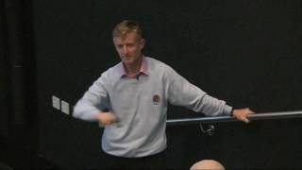
seven simple suggestions
Notes:
finish by 10

Slide 39
discussion
which suggestions did you find most surprising or inspirational?

Slide 40

pomodoro technique
www.pomodorotechnique.com

Slide 41
‘shut-up-and-write’!
https://thesiswhisperer.com/shut-up-and-write/

Slide 42
exercise (1 pomodoro)
Come up with a research topic (see Zobel p267 ex 1)
You can write down the title for your research topic plus one research question that your paper will answer
Notes:
finish by 10:30 - possible coffee break

Slide 43
abstracts
See Mike Ashby’s how to write a paper: http://goo.gl/8Ibmf0
Find the section on how to write an abstract

Slide 44
example abstract
Abstract Kiln-dried fruit drying time is readily predicted from initial moisture content since the environment is tightly controlled. For uncontrolled environments, such as a greenhouse solar dryer, a product's drying time varies depending on ambient conditions and is thus more difficult to predict. Prediction of the drying time is needed to better schedule dryer use. Data was obtained from a set of wireless scales that weigh the waste during solar drying after initial moisture content measurement of a sample. A set of linear and quadratic models for drying rate are tested with the best yielding a 39% reduction in RMSE over traditional models. The results indicate that the modelling approach is likely to be useful for open solar dryers where the temperature, and thus the drying rate, is not controlled.

Slide 45
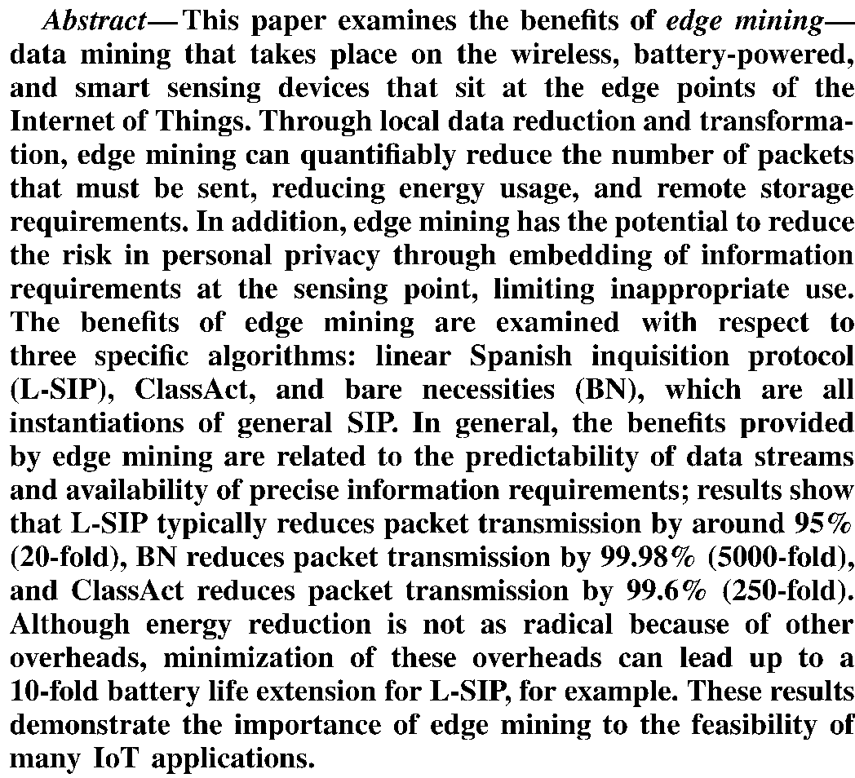

Slide 46
exercise (15 mins)
underneath your title, write a draft abstract applying the rules from Ashby:
1-3 sentences for each of
Motive; (what is the problem, why is it interesting?)
Method; (how is the problem examined?)
Results; (what evidence is there?)
Conclusions (what does it mean to anyone else?)
If you finish early, please go ahead and review and comment on other people’s abstract.
Notes:
11:30 finish

Slide 47
review
Selecting one or two of the abstracts at random
can we understand it?
is it concise?
are all 4 elements (motive / method, etc) there?
Things to watch for (and avoid):
vague statements about how interesting the subject is becoming
skipping elements (e.g. no statement about method)
hyperbole
Notes:
12:00 finish

Slide 48
exercise (1 pomodoro)
underneath your title, write a draft abstract applying the rules from Ashby (<= 3 sentences for each of Intro; Method; Results; Conclusions)
OR
write a five sentence abstract using Zobel chap 5 guide to abstracts
Notes:
11:30 finish

Slide 49
review
Selecting one or two of the abstracts at random
can we understand it?
is it concise?
Things to watch for (and avoid):
vague statements about how interesting the subject is becoming
skipping elements (e.g. no statement about method)
hyperbole
Notes:
12:00 finish

Slide 50
what we didn’t cover in this session
grammar
punctuation
spelling
and many other things about good writing …
… but please see the further reading

Slide 51
further reading
chapters 5, 6, 7, 8 of Zobel
Elements of Style - Strunk and White
Coursera - Writing in the Sciences
and many others!

