Slide 1
pgr week
Mathematics, Algorithms, Plots, Diagrams

Slide 2
intended learning outcomes
design research that produces rigorous results
locate, appraise, and summarise relevant literature
write a clear and concise research paper
present a persuasive presentation on the research paper
proofread and referee

Slide 3
maths - why to avoid
maths may put off many readers
you may just be reproducing proofs or formula found elsewhere for no good reason
it may not aid comprehension

Slide 4
maths - why to NOT avoid
(correct) maths forces you to be precise
trying to state things mathematically may help you clarify your ideas
maths may aid in ensuring your approach is reproducible
well-written maths may aid comprehension

Slide 5

maths
Strongly recommend LyX or LaTeX
or possibly:
http://www.codecogs.com/latex/eqneditor.php
(but result is pixelated unless you use pdf/svg)

Slide 6
advice from Donald Knuth
http://jmlr.csail.mit.edu/reviewing-papers/knuth_mathematical_writing.pdf
Also see: Writing a maths phase 2 paper at MIT http://goo.gl/gqWUUb

Slide 7
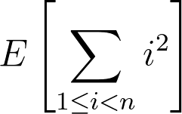
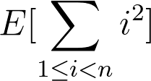
sizing parenthesis
Size parenthesis so they wrap their subclauses
Incorrect
Correct

Slide 8
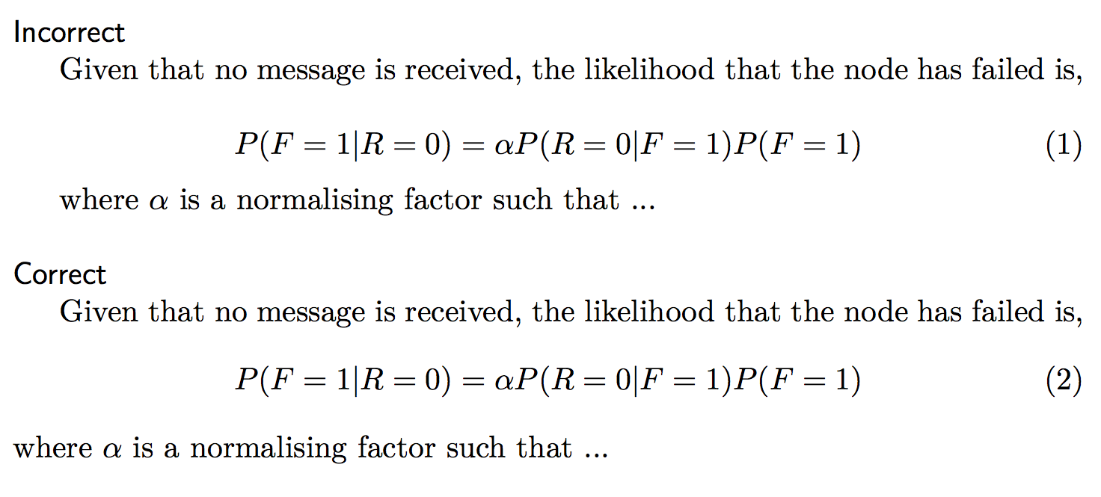
avoid wrong para breaks

Slide 9
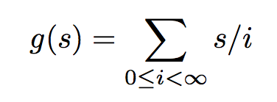
describe every external variable
Internal variables are like i, s in
other variables / functions need explanation.
e.g. what is g?

Slide 10
exercise (1 pomodoro)
Use LyX, LaTeX, or codecogs to typeset the following equation:
for bonus marks, put parenthesis around the bit being “maxed” so that the brackets are sized correctly

Slide 11
numbers
See the NIST advice [1] for recommendations on how to quote numerical values (such as 22 deg. C, or 3 min).
My quick summary:
1. Use the correct case (e.g. kWh not KWh or Kwh)
2. Put a non-breaking space between the numerical value and the unit (e.g. 3 min not 3min; 2 m/s not 2m/s)
3. Use SI units where possible.

Slide 12
expressing uncertainty
The standard deviation provides an estimate of how well you know a particular measurement. It is, however, an estimate.
The standard deviation should be expressed to ONE significant figure
unless the number is between 11 and 19 (times some power of ten) in which case you can use two significant figures
The number modified by the significant figure should be expressed to agree in place with the standard deviation
For example, a value resulting from a spreadsheet calculation of an average and standard deviation might be 10.1298 ± 0.2595. This should be expressed as 10.1 ± 0.3 or 10.1 (0.3) where the number in parenthesis is taken to be the estimated standard deviation. The estimate indicates that the value is only known to within three tenths of a unit of measurement. The figures beyond the tenths place, are not significant.

Slide 13
expressing uncertainty
Where possible, it is more meaningful to provide a 95% (say) confidence interval
Standard deviation does not give the confidence interval directly (look up std error and t statistic for more info)
Note: interval may not be evenly distributed around mean (e.g., 97% ± 5%???)
For further reading, look up measurement uncertainty

Slide 14
algorithms
algorithms are (only) worth including if they enable reproducibility
algorithms should not be obvious or readily available elsewhere
(e.g. showing how to calculate RMSE)
algorithms should be stated concisely but clearly
avoid flowcharts - consider pseudocode or literate programming
avoid using the term “calculate” when it is clear that a calculation is taking place
avoid * when you mean ×

Slide 15
example
weighted_sum(v, w):
for i in range(len(v)):
wsum += w[i]*v[i]
return wsum

Slide 16
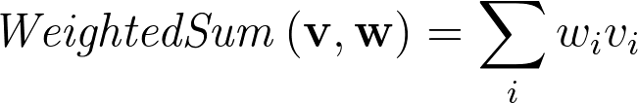
improved version
The same idea can be given as a formula:
Note that algorithmic statements are generally sequential, while equations are timeless, so use ← to make clear you mean assignment

Slide 17
or even without explanation
ws ← weighted_sum(v, w)
since the idea of a weighted sum is commonplace

Slide 18
plots - a check-list
labelled axes with units
consistent fonts and readable font sizes
connect points with lines only for continuous axes
consider boxplots to show distribution shape
Tufte: minimum ink for maximum information
size appropriately for eventual format (e.g., for two column report, width should be about 3.5cm)

Slide 19
plots (1? pomodoro)
use your preferred plotting program to graph the following data:
https://goo.gl/LNI5wy
plot any way you like but pay attention to grouping and timestamps

Slide 20
diagrams
Start with a rough sketch
Size your canvas appropriately before laying out
Use a consistent sizing of fonts and lines
Type consistency
Try to use standard diagrams
Be careful with resizing
Drawing arrows between shapes
Sizing boxes with text
Choosing a good colour scheme
Print out and review
Check for spelling errors
A check-list for graphics
https://jamesbrusey.coventry.domains/writing/drawing-diagrams-and-figures-for-research-articles-and-theses/

Slide 21
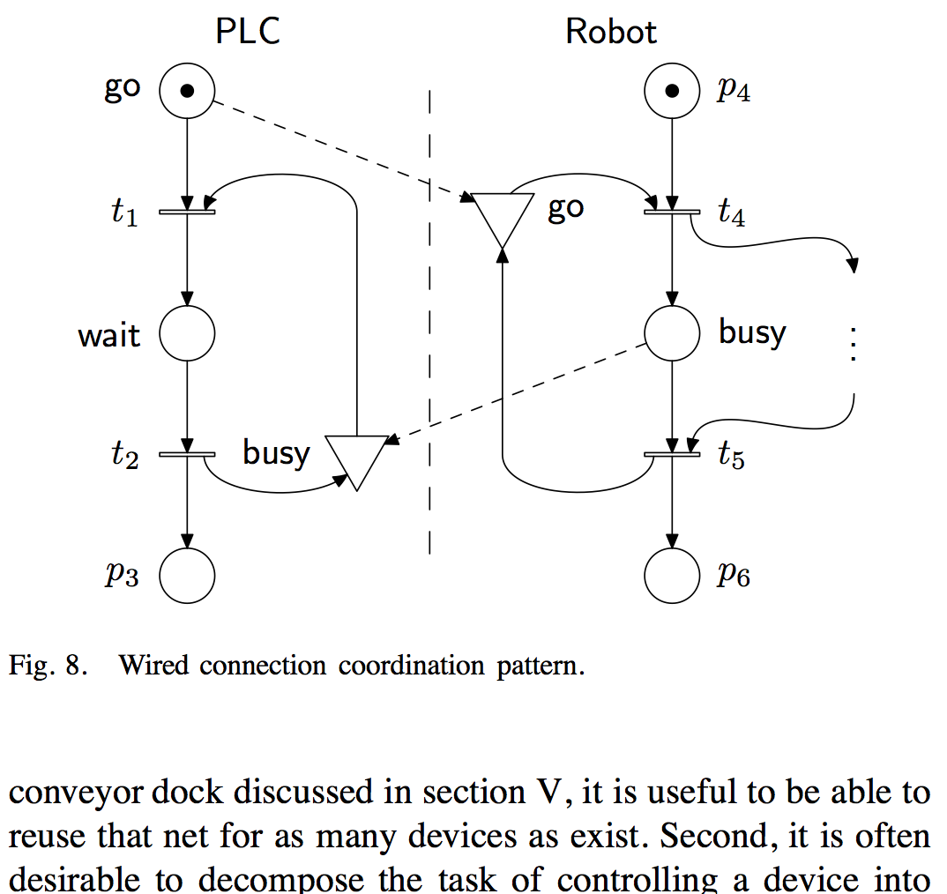
examples
Notes:
illustrates use of curved arrows to centroid of box or element (with offset for some arrows to keep them separate)
image produced using metapost

Slide 22
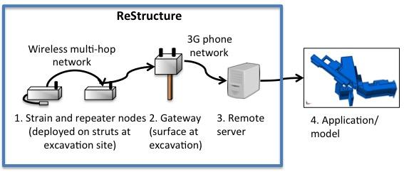
original architecture figure

Slide 23
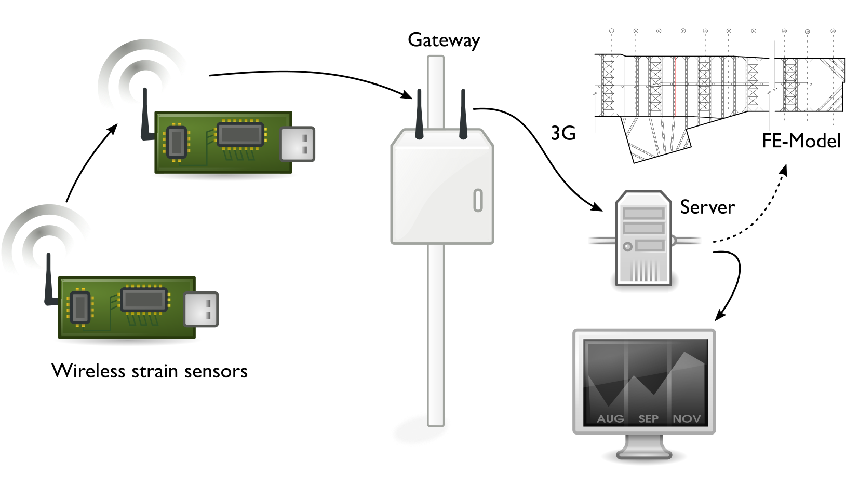
revised architecture figure

Slide 24
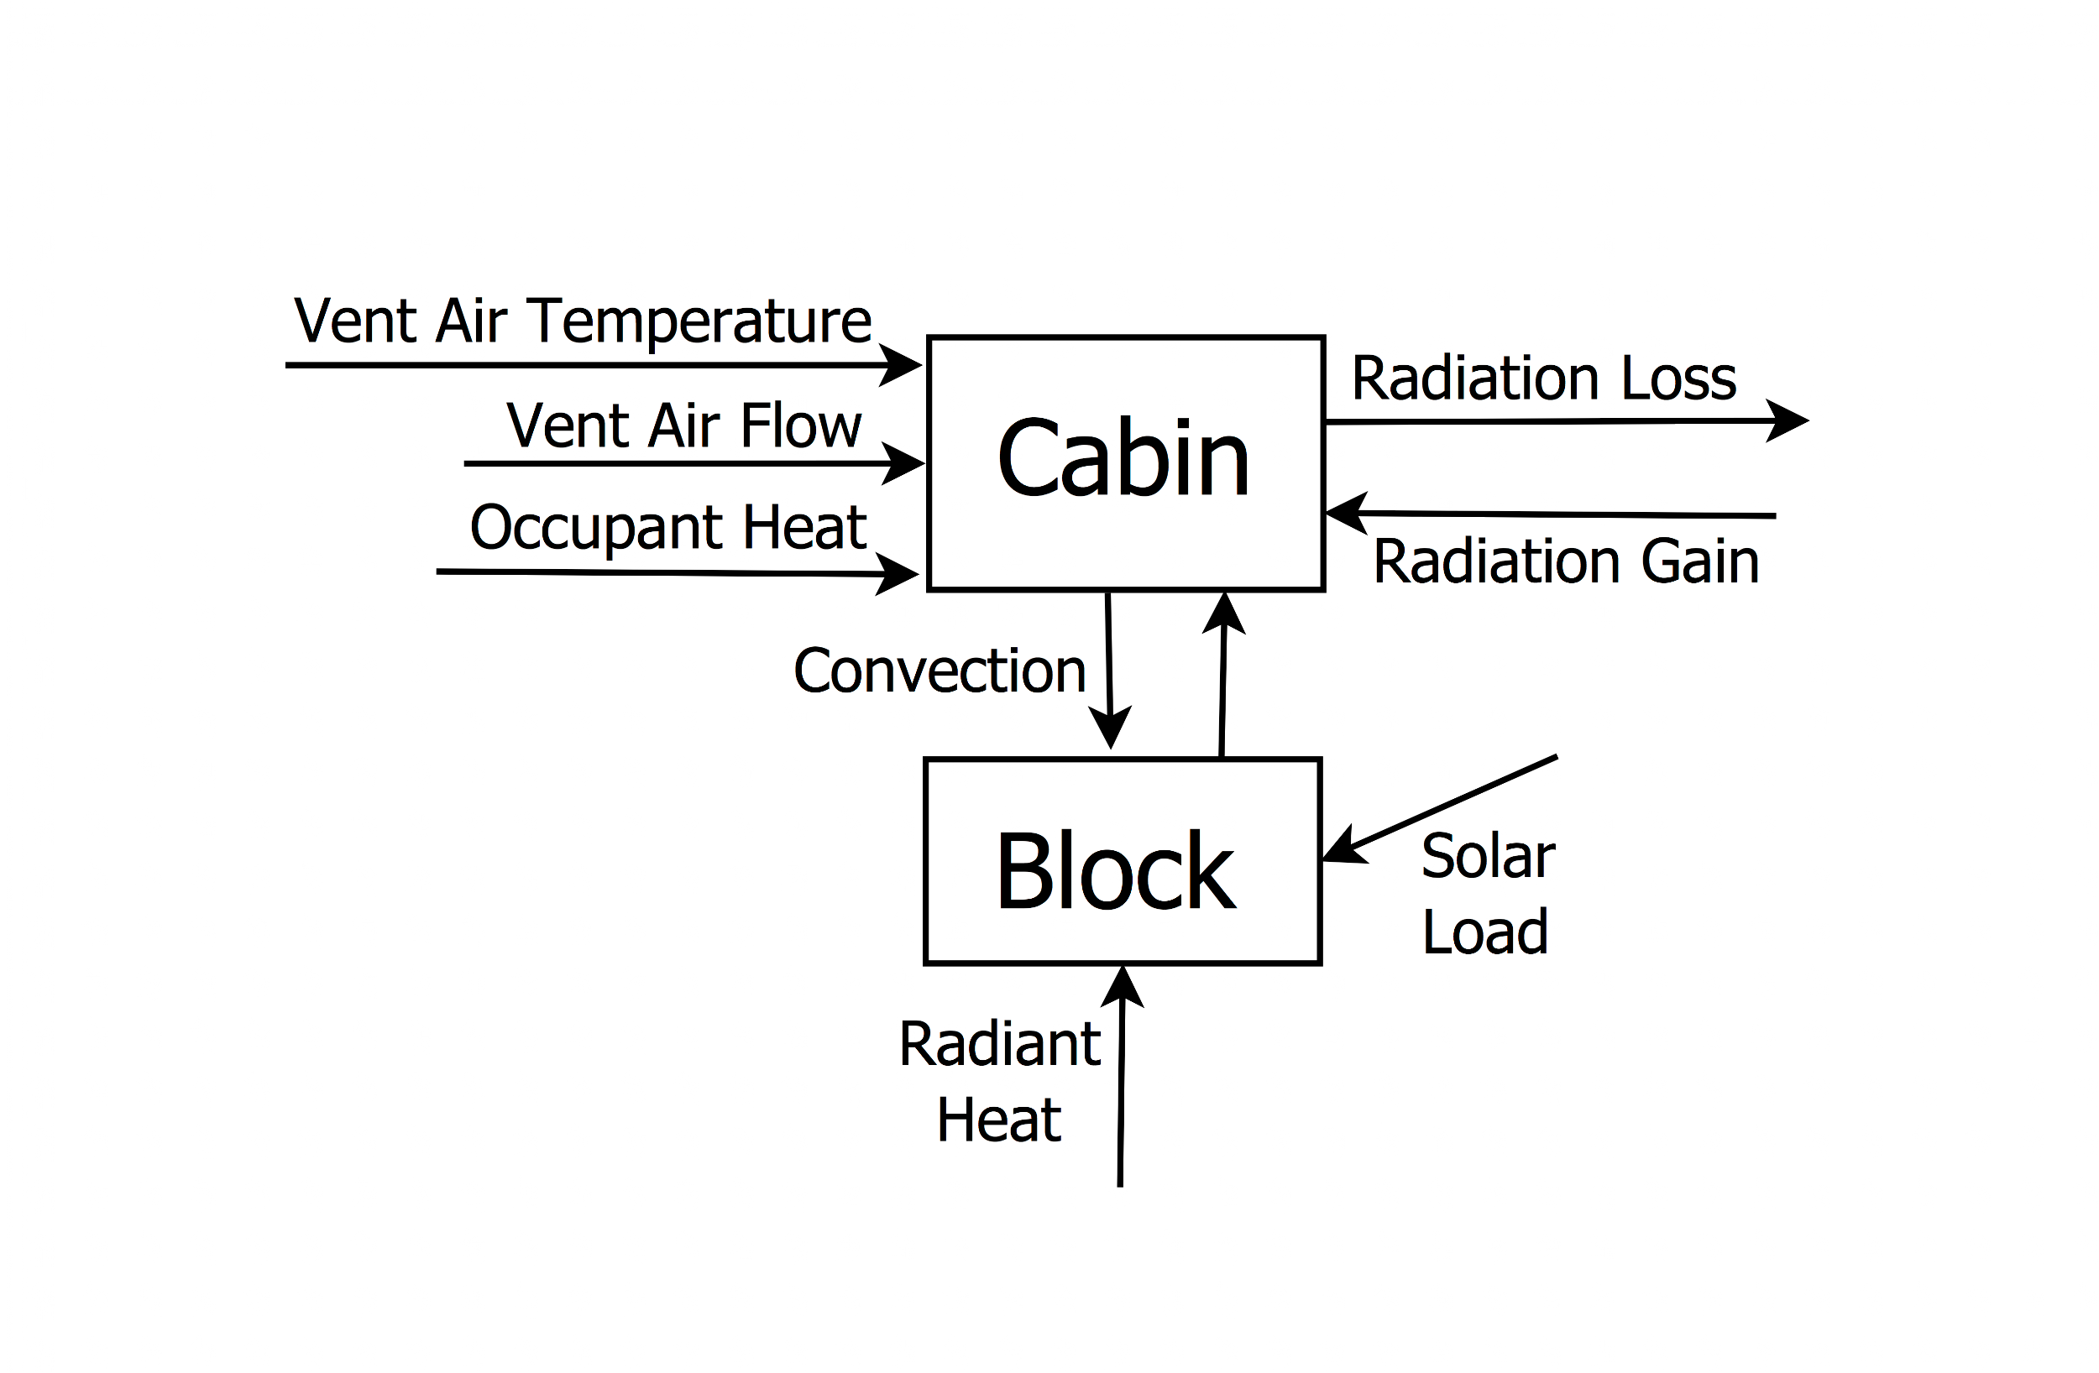
original diagram

Slide 25
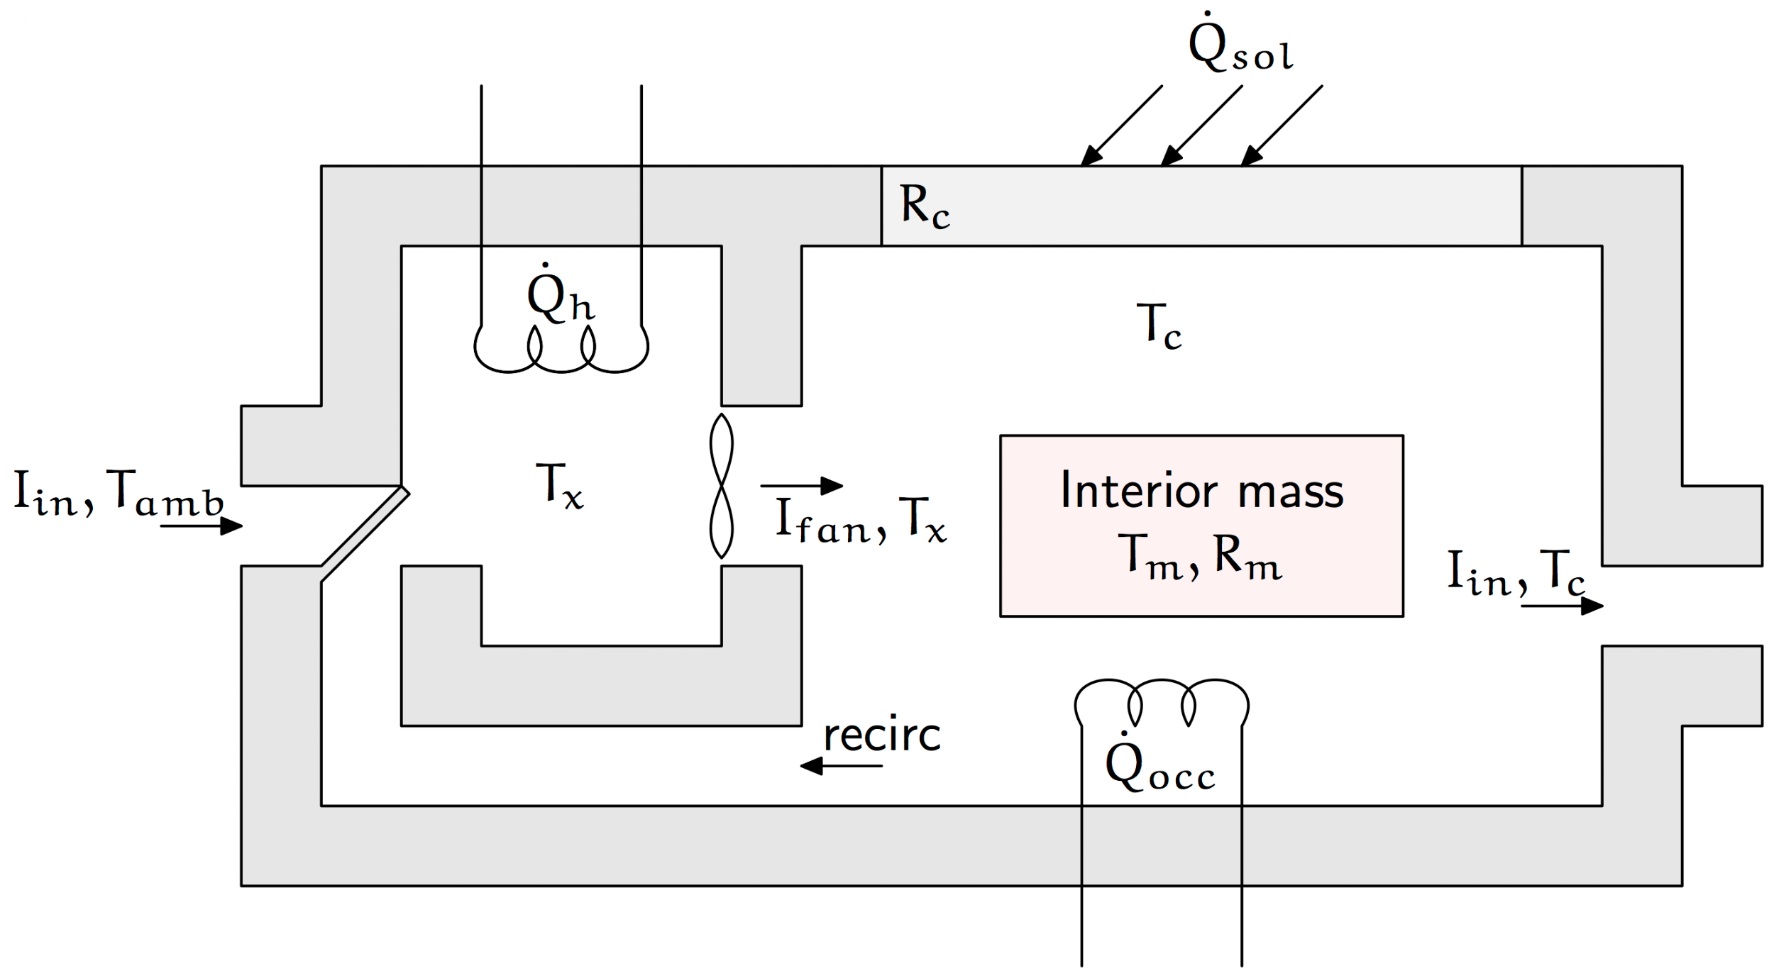
revised diagram

Slide 26
exercise (2 pomodoros)
roughly sketch a system diagram for your thesis or the research topic you previously proposed
e.g., a novel car HVAC controller might show the interaction between the car cabin, the blower, heater, air con, control input, etc.
now: put it into a drawing tool (e.g., inkscape, visio, coreldraw etc) - you may want to review the checklist

Slide 27
review
swap your diagram with a partner and critique each other’s diagram using the checklist / drawing guidelines
did you come up with suggestions that disagreed with or were not on the checklist?

Slide 28
exercise (1 pomodoro)
find a diagram from a paper in your topic area and try to reproduce using vector drawing software package (e.g., inkscape, etc.)
if the quality of your result is lower, it could be a problem with the tool that you are using.

