Slide 1
pgr week
Literature search / review

Slide 2
intended learning outcomes
design research that produces rigorous results
locate, appraise, and summarise relevant literature
write a clear and concise research paper
present a persuasive presentation on the research paper
proofread and referee

Slide 3
what’s the point of reading?
the aim of reading research literature is to gain understanding
the key to successful reading is to be able to see the value / contribution of a paper, while recognising its flaws

Slide 4
dealing with literature
by the time you hand in your thesis, your understanding of the literature should be comprehensive
consider, by preference, only reputable sources
skim read or browse initially
avoid wasting time on poor papers
catalogue and organise papers into folders
don’t allow reading to become procrastination
never cite or write about a paper you haven’t read

Slide 5
finding literature
search the web with obvious terms
use academic search engines (google scholar, scopus, researchgate)
visit websites for research groups / researchers in the area
follow citation references in relevant papers (backward chaining)
forward chain from very strong papers also - what papers cited this one?
search publisher specific engines (ACM, IEEE)
search for articles in your target journal
use your library catalogue
use online thesis repositories such as DART and http://ethos.bl.uk
physically go to the library
discuss your topic with others

Slide 6
assessing the results
searching for literature will help you to refine your search terms
you may also need to repeat your search close to the end of your writing to adjust for the learning gained
keep searching and reading as separate activities
after searching, your topic may not look original (so possibly don’t waste time on it) but be aware that an original contribution may still be possible

Slide 7
reading critically
is there a (significant) contribution?
is it a relevant one?
are results correct?
is appropriate literature discussed?
does the methodology answer the posed question?
are the proposals and results critically analyzed?
are appropriate conclusions drawn from the results?
are the technical details correct?
could the results be verified?
are there ambiguities or inconsistencies?
(from Zobel, p. 24)

Slide 8
developing a literature review
start by producing a summary of each paper you read (can be in “note to self” style). Focus on contribution; obvious flaws; possible counter-arguments
gradually revise, discarding some, less relevant papers
emerge a strong structure and ensure your text explains the topic area
consider developing a taxonomy to show area structure
consider tabulating papers to summarise details (e.g. number of experiments)

Slide 9
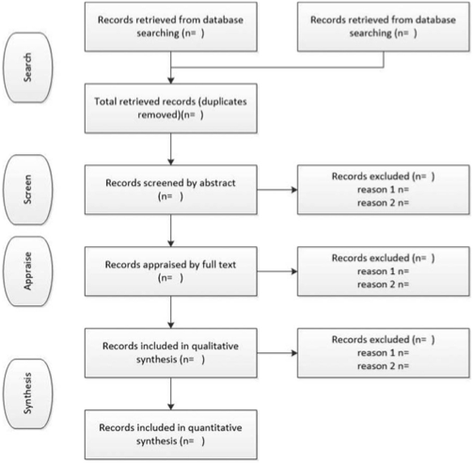
Systematic
review
http://prisma-statement.org/PRISMAStatement/FlowDiagram.aspx
Gough, D., Oliver, S., Thomas, J. (2012). An introduction to Systematic Reviews. London: Sage.

Slide 10
exercise (1 pomodoro)
go through the “finding literature” checklist (apart from visiting the library) for your chosen research topic

Slide 11
exercise (1 pomodoro)
select a few papers from your search and browse through / skim read to gain a rough assessment
aim to find at least one interesting paper that would be worth more detailed reading

Slide 12
exercise (1+ pomodoros)
select an interesting paper from the previous exercise and read it in detail - you may want to print it out first
write a brief answer to each of:
what are the researchers trying to find out?
why is the research important?
what things were measured?
what were the results?
what do the authors conclude? and what factors do they attribute to their findings?
can you accept the findings as true? Discuss any failings or shortcomings.
(Zobel, p268)

