Slide 1
pgr week
experiments and research questions

Slide 2
intended learning outcomes
design research that produces rigorous results
locate, appraise, and summarise relevant literature
write a clear and concise research paper
present a persuasive presentation on the research paper
proofread and referee

Slide 3
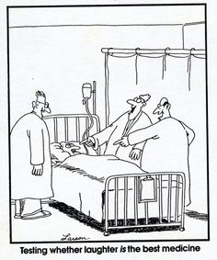

Slide 4
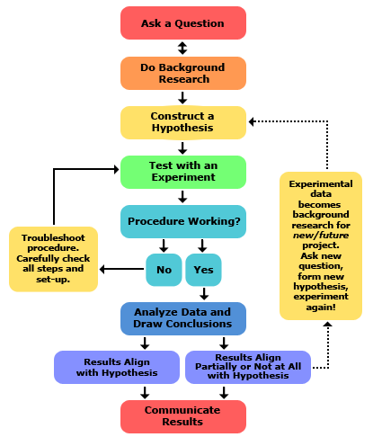

Slide 5
exercise
How would you study the “quality” of this course? How good is it? Does it achieve its aims?
In groups, come up with a research question that asks this type of question more precisely.

Slide 6
review
probably we found many ways to pose this question
interestingly different questions will lead us to use different experimental methods
it will also lead to potentially different conclusions (although hopefully not conflicting ones)

Slide 7
critical thinking checklist
Identify what's important:
What are the key ideas, problems, arguments, observations, findings, conclusions?
What evidence is there?
Distinguish critical from other types of writing (eg descriptive); fact from opinion; bias from reason
Evaluate what you find:
Explore the evidence - does it convince?
What assumptions are being made and inferences drawn?
Is there engagement with relevant, up to date research?
How appropriate are the methods of investigation?
Is there a consistent and logical line of reasoning?
Do you agree with what's being said? Why?
How is language being used (emotive, biased etc.)?
Look beyond what you're reading/hearing:
What other viewpoints, interpretations and perspectives are there? What's the evidence for these? How do they compare?
How does your prior knowledge and understanding relate to these ideas, findings, observations etc.?
What are the implications of what you're reading/hearing?
Clarify your point of view:
Weigh up the relevant research in the area
Find effective reasons and evidence for your views
Reach conclusions on the basis of your reasoning
Illustrate your reasons with effective examples

Slide 8
identify what's important
What are the key ideas, problems, arguments, observations, findings, conclusions?
What evidence is there?
Distinguish critical from other types of writing (eg descriptive); fact from opinion; bias from reason

Slide 9
evaluate what you find
Explore the evidence - does it convince?
What assumptions are being made and inferences drawn?
Is there engagement with relevant, up to date research?
How appropriate are the methods of investigation?
Is there a consistent and logical line of reasoning?
Do you agree with what's being said? Why?
How is language being used (emotive, biased etc.)?

Slide 10
look beyond what you're reading/hearing
What other viewpoints, interpretations and perspectives are there? What's the evidence for these? How do they compare?
How does your prior knowledge and understanding relate to these ideas, findings, observations etc.?
What are the implications of what you're reading/hearing?

Slide 11
clarify your point of view
Weigh up the relevant research in the area
Find effective reasons and evidence for your views
Reach conclusions on the basis of your reasoning
Illustrate your reasons with effective examples

Slide 12
exercise
How good is this course? Based on the previous research question:
Discuss the question in your groups and come up with 3 or 4 different experiment designs that would answer it

Slide 13
different types of research design
case studies
one group pre-test post-test design
static group comparison
true experimental design

Slide 14

case study
why?
rare instances?
may still be informative
why not?
cannot analyse statistically
one-off may really be a one-off

Slide 15
group pre-test post-test design
experiment group
pretest
treatment
post-test
why?
shows change in variable, before versus after
why not?
no randomised selection
no control group

Slide 16
static group comparison
experiment group
treatment
post-test
control group
post-test
why? / why not?
control / experiment selection should be random
Notes:
control group avoids maturation threat but note that there is no pre-test now

Slide 17
true experimental design
For an experiment to be considered a true design:
The sample groups must be assigned randomly.
There must be a viable control group.
Only one variable can be manipulated and tested. It is possible to test more than one, but such experiments and their statistical analysis tend to be cumbersome and difficult.
The tested subjects must be randomly assigned to either control or experimental groups

Slide 18
research validity
Outside the study: External validity
Does the same thing happen in other settings?
Other labs?
Everyday settings?
Inside the study:
Internal validity
Was the research done “right”?

Slide 19
threats to internal validity
History
Maturation
Testing
Instrumentation
Statistical regression to mean
Selection bias
Experimental mortality
Resentful demoralization of the control group
+ any interactions between the above…

Slide 20
threats to internal validity
History
Something that happened other than [xxx] (tornado, budget cut, season change)
Maturation
Testing
Instrumentation
Statistical regression to mean
Selection bias
Experimental mortality
Resentful demoralization of the control group
+ any interactions between the above…

Slide 21
threats to internal validity
History
Maturation
Something that happened in the individuals (hunger, growth, age, sickness)
Testing
Instrumentation
Statistical regression to mean
Selection bias
Experimental mortality
Resentful demoralization of the control group
+ any interactions between the above…

Slide 22
threats to internal validity
History
Maturation
Testing
Taking a test again and getting better at taking the test
Instrumentation
Statistical regression to mean
Selection bias
Experimental mortality
Resentful demoralization of the control group
+ any interactions between the above…

Slide 23
threats to internal validity
History
Maturation
Testing
Instrumentation
Changes in the calibration of a measuring instrument (change in how you diagnose), observers, scorers
Statistical regression to mean
Selection bias
Experimental mortality
Resentful demoralization of the control group
+ any interactions between the above…

Slide 24
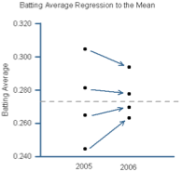
threats to internal validity
History
Maturation
Testing
Instrumentation
Statistical regression to mean
Selecting outliers for your study that “regress” (go back) to the mean or average.
Selection bias
Experimental mortality
Resentful demoralization of the control group
+ any interactions between the above…

Slide 25
threats to internal validity
History
Maturation
Testing
Instrumentation
Statistical regression to mean
Selection bias
Selecting people for your study on the basis of their scores
Experimental mortality
Resentful demoralization of the control group
+ any interactions between the above…

Slide 26
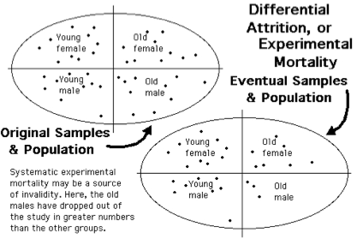
threats to internal validity
History
Maturation
Testing
Instrumentation
Statistical regression to mean
Selection bias
Experimental mortality
Resentful demoralization of the control group
+ any interactions between the above…

Slide 27
threats to internal validity
History
Maturation
Testing
Instrumentation
Statistical regression to mean
Selection bias
Experimental mortality
Resentful demoralization of the control group
+ any interactions between the above…

Slide 28
threats to internal validity
History
Maturation
Testing
Instrumentation
Statistical regression to mean
Selection bias
Experimental mortality
Resentful demoralization of the control group
+ any interactions between the above …

Slide 29
External threats to validity
Reactive or interactive effects of testing
I figure out what you are looking for from the questions you are asking me, the teacher tries harder when s/he knows his/her course is being evaluated
Reactive effects to experimental setting
Acting differently when being videotaped, in a lab, etc.
Multiple treatment interference
When you take a course in writing, you may also be taking other writing courses at the time which may impact outcomes

