Slide 1
pgr week
Research toolkit

Slide 2
intended learning outcomes
design research that produces rigorous results
locate, appraise, and summarise relevant literature
write a clear and concise research paper
present a persuasive presentation on the research paper
proofread and referee

Slide 3
what’s common about most PhDs?
answer: they’re (almost) all doing data science

Slide 4
data science is OSEMN
Obtaining data
Scrubbing data
Exploring data
Modelling data
Interpreting data
(Janssens (2014) Data science at the command line. O’Reilly)

Slide 5
So what’s wrong with Excel?
many students try to use excel for data science
this tends to fail because:
it can’t handle large data-sets
workflows cannot be reproduced easily
it has limited stats tools
it is difficult to debug or check

Slide 6
a solution?: learn the command line
https://www.codecademy.com/courses/learn-the-command-line
See http://datascienceatthecommandline.com/

Slide 7




version control

Slide 8
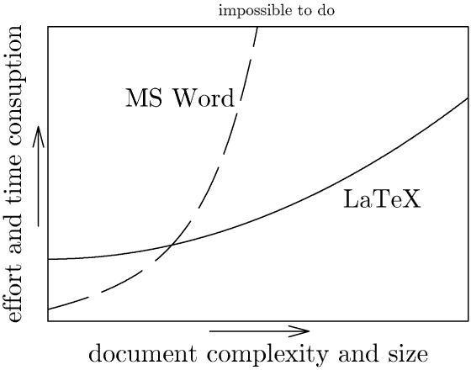


word processors

Slide 9


New model - markdown
markdown
org-mode
asciidoc

Slide 10

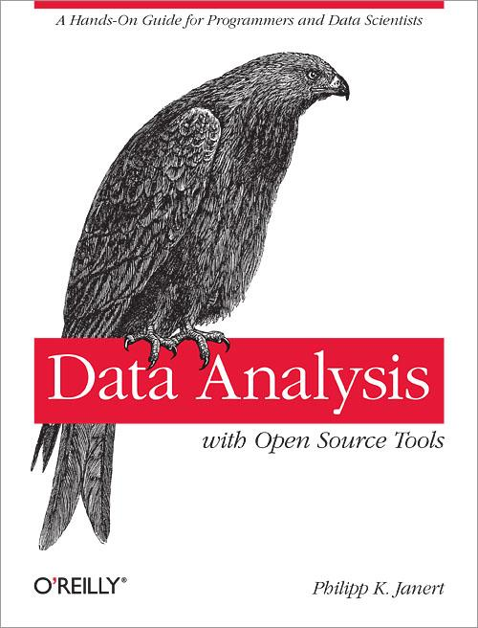
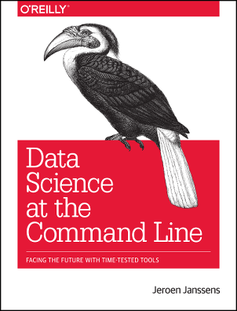
statistics

Slide 11
GNU Make

Slide 12
organisation
keep a research journal and carry it around
useful tip: write longhand journal entries to practise writing
keep a to-do list (e.g. http://trello.com) ...
… but avoid busy-work
schedule e-mail processing for low point
organise your literature into folders
consider using a day planner

Slide 13
presentation tools
ms powerpoint, google slides, apple keynote
but also consider:
latex or markdown with beamer
great for maths
looks very academic

Slide 14
make a home page
google sites?
university “mysite” page?
a “domain of our own” - coventry.domains
other tools? (personally, emacs and html ;)

Slide 15
Contributed
tldrthis.com
github app for Windows
elicit.org - AI research assistant
julialang.org - Julia
researchrabbit.ai
typeset.io
mathpix.com
draw.io
microsoft planner / microsoft todo
zotero, betterbibtex, zotero app on ipad
chatpdf.com

Slide 16
emacs tricks that vs code might have soon
tramp - ssh connecting to servers
magit - like github app on windows
org-mode - markdown on steroids
org-ref - citations in org documents

