Slide 1
PowerShell Code Review
January 16, 2020

Slide 2
Current Projects
Disable-EndAccessDate.ps1 – Using SQL Instance
Importing WVU Foundation Address Book
Code to clean up home directories

Slide 3
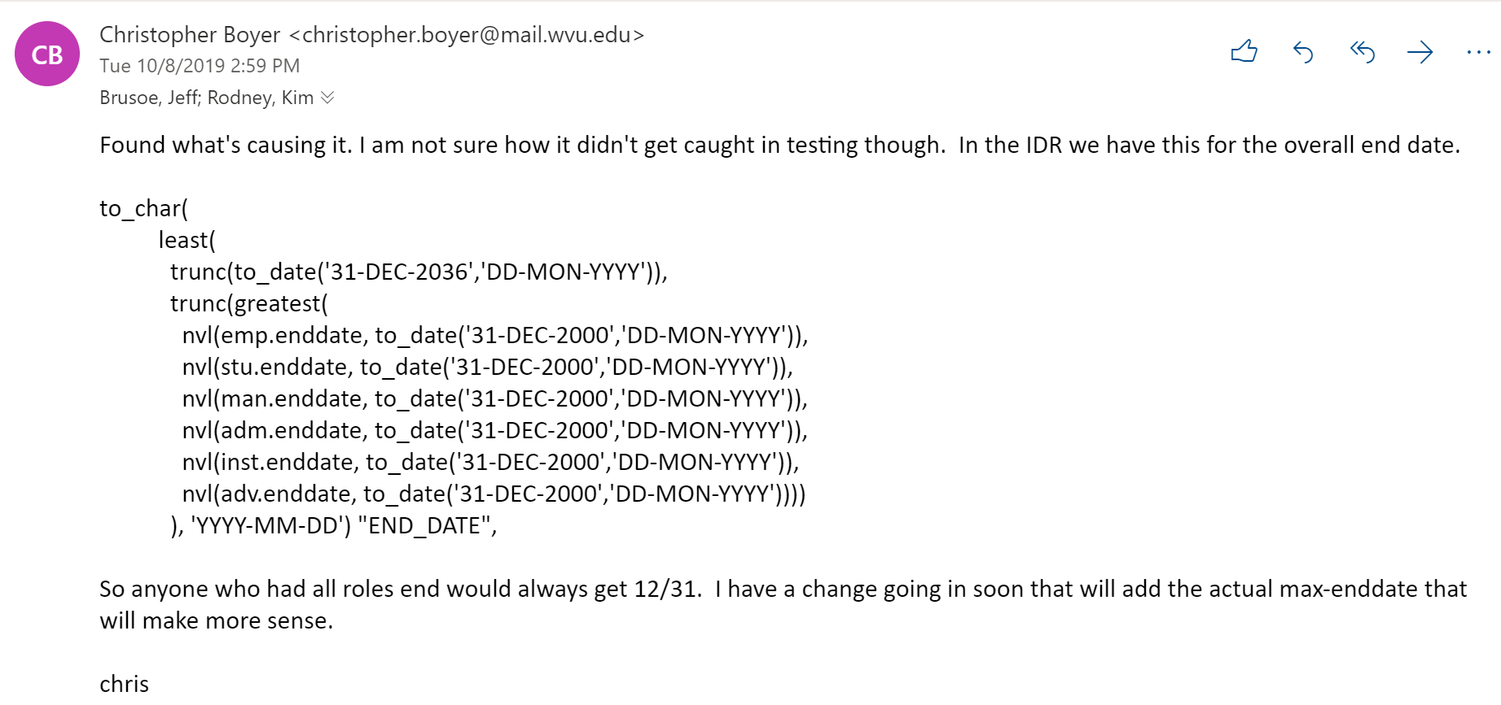


Slide 4
