Slide 1
PowerShell Code Review April 2, 2020

Slide 2
Current Projects
New files
Clean up home directories
Add users back to groups
Remote access requests(Kevin)
Fixing up nagging code issues
Going through and ensuring files
Work as intended
Scheduled tasks are working properly
Have README.md files
Update HSCPowershellFileSummary.md
Update ScheduledTaskSummary.md

Slide 3
Current Projects
Move files to new SQL Server Module

Slide 4
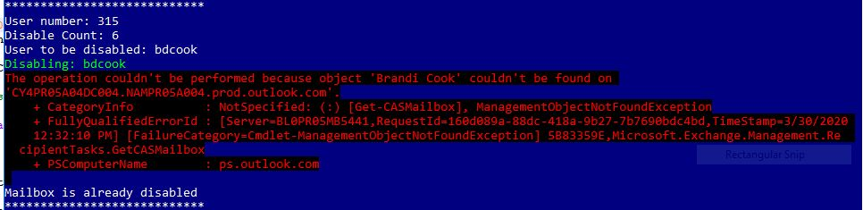

Slide 5
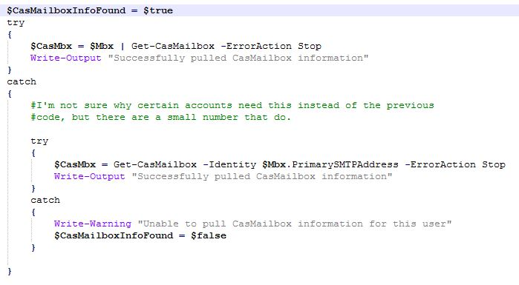

Slide 6
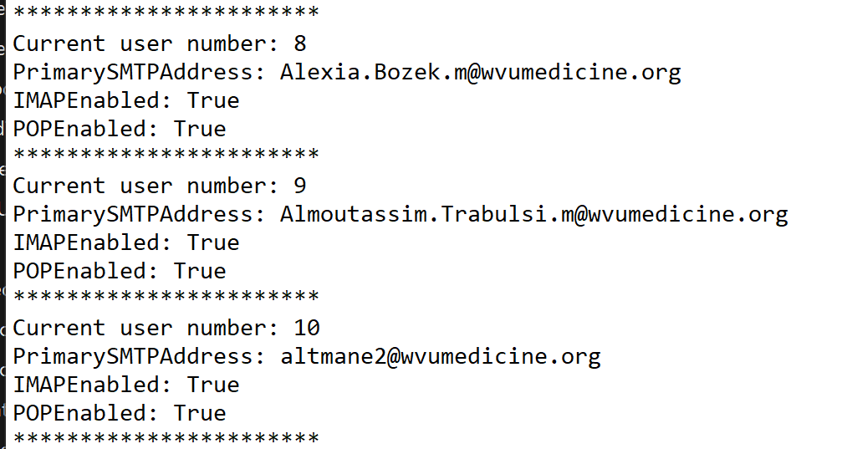

Slide 7
New SQL Server Module
Move files to new SQL Server Module
Old version relied on System.Net.SQLClient
New version uses Invoke-SqlCmd

Slide 8
