Slide 1
PowerShell Code Review April 30, 2020

Slide 2
Current Projects
New files
Update-AddressList.ps1
Update-WVMAddressList.ps1
Get-ExchangeForwardingSMTPAddress.ps1
Fixing up nagging code issues
Disconnects
Unable to find a small percentage of users
Looking at new Exchange Module

Slide 3
Exchange Online PowerShell V2 Module

Slide 4
https://docs.microsoft.com/en-us/powershell/exchange/exchange-online/exchange-online-powershell-v2/exchange-online-powershell-v2?view=exchange-ps
“The Exchange Online PowerShell V2 module is currently in Preview.”
“The Exchange Online PowerShell V2 module contains a small set of new cmdlets that are optimized for bulk data retrieval scenarios (think: thousands and thousands of objects). ”

Slide 5
Current Plan
Create a test HSC-Office365Module.psm1 which uses these new cmdlets.
Need to also verify authentication works properly
Will slowly start to migrate to create files that work with it, but will primarily use the old version until out of Preview.

Slide 6
Update-AddressList.ps1

Slide 7
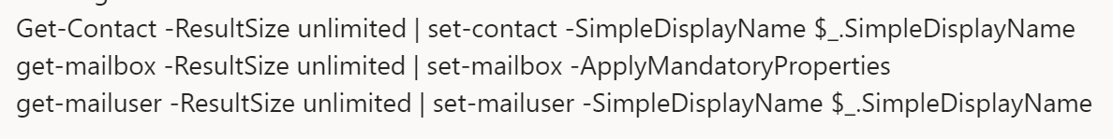

Slide 8
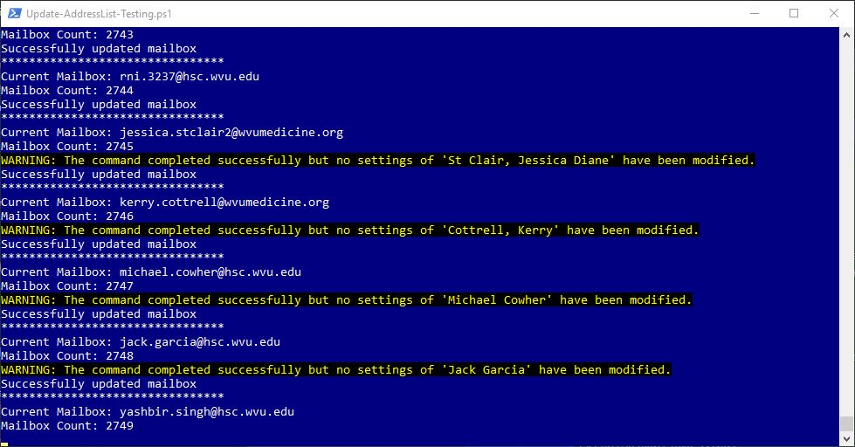

Slide 9
Determining Even/Odd Numbers
Divide a number by 2 and look at it’s remainder:
4/2 = 2 remainder 0
5/2 = 2 remainder 1
6/2 = 3 remainder 0
7/2 = 3 remainder 1

Slide 10
Determining Divisibility by 3
Divide a number by 3 and look at it’s remainder:
3/3 = 1 remainder 0
4/3 = 1 remainder 1
5/3 = 1 remainder 2
6/3 = 2 remainder 0
7/3 = 2 remainder 1
8/3 = 2 remainder 2
9/3 = 3 remainder 0

Slide 11
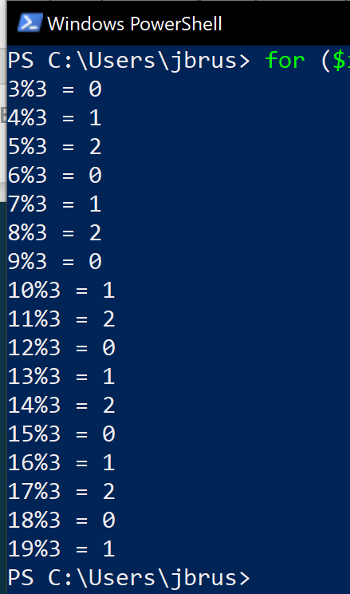

Slide 12
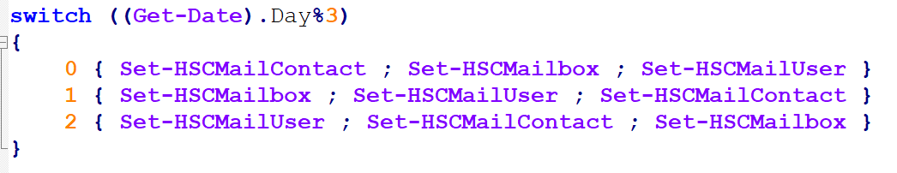

Slide 13
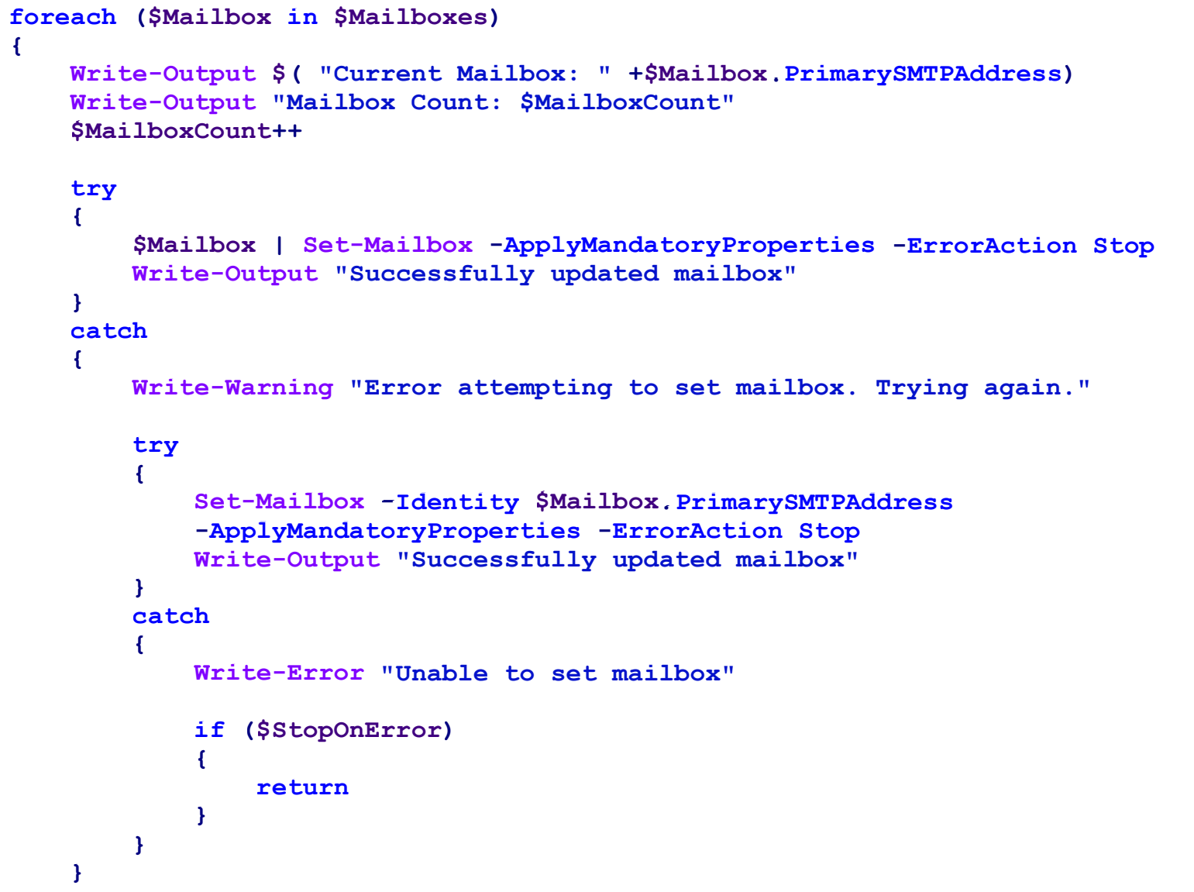

Slide 14
Update-WVUMAddressList.ps1

Slide 15
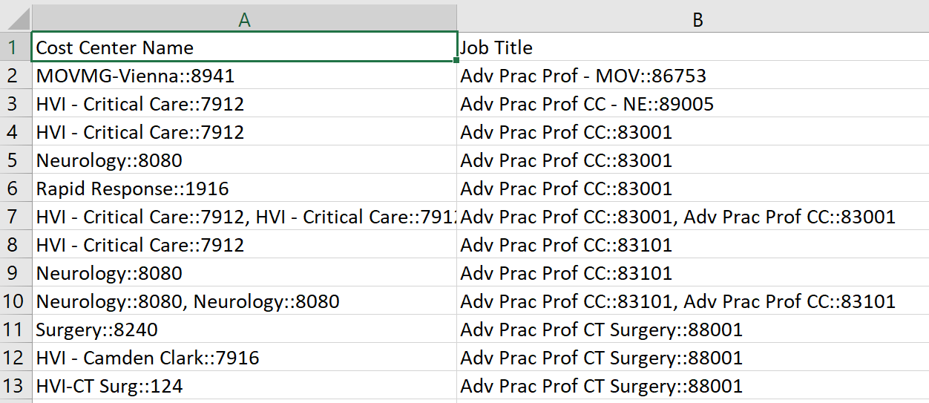

Slide 16
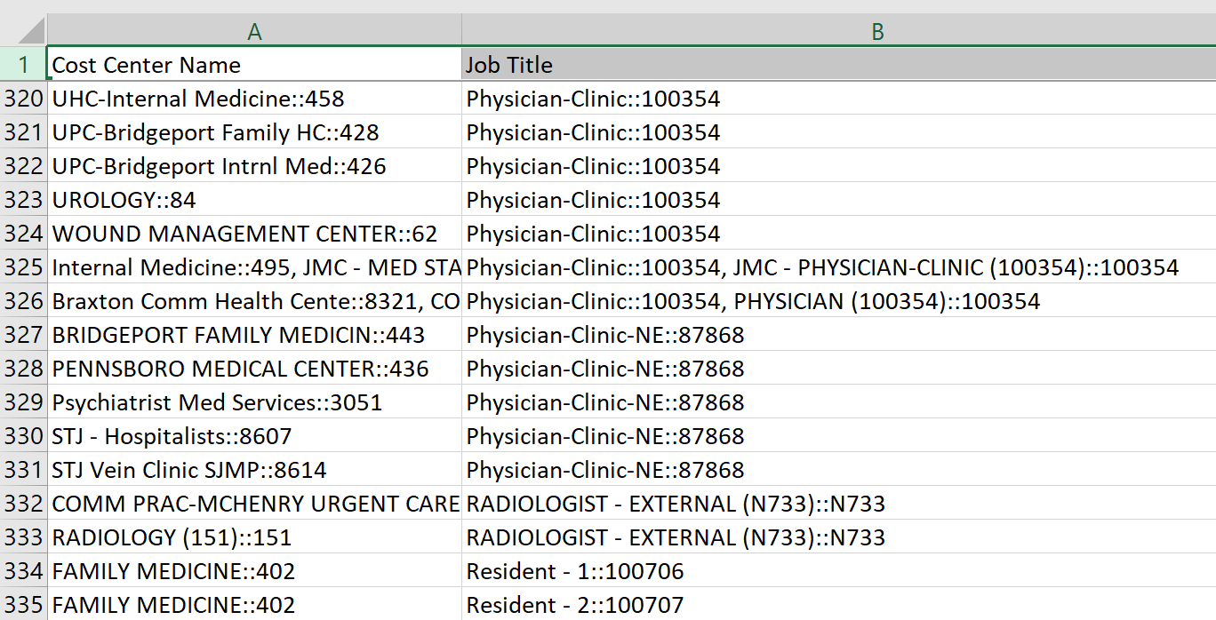

Slide 17
Disable-POPIMAP.ps1

Slide 18
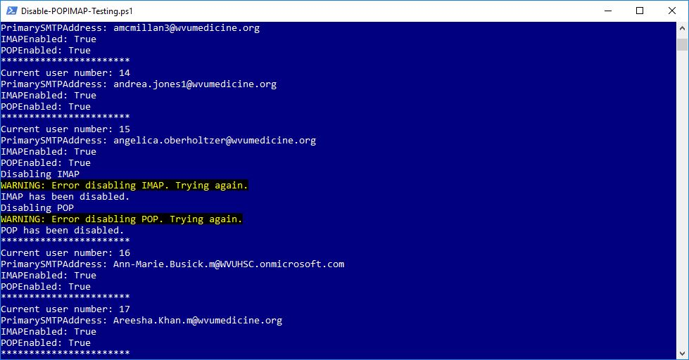

Slide 19
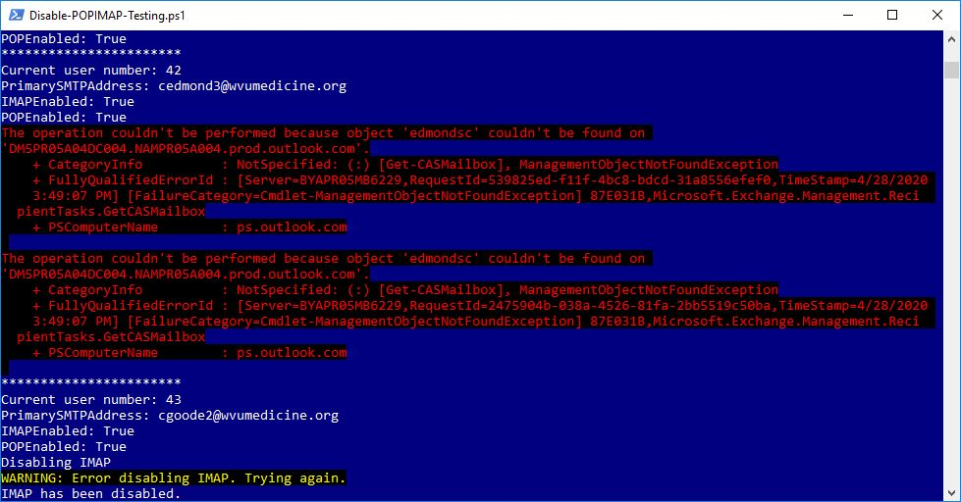

Slide 20
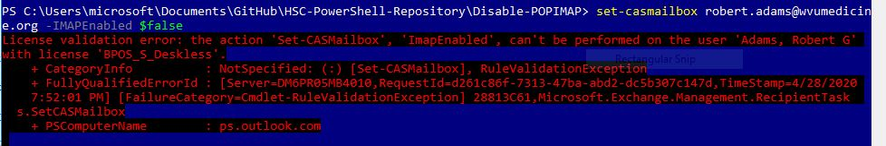

Slide 21
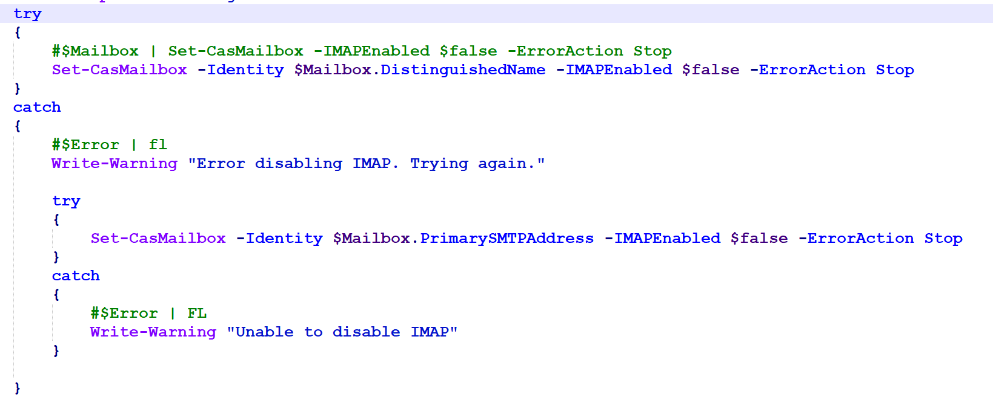

Slide 22
Get-ExchangeForwardingSMTPAddress.ps1

Slide 23
