Slide 1
PowerShell Code Review May 14, 2020

Slide 2
Current Projects
New Files
Get-WVUMExt13.ps1
Import-WVUMExt13.ps1
Compare-Ext15WithPrimarySMTPAddress.ps1
Set-ManagerField.ps1

Slide 3
Current Projects
Updated Files
Get-ExchangeForwardingRule.ps1
Cleaned up code & Removed unnecessary code
Get-MainCampusMailbox.ps1
Moved to HSC common code & Office 365 module
Export-ToSole.ps1
Moved to updated HSC SQL Module
Get-SANEncryptionKey.ps1
Corrected error with sending emails
Moved to HSC common code file
Set-MailContactCompanyField-MSOL.ps1
Set-ADMailAttribute.ps1

Slide 4
Projects Being Worked On
Kevin
Upgrading sysscript2 (Currently running Server 2012)
Creating sysscript5 to test out PowerShell Core
Testing of:
PowerShell Core
Exchange PowerShell Version 2
Method of automatically verifying files completed succesfully

Slide 5

Get-WVUMExt13.ps1

Slide 6
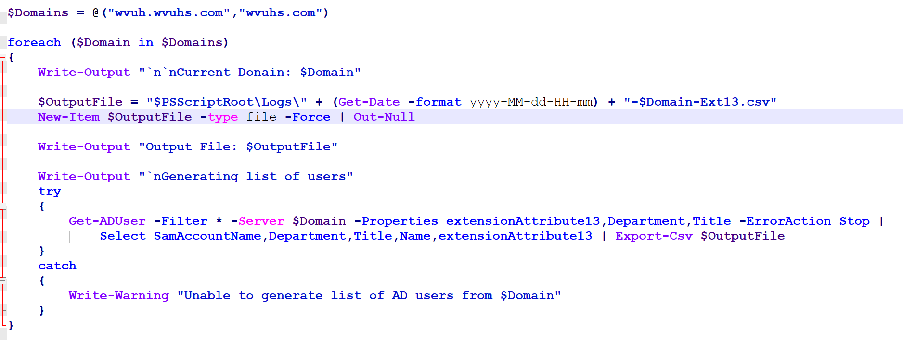

Slide 7
Import-WVUMExt13.ps1

Slide 8
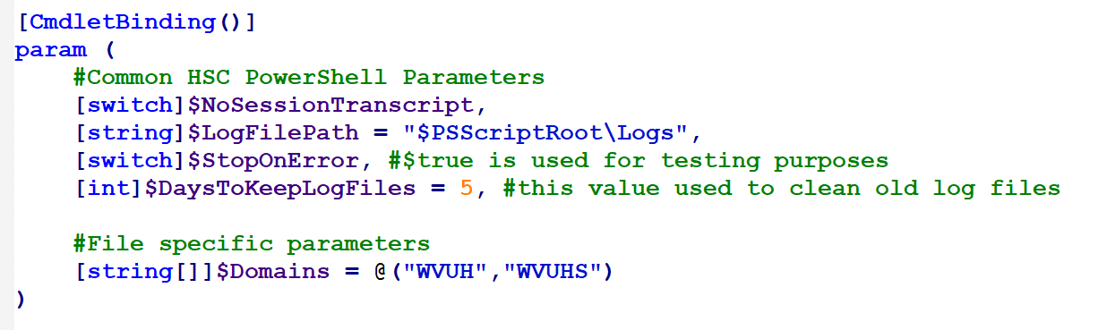

Slide 9
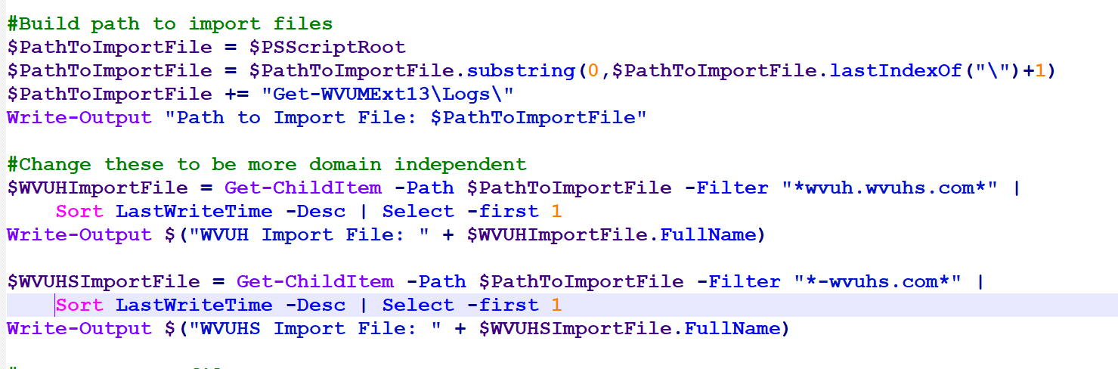

Slide 10
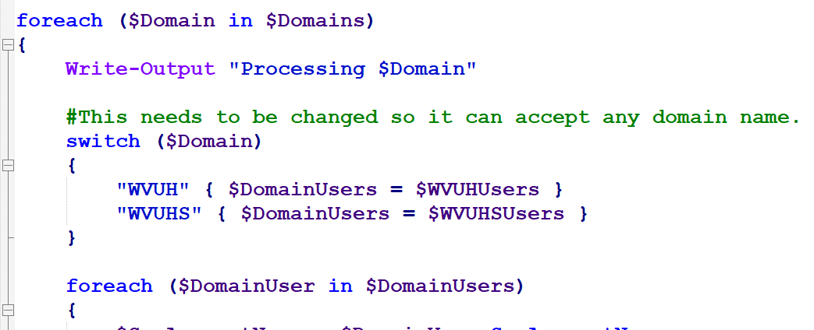

Slide 11
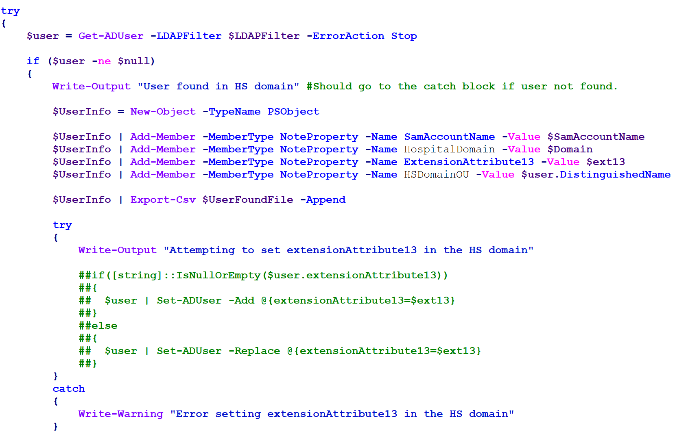

Slide 12
Compare-Ext15WithPrimarySMTPAddress.ps1

Slide 13
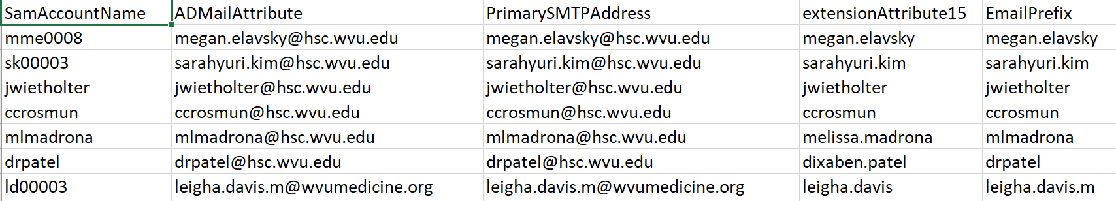

Slide 14
Set-ManagerField.ps1

Slide 15
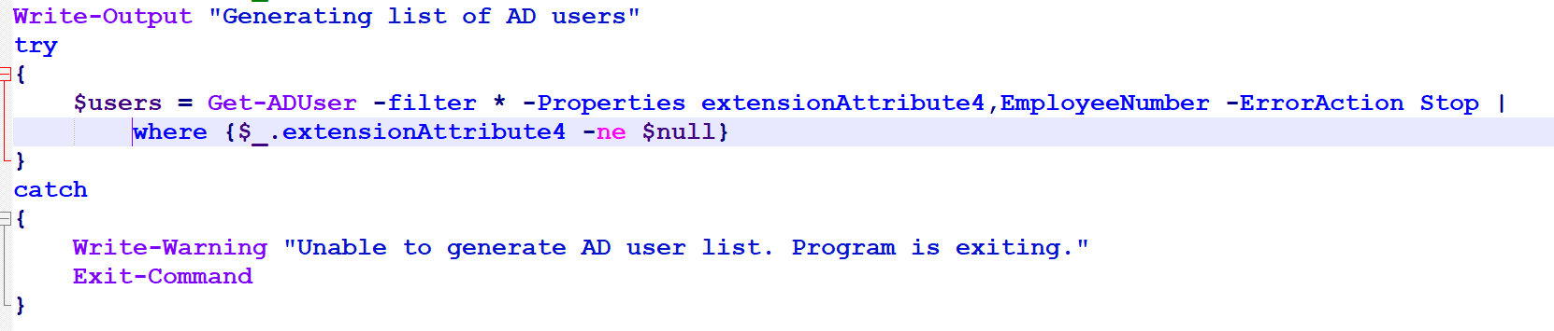

Slide 16
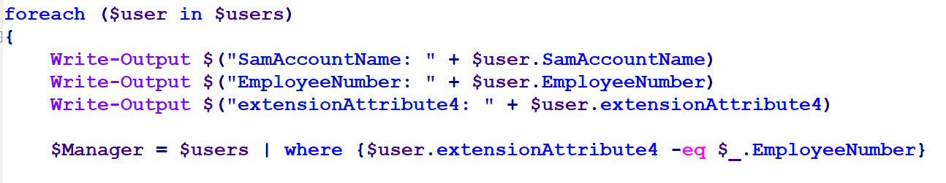

Slide 17
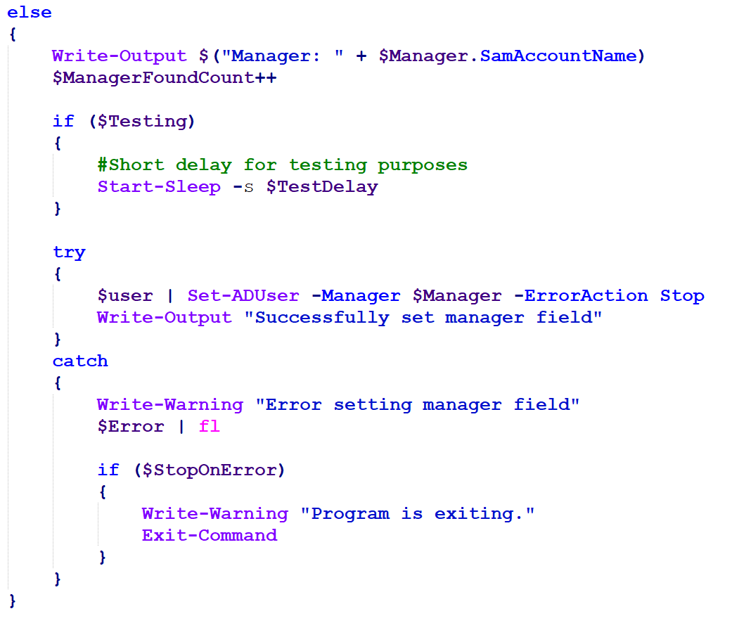

Slide 18
