Slide 1
PowerShell Code Review June 25, 2020

Slide 2
New/Updated Files
Get-RDTPFaxAudit.ps1
Update-EmailFromExt15.ps1
Kevin’s Files
HSC-CommonCodeModule.psm1
HSC-CommonCodeModule.psd1
HSC-Office365Module.psm1
HSC-Office365Module.psd1

Slide 3
Still Working On…
Visual Studio Code
PowerShell Script Analyzer
PowerShell Pester

Slide 4
HSC-CommonCodeModule.psm1

Slide 5
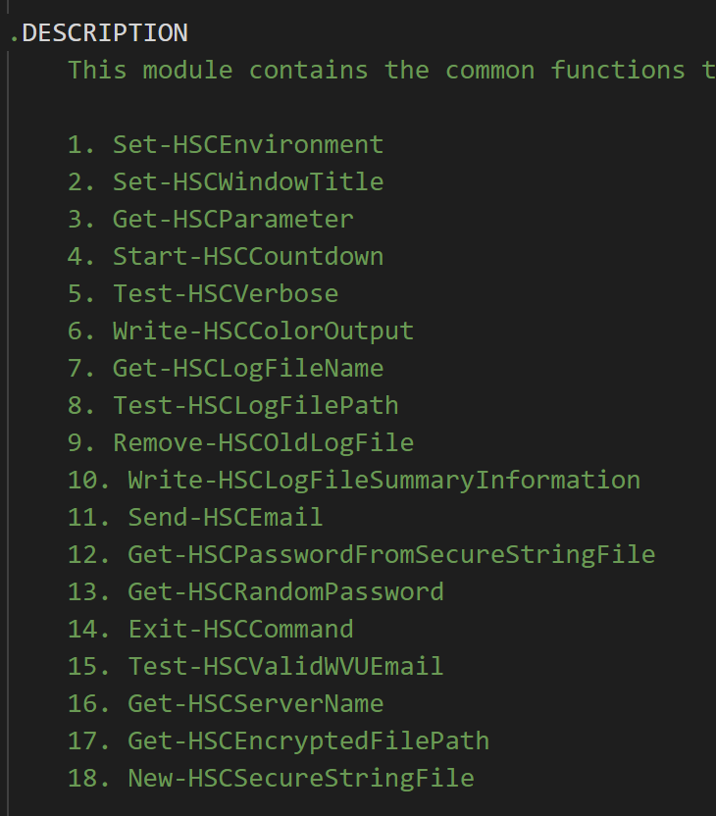

Slide 6
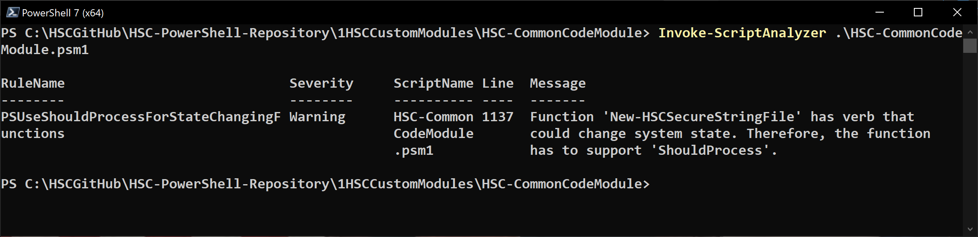

Slide 7
HSC-CommonCodeModule.psd1

Slide 8
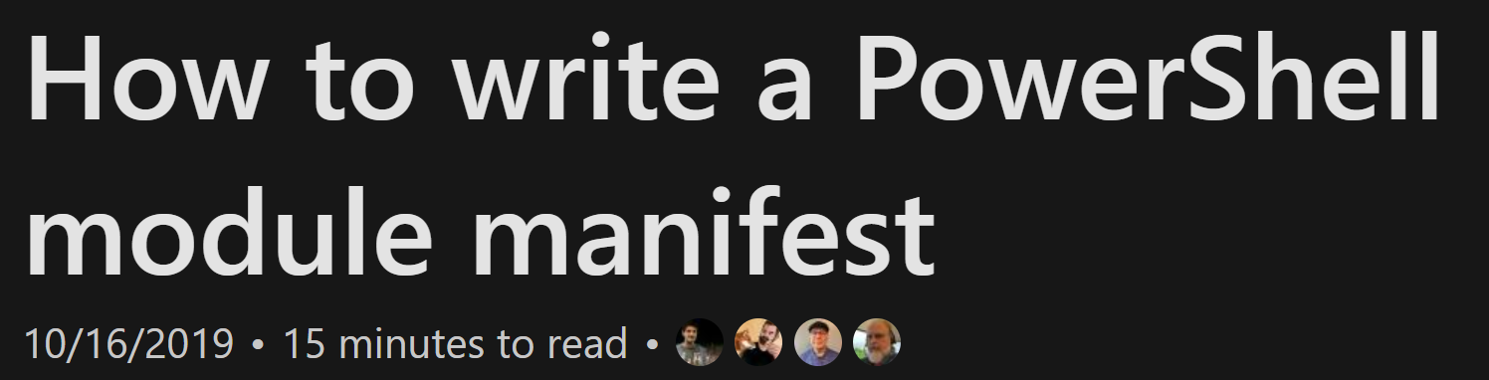
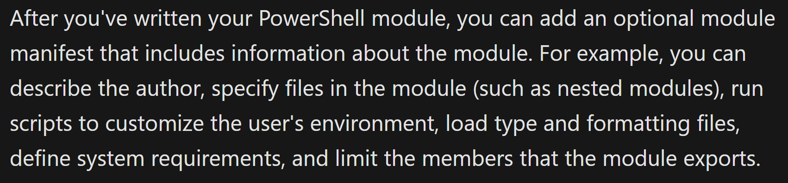

Slide 9
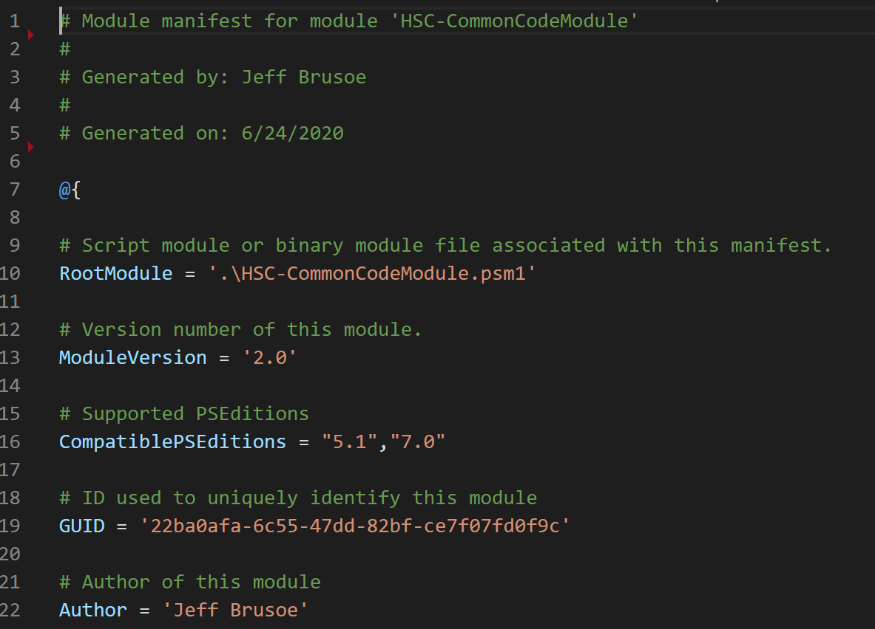

Slide 10
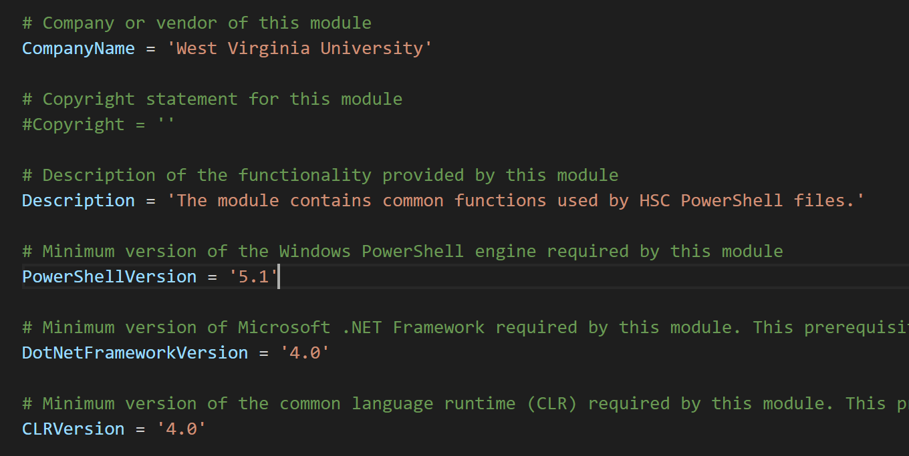

Slide 11
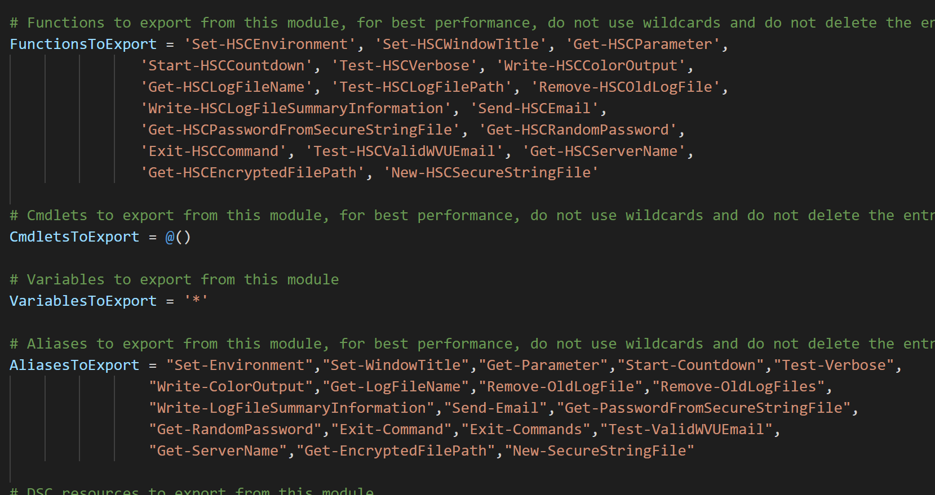

Slide 12
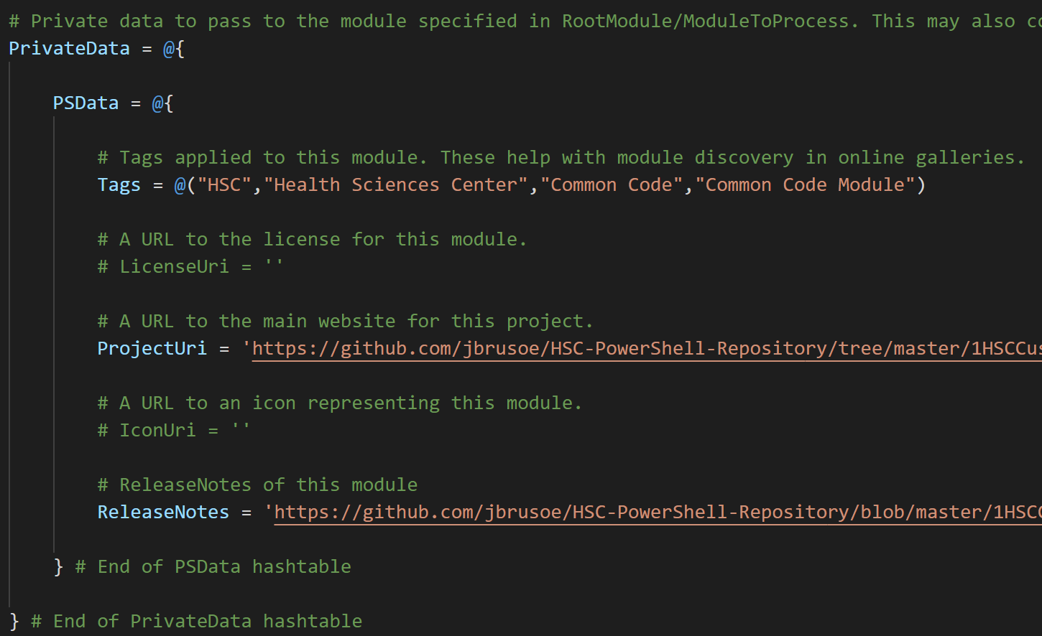

Slide 13
HSC-Office365Module.psm1

Slide 14
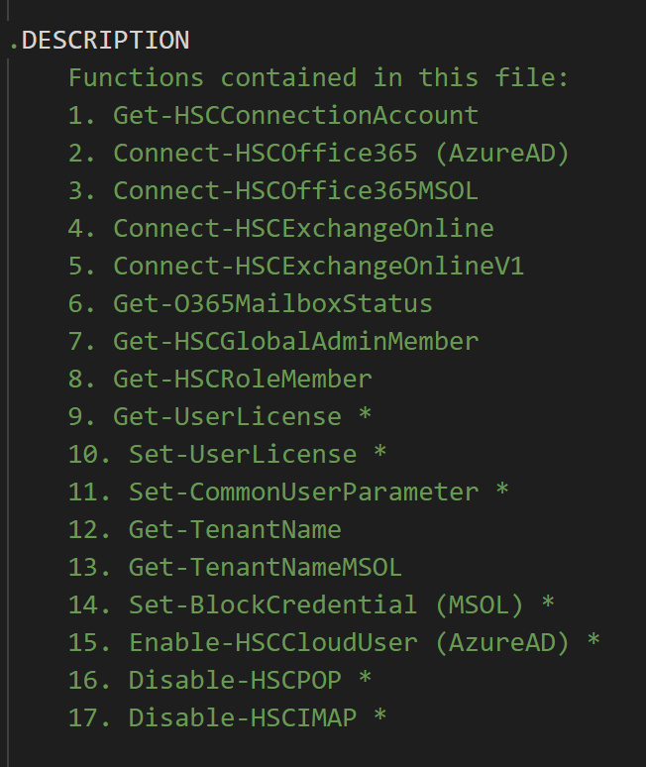

Slide 15
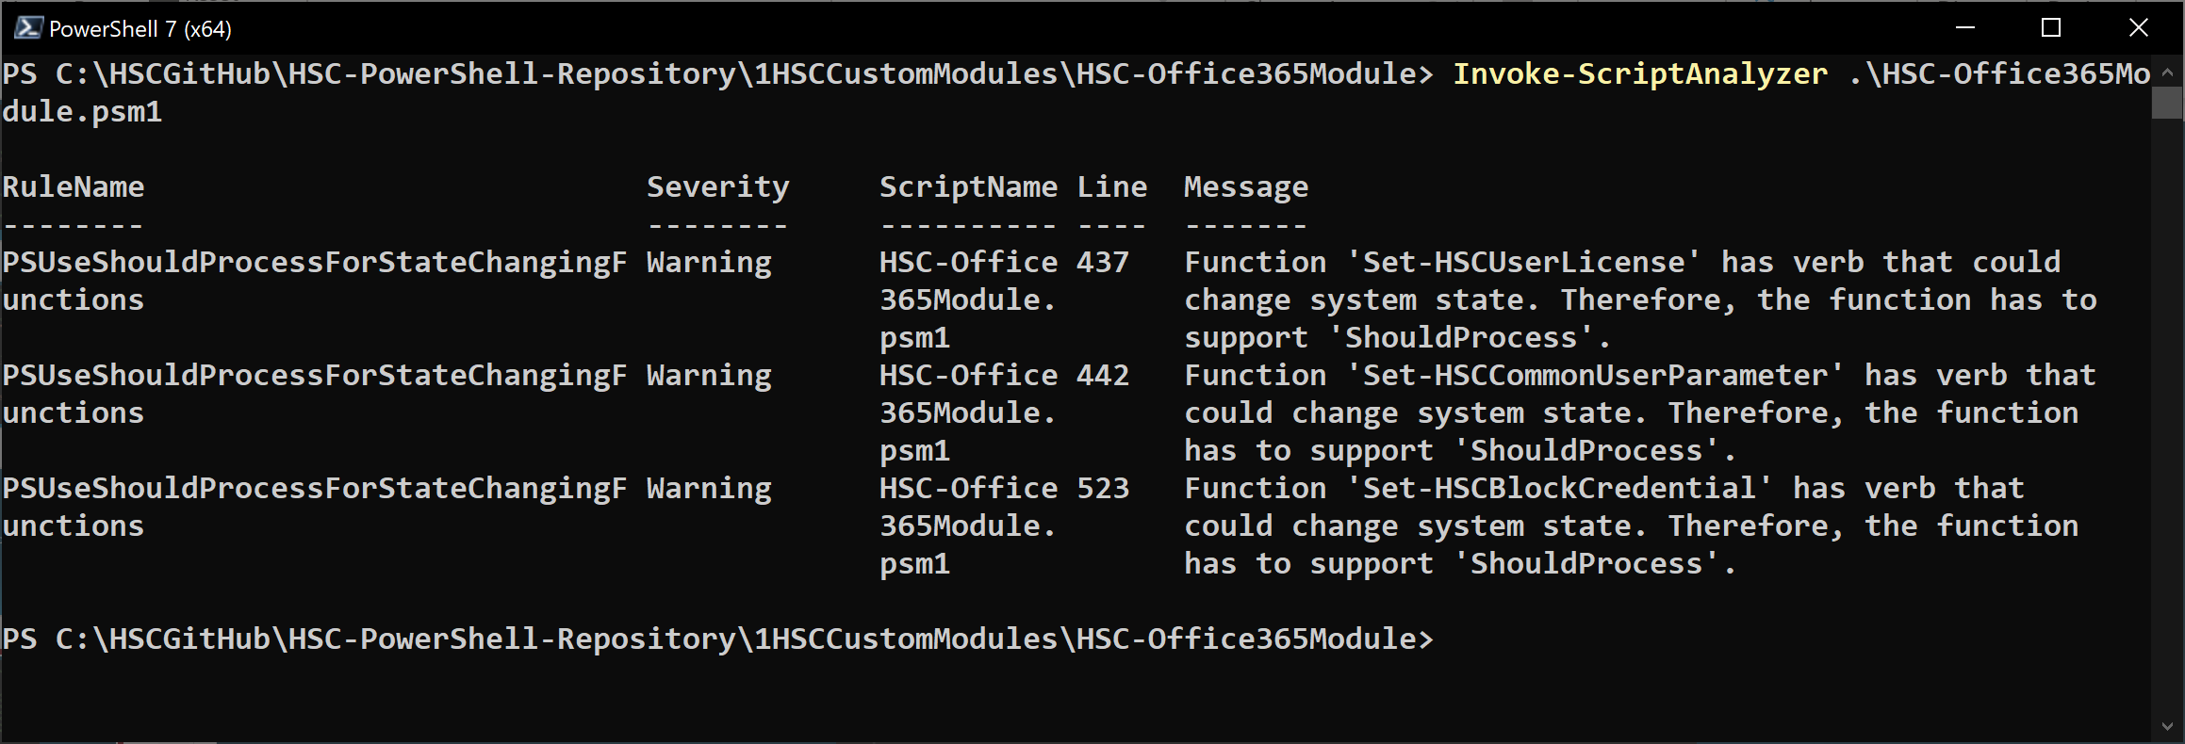

Slide 16
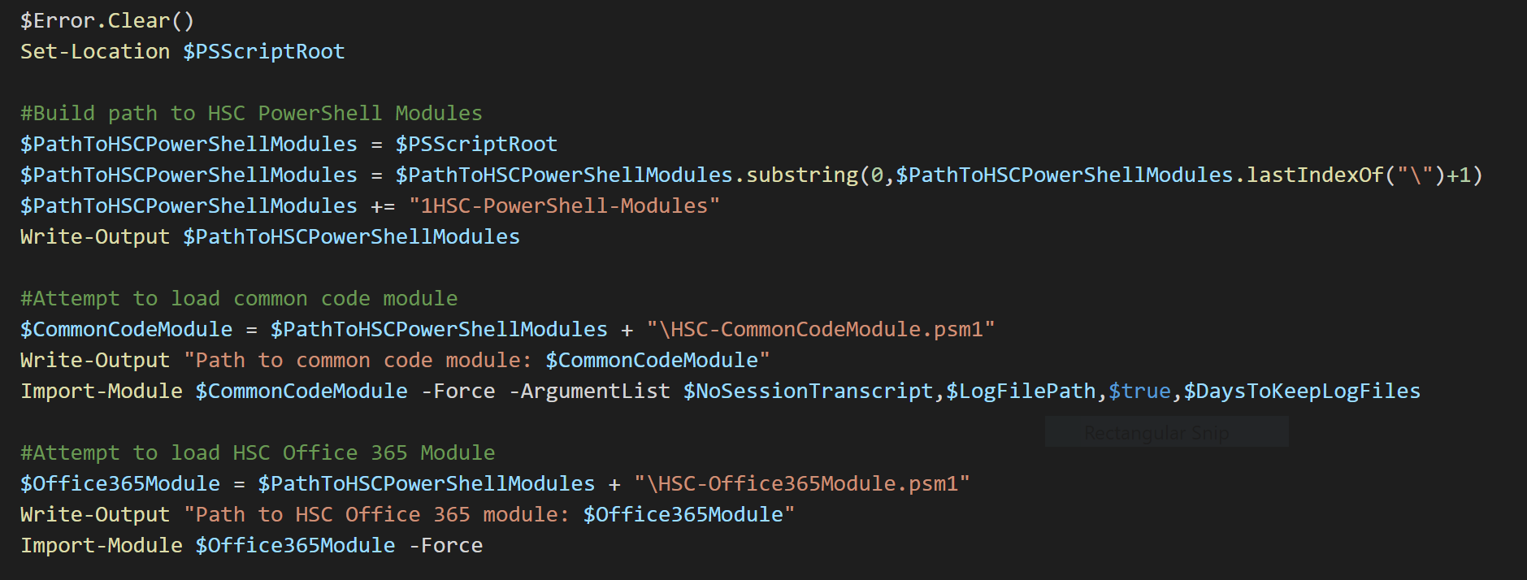

Slide 17
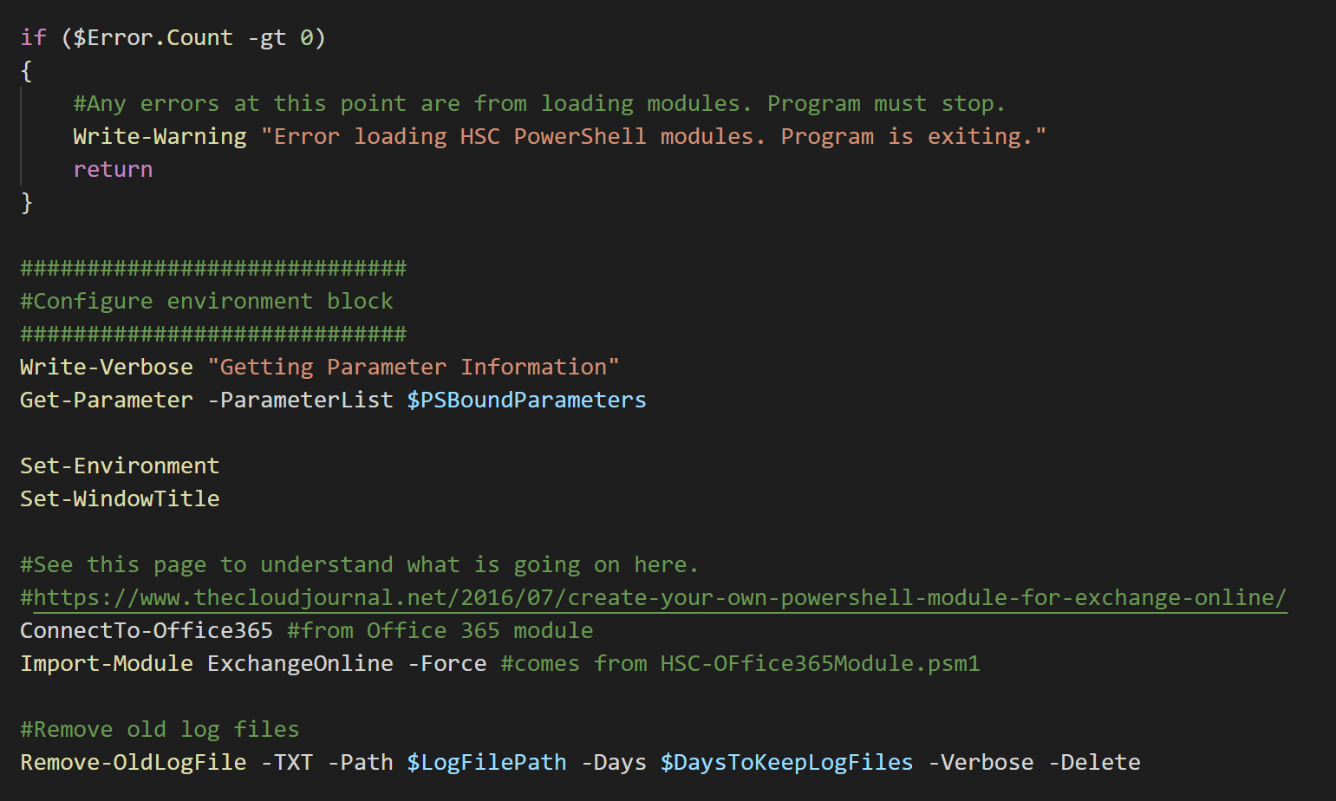

Slide 18
HSC-Office365Module.psd1

Slide 19
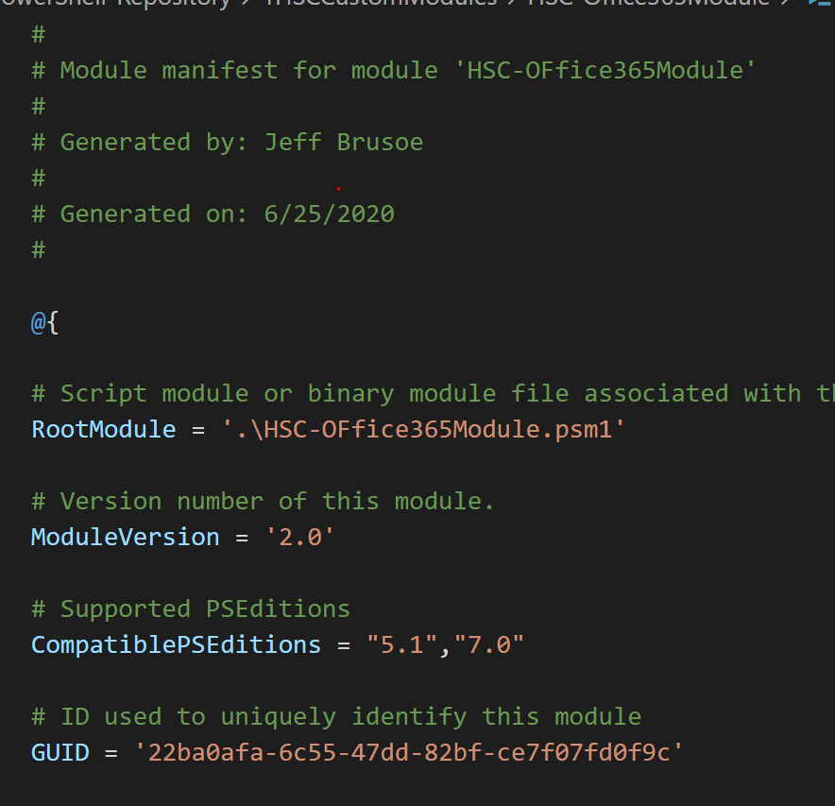

Slide 20
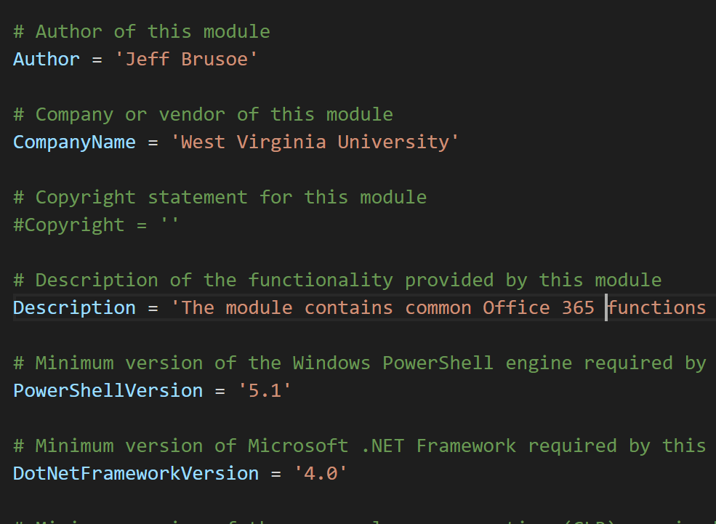

Slide 21
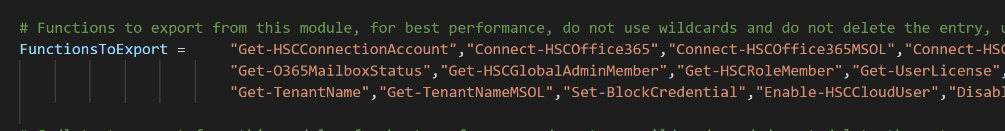

Slide 22
Module Directories

Slide 23
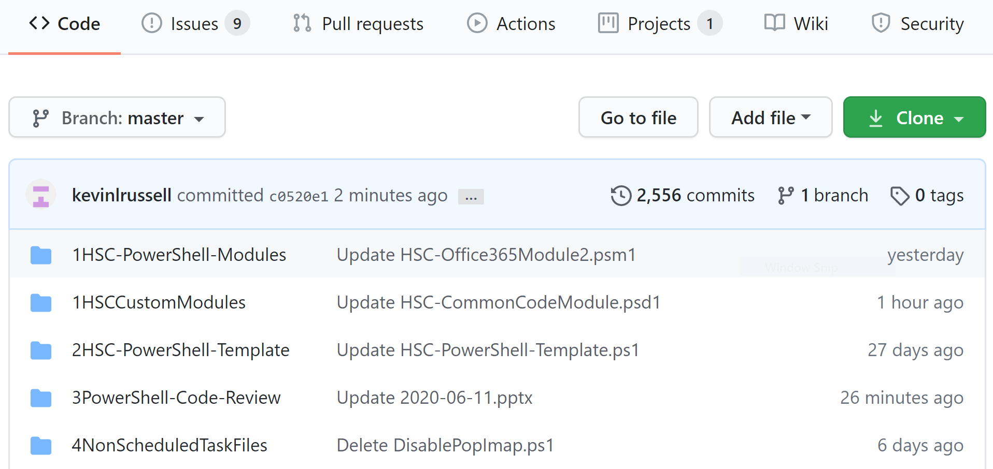

Slide 24
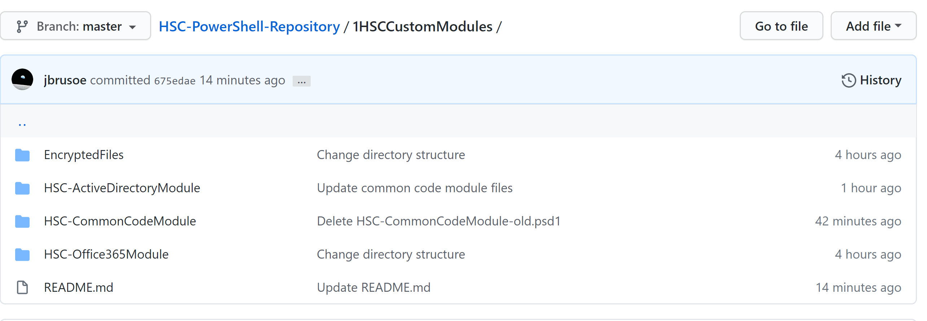

Slide 25
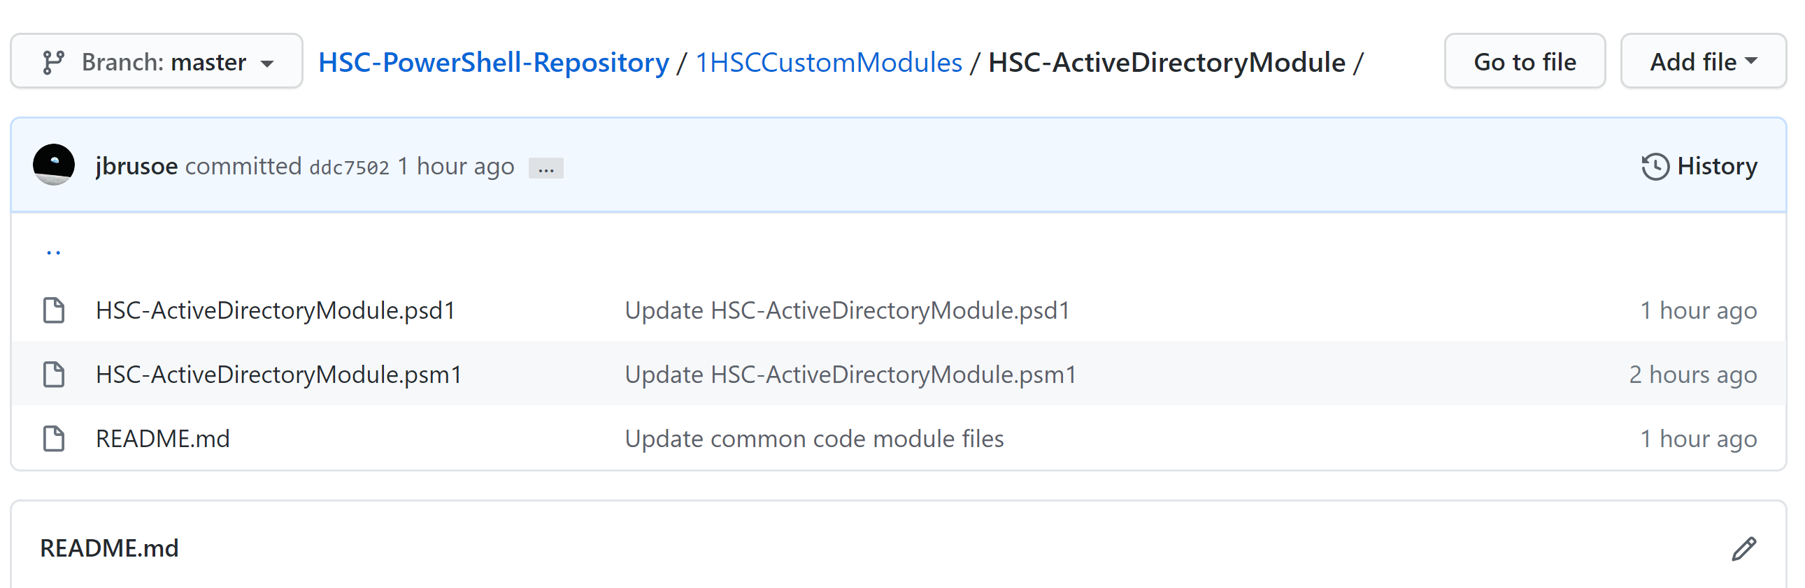

Slide 26
