Slide 1
PowerShell Code Review July 23, 2020

Slide 2
Updated many module functions (See https://github.com/jbrusoe/HSC-PowerShell-Repository/blob/master/3PowerShell-Code-Review/2020-07-23/README.md)
Register-HSCPSRepoAndInstallModule.ps1 (Kevin)
Set-PasswordRequired.ps1
Create-NewAccount.ps1

Slide 3
Register-HSCPSRepoAndInstallModule.ps1

Slide 4
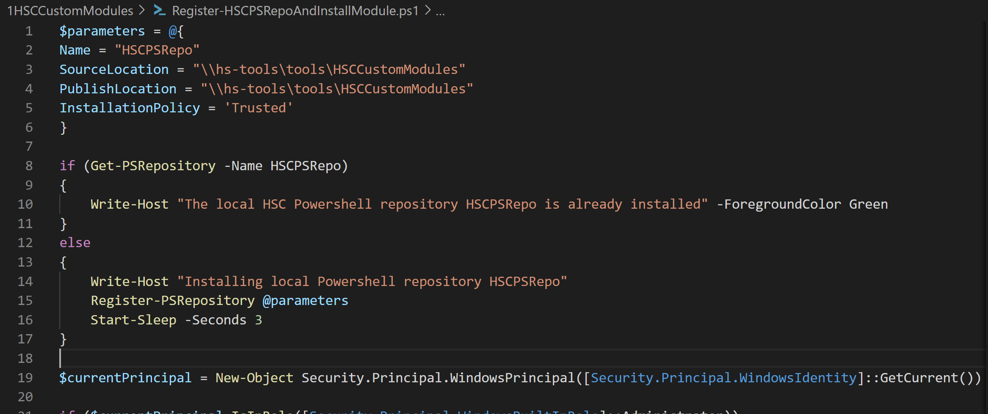

Slide 5
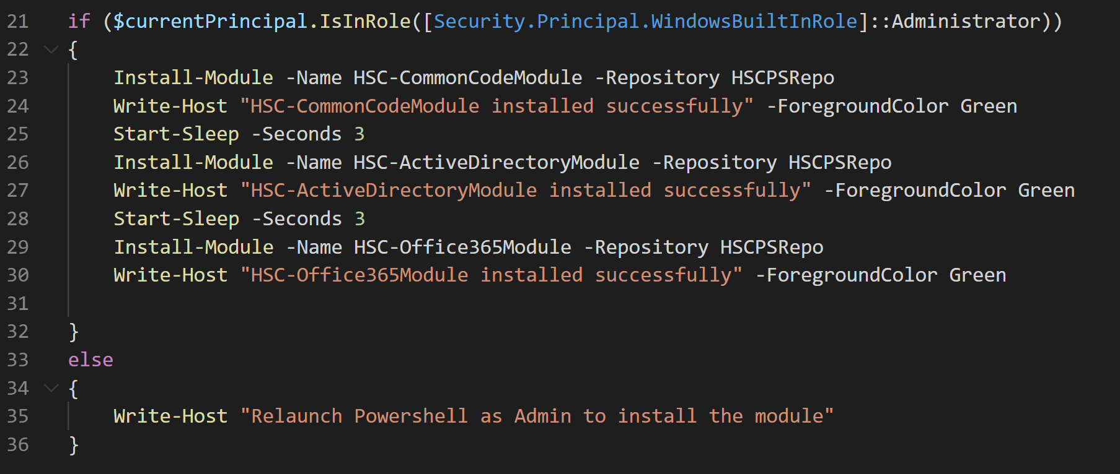

Slide 6
Set-PasswordRequired.ps1

Slide 7
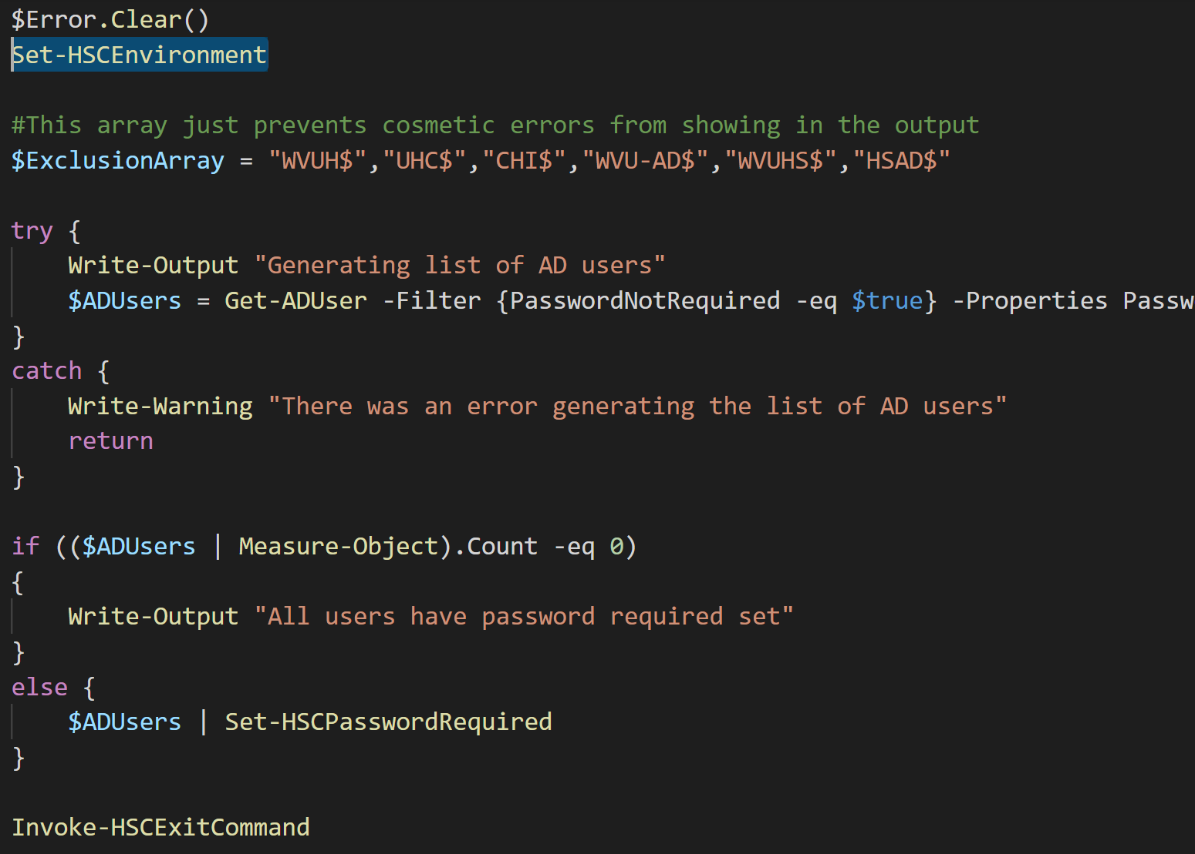

Slide 8
Create-NewAccount.ps1

Slide 9
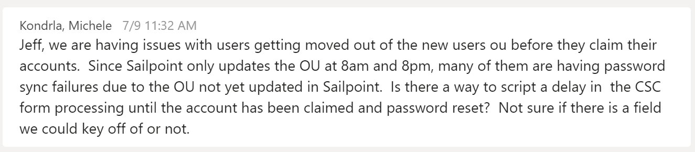

Slide 10
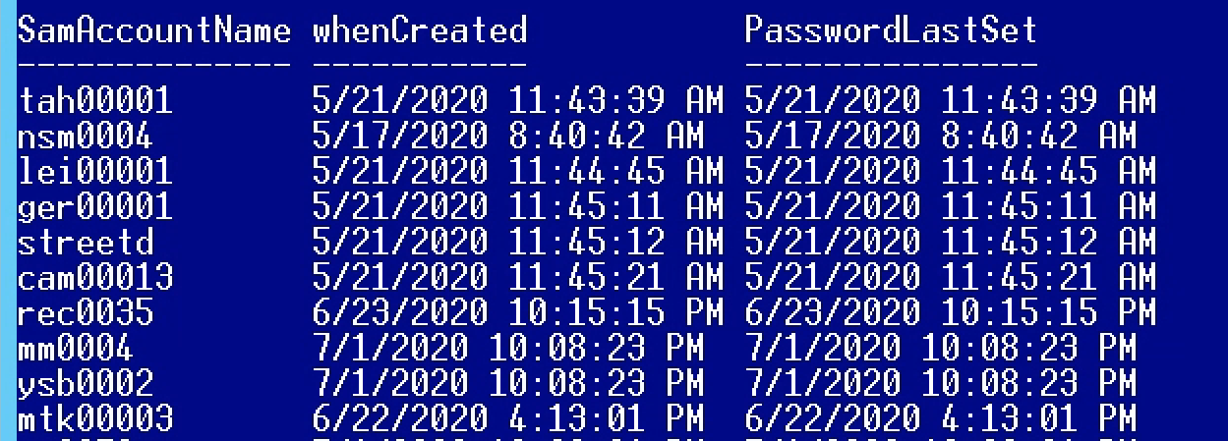

Slide 11
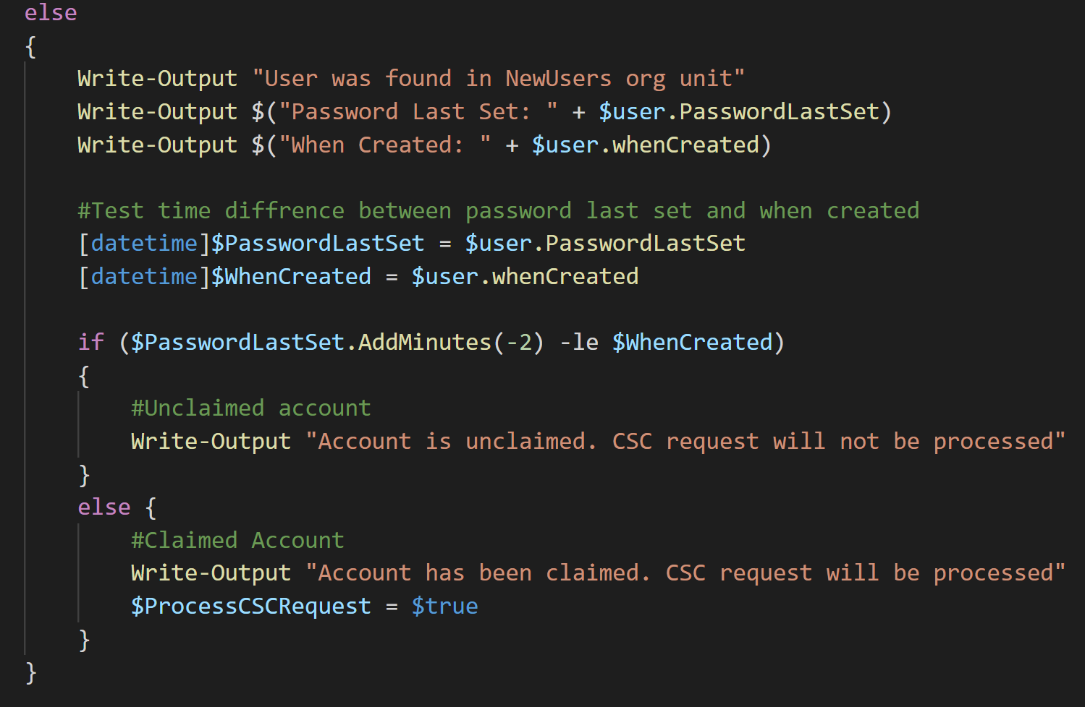

Slide 12
