Slide 1
PowerShell Code Review August 6, 2020

Slide 2
Jeff
Get-UpcomingDisabledAccount.ps1
Changes & Updates to
Create-NewAccount.ps1
HSC-CommonCodeModule.psm1
HSC-ActiveDirectoryModule.psm1
Sysscript2
Kevin
Create HSC-VMModule.psm1
New-HSCVM Function

Slide 3
In Progress
Register-HSCPSRepoAndInstallModule.psm1
Implement No365.csv
Removing C:\AD-Development directories

Slide 4
Get-UpcomingDisabledAccount.ps1

Slide 5
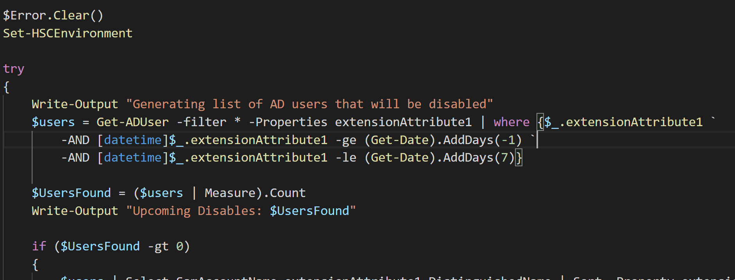

Slide 6
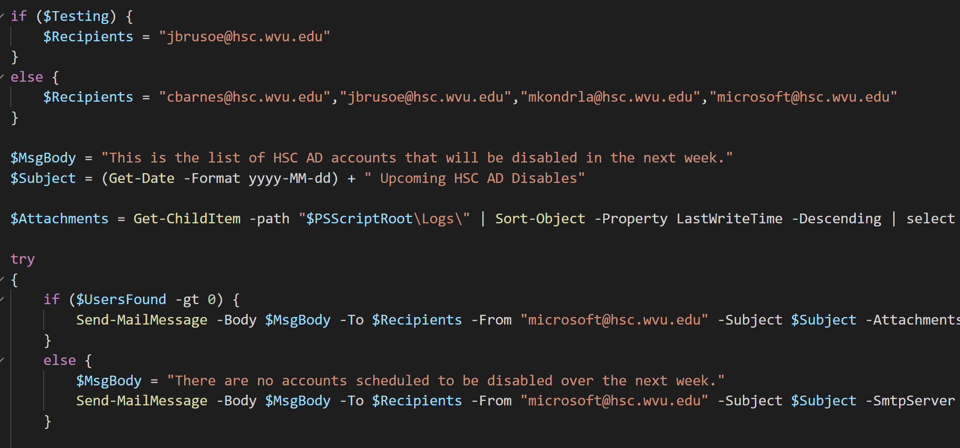

Slide 7
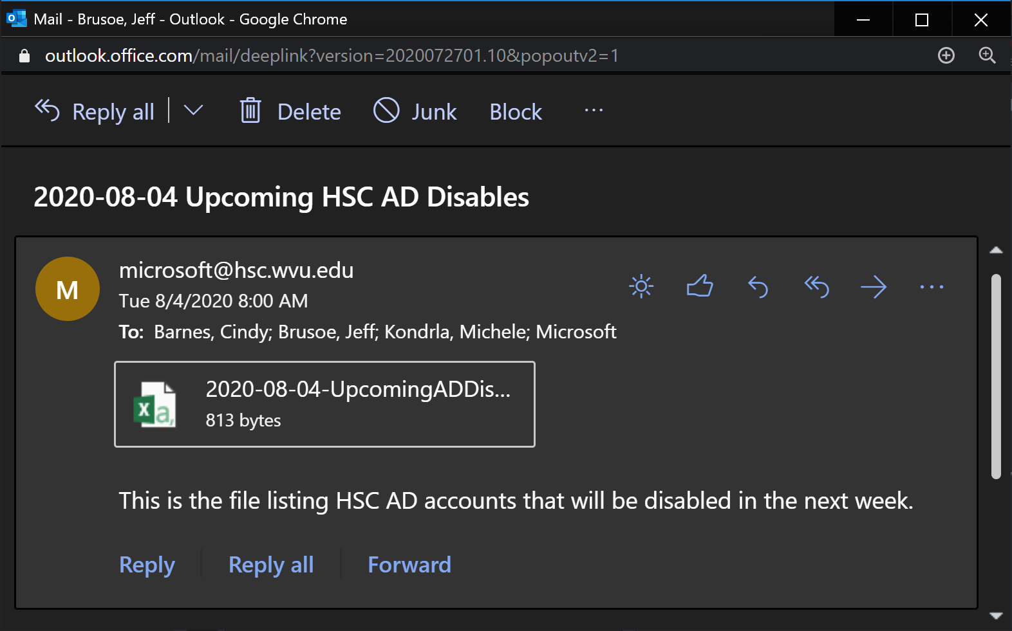

Slide 8
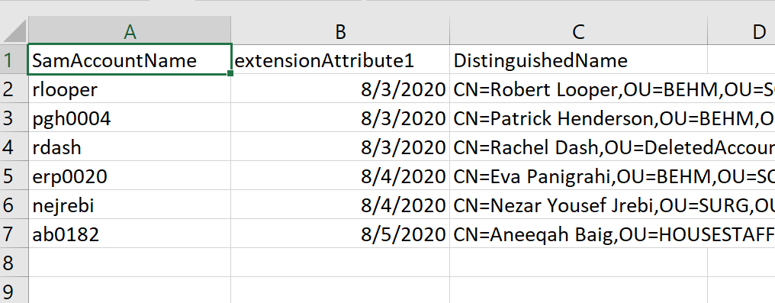

Slide 9
Create New Account Process

Slide 10
Updates & Bug Fixes
Process Summary – https://github.com/jbrusoe/HSC-PowerShell-Repository/blob/master/Create-NewAccount/README.md
Confirmation Email
Copy session transcript to separate directory if CSC request is processed
Get-HSCDirectoryMapping Function
Get-HSCGroupMapping Function
Get-HSCAccountClaimStatus

Slide 11
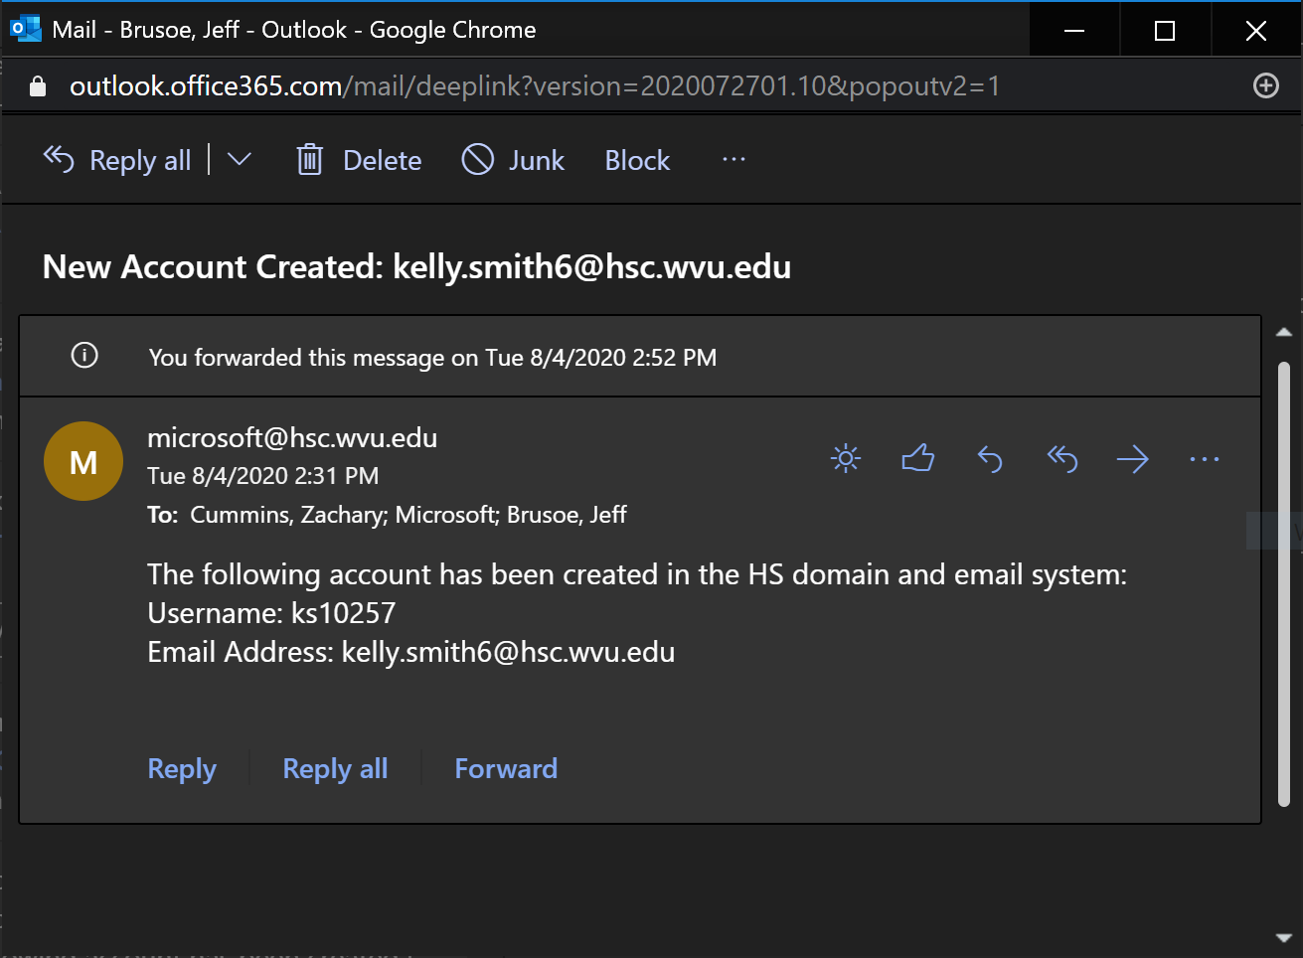

Slide 12
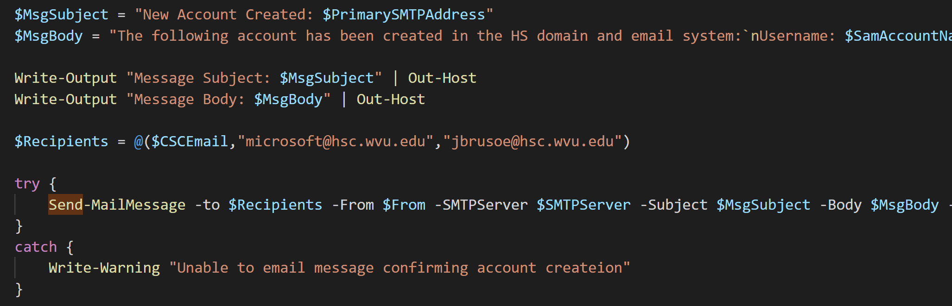

Slide 13
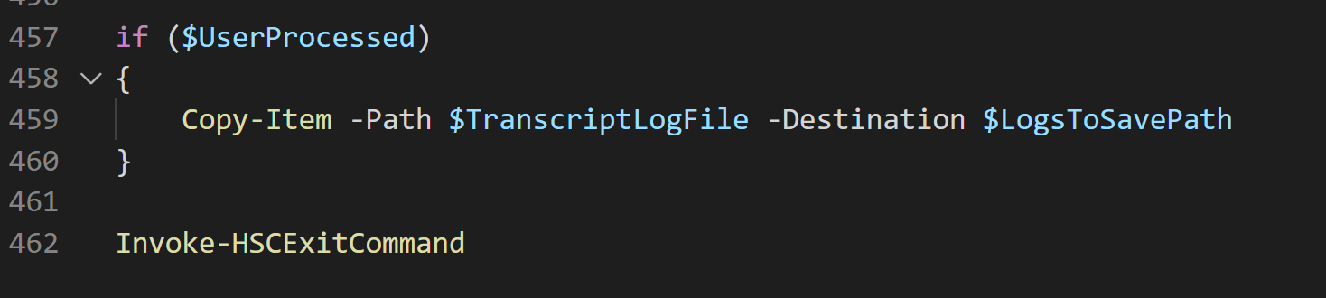

Slide 14
In progress:
Implement No365.csv

