Slide 1
PowerShell Code Review September 3, 2020

Slide 2
One time use files
Add-ADOrgUnitToGroup.ps1
Get-EmailBounce.ps1
Get-UnusedFile.ps1
Move-HSCUserAccount.ps1
Test-ValidUser.ps1

Slide 3
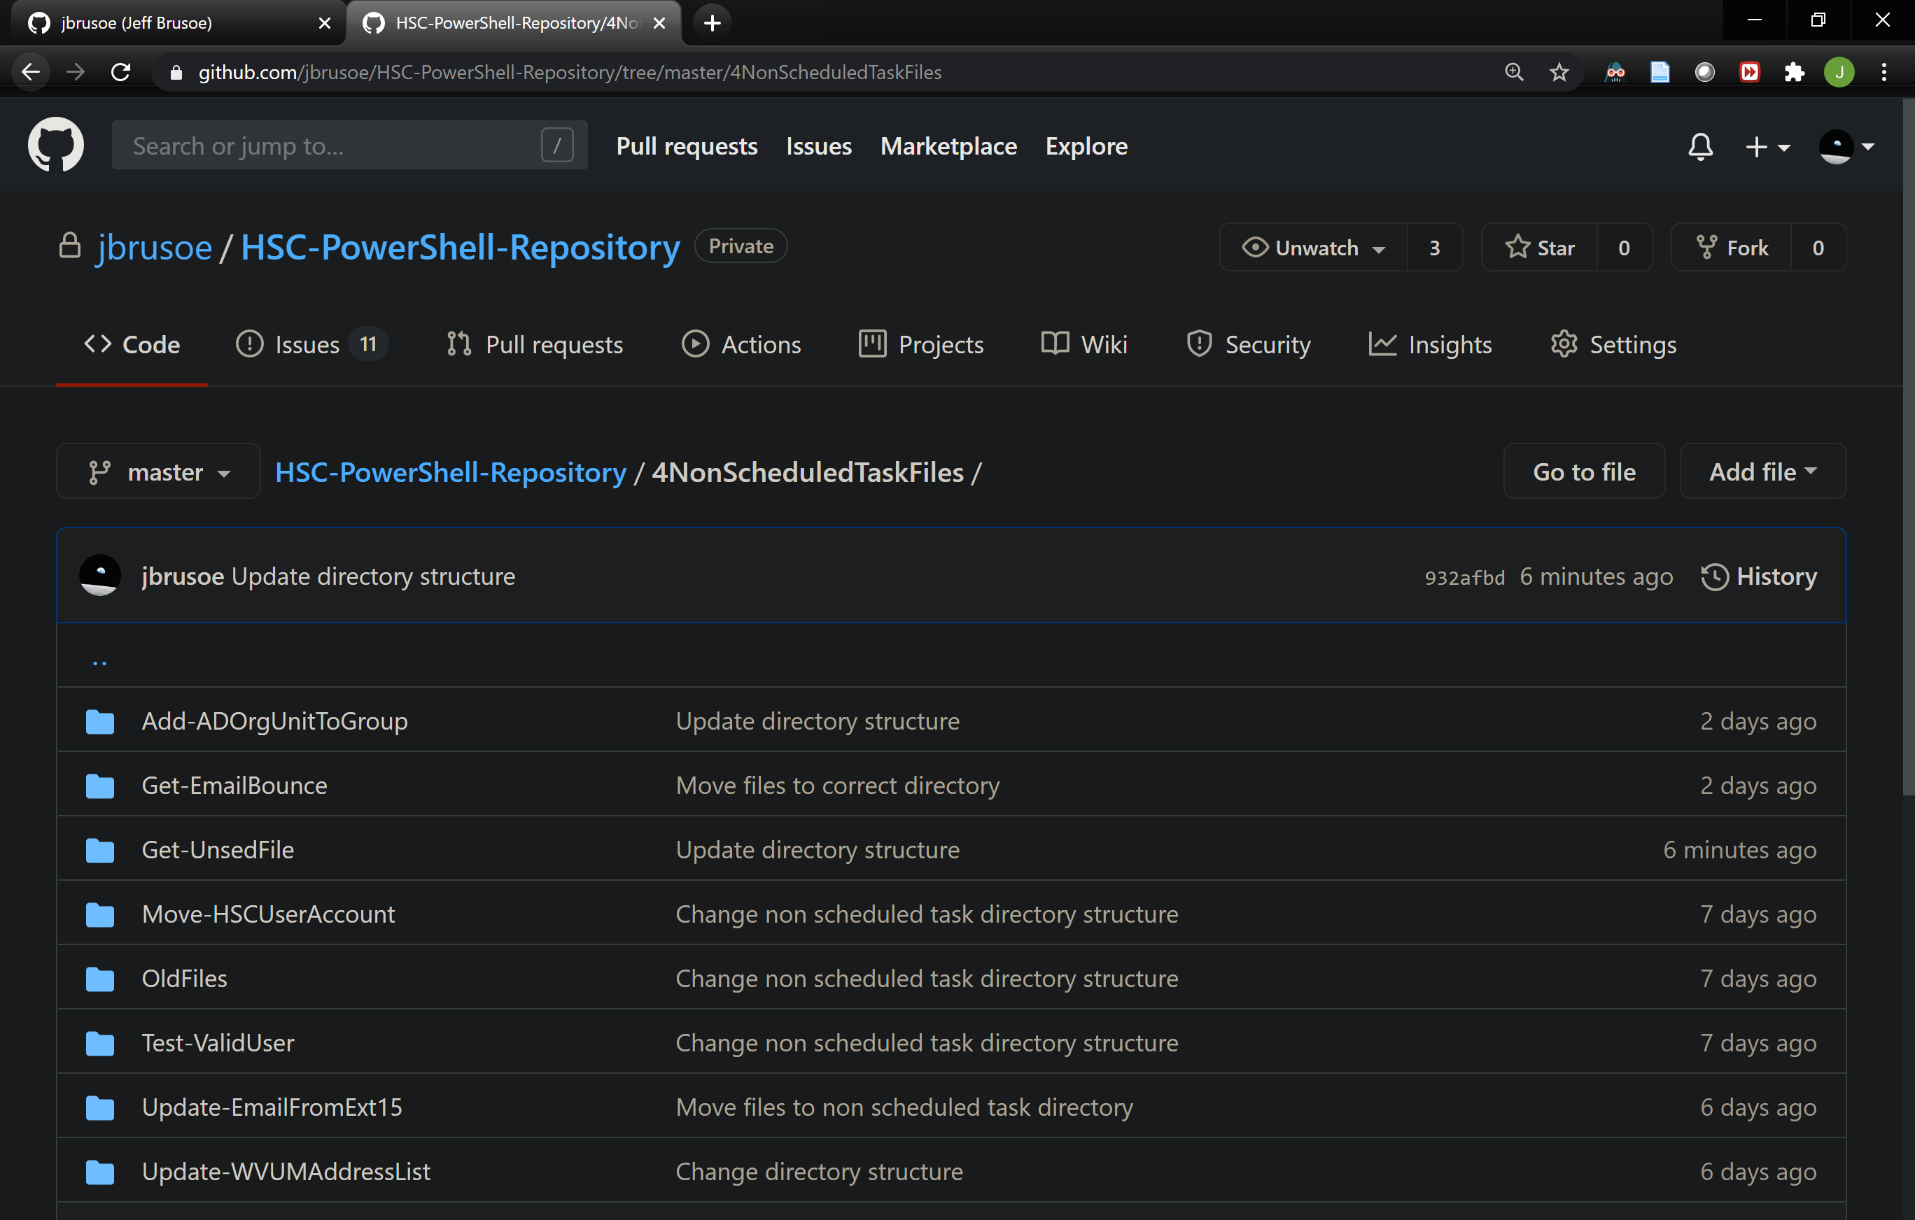

Slide 4
Migrated to New HSC Modules
Get-WVUMExt13.ps1
Export-ToSOLE.ps1 (In Progress)
Set-StandardUserAccount.ps1
Get-DisabledUser.ps1

Slide 5
Significant Changes Due to Connection Errors
Disable-AccountSecurityCompliance.ps1
Disable-ExchangeForwardingRule.ps1
Remove-ForwardingSMTPAddress.ps1

Slide 6
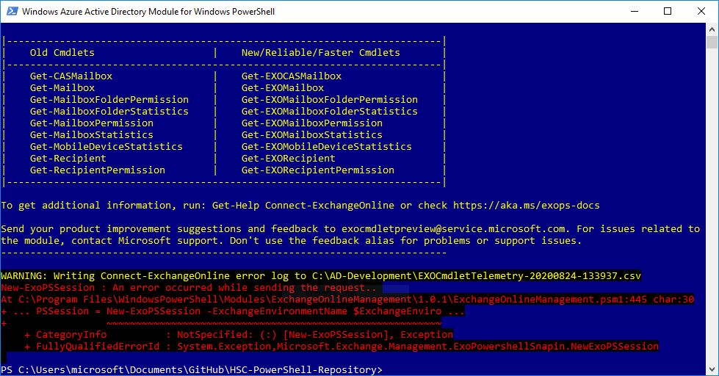

Slide 7


Slide 8
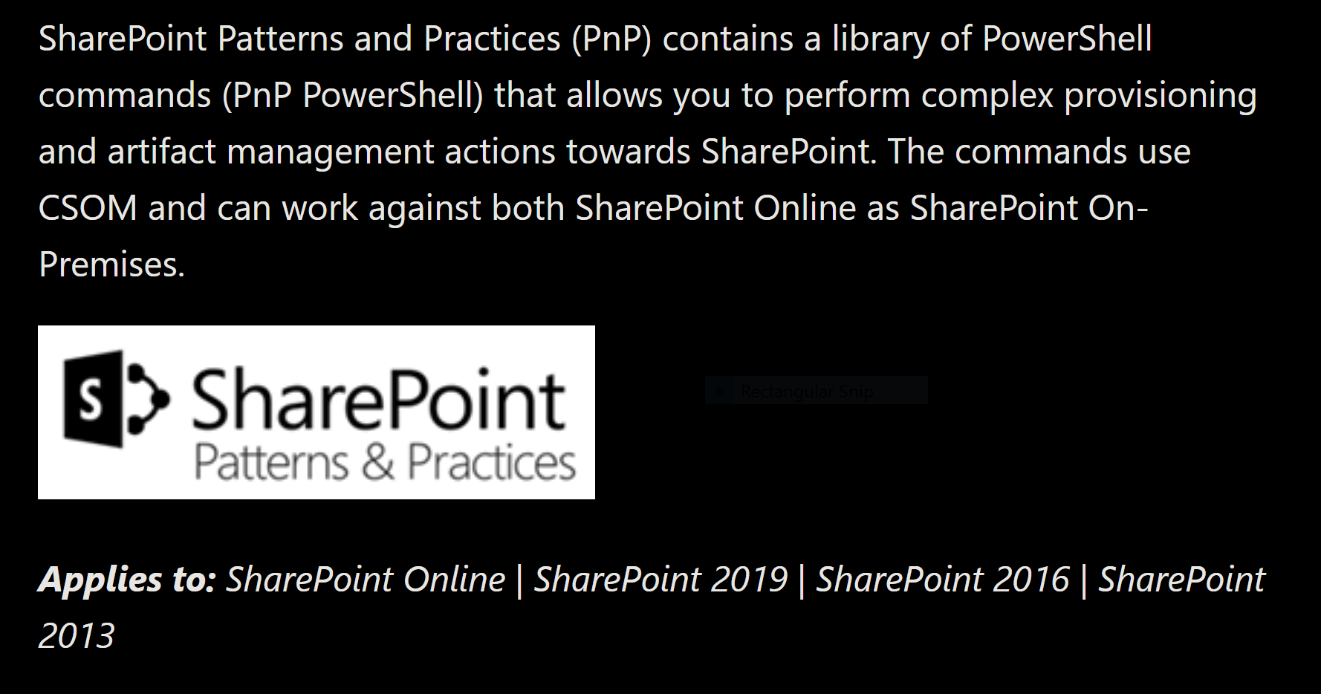

Slide 9
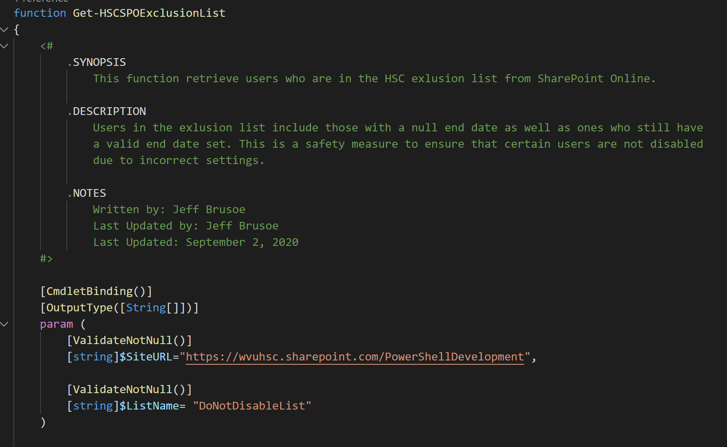

Slide 10
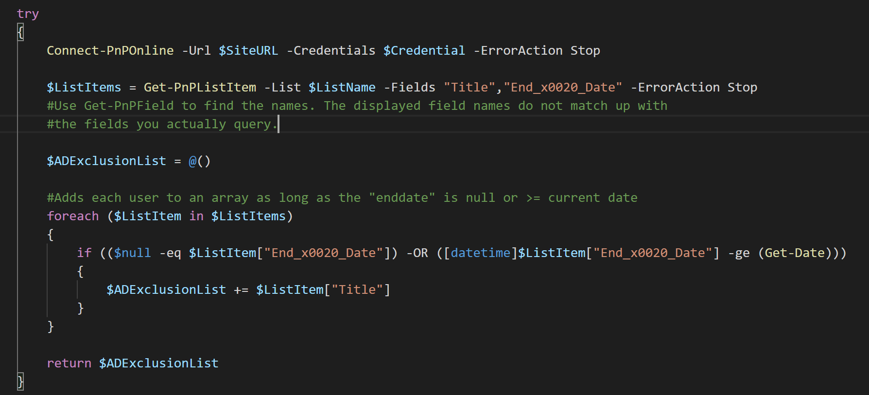

Slide 11
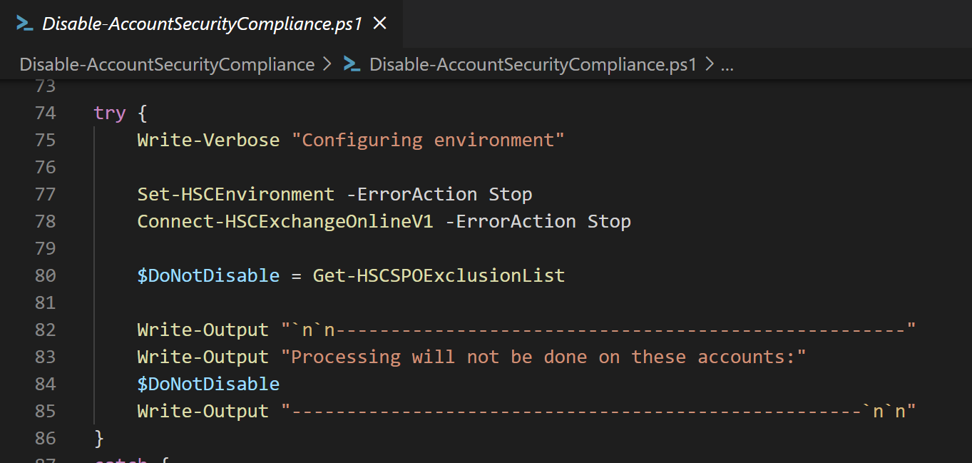

Slide 12
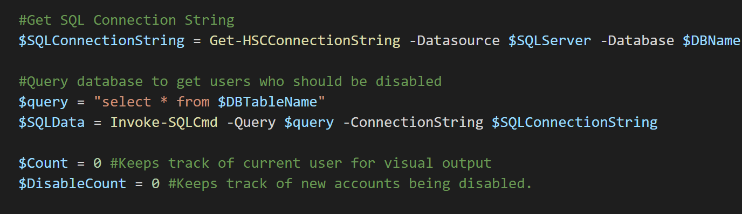

Slide 13


