Slide 1
PowerShell Code Review September 17, 2020

Slide 2
One time use files
Clear-Ext5.ps1
Get-UnusedDirectory.ps1
New Files
Backup-ADExtensionAttribute.ps1

Slide 3
New Functions
Get-HSCLastFile
Get-HSCLitigationHold
Get-HSCLitigationHoldV1
Cleaned Up Old Files
Set-BlockCredential.ps1
Set-ADMailAttribute.ps1

Slide 4
Cleaned Up Old Files Continued
Set-ManagerField.ps1
Disable-EndAccessDate.ps1 (Still working on this)
Export-ToSOLE.ps1 (still working on this)
Disable-AccountSecurityCompliance.ps1
Set-PasswordRequired.ps1
Disable-NewUsersOU.ps1
Enable-AccountAfterPasswordChange.ps1

Slide 5
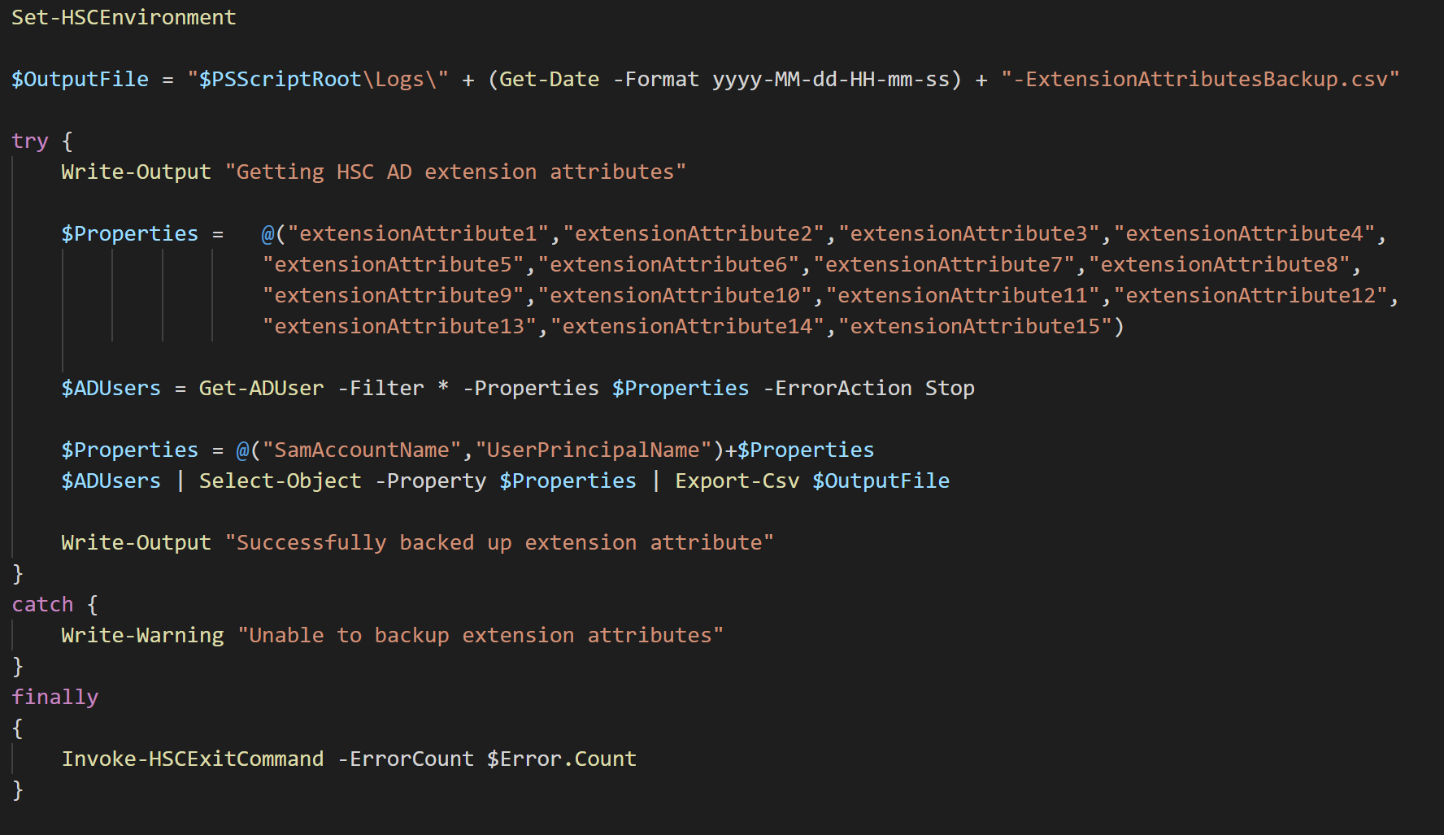

Slide 6
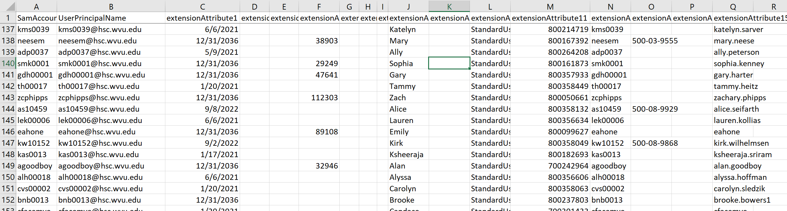

Slide 7
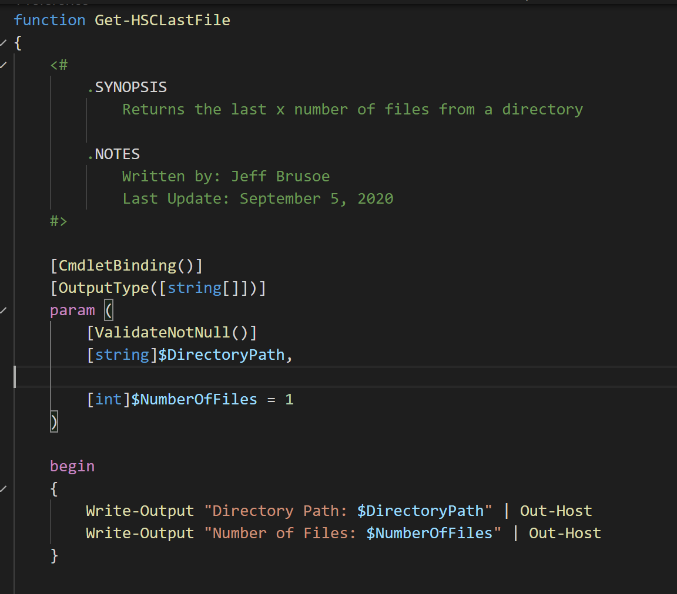

Slide 8
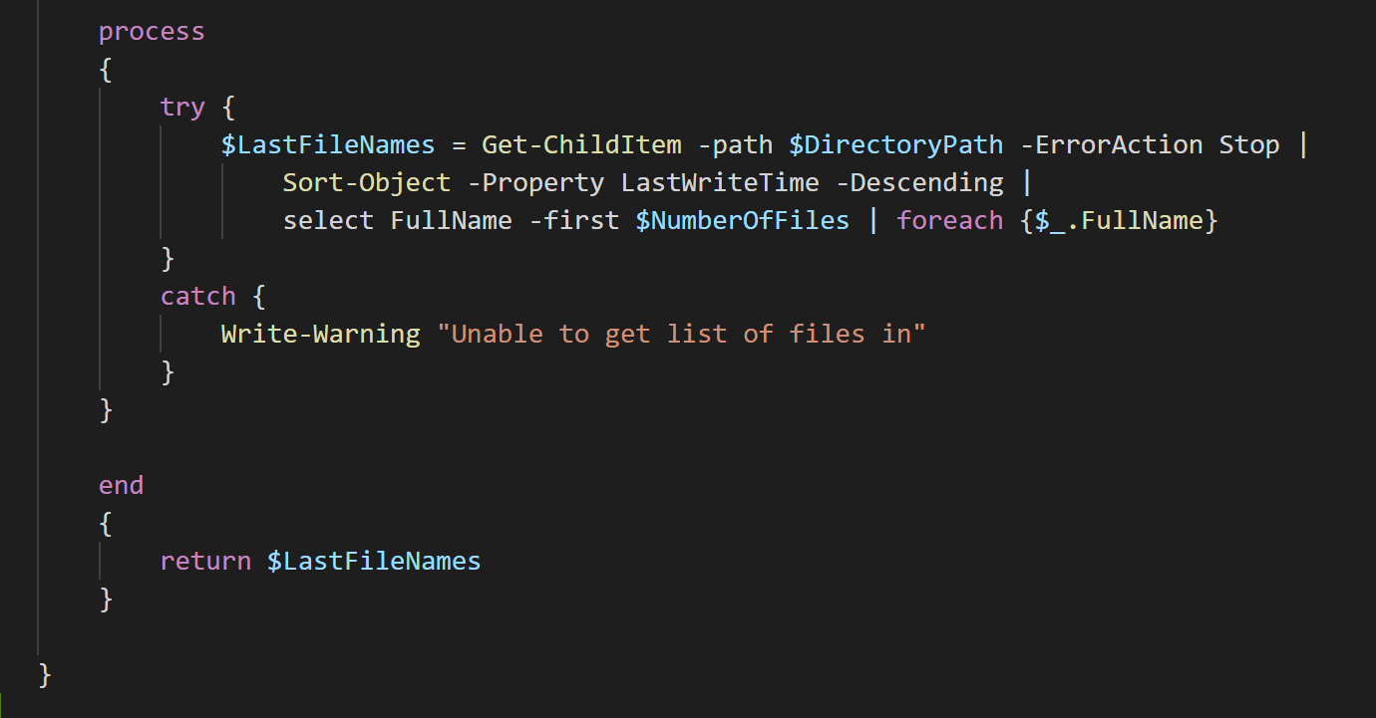

Slide 9
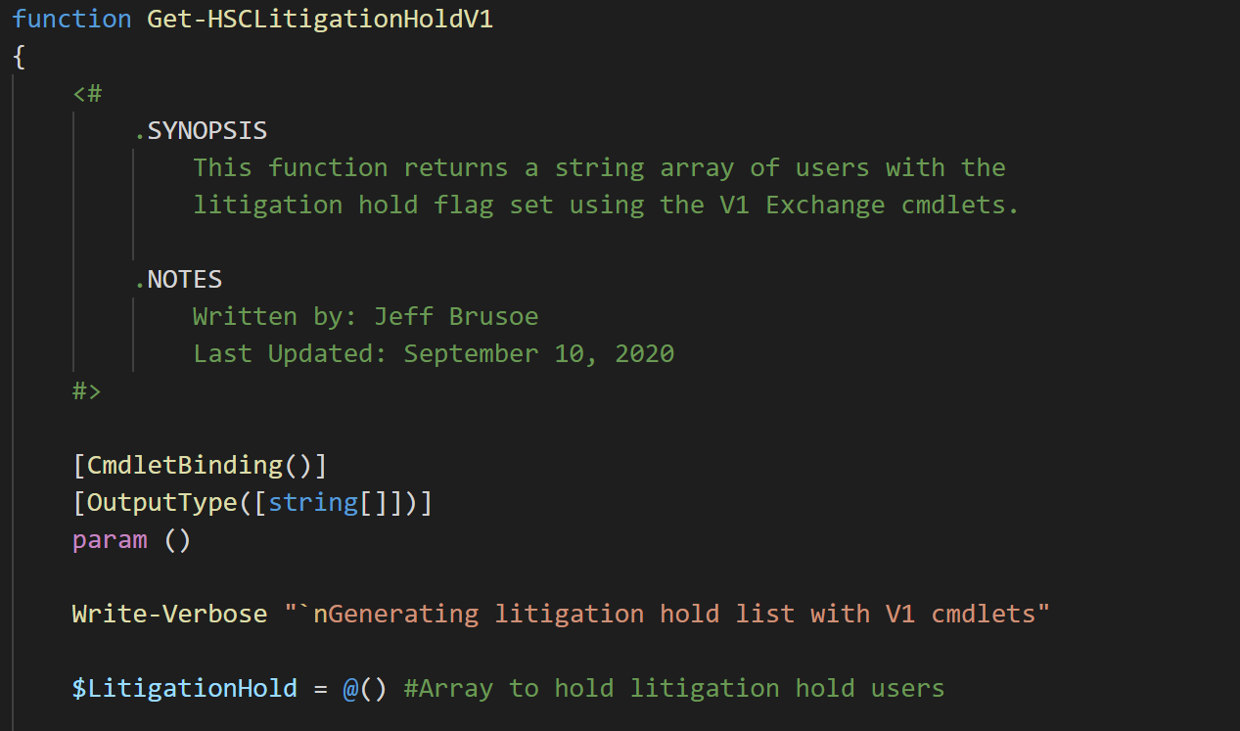

Slide 10
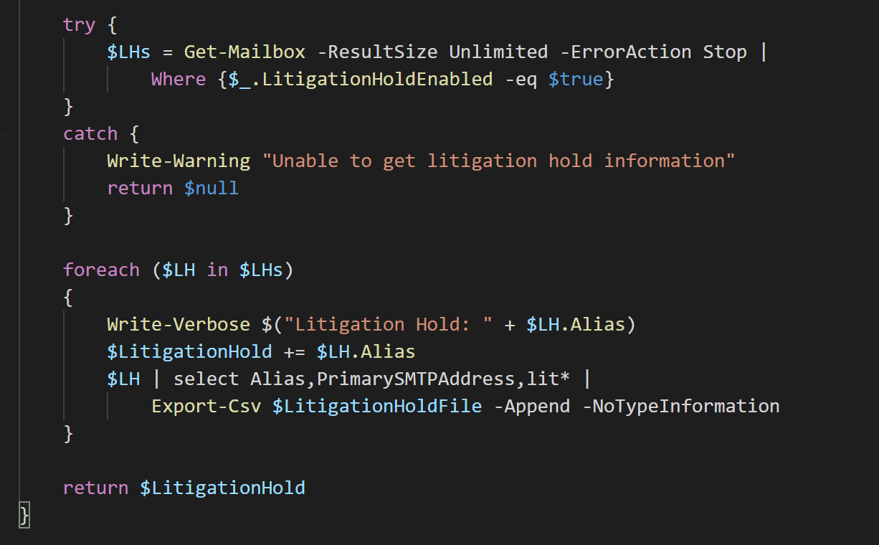

Slide 11
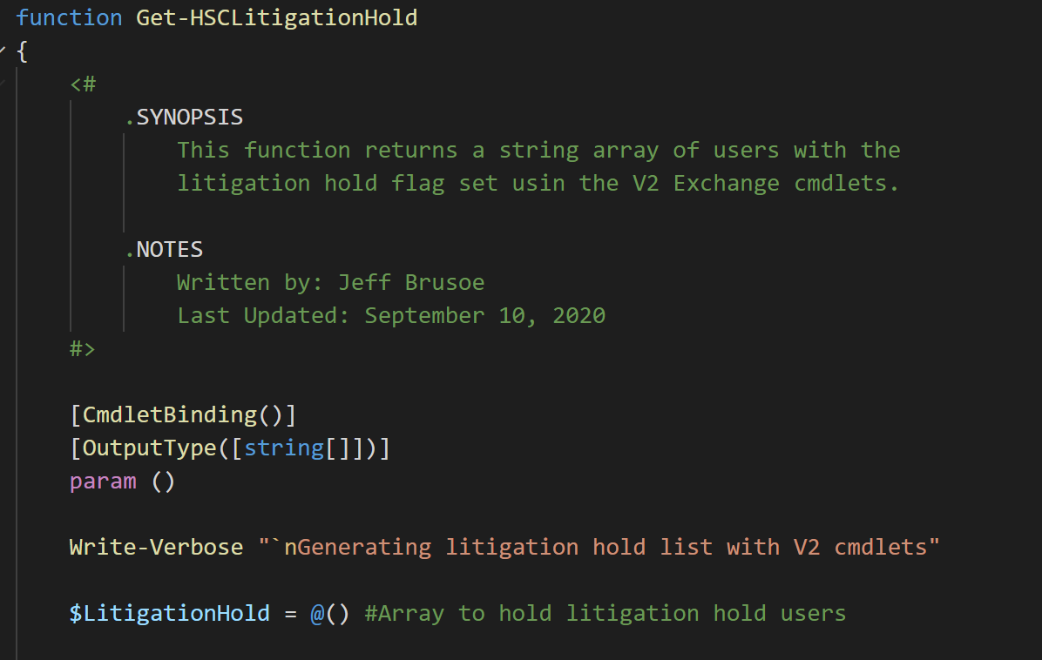

Slide 12
