Slide 1
PowerShell Code Review October 15, 2020

Slide 2
Matt’s Files
Get-IDFScanAutomation.ps1
Get-SCCMEmailLogOSD.ps1
Send-IDFReportsToSharePoint.ps1
Set-SCCMLocationAD.ps1
Update-ComputerLocationFromSOLE.ps1

Slide 3
New Files
HSC-SQLModule.psd1
Update-SharedUserDB.ps1
Remove-ExchangeForwardingRuleRandom.ps1
New Functions
Add-HSCProxyAddress
Test-HSCADModuleLoaded

Slide 4
Updated Files
Set-HospitalHIPAATraining.ps1
Remove-ExchangeForwardingRule.ps1

Slide 5
Matt’s Files

Slide 6
HSC-SQLModule.psd1

Slide 7
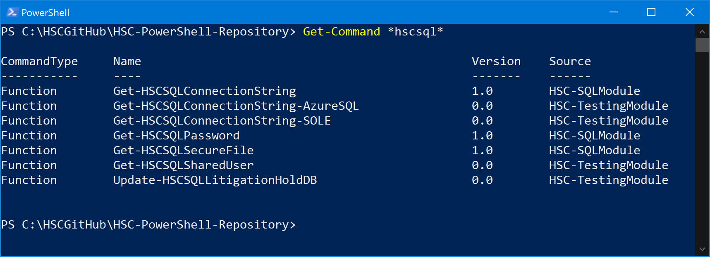

Slide 8
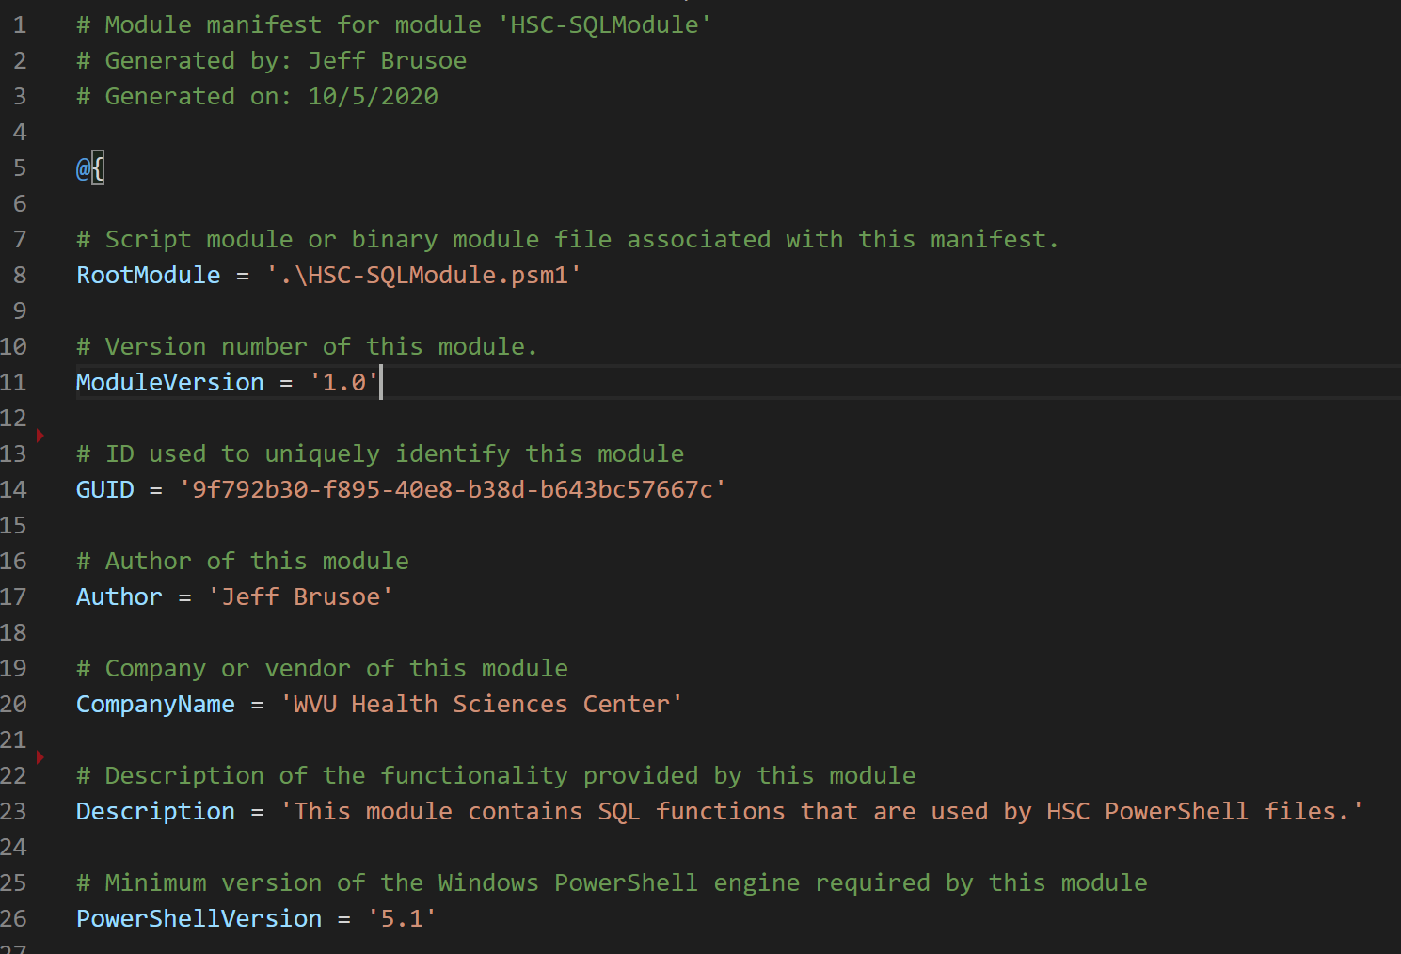

Slide 9
https://docs.microsoft.com/en-us/powershell/scripting/developer/module/how-to-write-a-powershell-module-manifest?view=powershell-7#module-manifest-elements

Slide 10
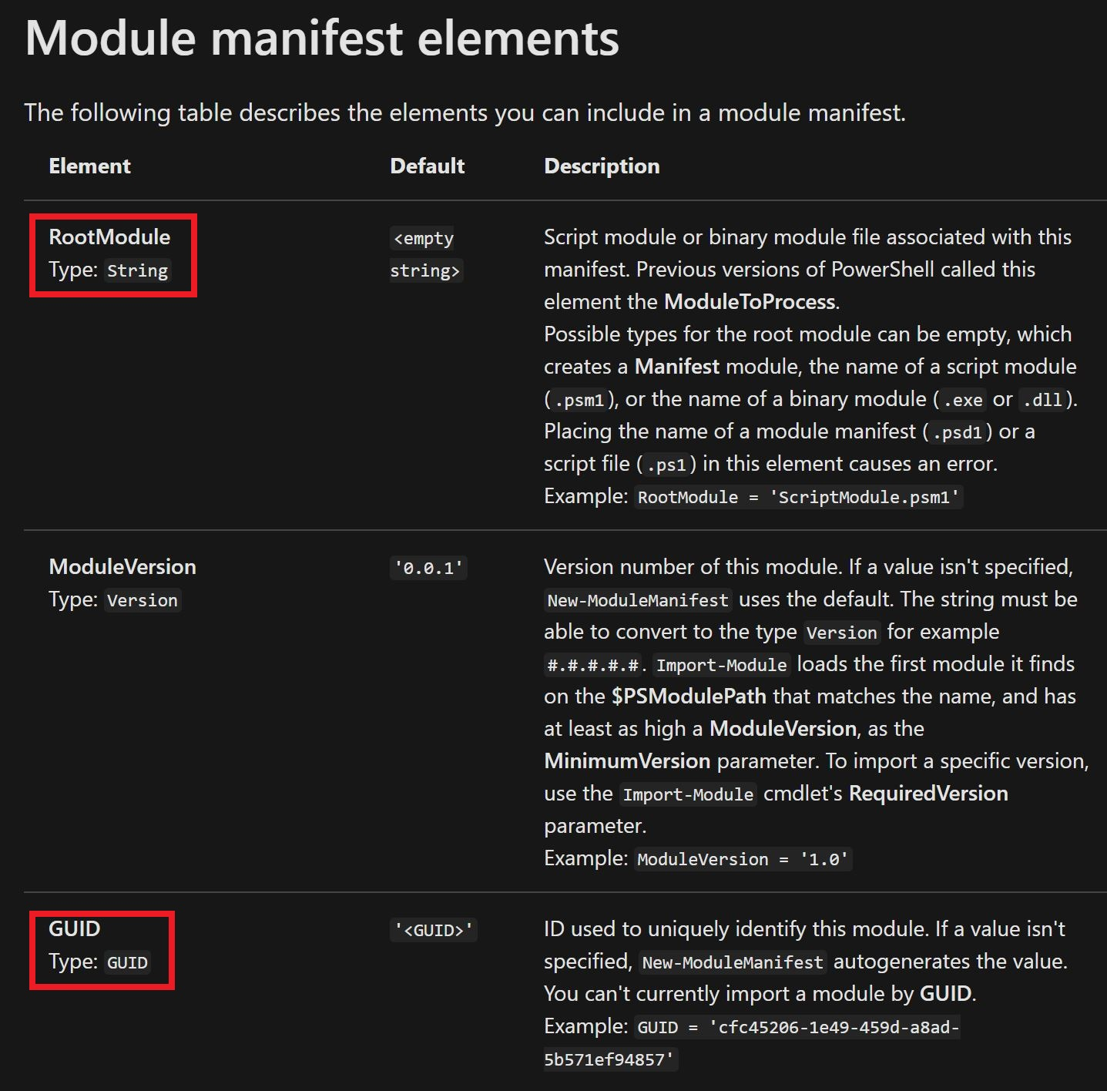

Slide 11
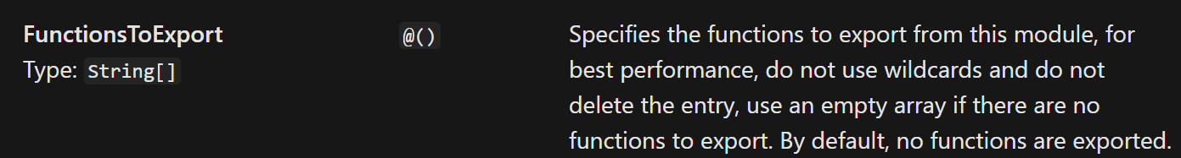
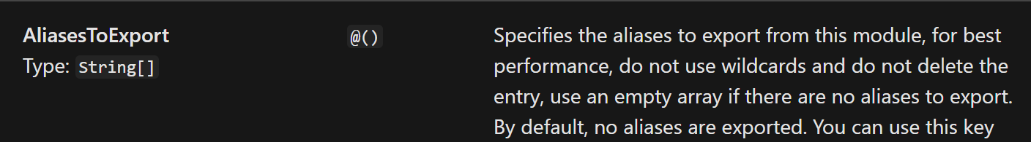

Slide 12
Update-SharedUserDB.ps1

Slide 13
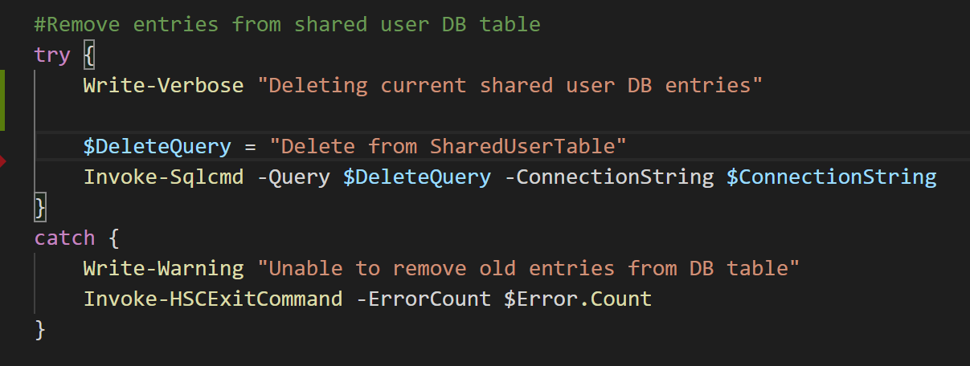

Slide 14
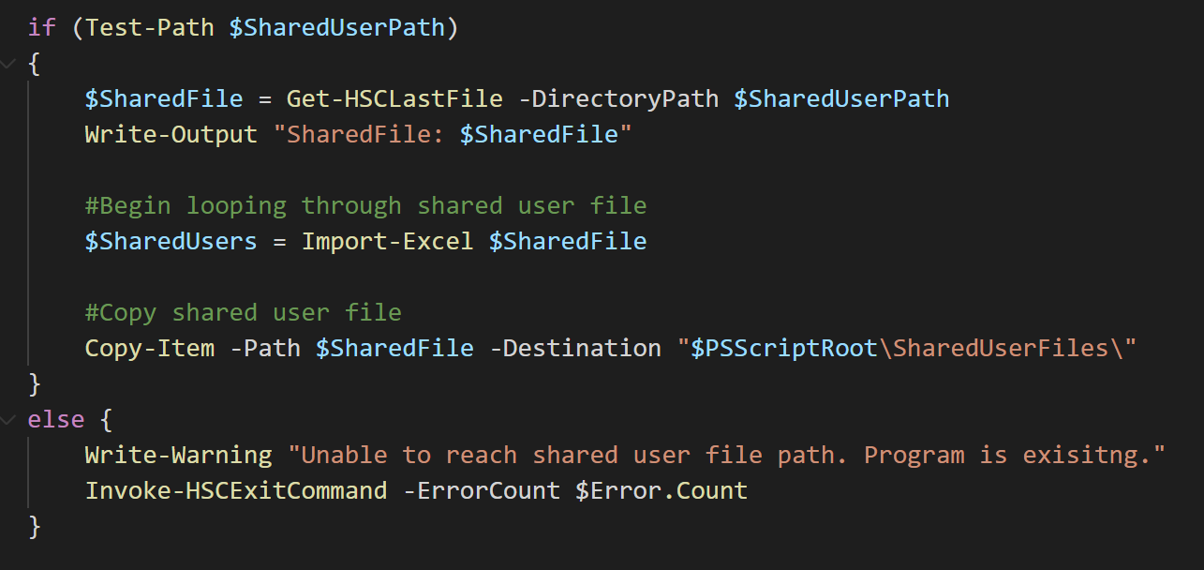

Slide 15
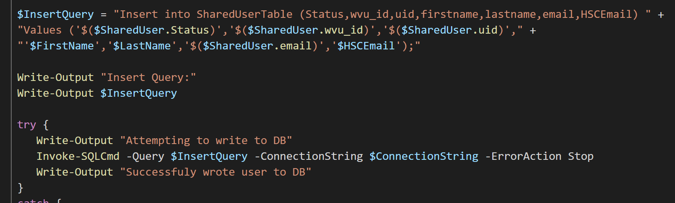

Slide 16
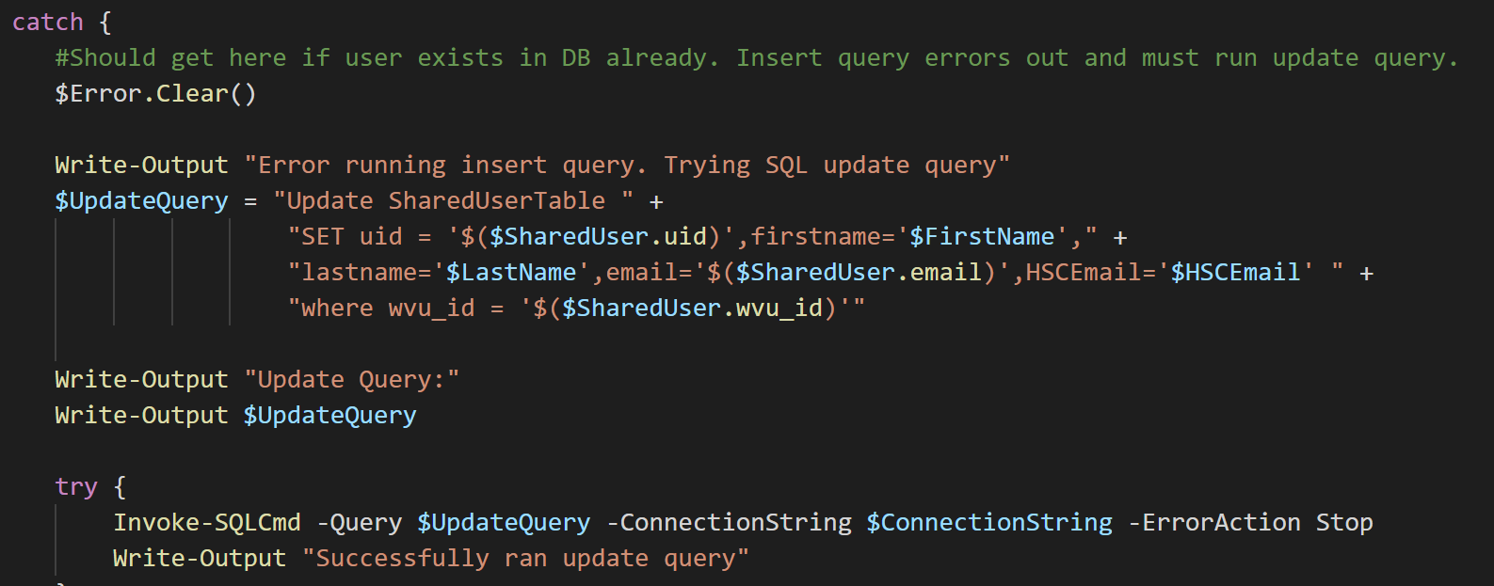

Slide 17
Remove-ExchangeForwardingRule.ps1

Slide 18
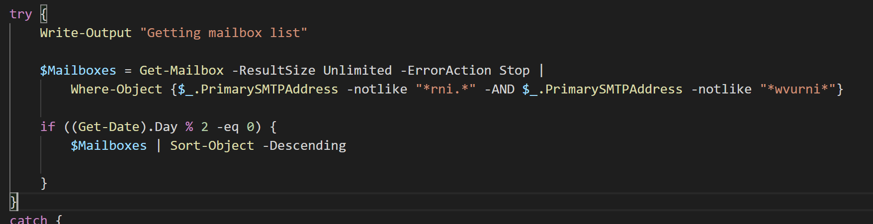

Slide 19
Remove-ExchangeForwardingRuleRandom.ps1

Slide 20
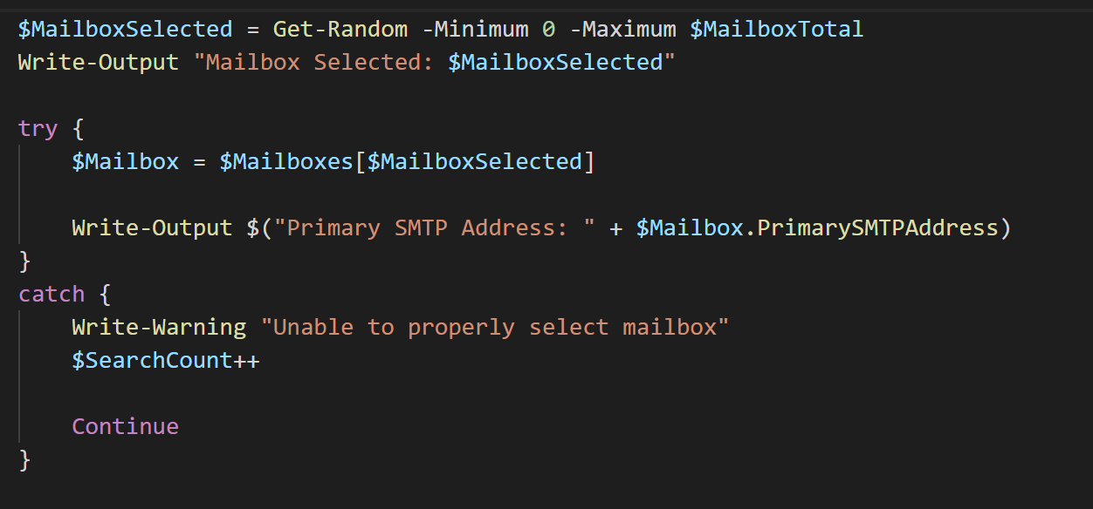

Slide 21
Set-HospitalHIPAATraining.ps1

Slide 22
Add-HSCProxyAddress

Slide 23
Test-HSCADModuleLoaded

Slide 24
