Slide 1
PowerShell Code Review October 15, 2020

Slide 2
HSC PowerShell Style Guide

Slide 3
Microsoft
Cmdlet Development Guidelines
Required Development Guidelines
Strongly Encouraged Development Guidelines
Advisory Development Guidelines
PowerShell Best Practices and Style Guide

Slide 4


Slide 5
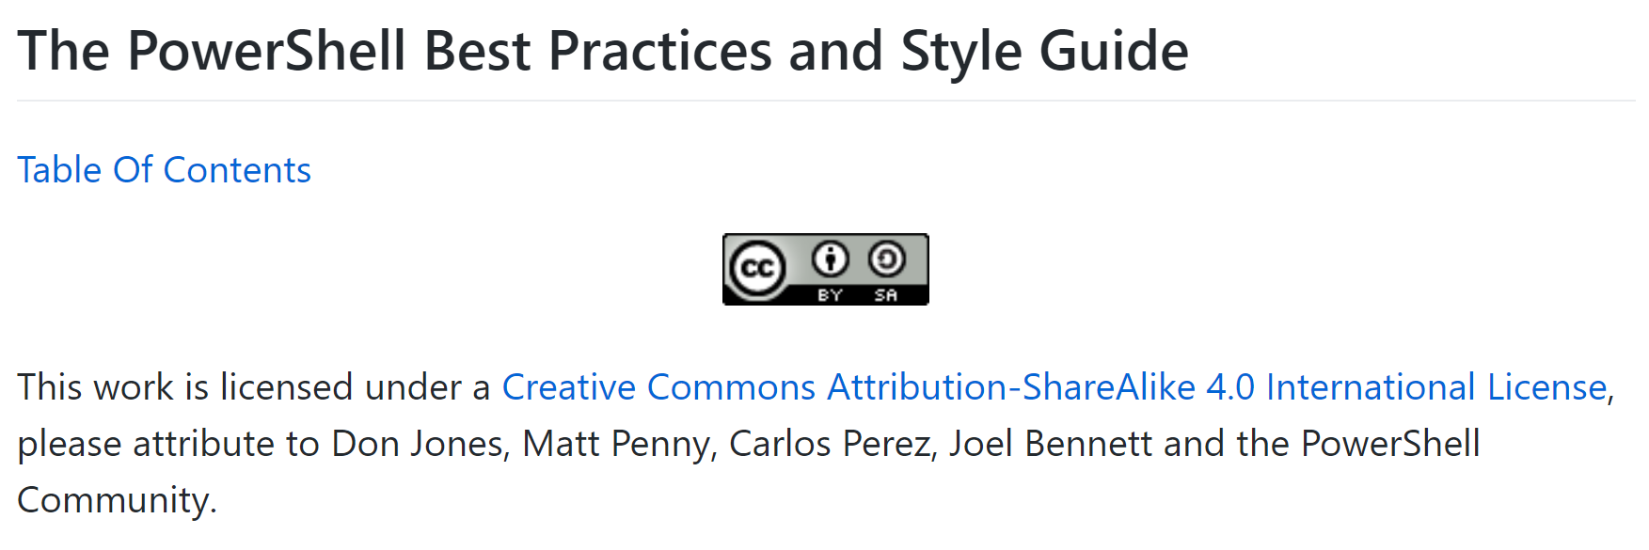

Slide 6
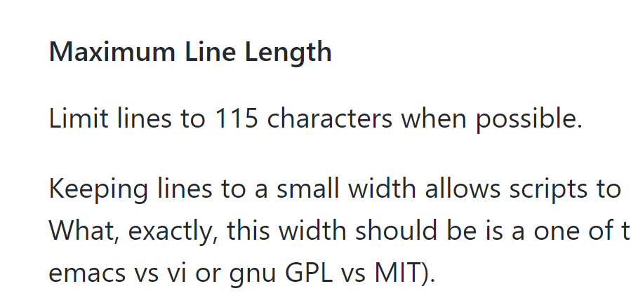

Slide 7
New Files
Send-SharedUserUpdateToWVUM.ps1
Update-SharedUserDistributionList.ps1
New Functions
Get-WVUMEmployeeID
Get-HSCADPrimarySMTPAddress
Updated Files
Update-SharedUserDB.ps1

Slide 8
Update-SharedUserDB.ps1

Slide 9
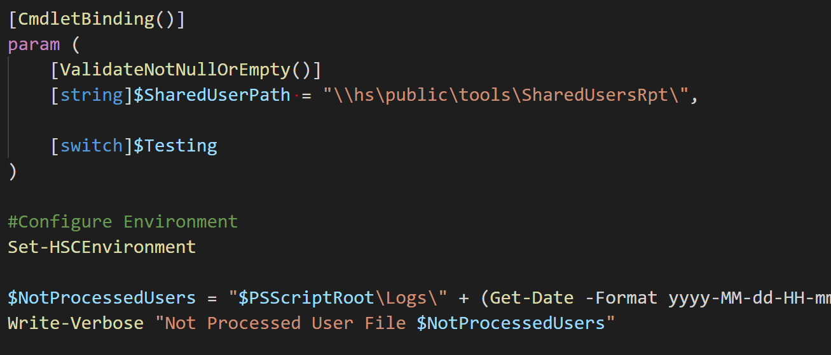

Slide 10
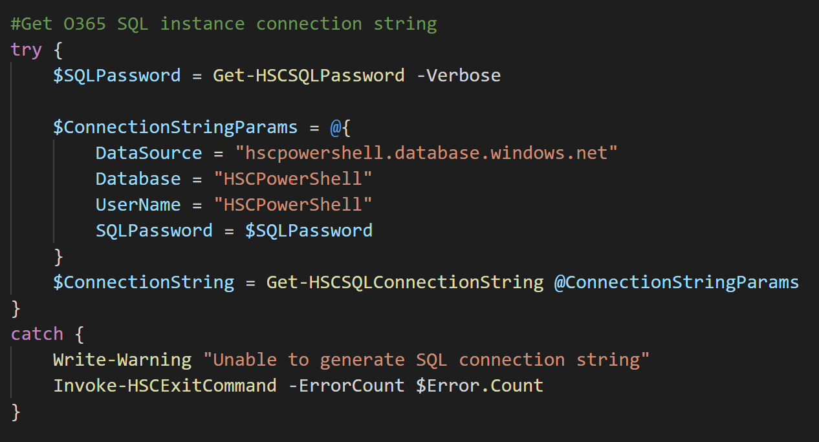

Slide 11
Update-SharedUserDistributionList.ps1

Slide 12
Send-SharedUserUpdateToWVUM.ps1

Slide 13
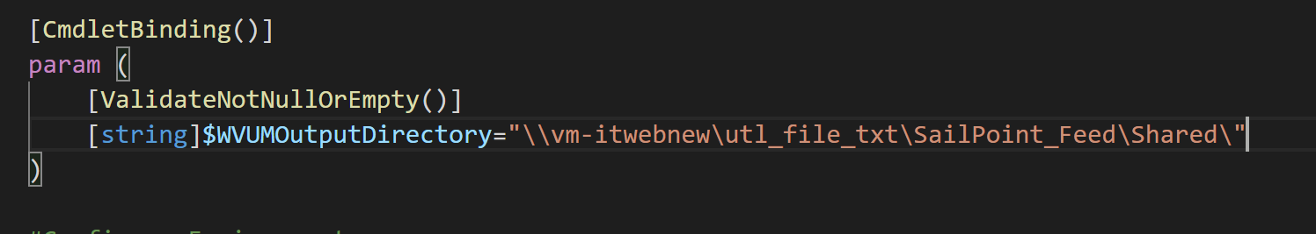

Slide 14
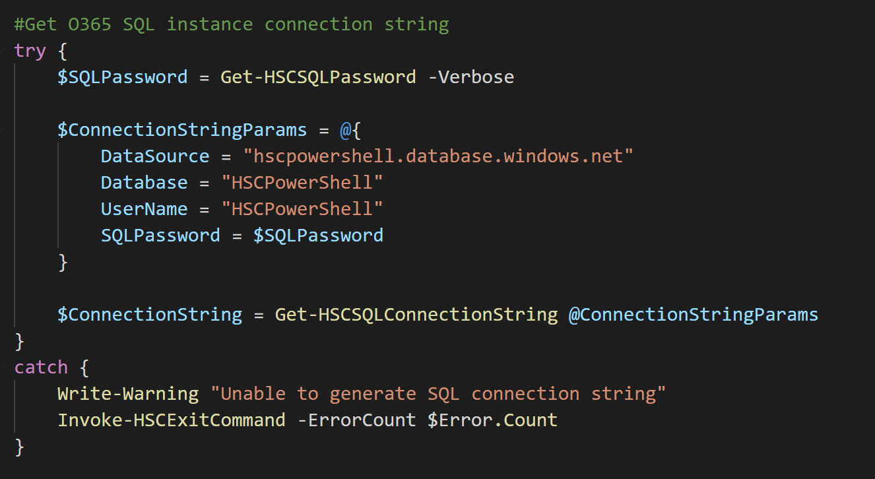

Slide 15
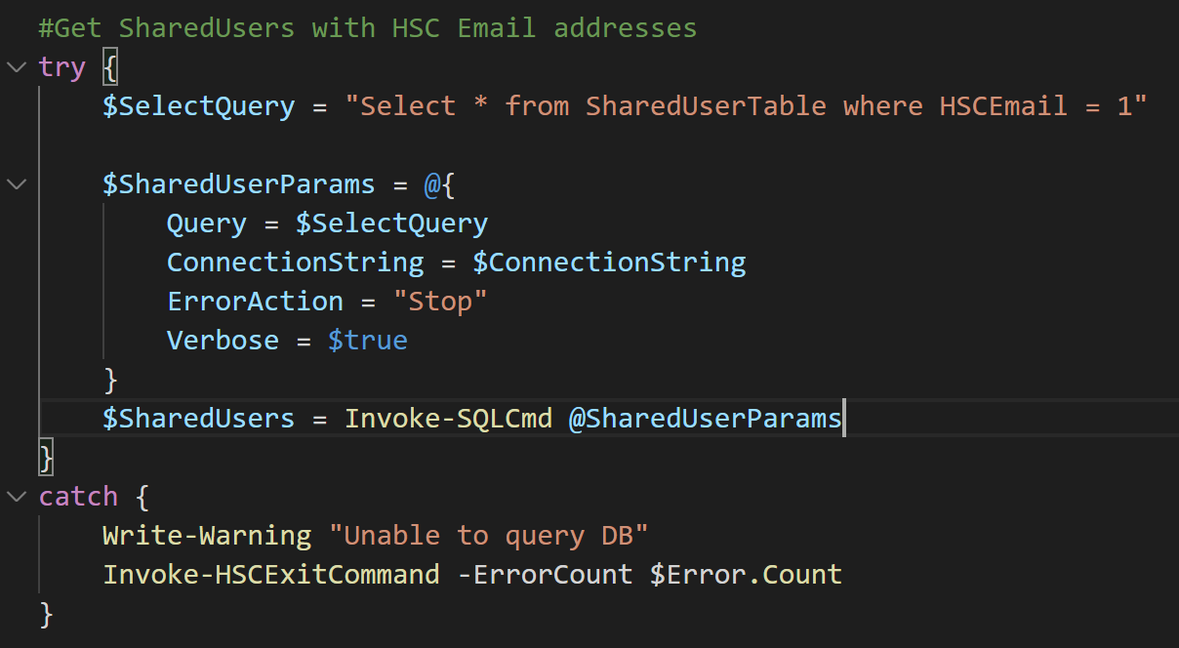

Slide 16
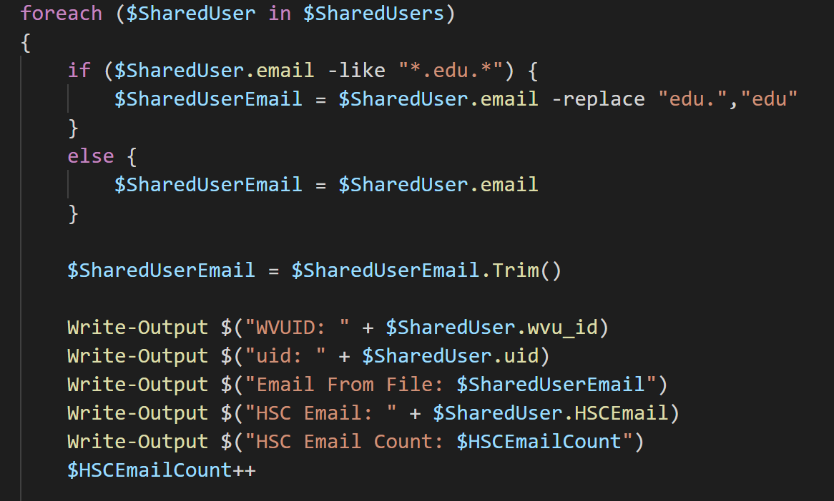

Slide 17
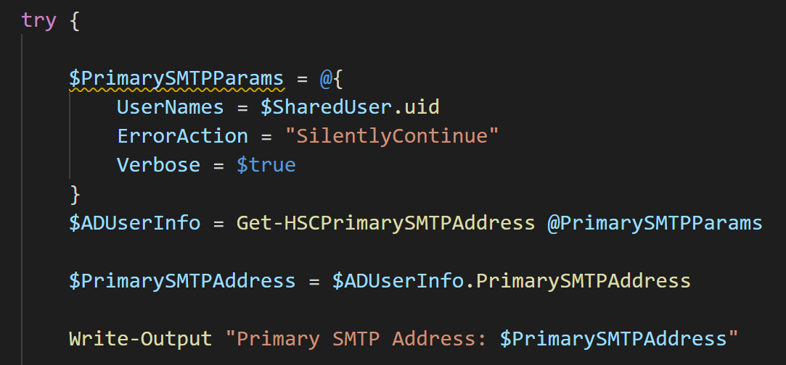

Slide 18
Get-WVUMEnterpriseID

Slide 19
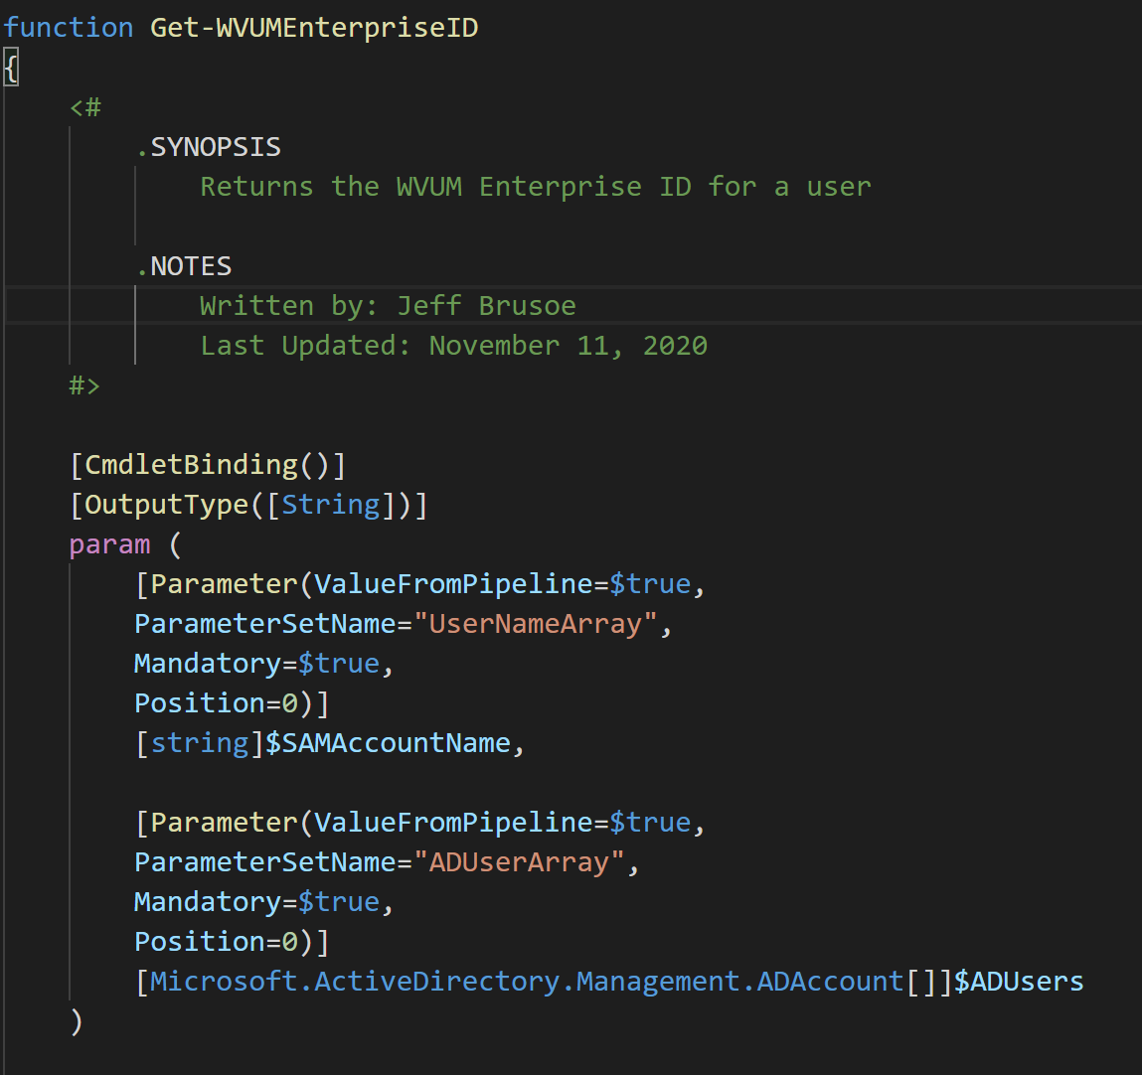

Slide 20
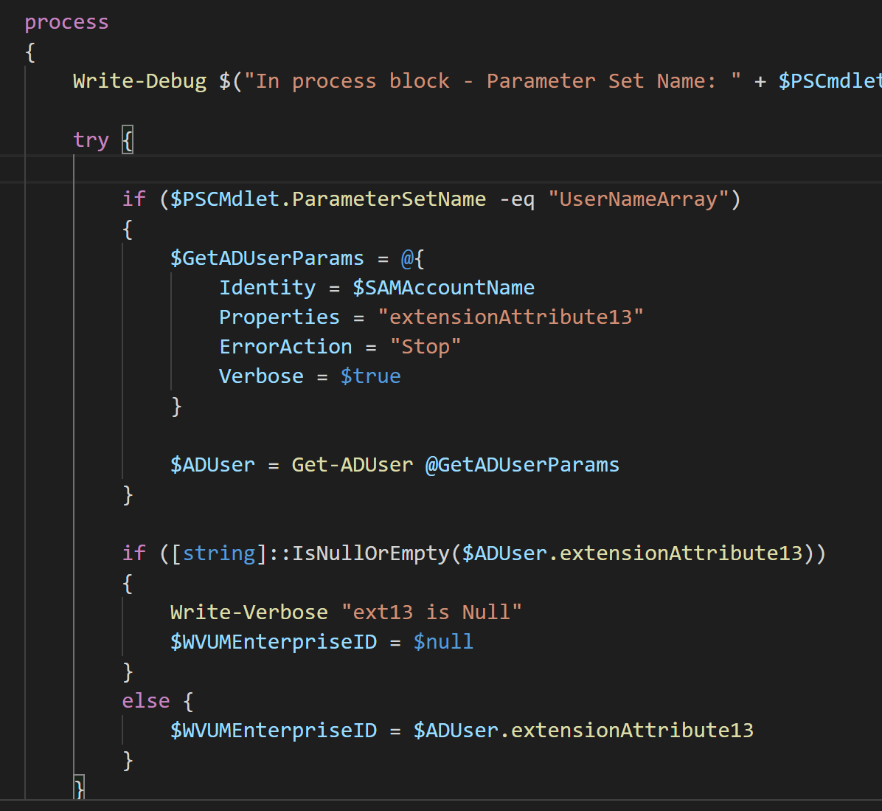

Slide 21
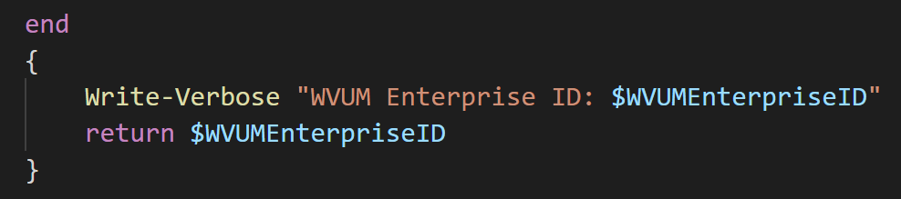

Slide 22
Get-HSCPrimarySMTPAddress

Slide 23
