Slide 1
PowerShell Code Review December 10, 2020

Slide 2
New Files
Backup-HSADProxyAddress.ps1
Backup-WVUMProxyAddress.ps1
Set-AllUserDL.ps1
Get-OldComputer.ps1
Find-UnusedFolder.ps1
Set-DellBIOSSettings.ps1

Slide 3
Updated Files
Backup-O365ProxyAddress.ps1
Import-MainCampusMailbox.ps1

Slide 4
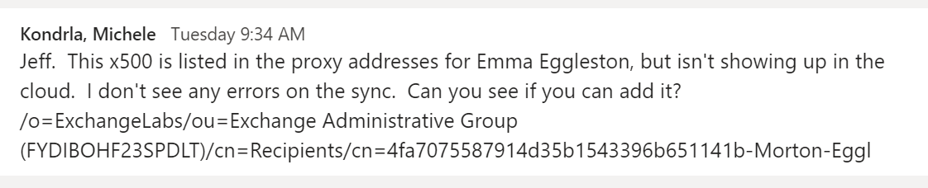

Slide 5
Backup-HSADProxyAddress.ps1

Slide 6
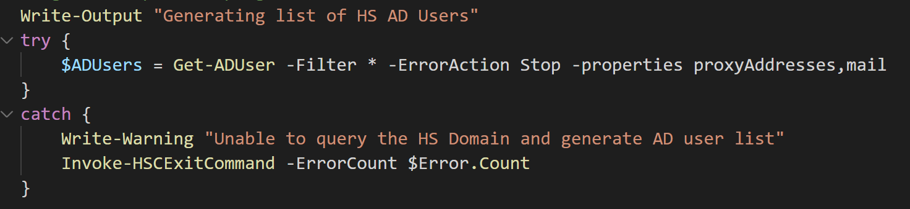

Slide 7
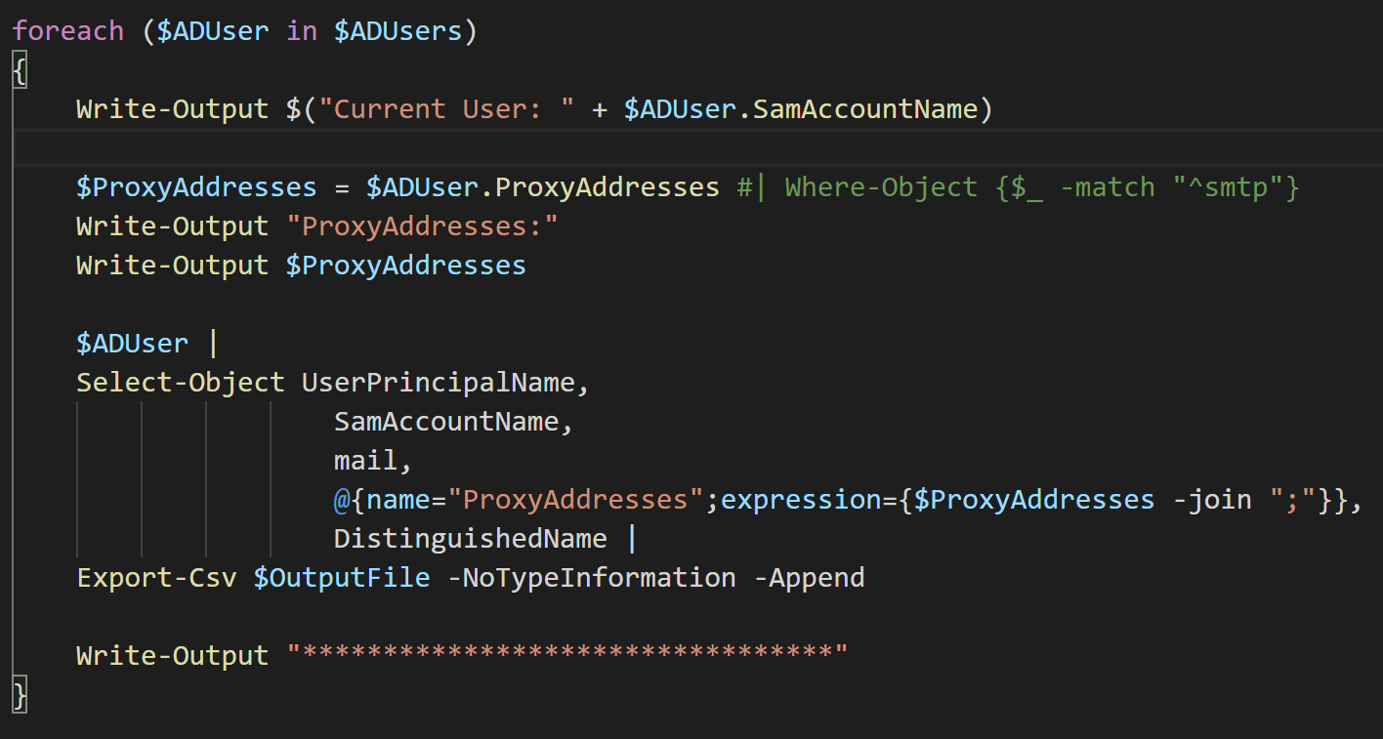

Slide 8
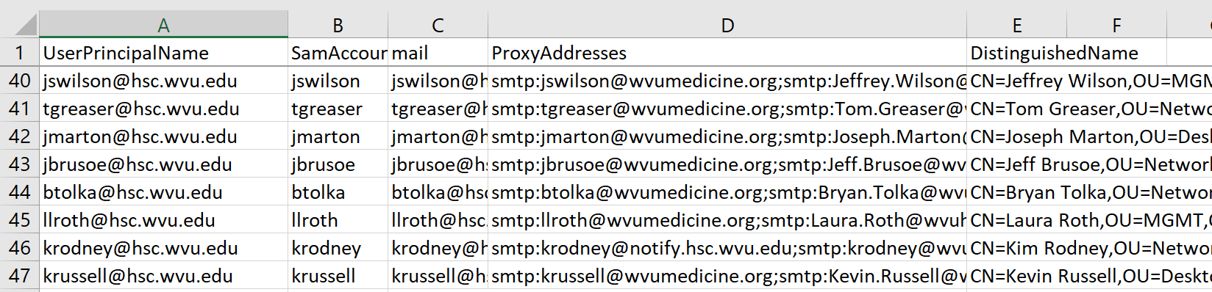

Slide 9
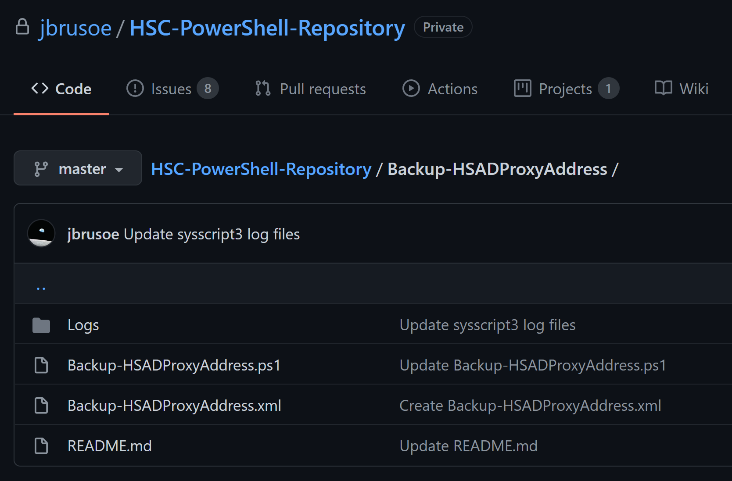

Slide 10
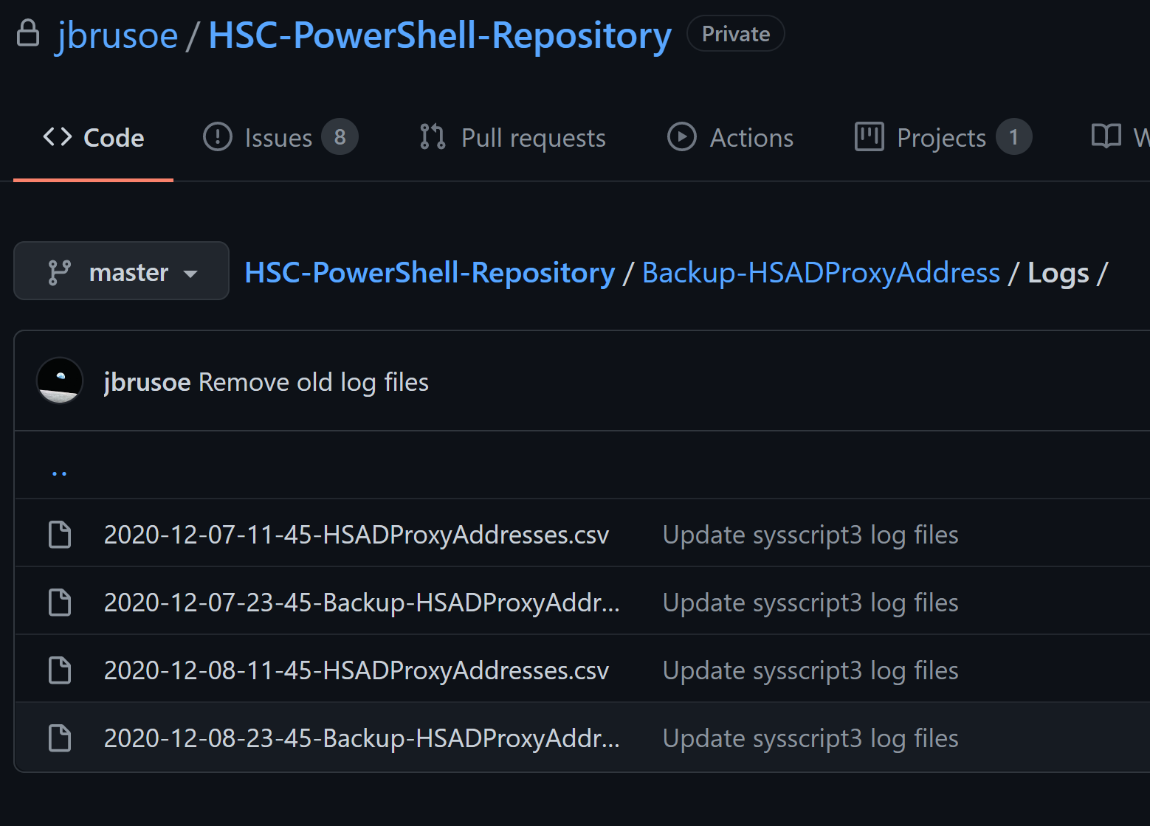

Slide 11
Backup-O365ProxyAddress.ps1

Slide 12
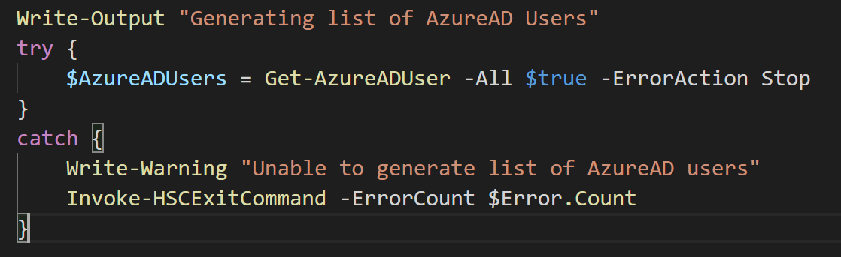

Slide 13
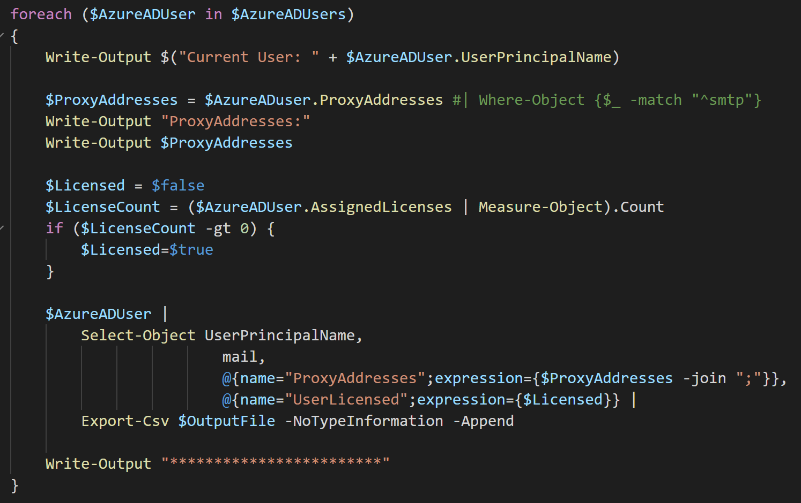

Slide 14
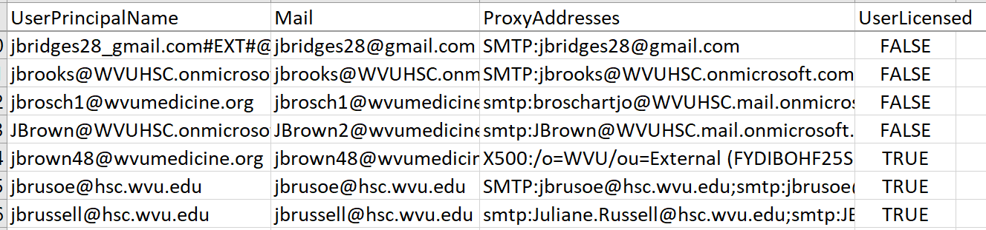

Slide 15
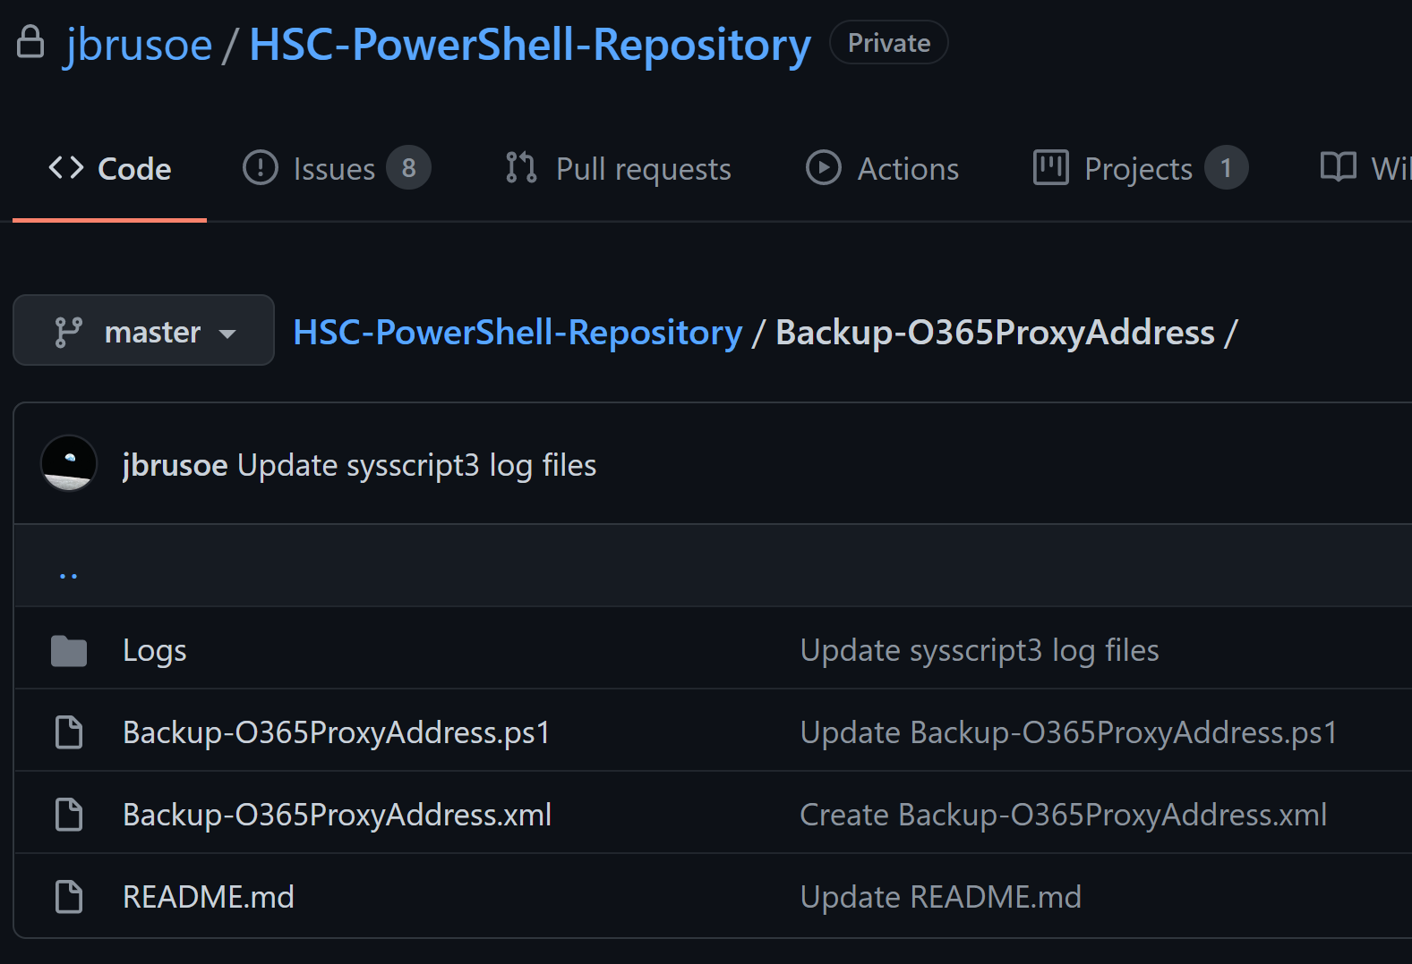

Slide 16
Backup-WVUMProxyAddress.ps1

Slide 17
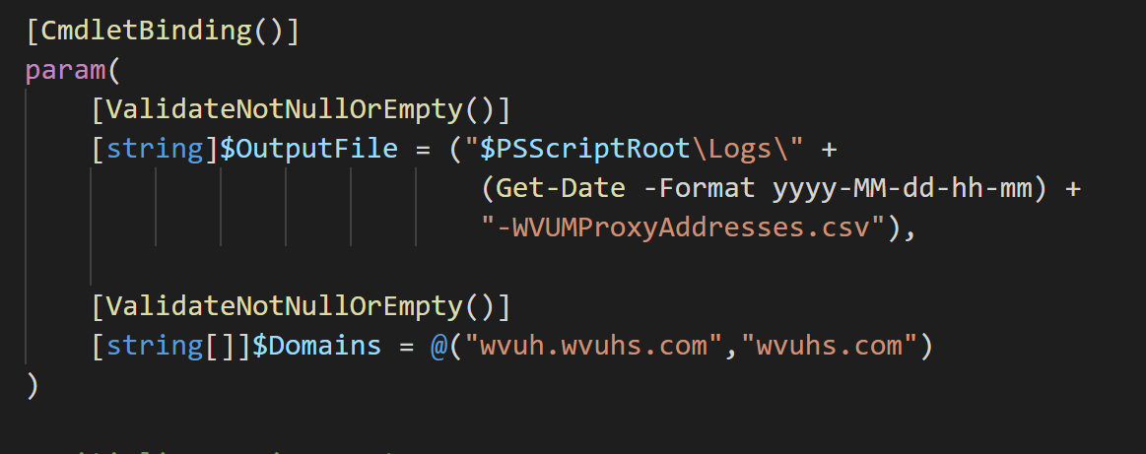

Slide 18
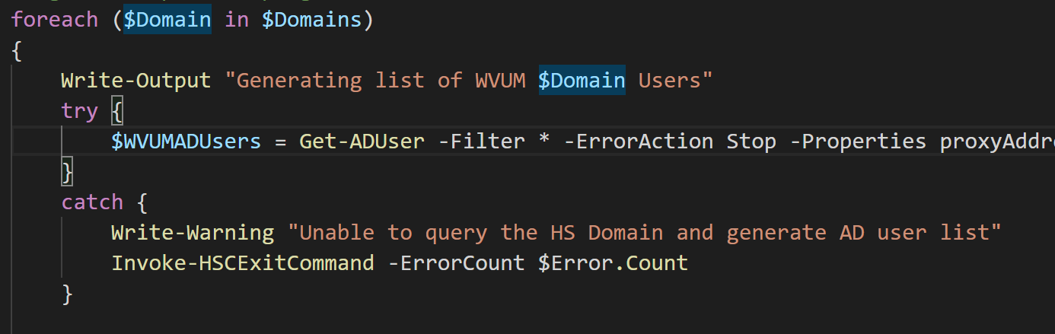

Slide 19
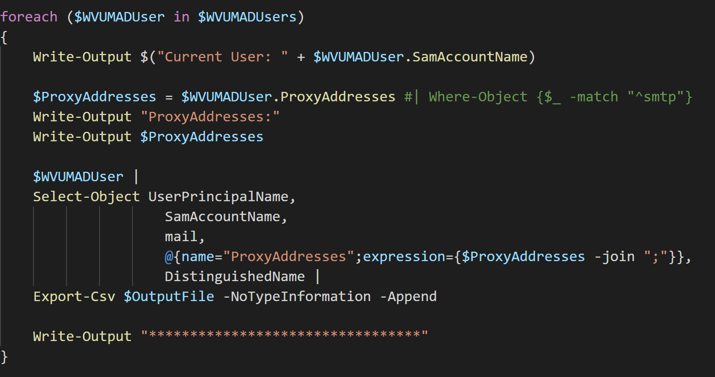

Slide 20
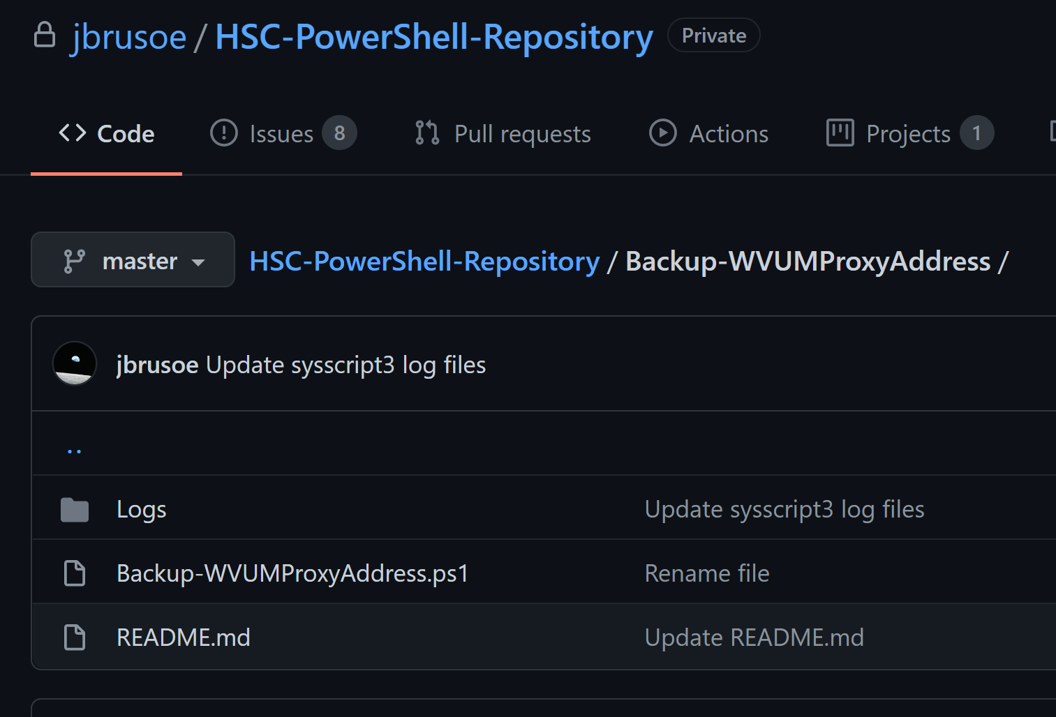

Slide 21
Get-OldComputer.ps1

Slide 22
Find-UnusedFolder.ps1

Slide 23
Import-MainCampusMailbox.ps1

Slide 24
Set-AllUserDL.ps1

Slide 25
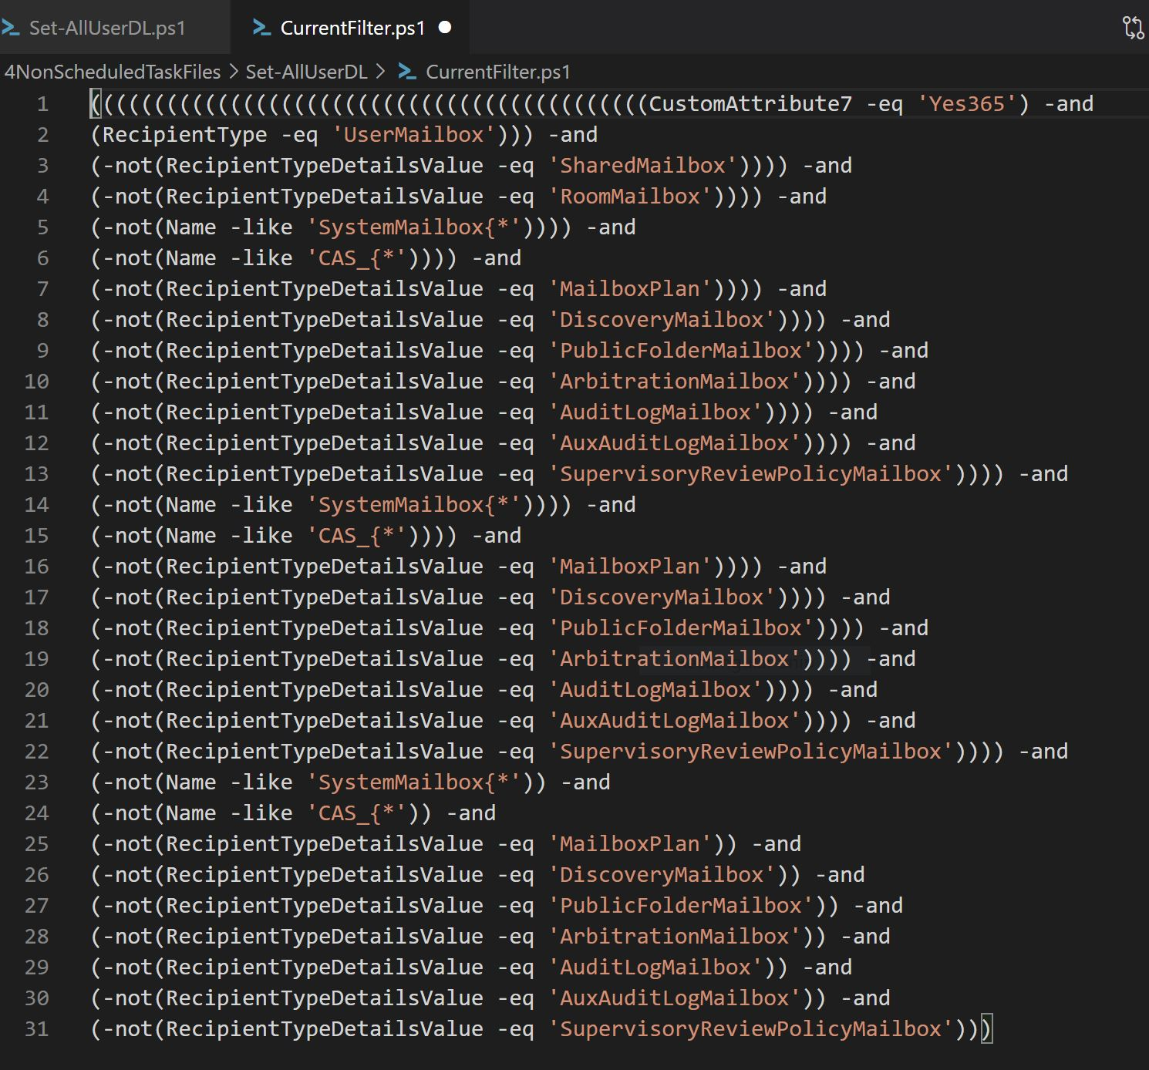

Slide 26
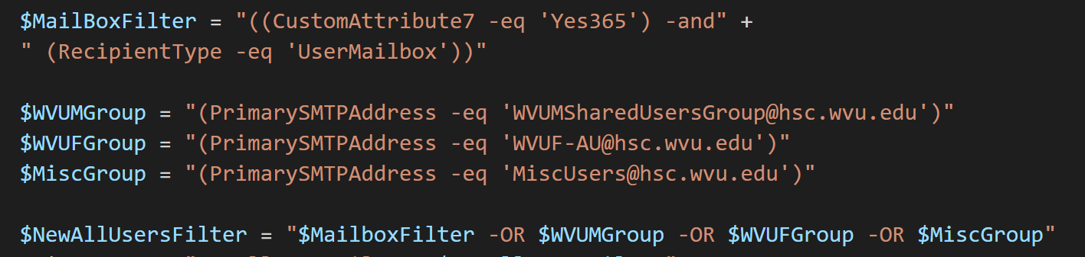

Slide 27
