Slide 1
PowerShell Code Review January 7, 2021

Slide 2
Get-WVUFAddressBook.ps1
Set-CorrectEmailAddress.ps1
Enable-AccountAfterPasswordReset.ps1
Disable-POPIMAP.ps1
Enable-AccountSecurityCompliance.ps1
Get-ExchangeForwardingRule.ps1
Get-ExchangeForwardingSMTPAddress.ps1
Disable-NewUsers.ps1

Slide 3
Disable-AccountSecurityCompliance.ps1
Get-UpcomingDisabledAccount.ps1

Slide 4
Get-WVUFAddressBook.ps1

Slide 5
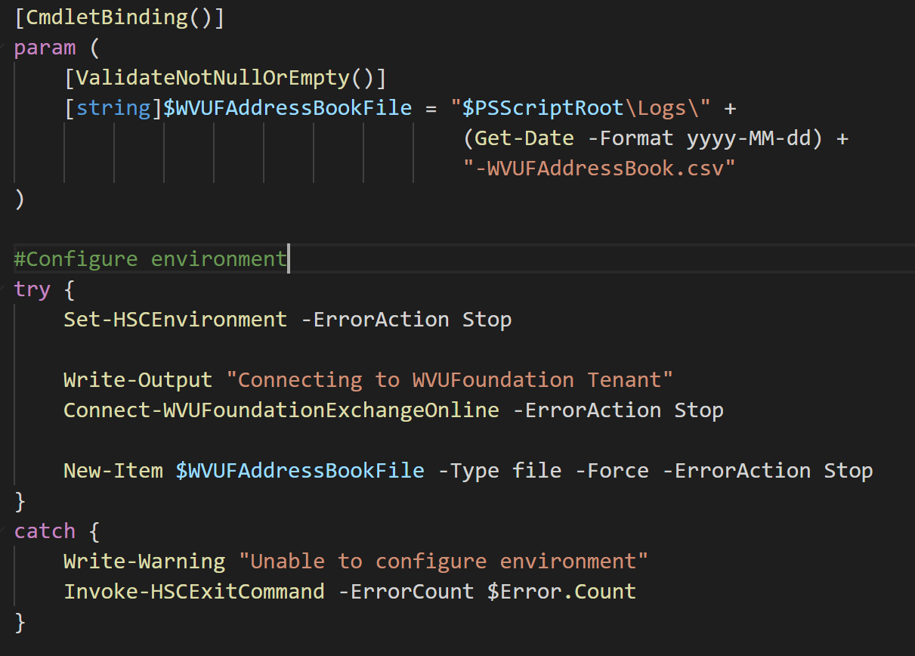

Slide 6
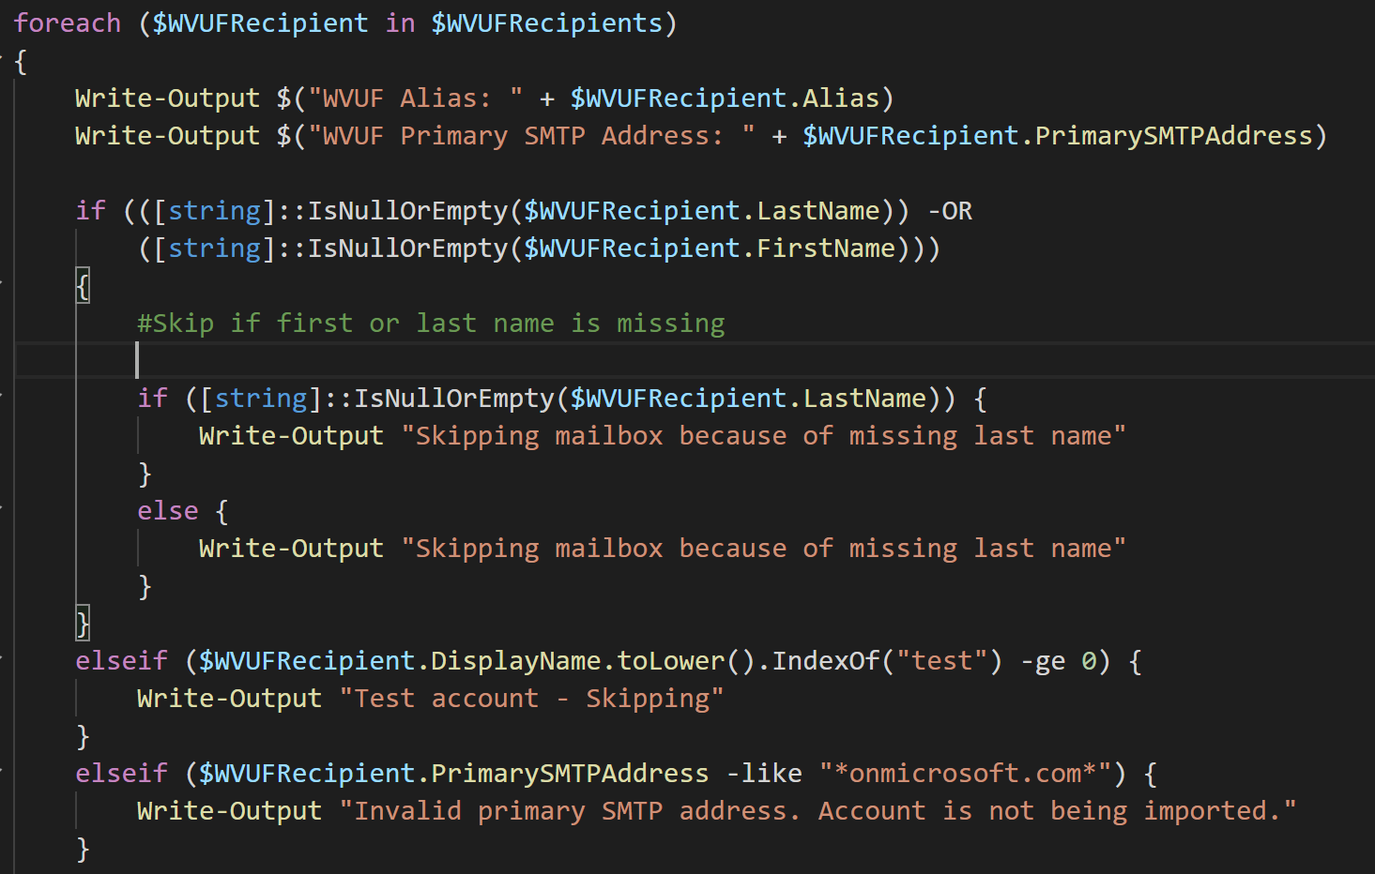

Slide 7
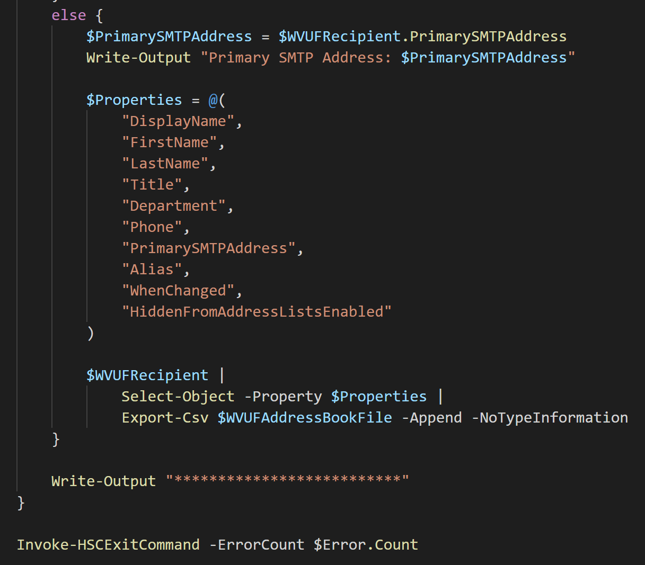

Slide 8
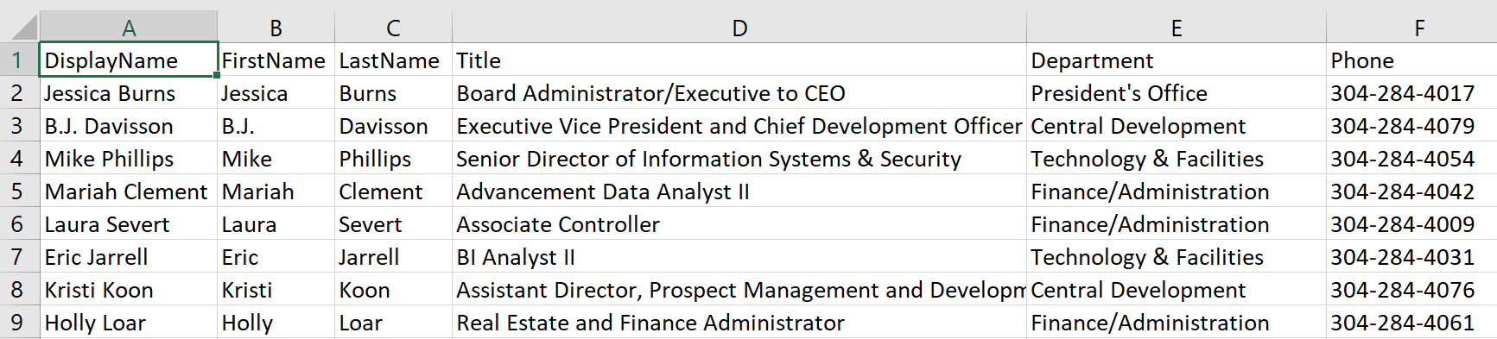
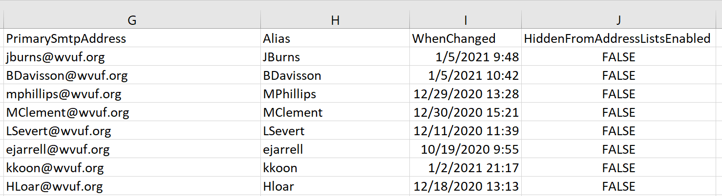

Slide 9
Set-CorrectEmailAddress.ps1

Slide 10
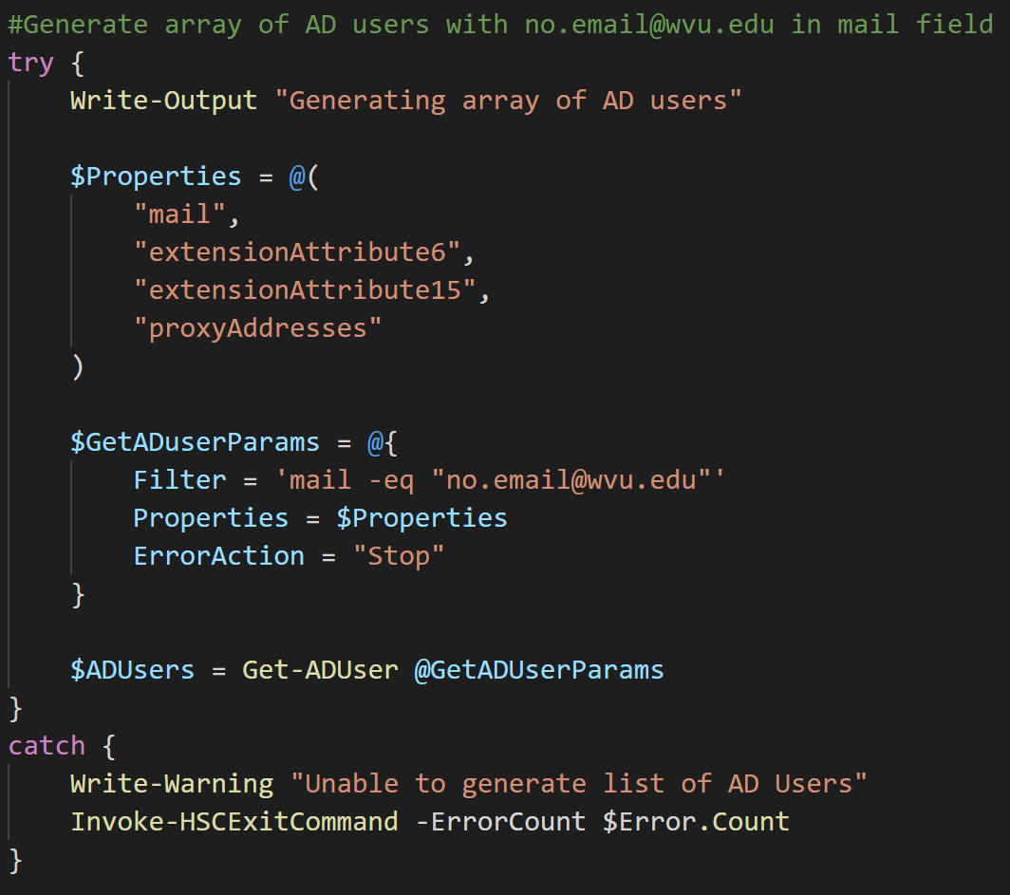

Slide 11
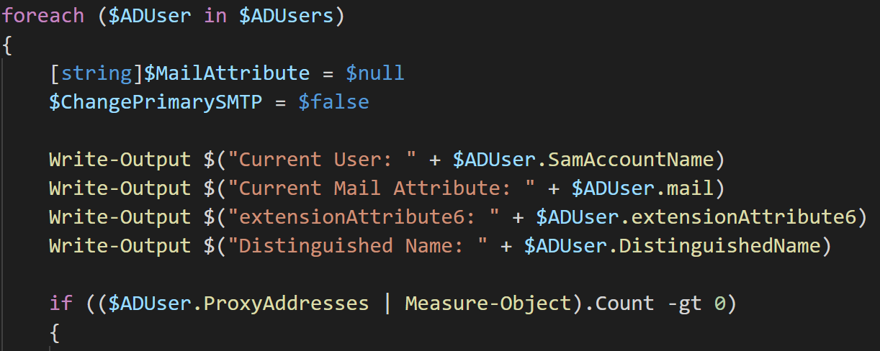

Slide 12
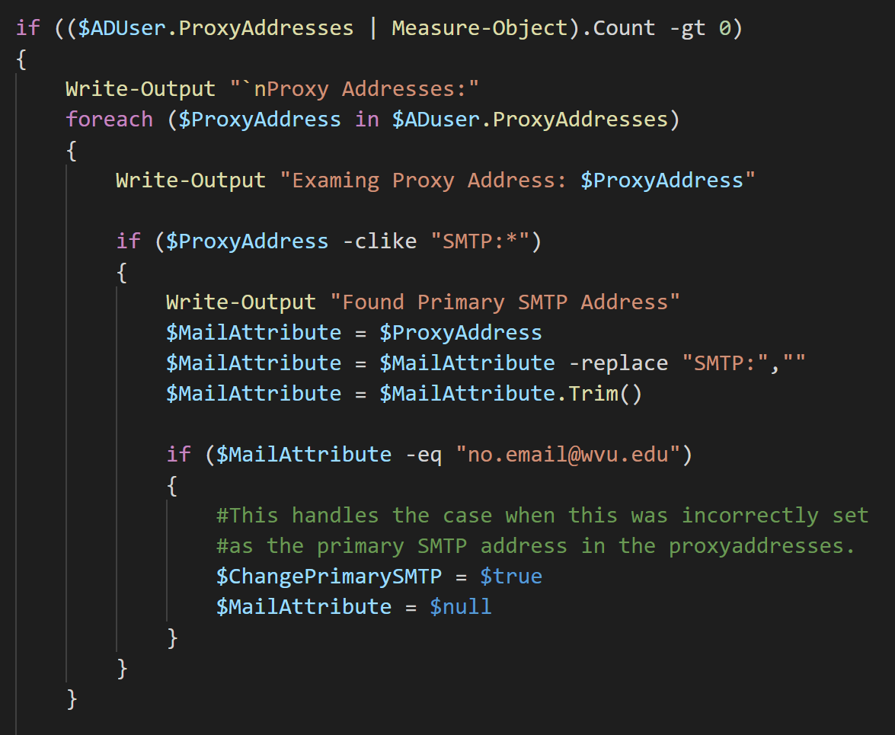

Slide 13
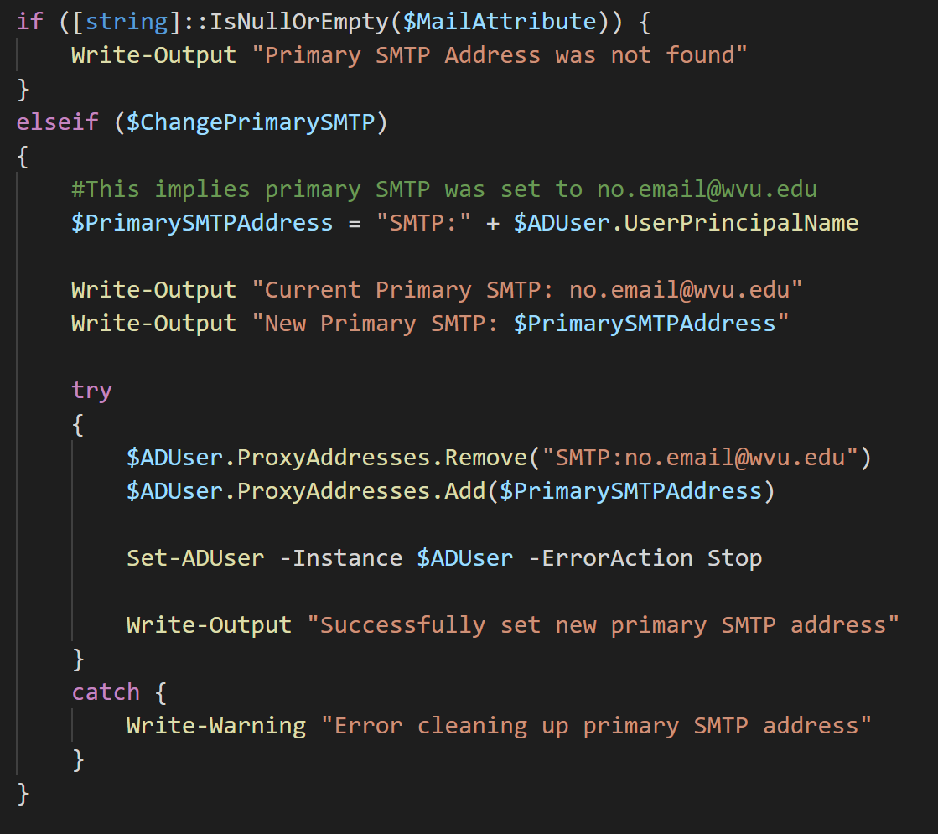

Slide 14
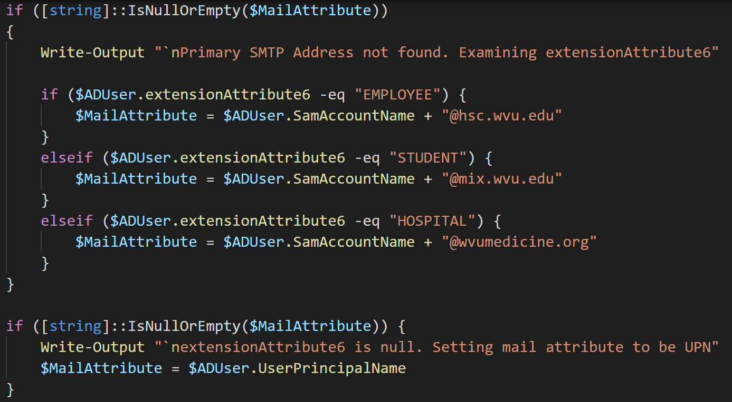

Slide 15
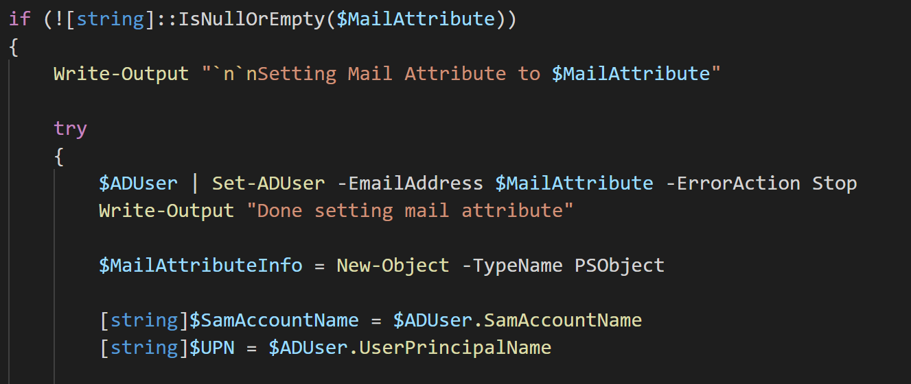

Slide 16
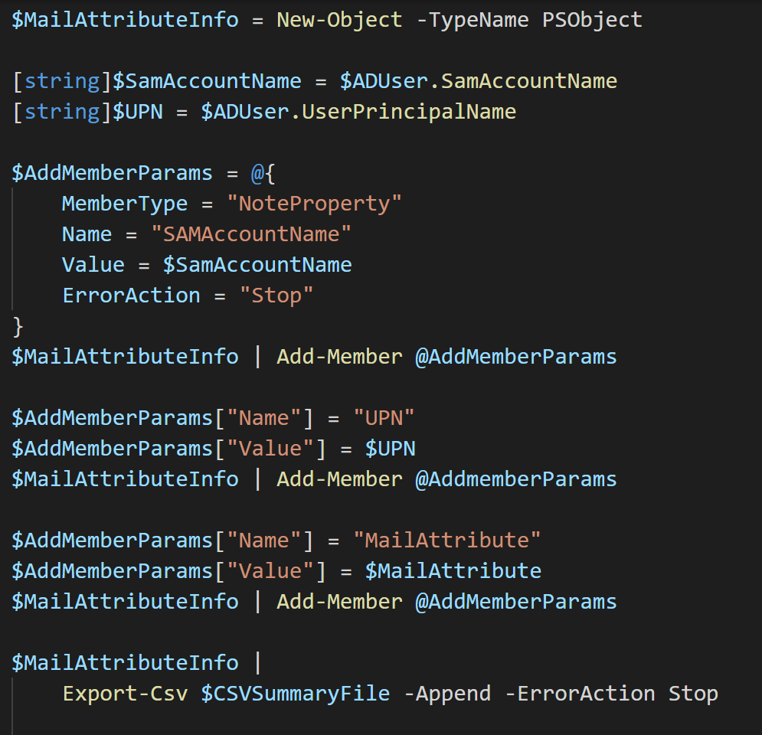

Slide 17
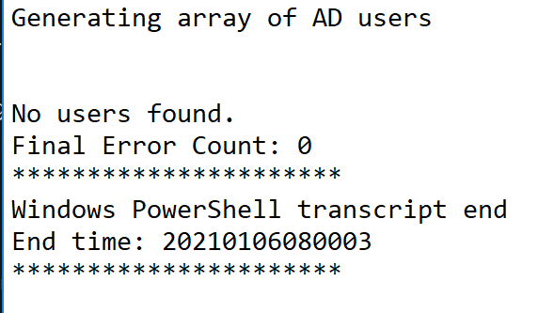

Slide 18
Enable-AccountAfterPasswordReset.ps1

Slide 19
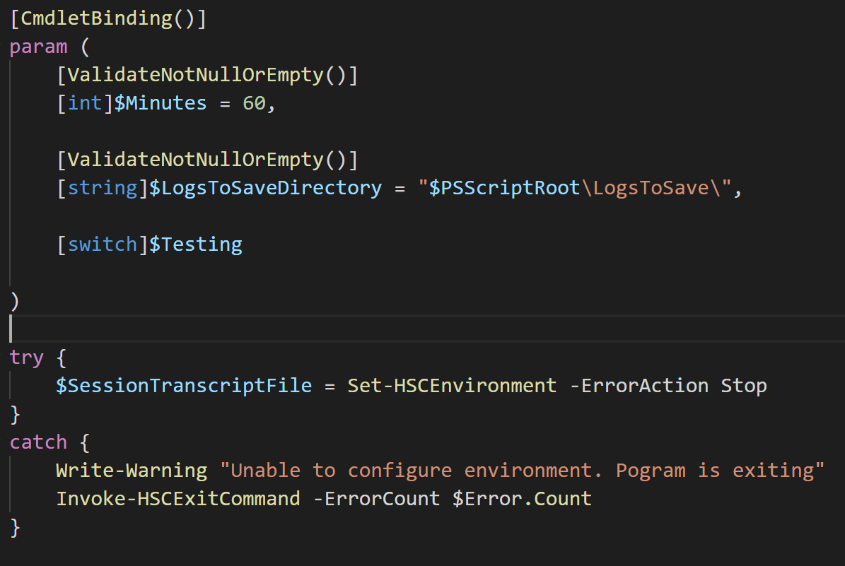

Slide 20
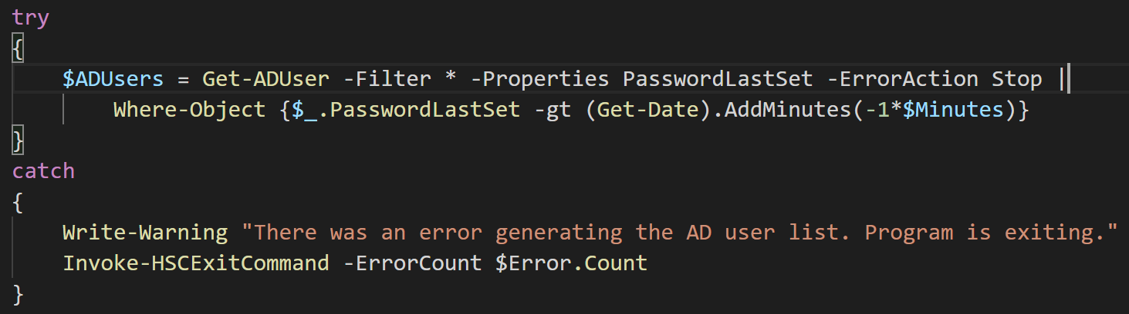

Slide 21
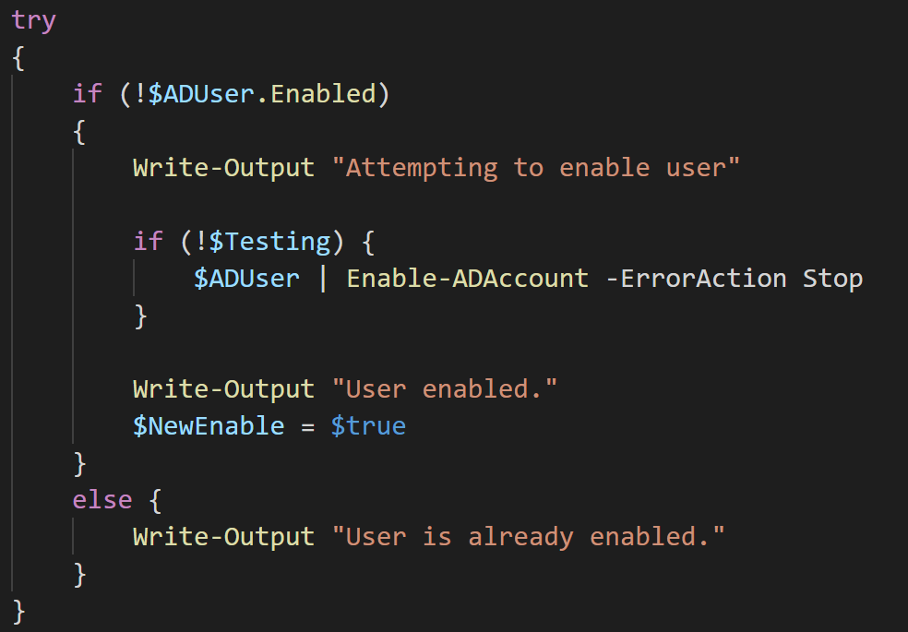

Slide 22
