Slide 1
PowerShell Code Review January 21, 2021

Slide 2
Create-NewAccount-NoCSCForm.ps1
Cancer Center Distribution Lists
Disable-EndAccessDate.ps1
Import-WVUMExt13.ps1

Slide 3
Create-NewAccount-NoCSCForm.ps1

Slide 4
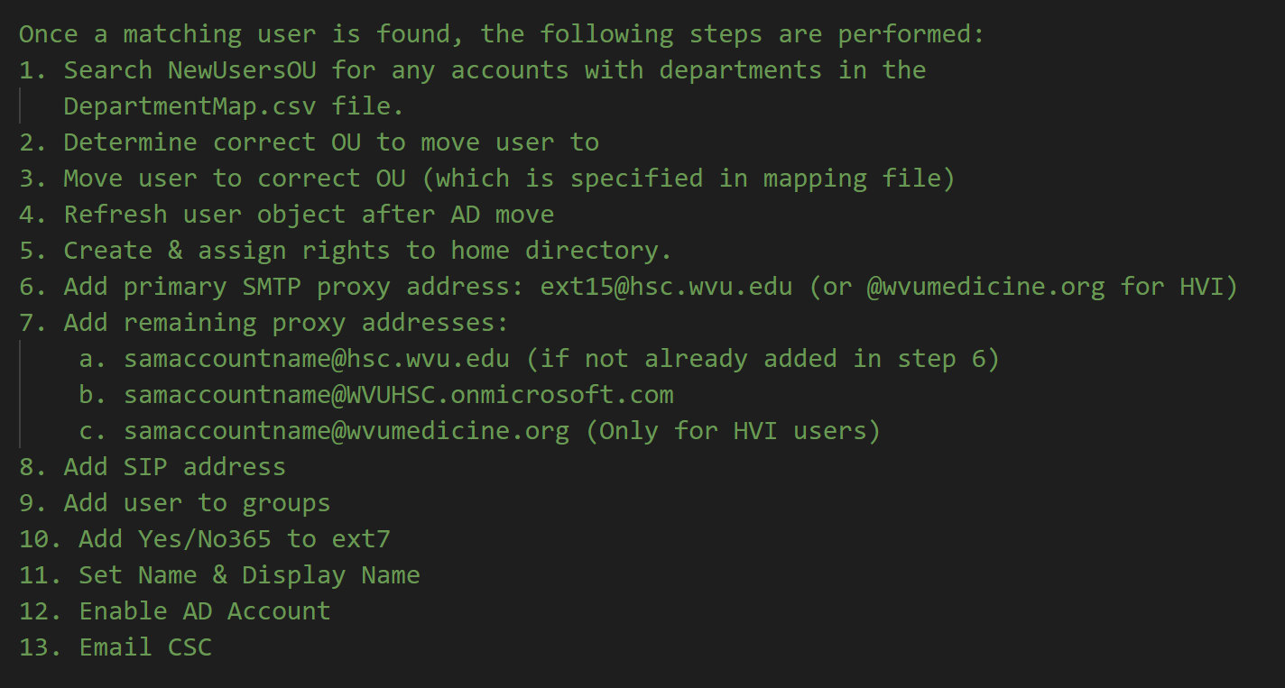

Slide 5
Scheduled task is running every 10 minutes on sysscript4
Several dentistry departments have been added to the original four departments in the department map file.

Slide 6
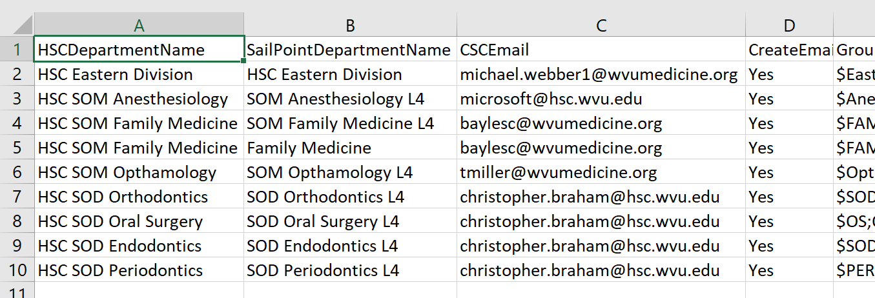

Slide 7
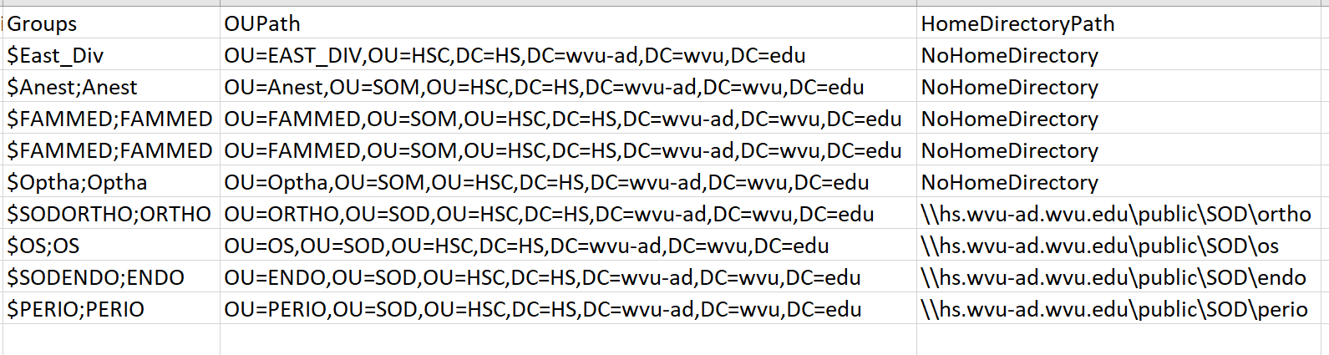

Slide 8
Cancer Center Distribution Lists

Slide 9
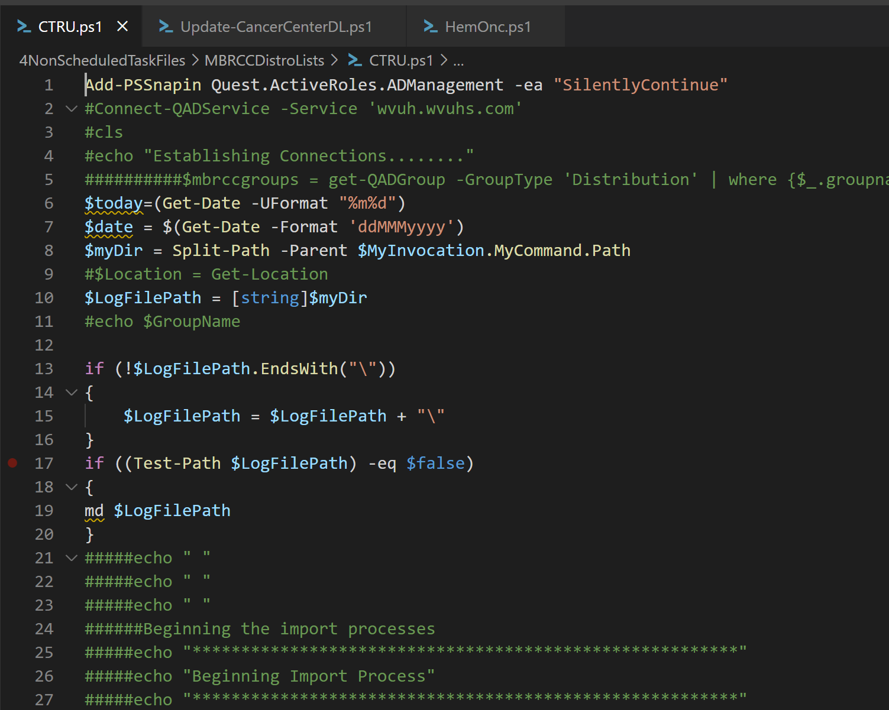

Slide 10
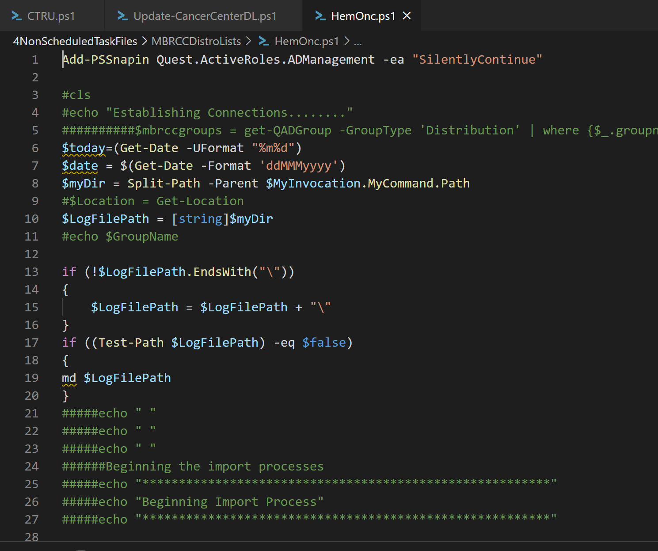

Slide 11
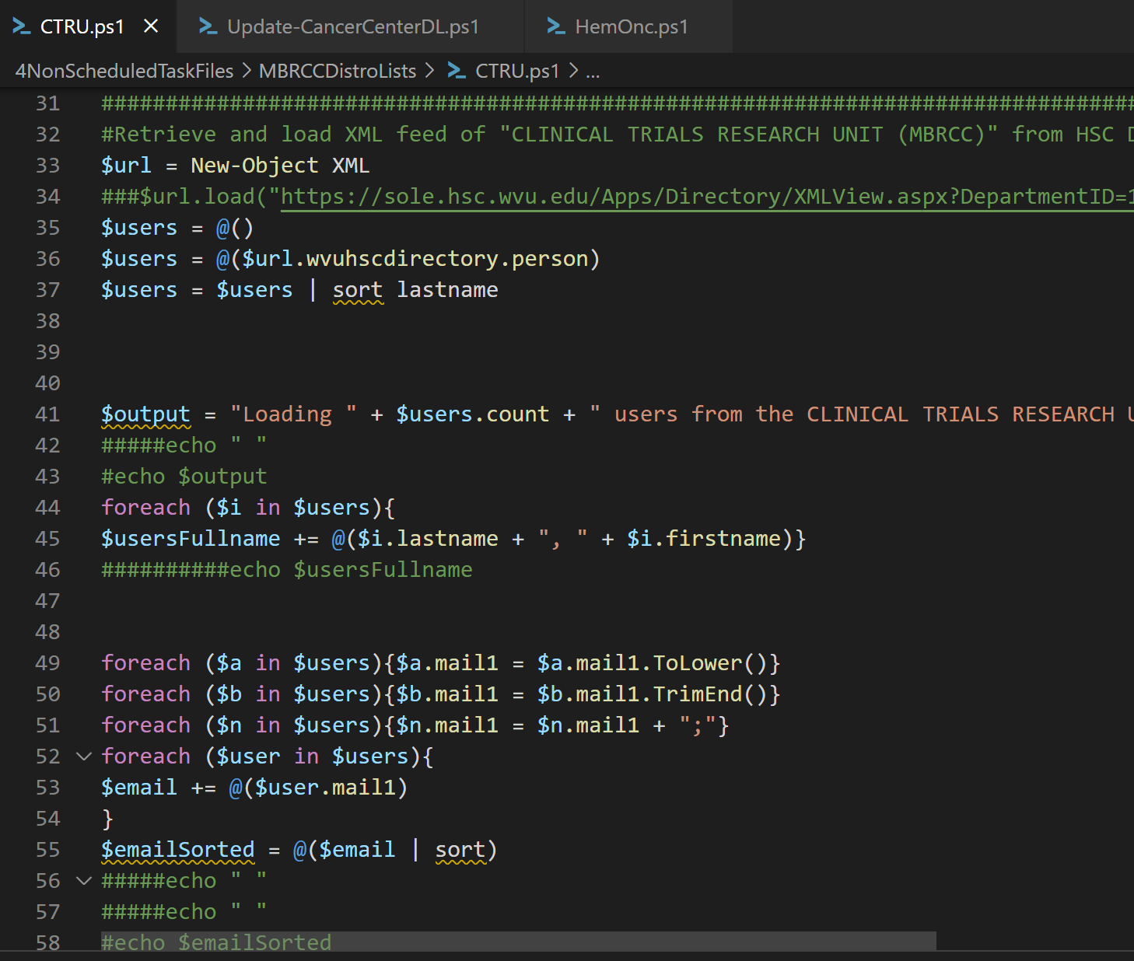

Slide 12
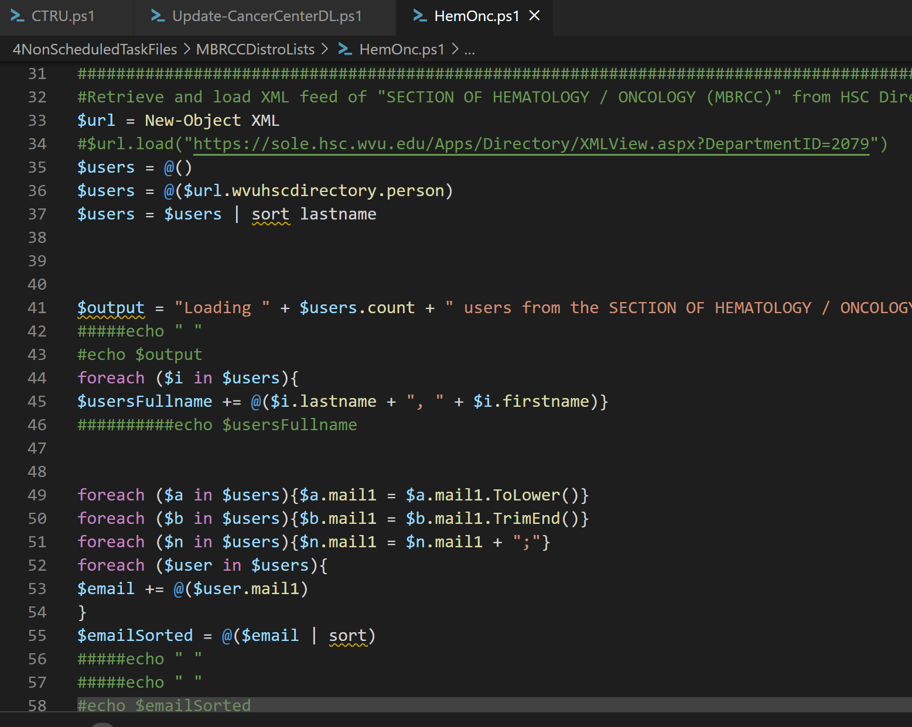

Slide 13
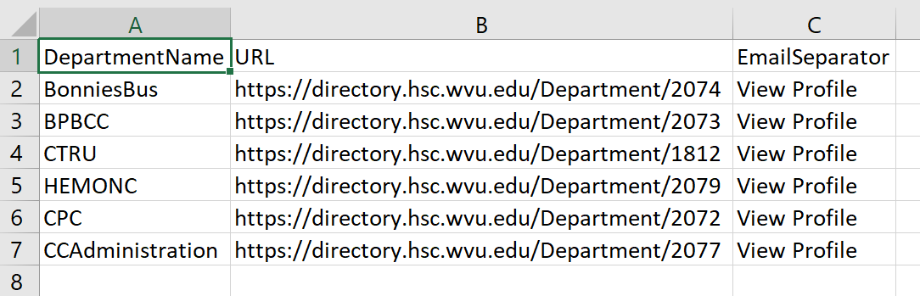

Slide 14
Disable-EndAccessDate.ps1

Slide 15
