Slide 1
PowerShell Code Review February 4, 2021

Slide 2
Update-CancerCenterDL.ps1
Get-HSCADGroupName
Get-HSCDepartmentDirectoryFromWeb
Disable-EndAccessDate.ps1
Import-WVUFAddressBook.ps1
Kevin’s Printing File

Slide 3
Update-CancerCenterDL.ps1

Slide 4
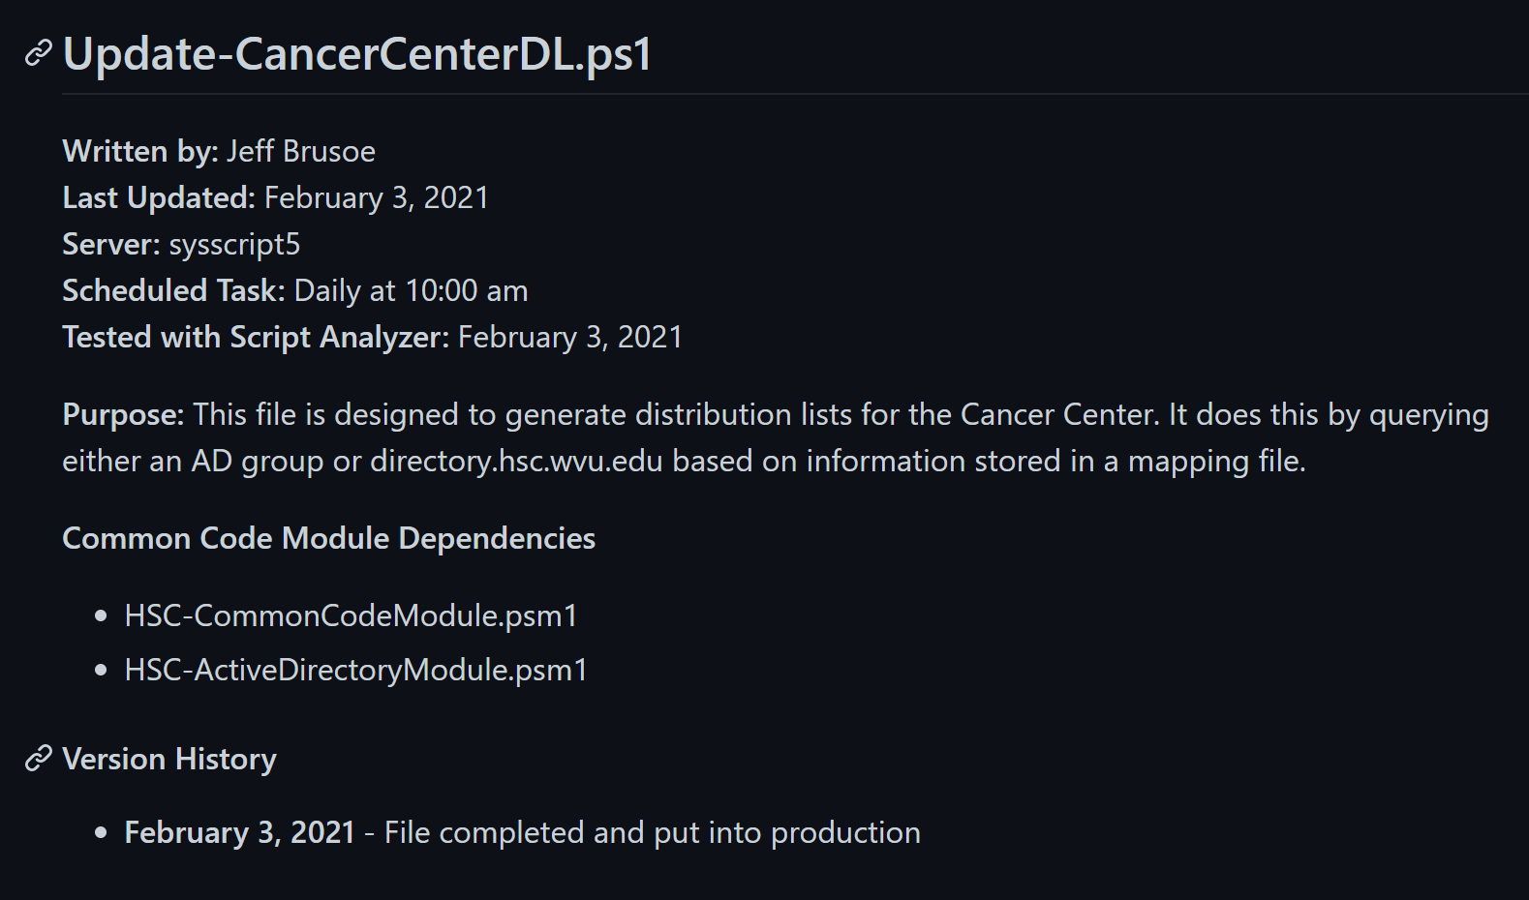

Slide 5
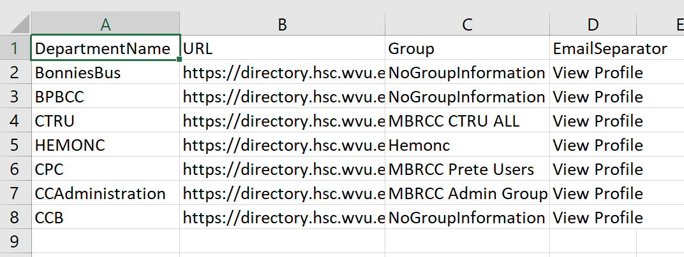

Slide 6
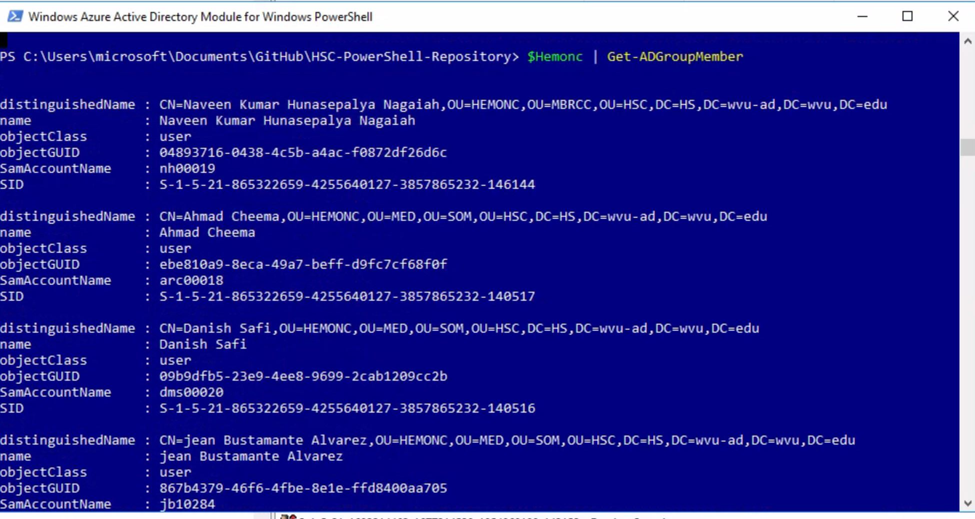

Slide 7
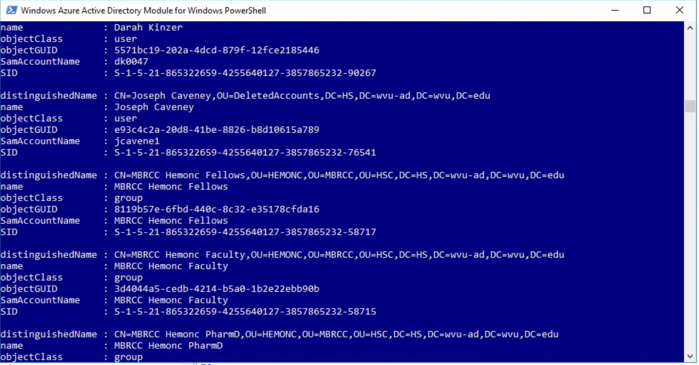

Slide 8


Slide 9


Slide 10


Slide 11
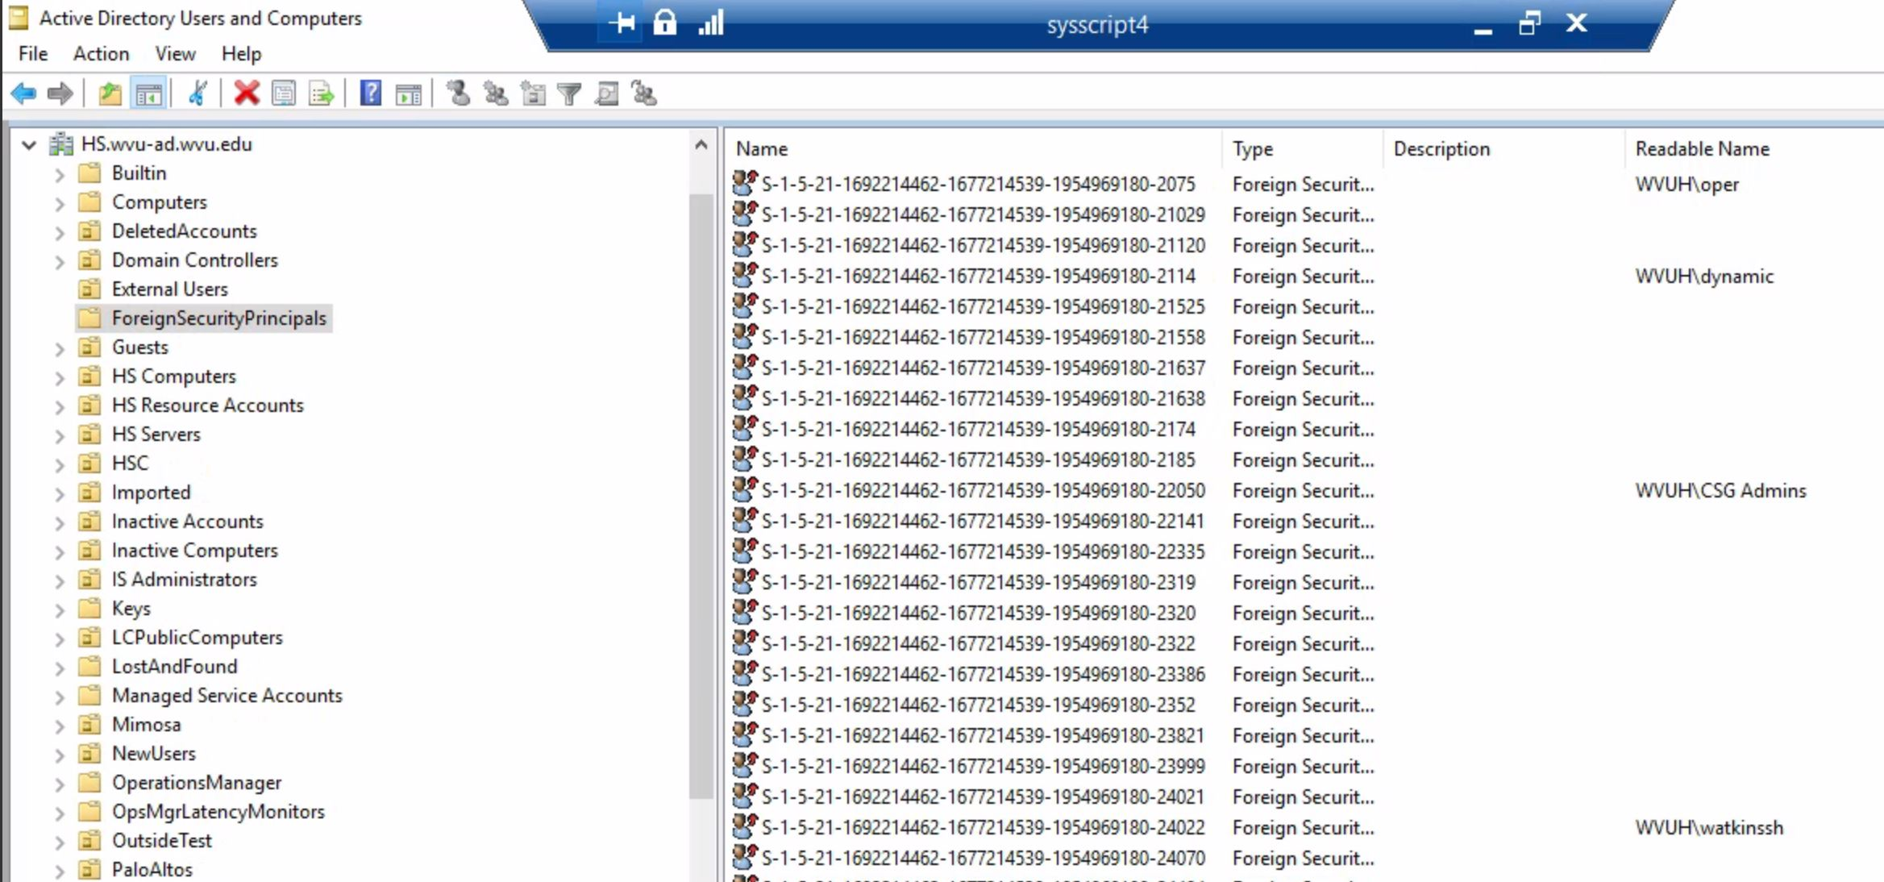

Slide 12

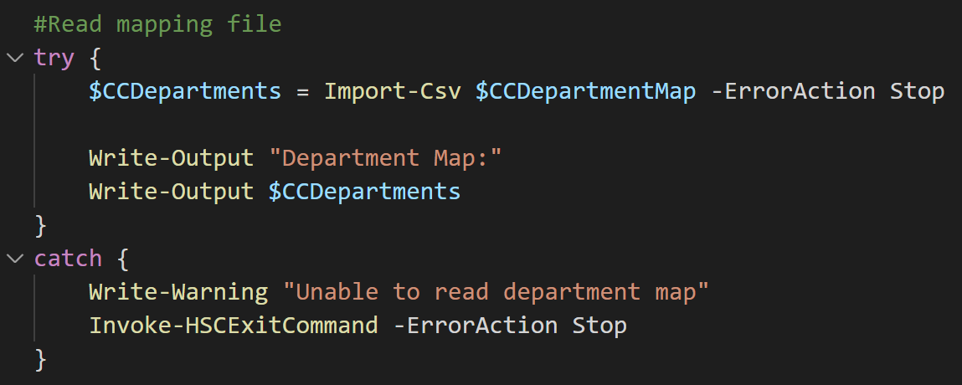

Slide 13
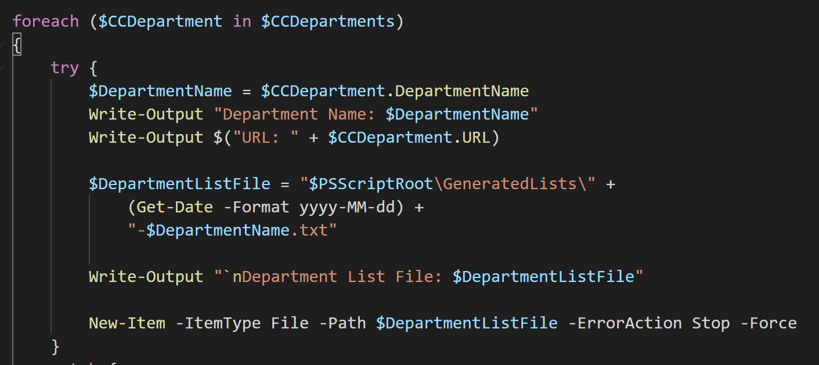

Slide 14
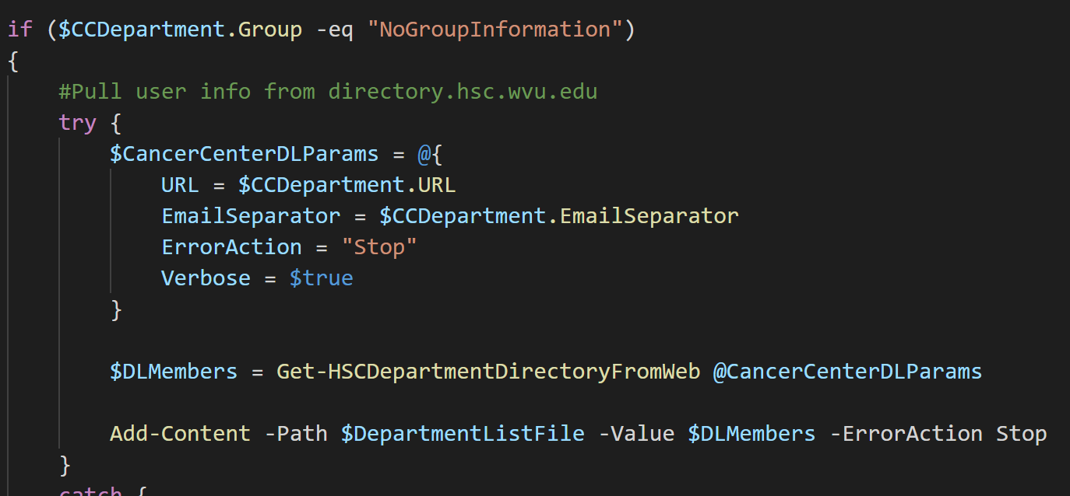

Slide 15
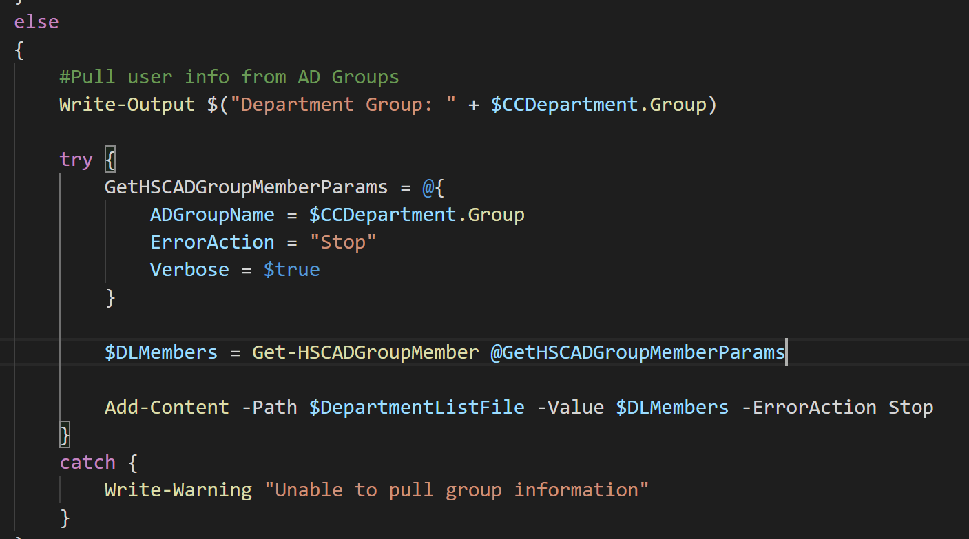

Slide 16
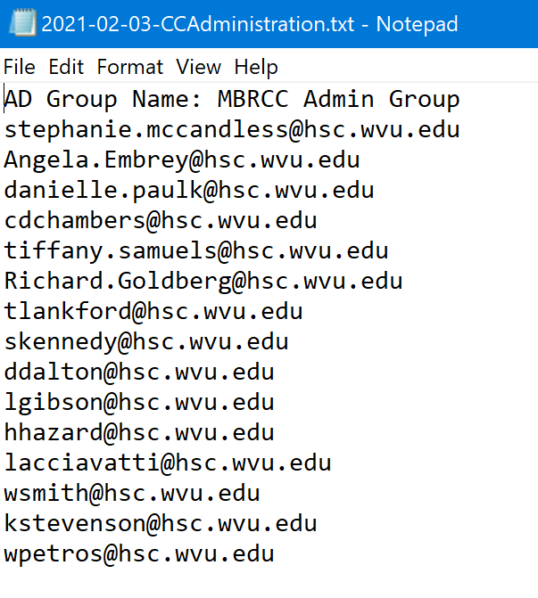
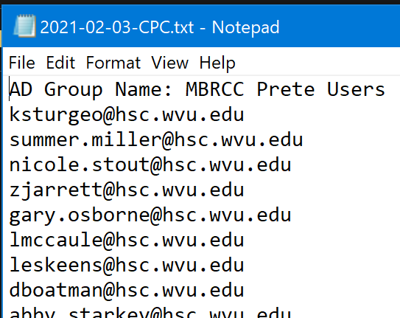

Slide 17
Get-HSCADGroupName

Slide 18
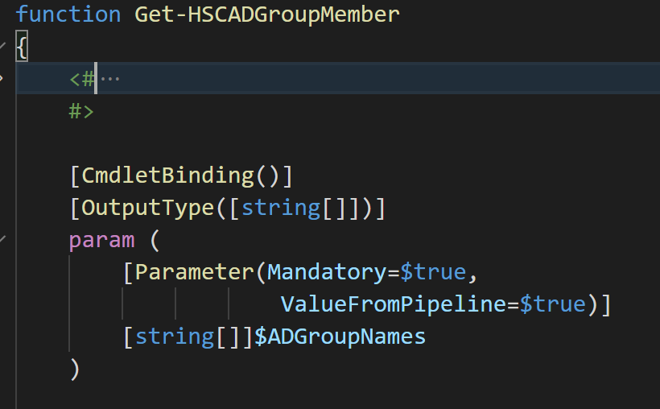

Slide 19
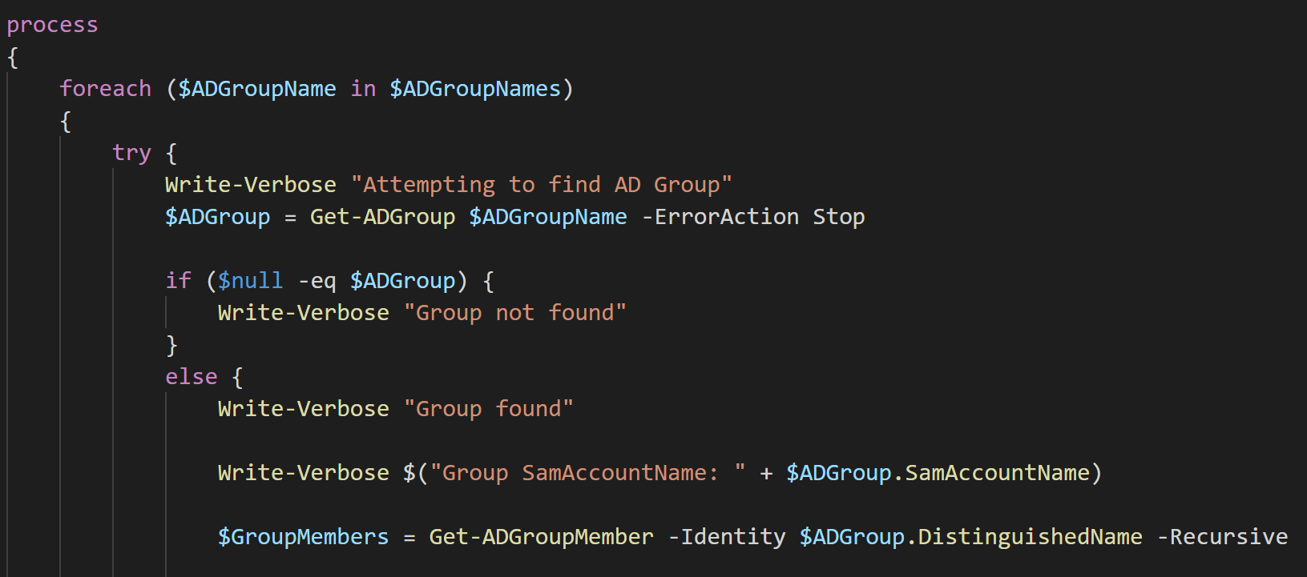

Slide 20
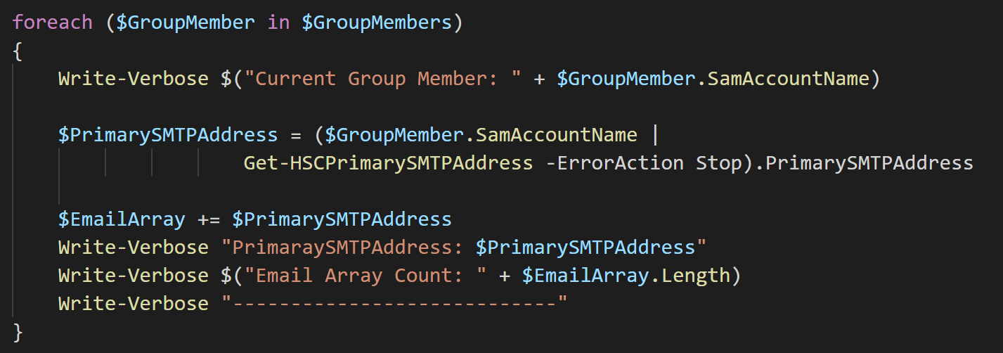


Slide 21
Get-HSCDepartmentDirectoryFromWeb

Slide 22
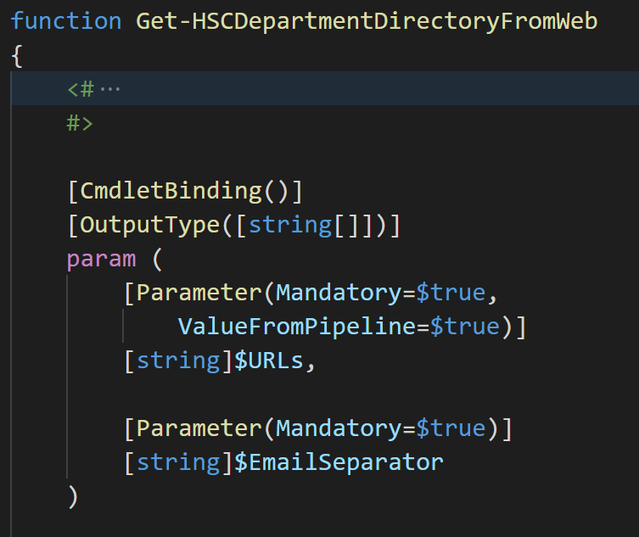

Slide 23
Disable-EndAccessDate.ps1

Slide 24
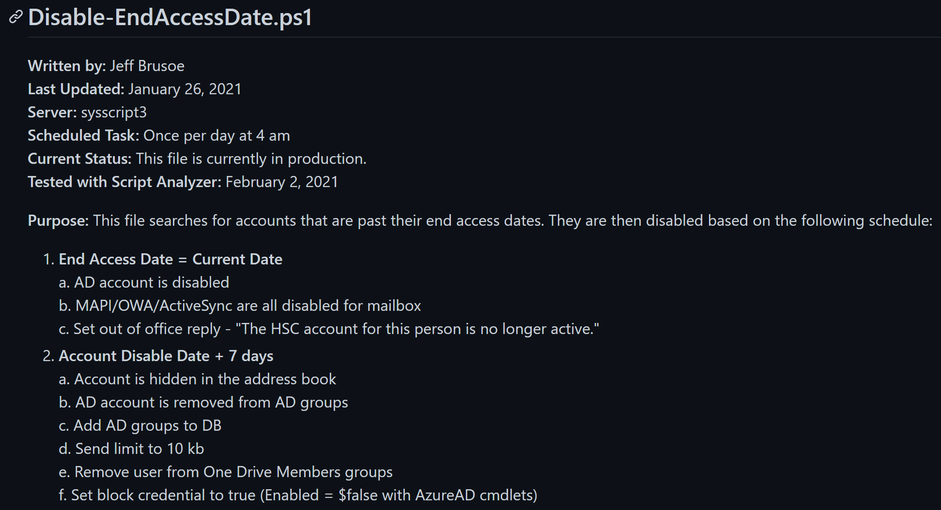

Slide 25
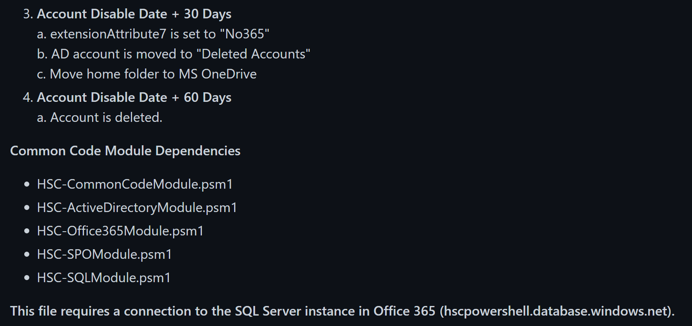

Slide 26
Import-WVUFAddressBook.ps1

Slide 27
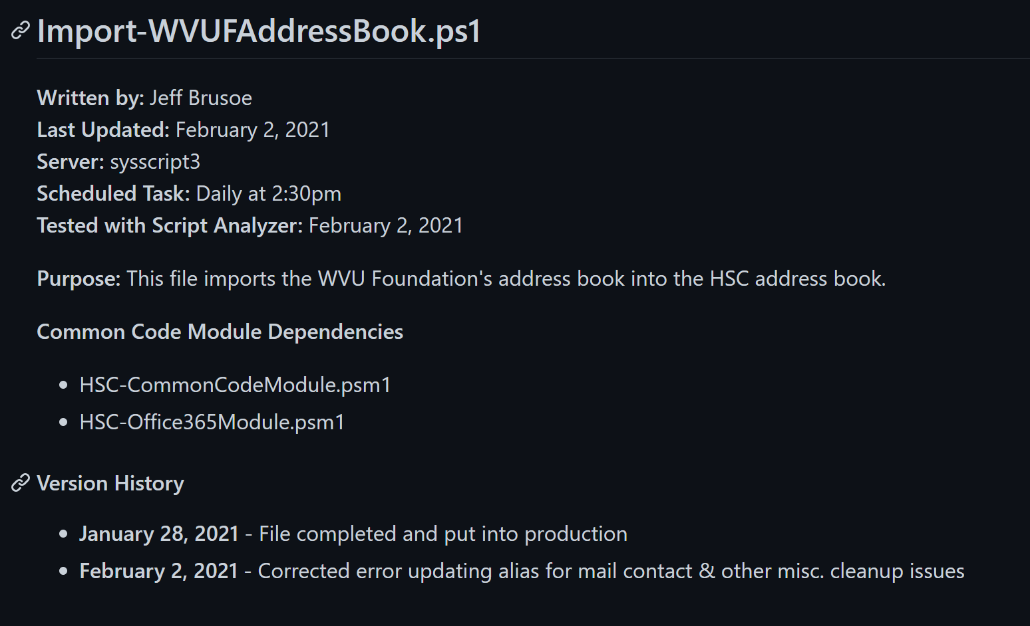

Slide 28
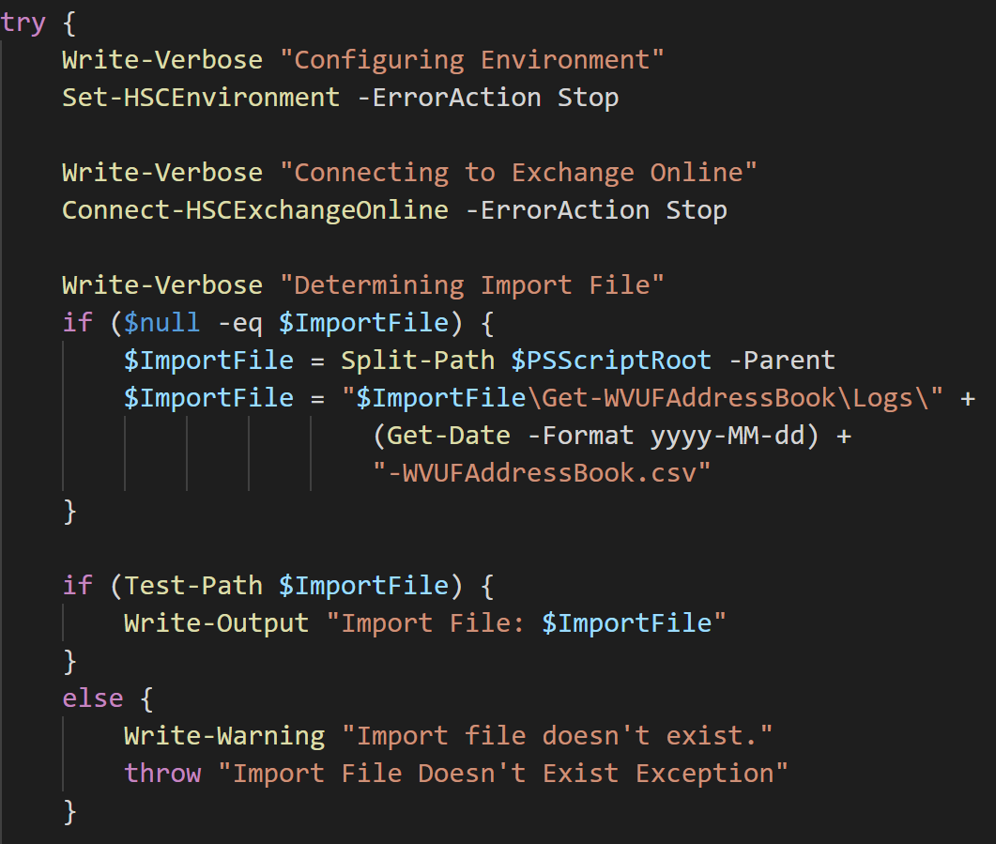

Slide 29
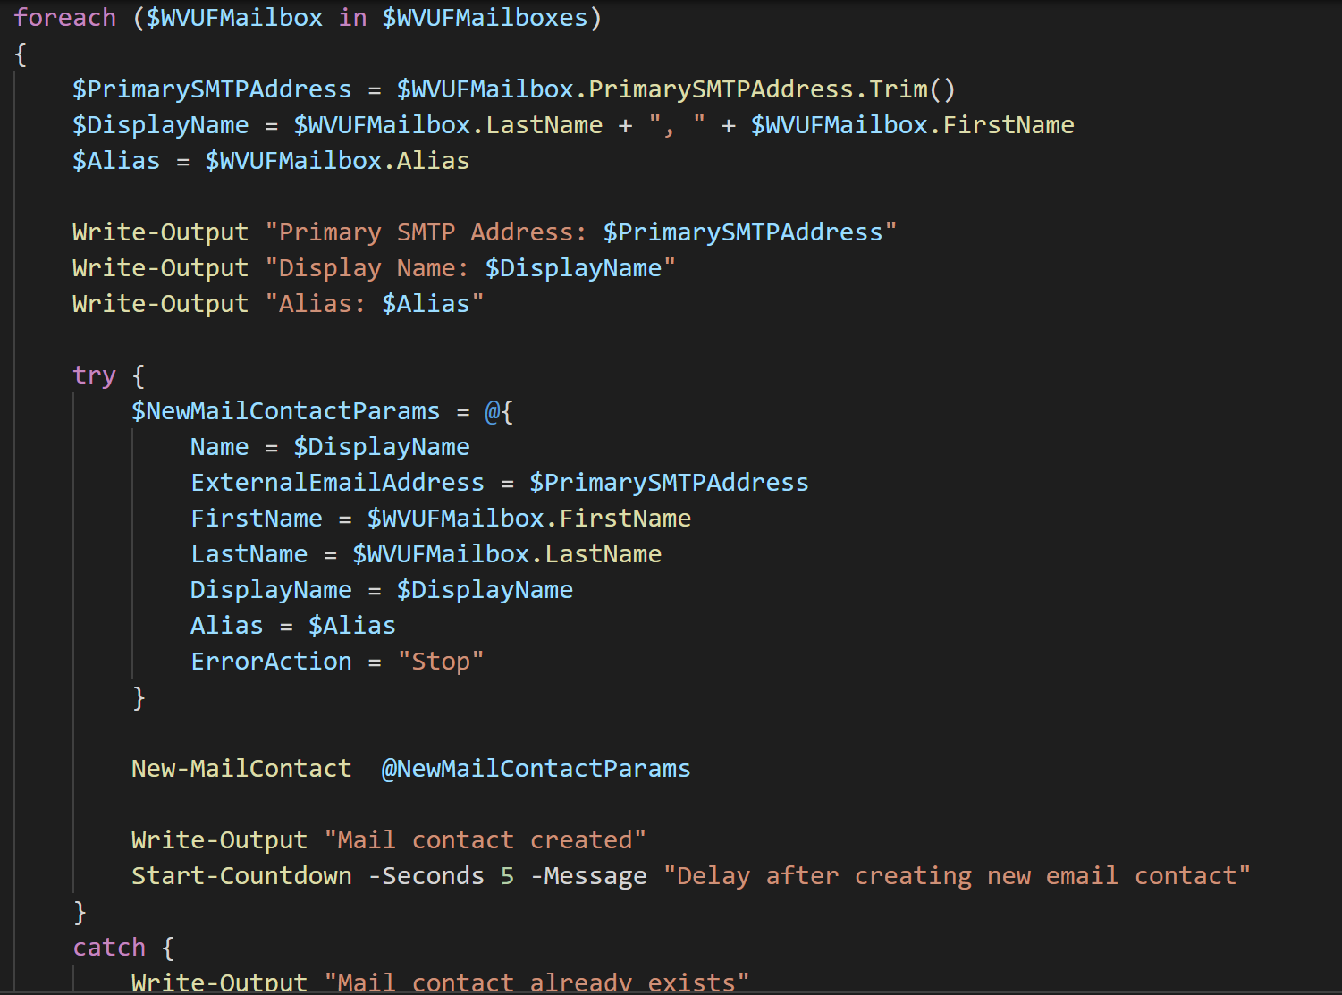

Slide 30
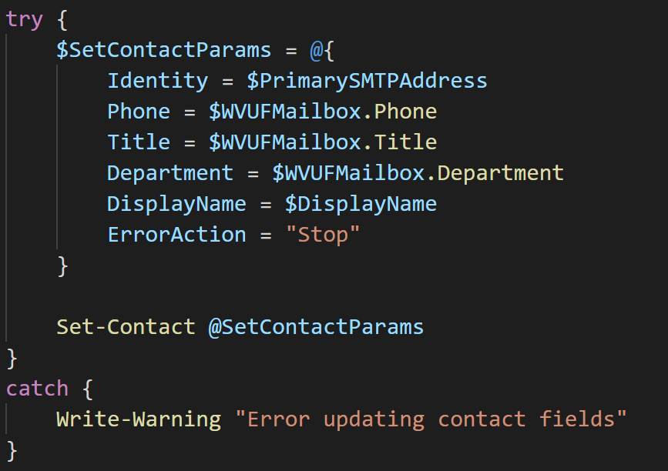

Slide 31
