Slide 1
PowerShell Code Review February 18, 2021

Slide 2
HSC-CommonCodeModule.tests.ps1
HSC-CommonCodeModule.psm1
HSC-PSMachineLearning.psm1
Set-ADComputerLocationFromSCCM.ps1
Update-ComputerLocationFromSOLE.ps1
Create-NewAccountManual.ps1
Set-SharedUserAfterMigration.ps1

Slide 3
HSC-CommonCodeModule.psm1 & HSC-CommonCodeModule.tests.ps1

Slide 4
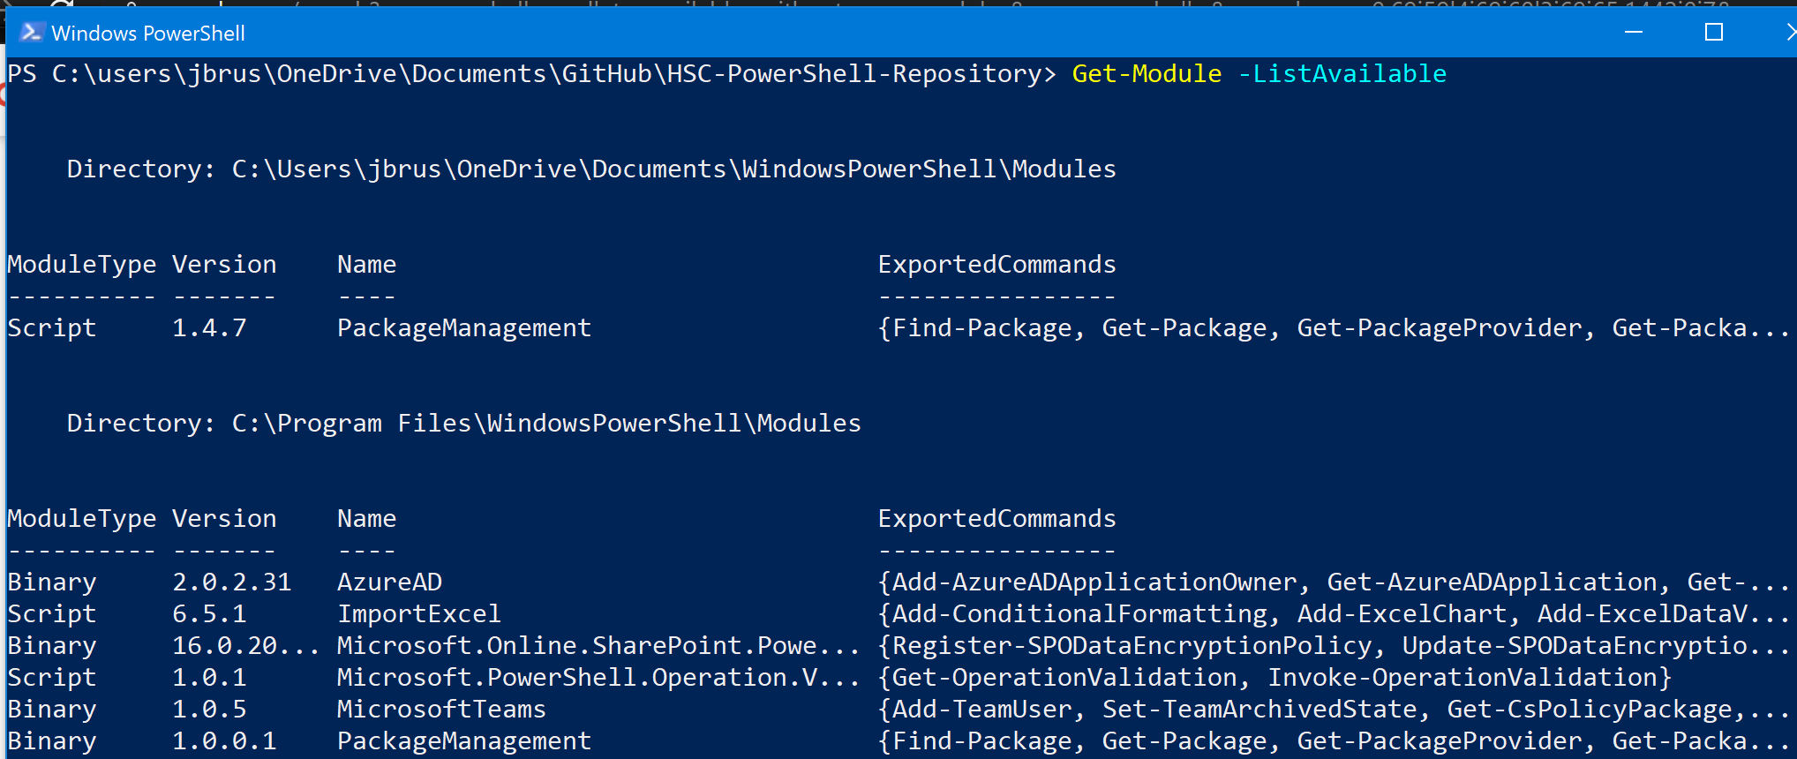

Slide 5
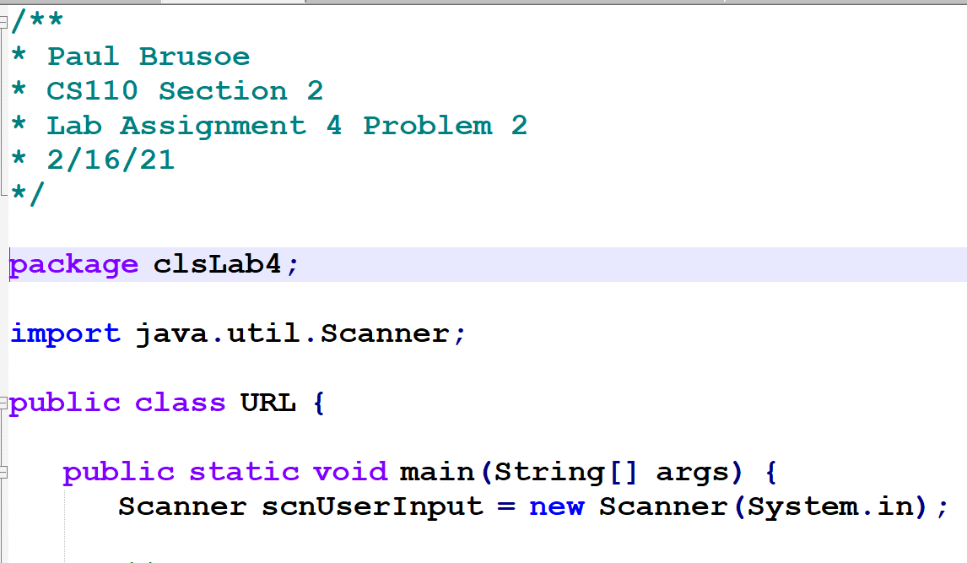

Slide 6
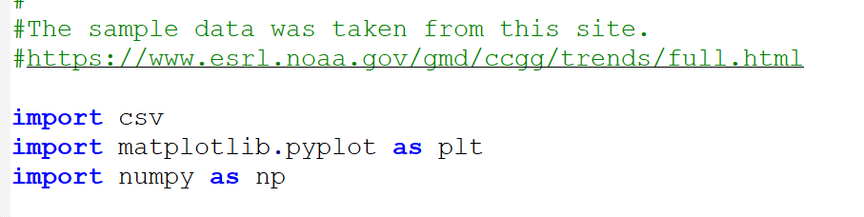

Slide 7
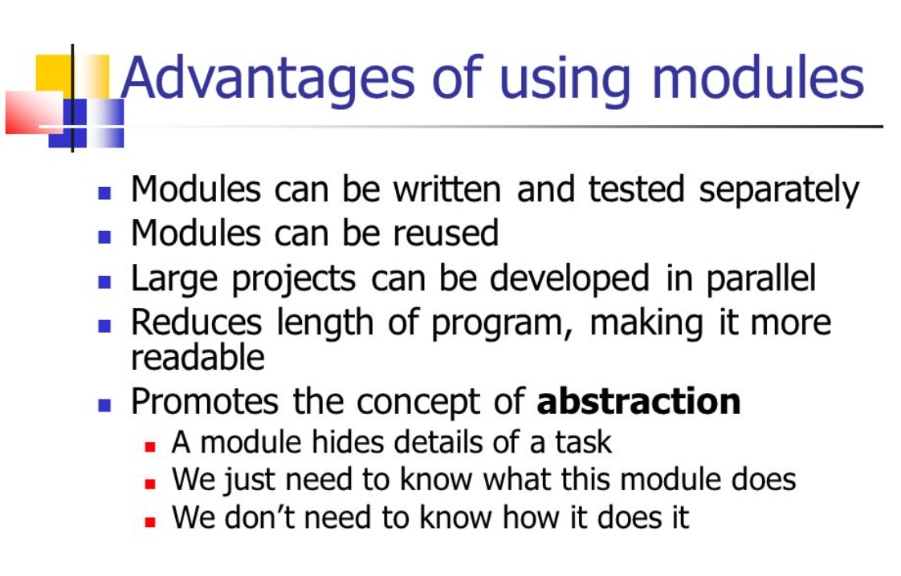

Slide 8
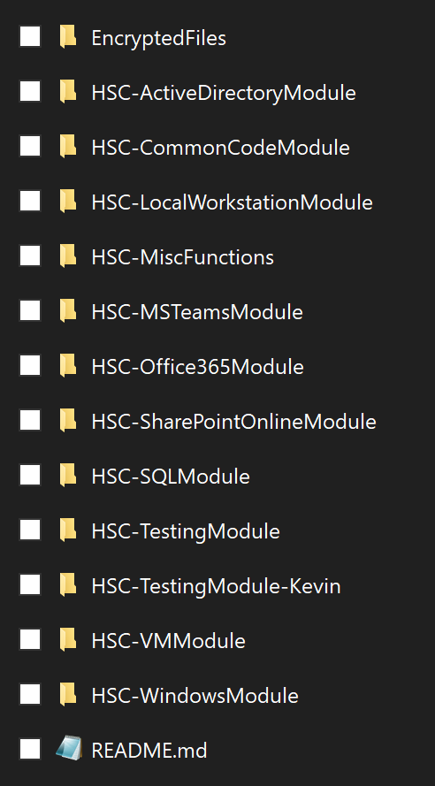

Slide 9
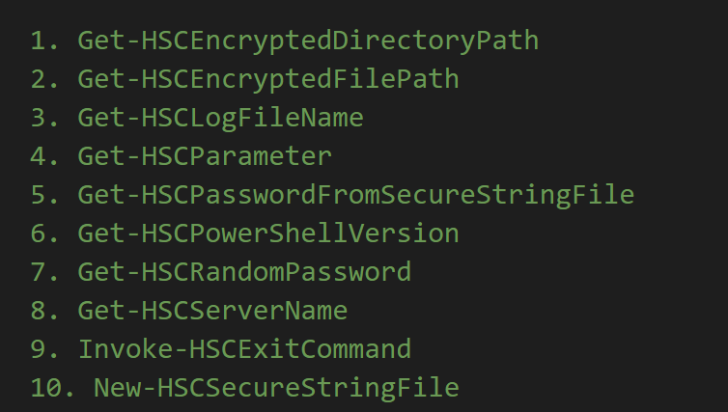
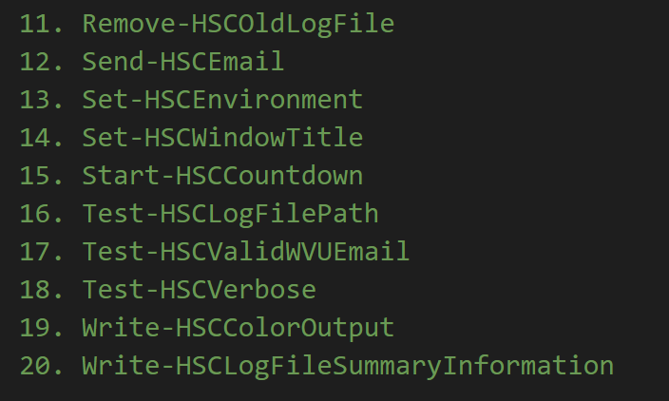
HSC-CommonCodeModule.psm1

Slide 10
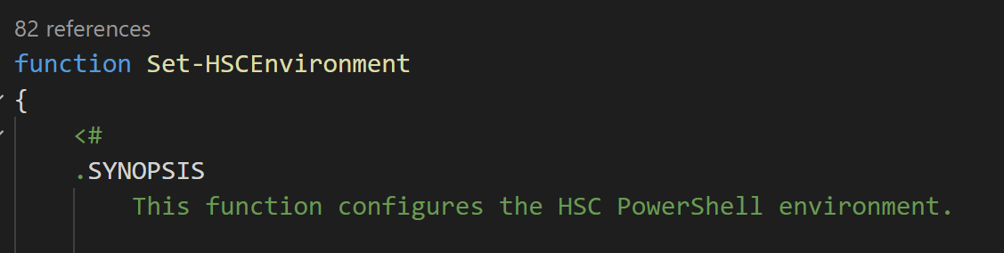

Slide 11
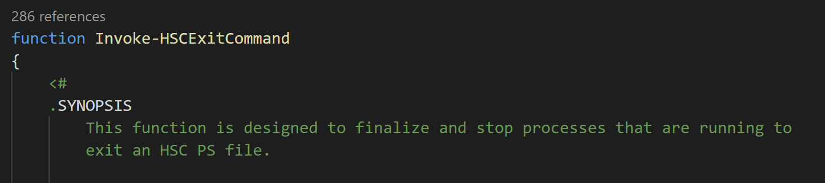

Slide 12
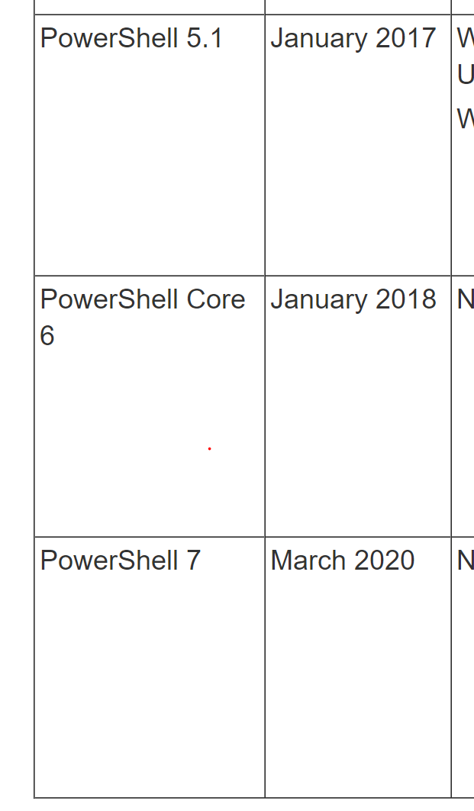

Slide 13
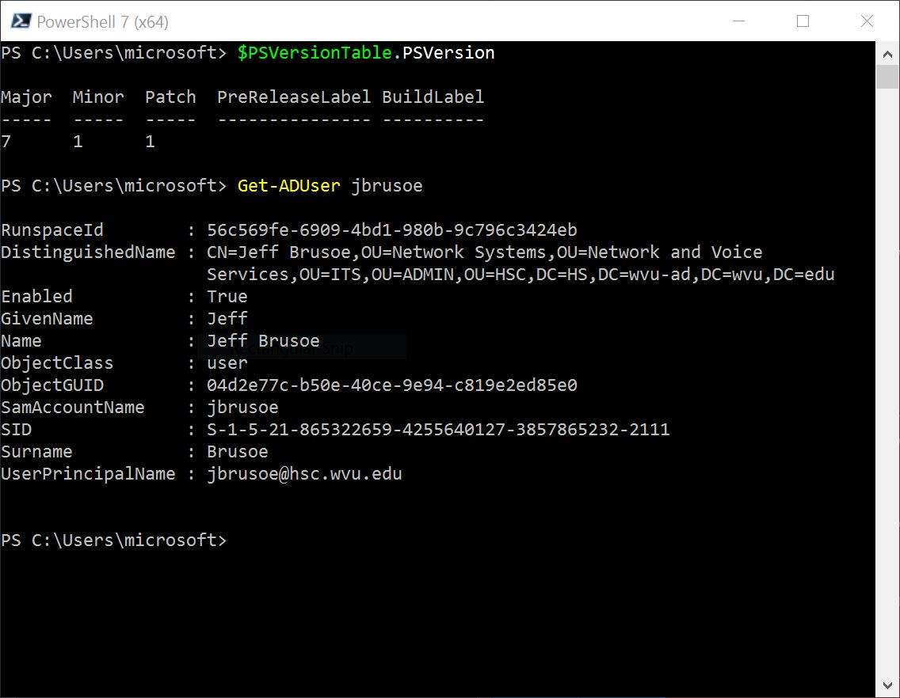

Slide 14
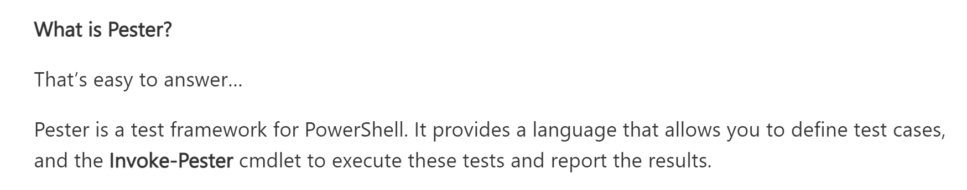

Slide 15
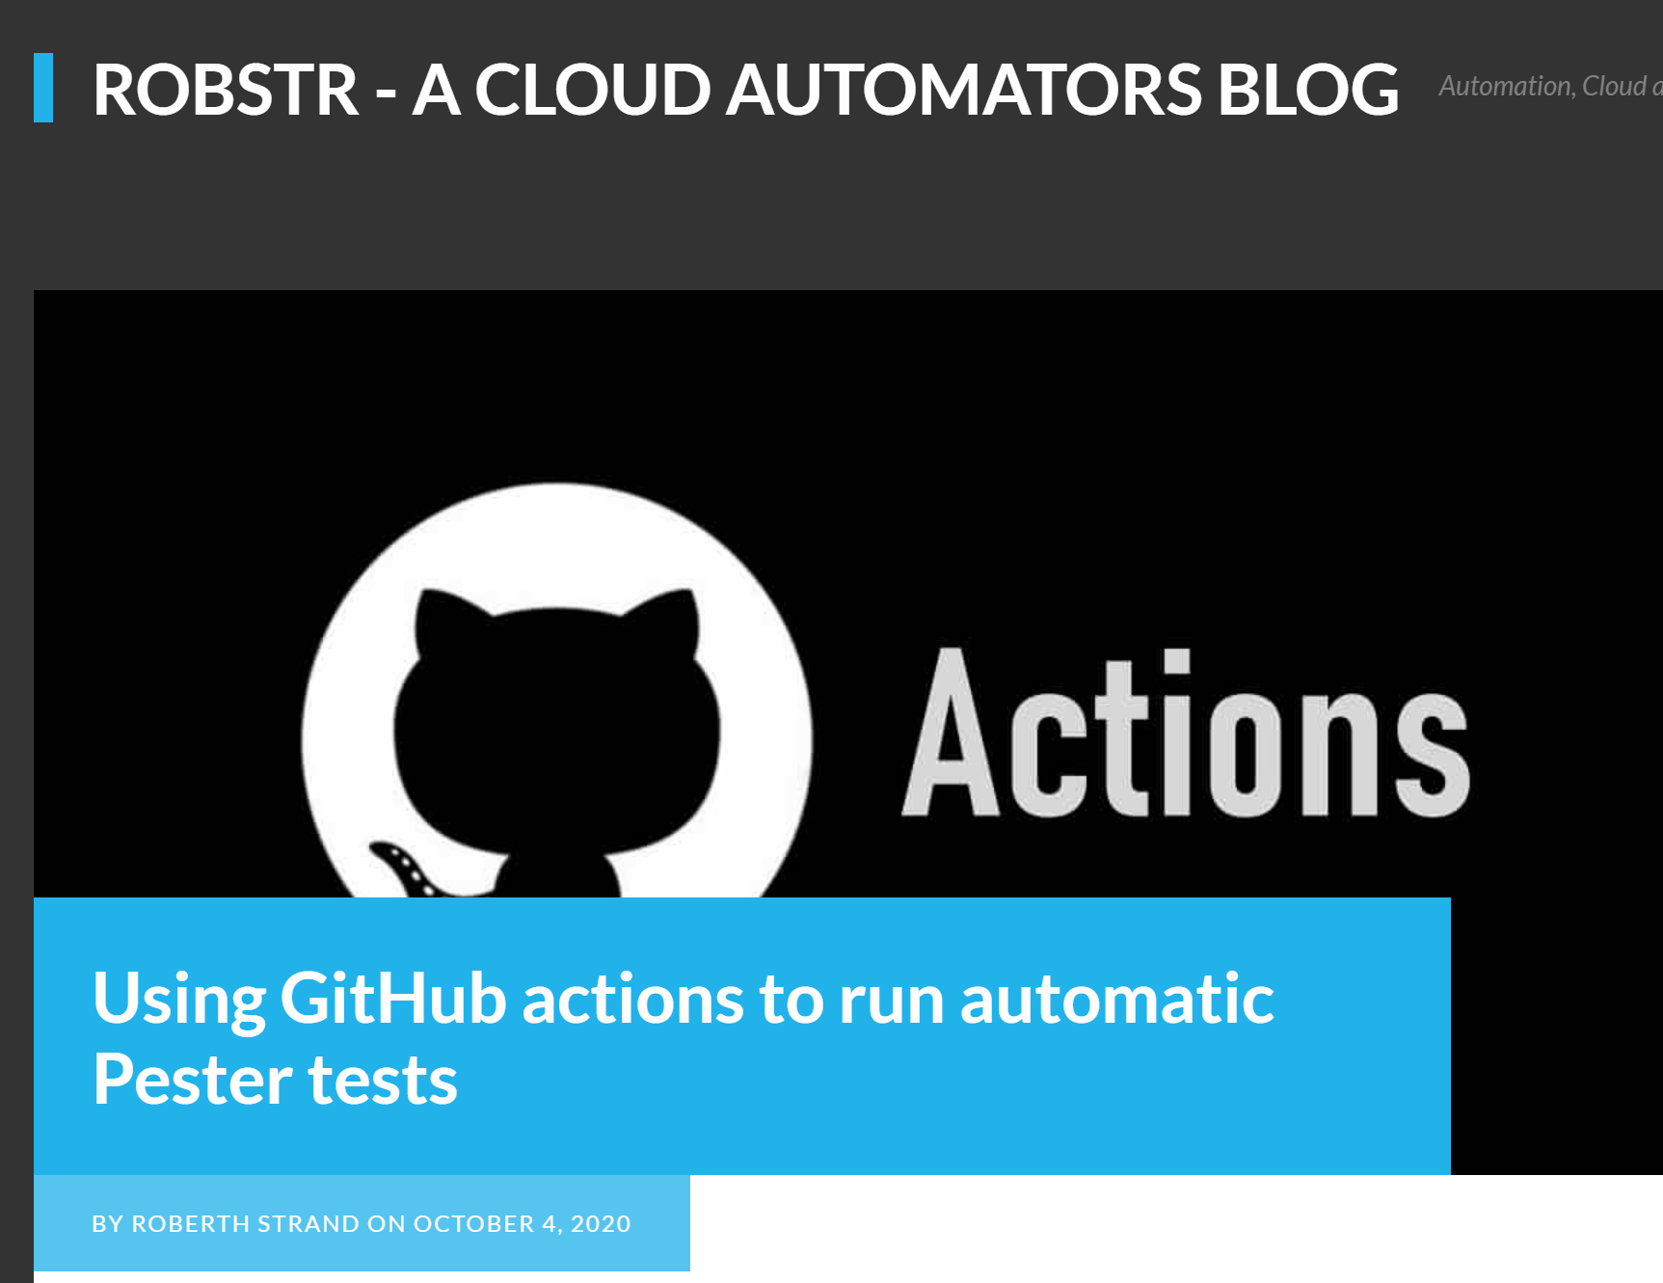

Slide 16
HSC-CommonCodeModule.tests.ps1
This file contains the Pester tests to run on HSC-CommonCodeModule.psm1

Slide 17
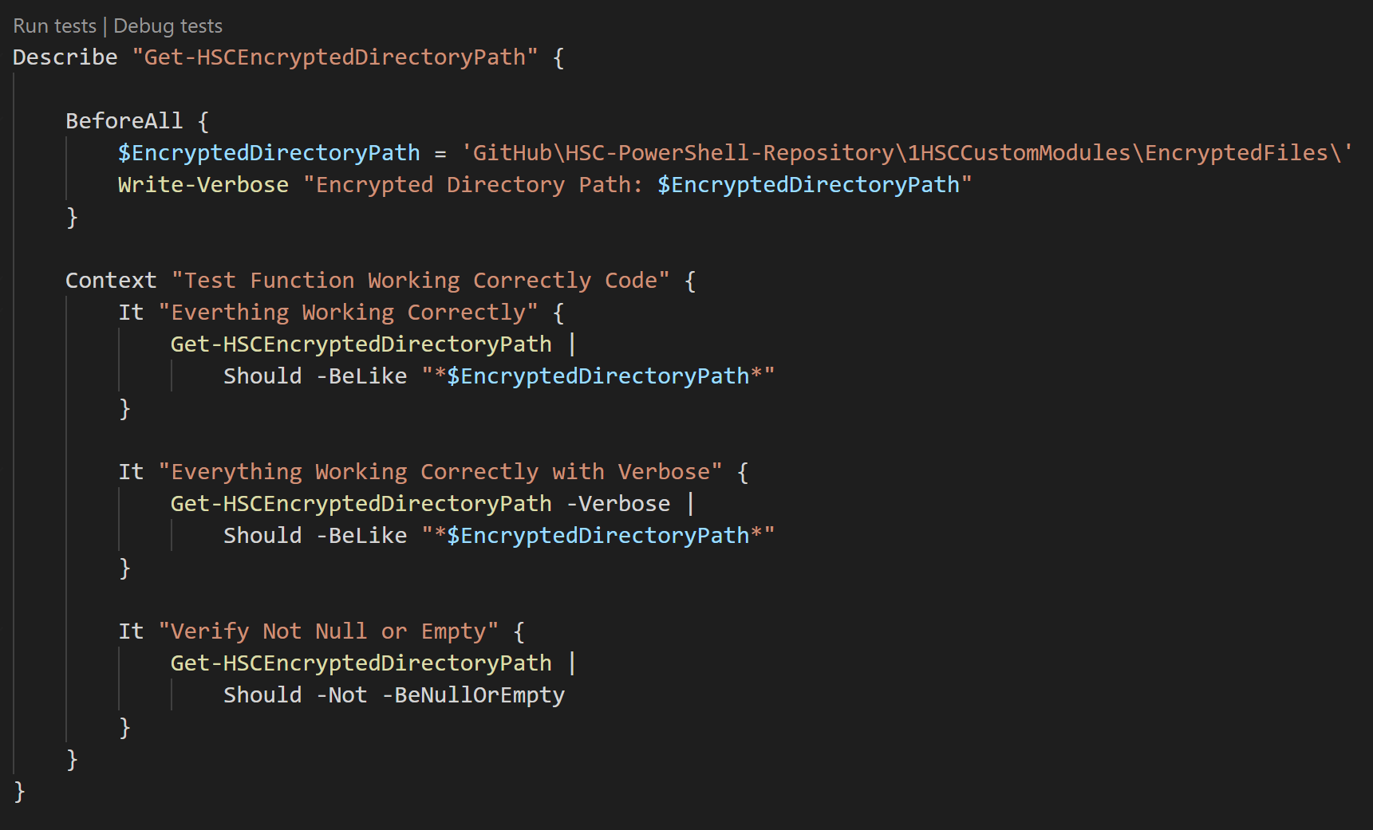

Slide 18
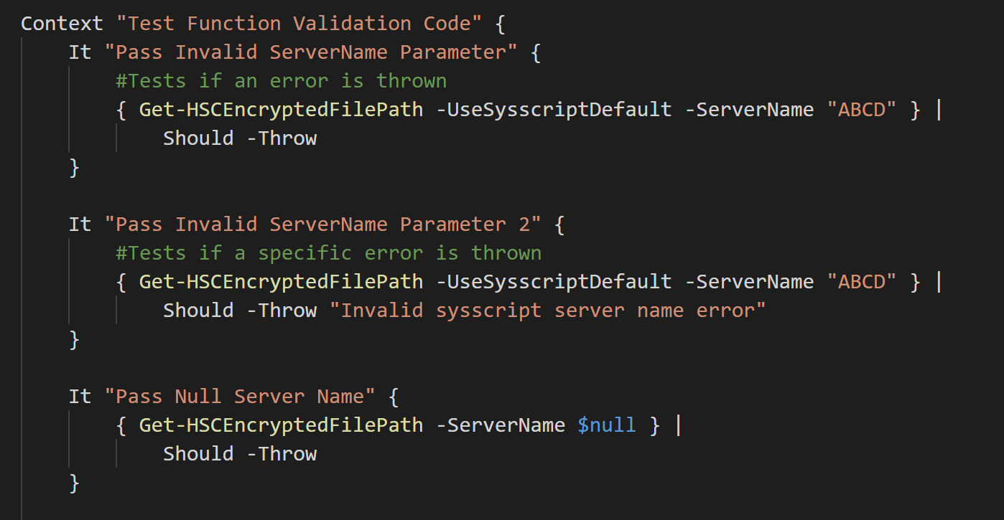

Slide 19
HSC-PSMachineLearning.psm1

Slide 20
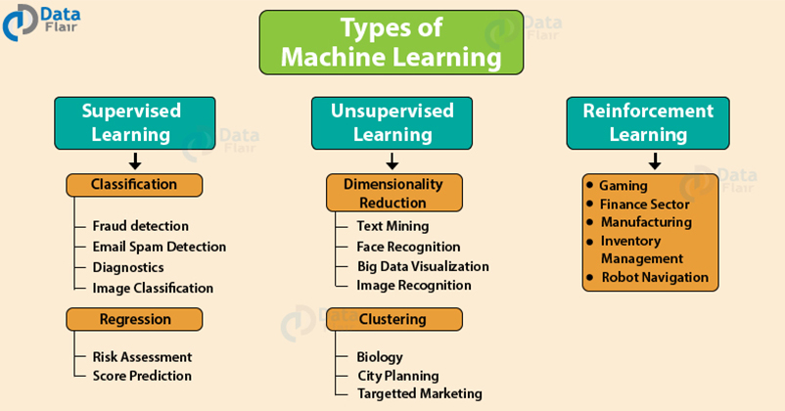

Slide 21
