Slide 1
PowerShell Code Review March 18, 2021

Slide 2
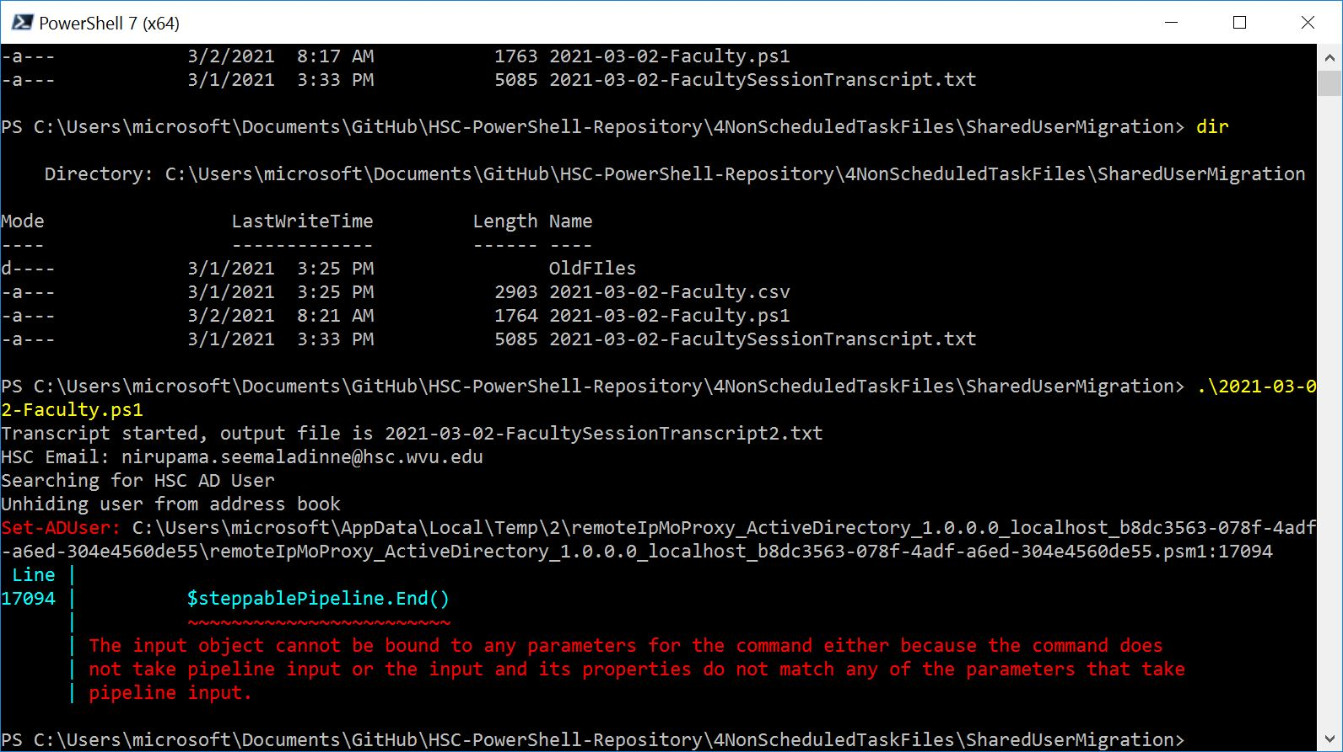

Slide 3
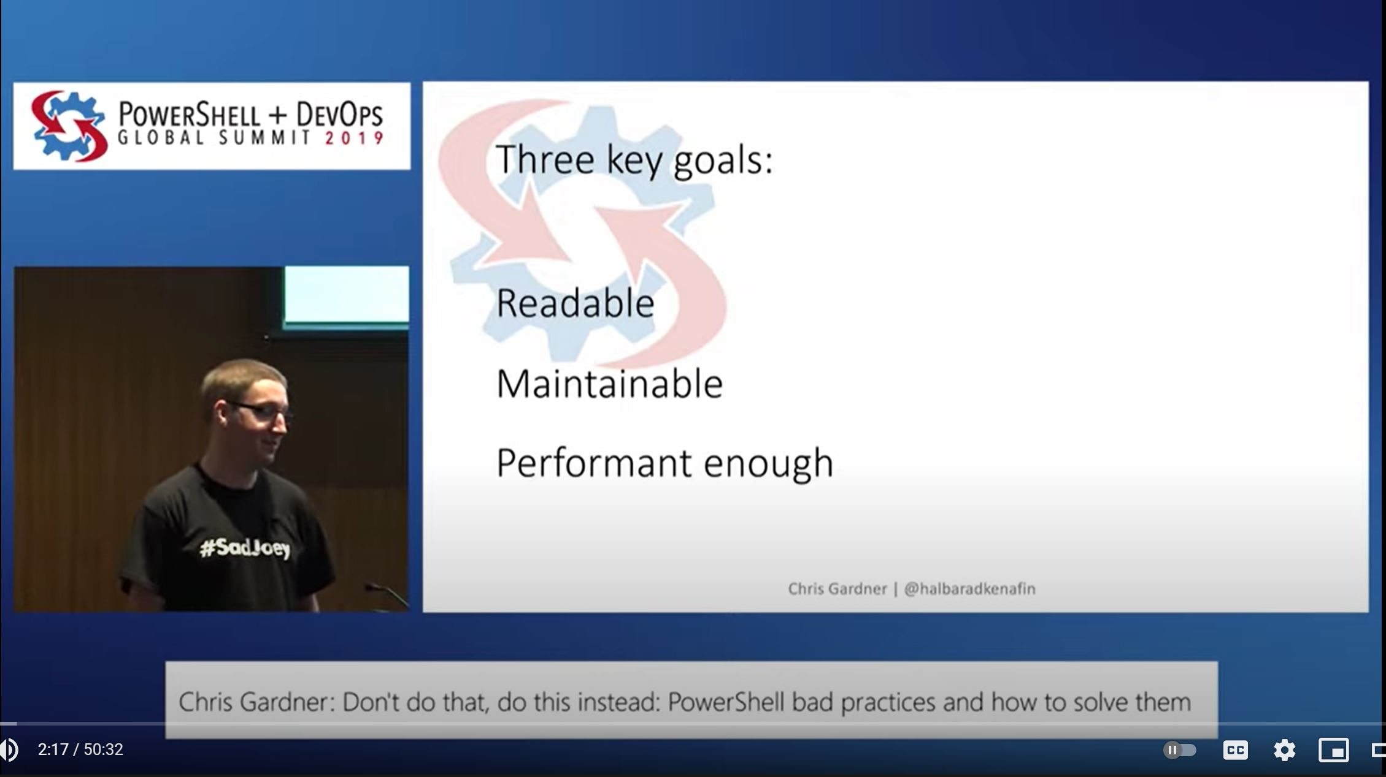

Slide 4
Functions:
Get-HSCGitHubRepoPath
Set-HSCAddressBookVisibility
Get-HSCNTFSFolderPermission (Kevin)
Files:
Get-RRQuarantineMessage.ps1
Set-StandardUserAccount.ps1
Remove-WVUMHIPAATraining.ps1

Slide 5
Get-HSCGitHubRepoPath

Slide 6
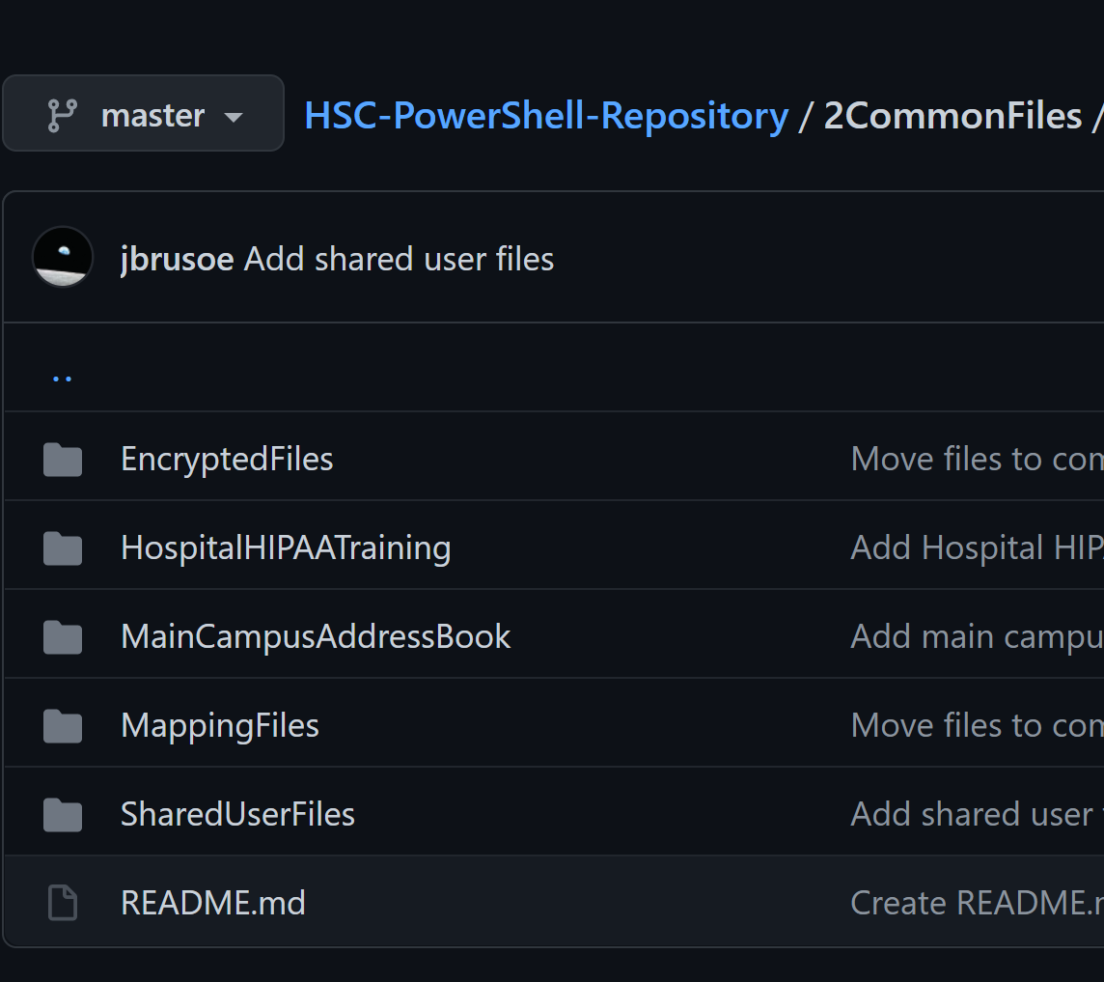

Slide 7
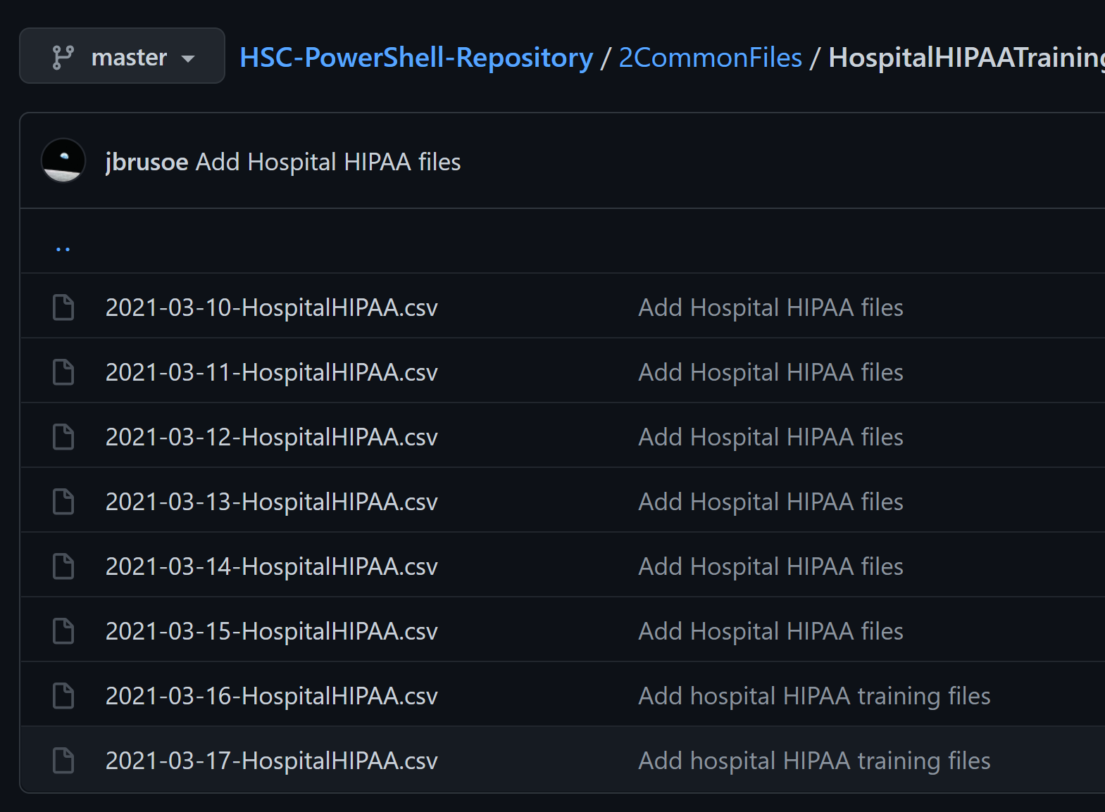

Slide 8
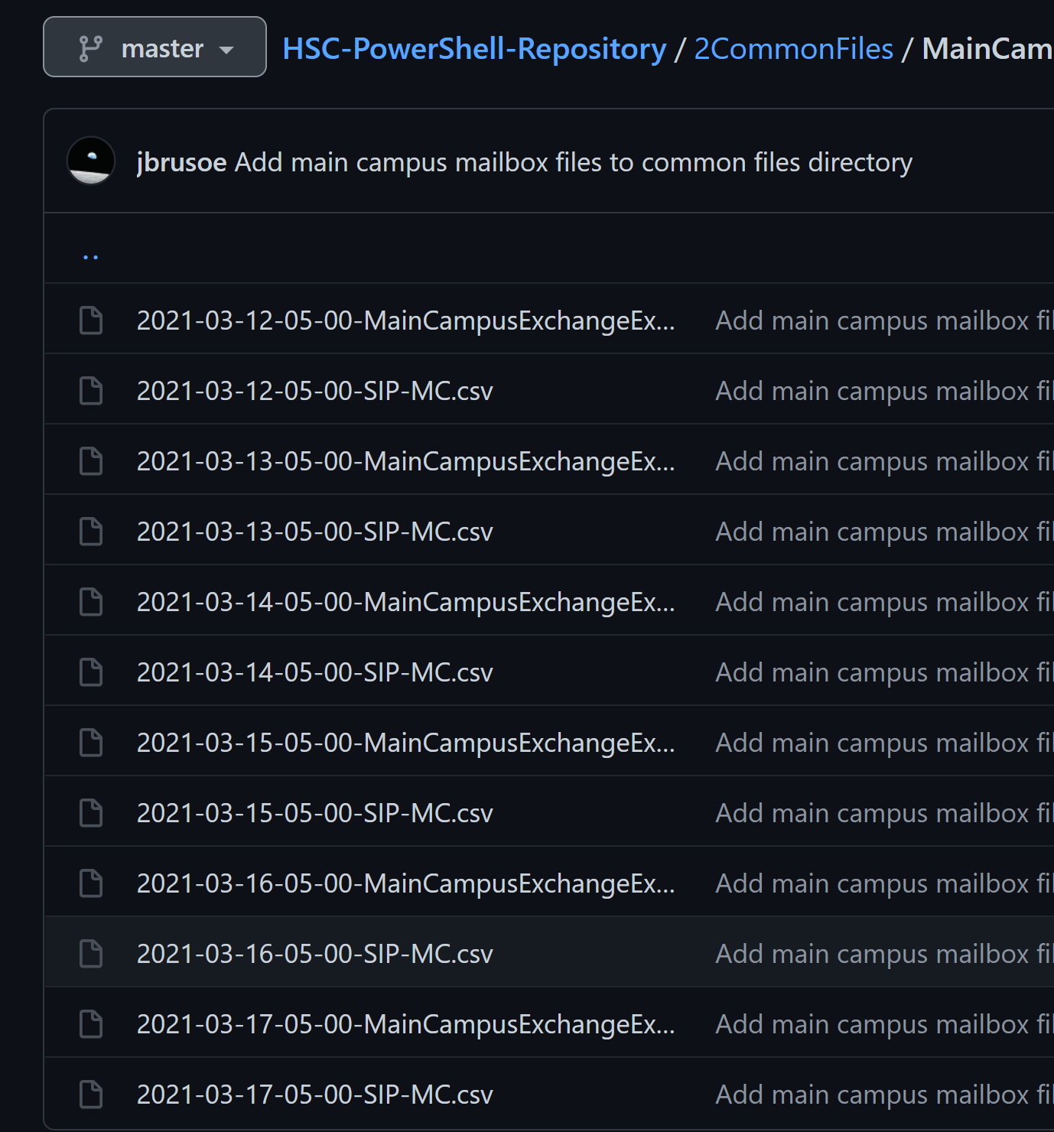

Slide 9
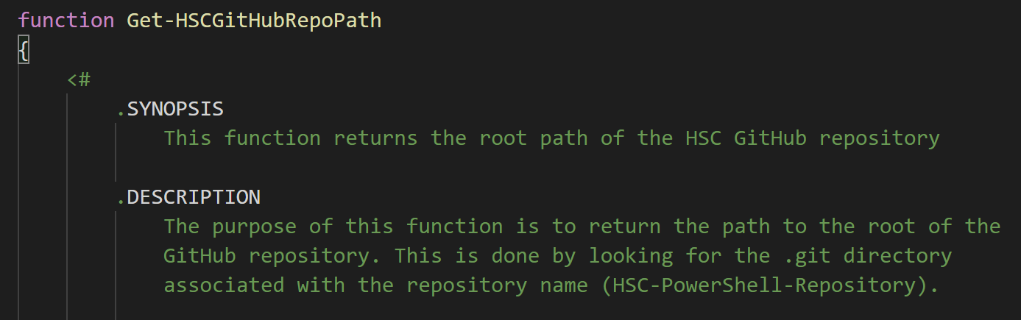

Slide 10
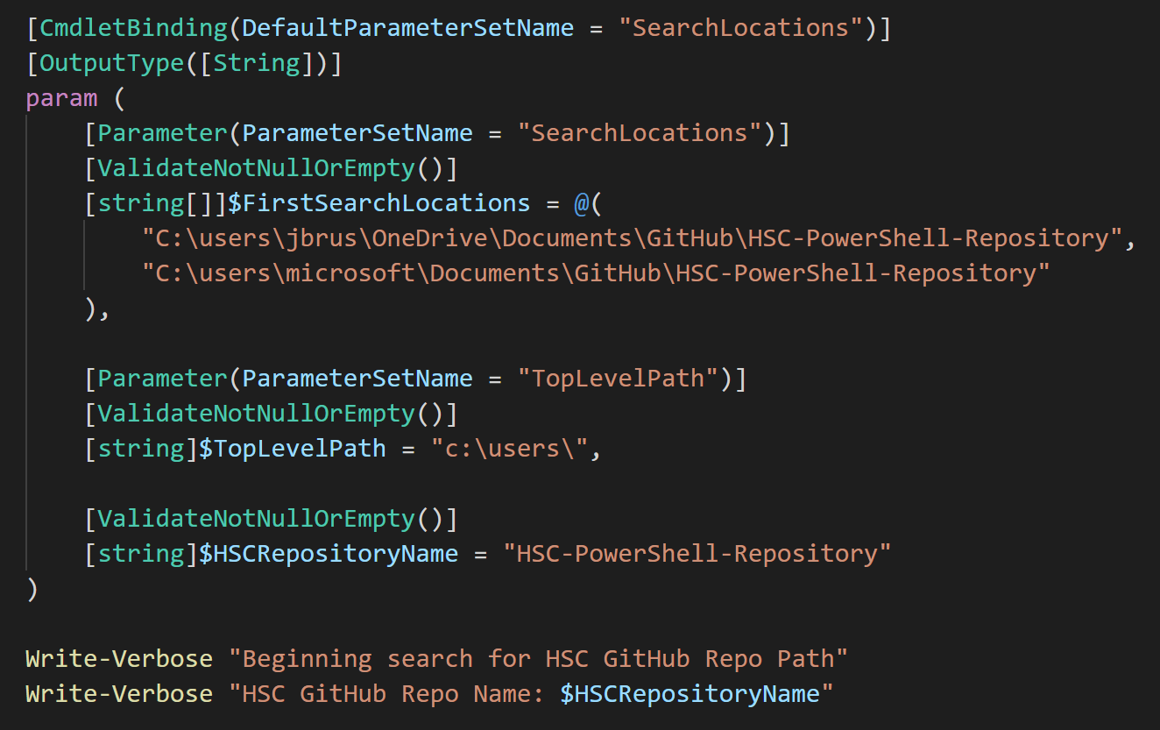

Slide 11
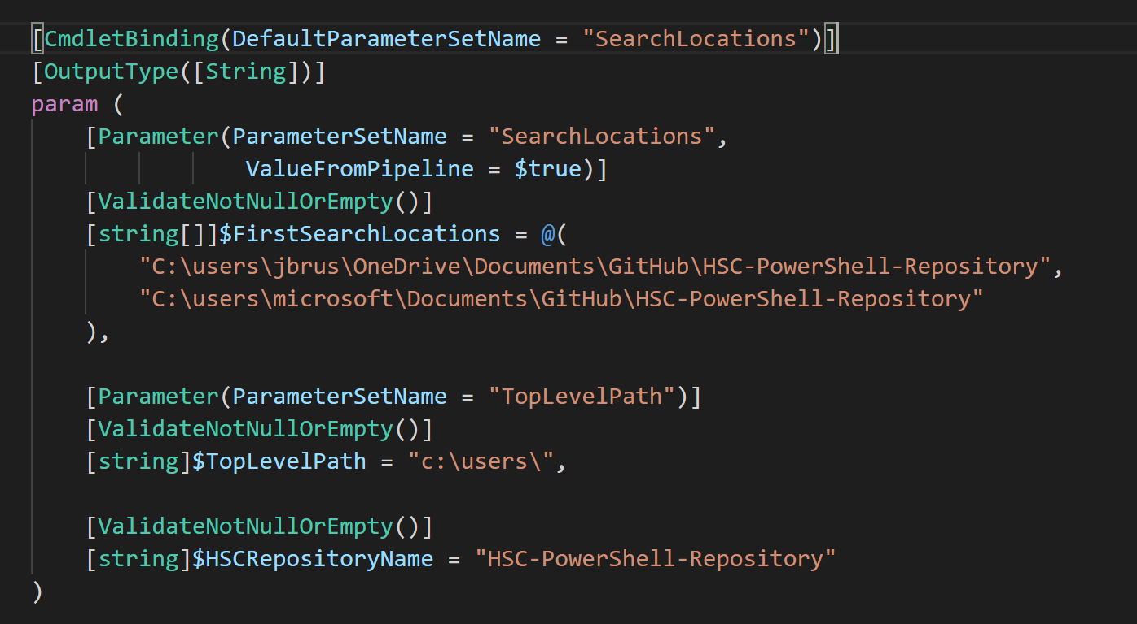

Slide 12
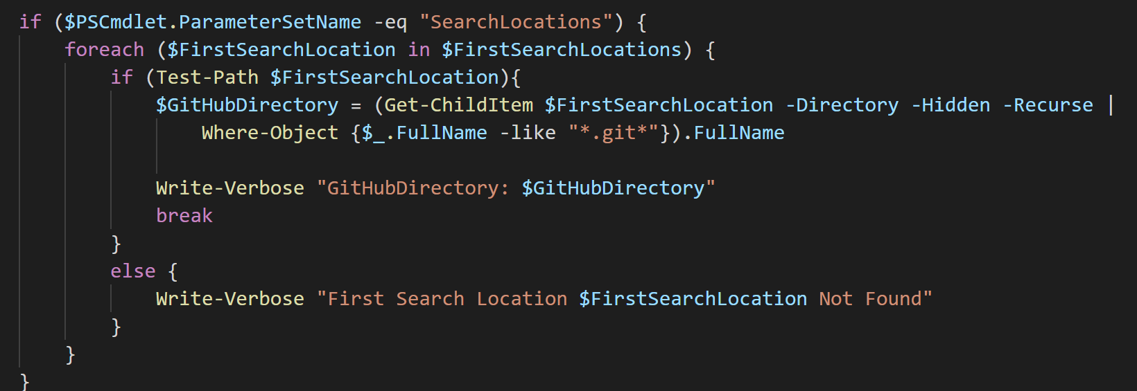

Slide 13
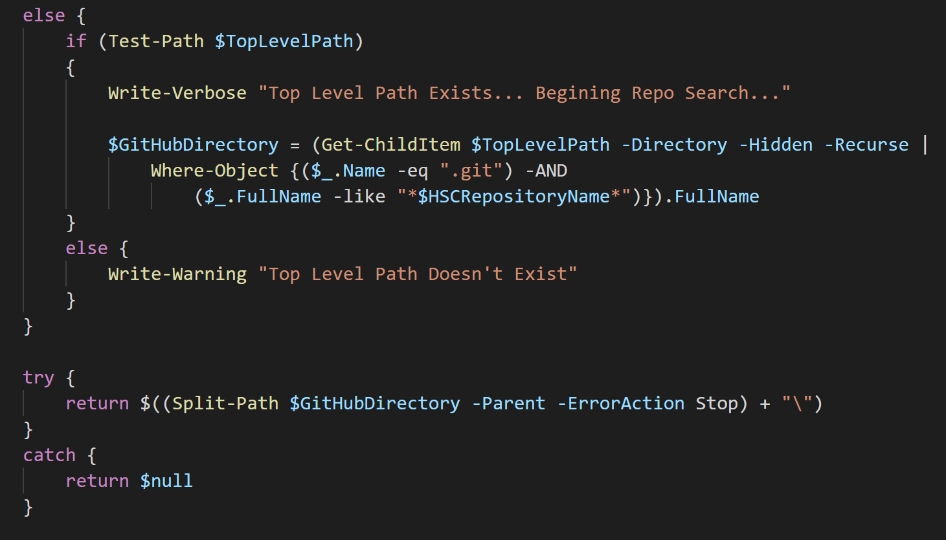

Slide 14
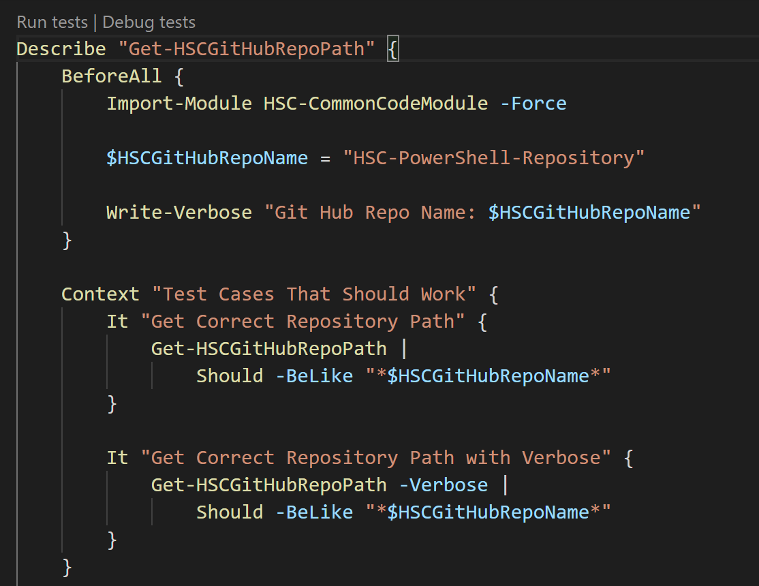

Slide 15
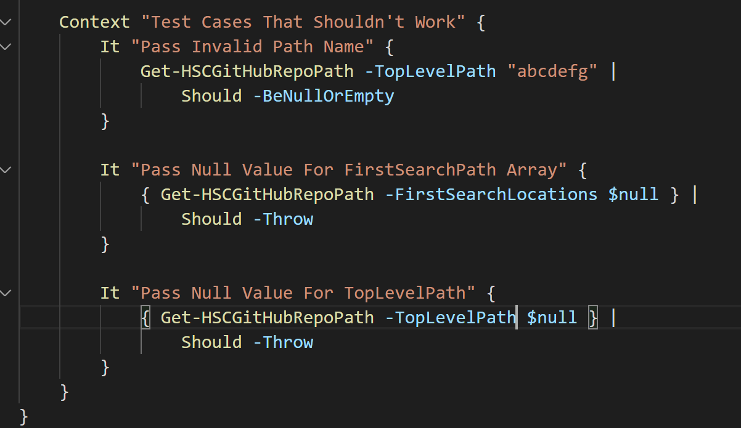

Slide 16
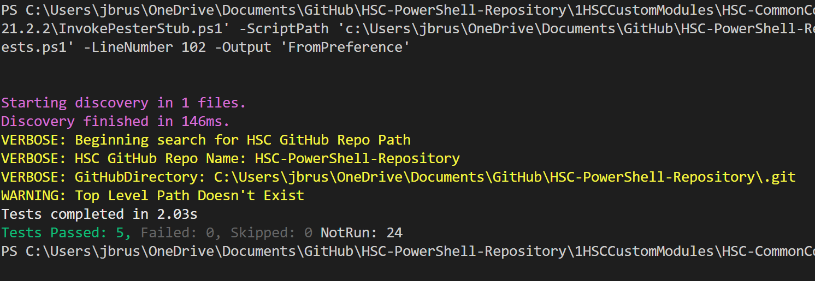

Slide 17
Set-HSCAddressBookVisibility

Slide 18
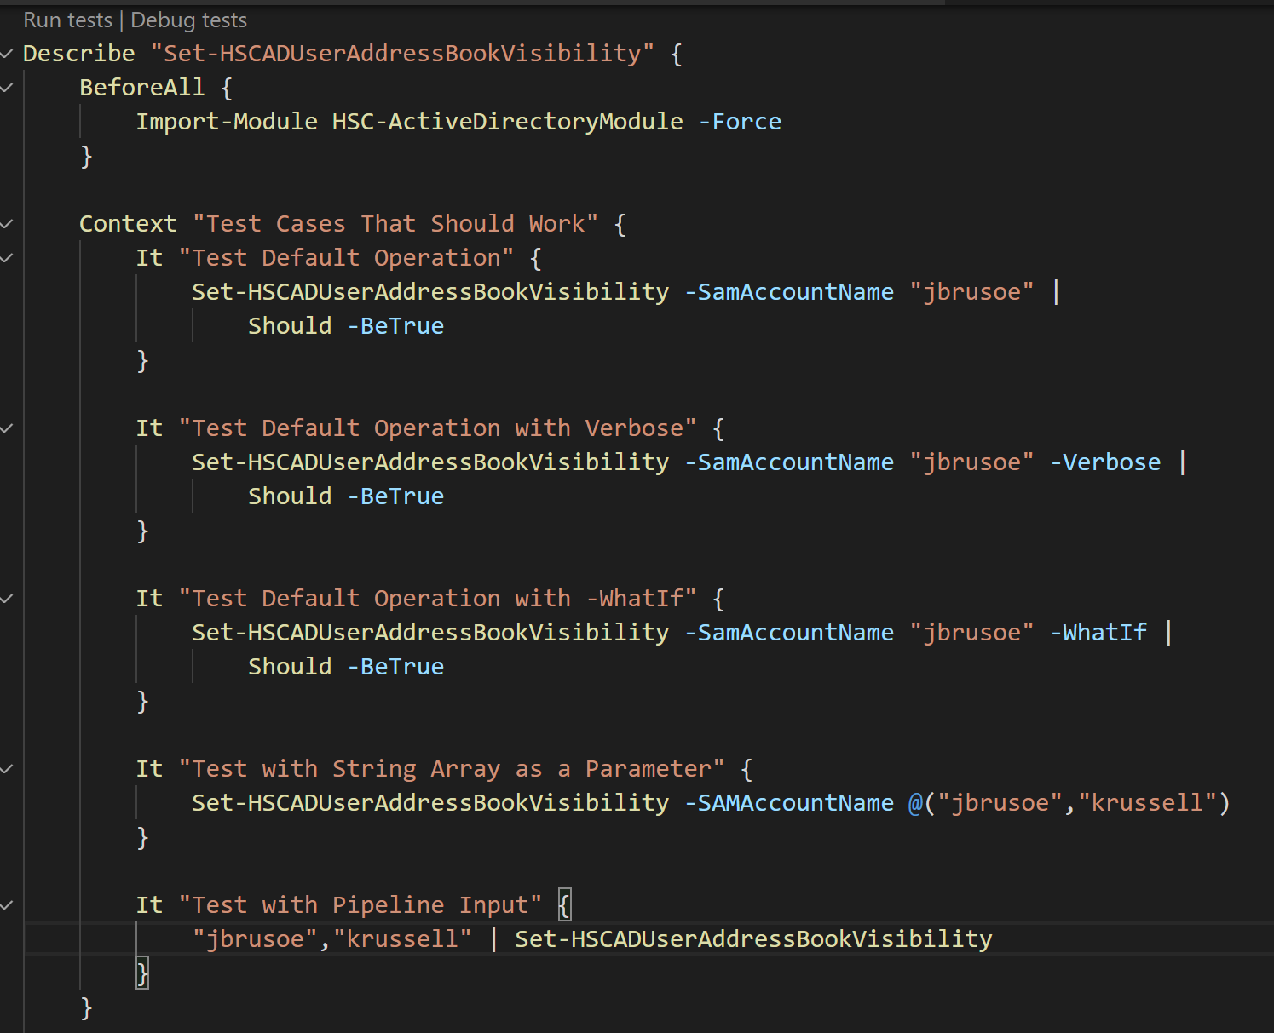

Slide 19
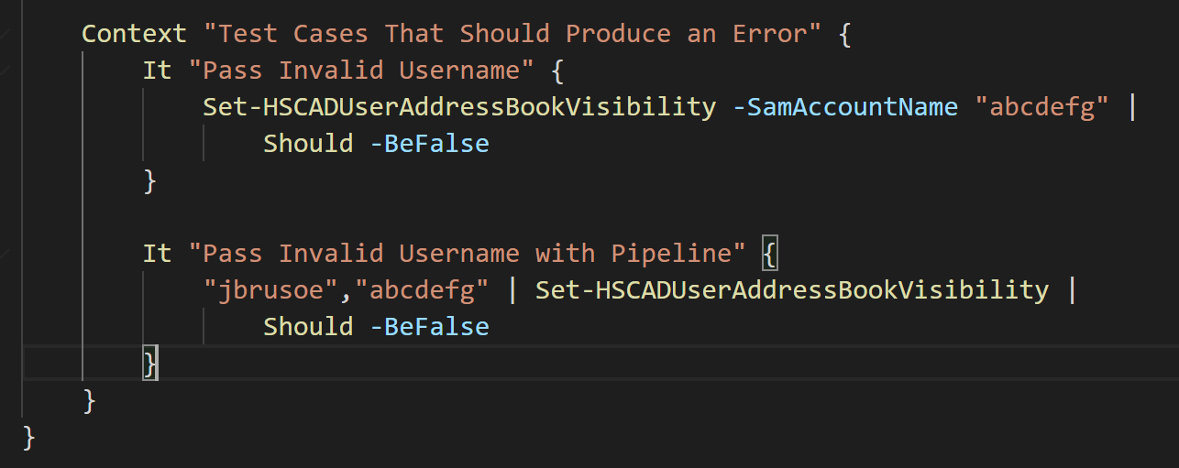

Slide 20
