Slide 1
PowerShell Code Review April 15, 2021

Slide 2
platyPS - https://github.com/PowerShell/platyPS
PowerShell Runspaces
Update-CancerCenterDL.ps1
Get-HSCADUserMailNickname
Set-HSCADUserMailNickname
Kevin’s File

Slide 3
platyPS

Slide 4


Slide 5
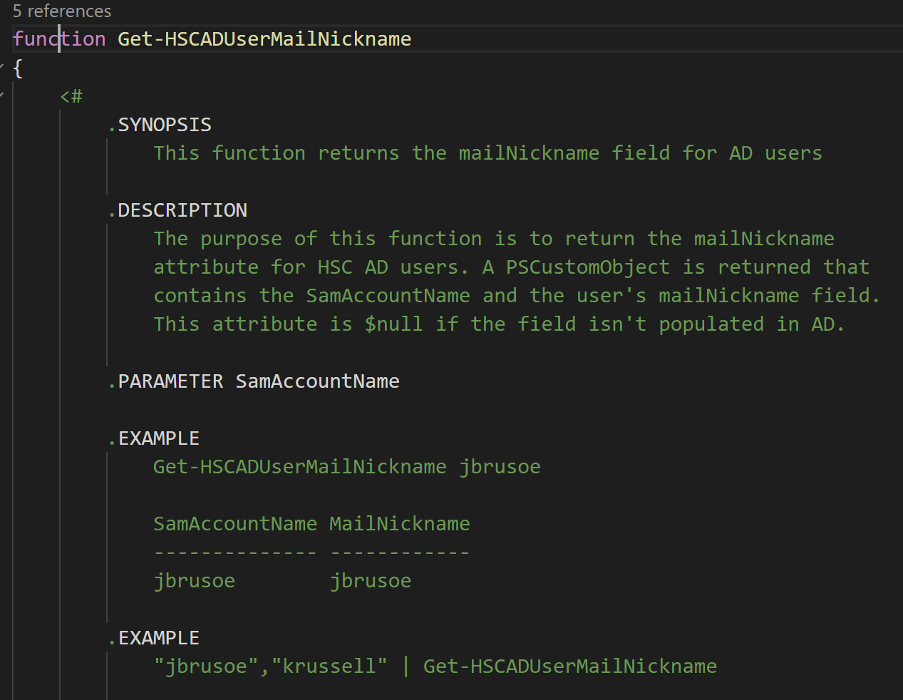

Slide 6
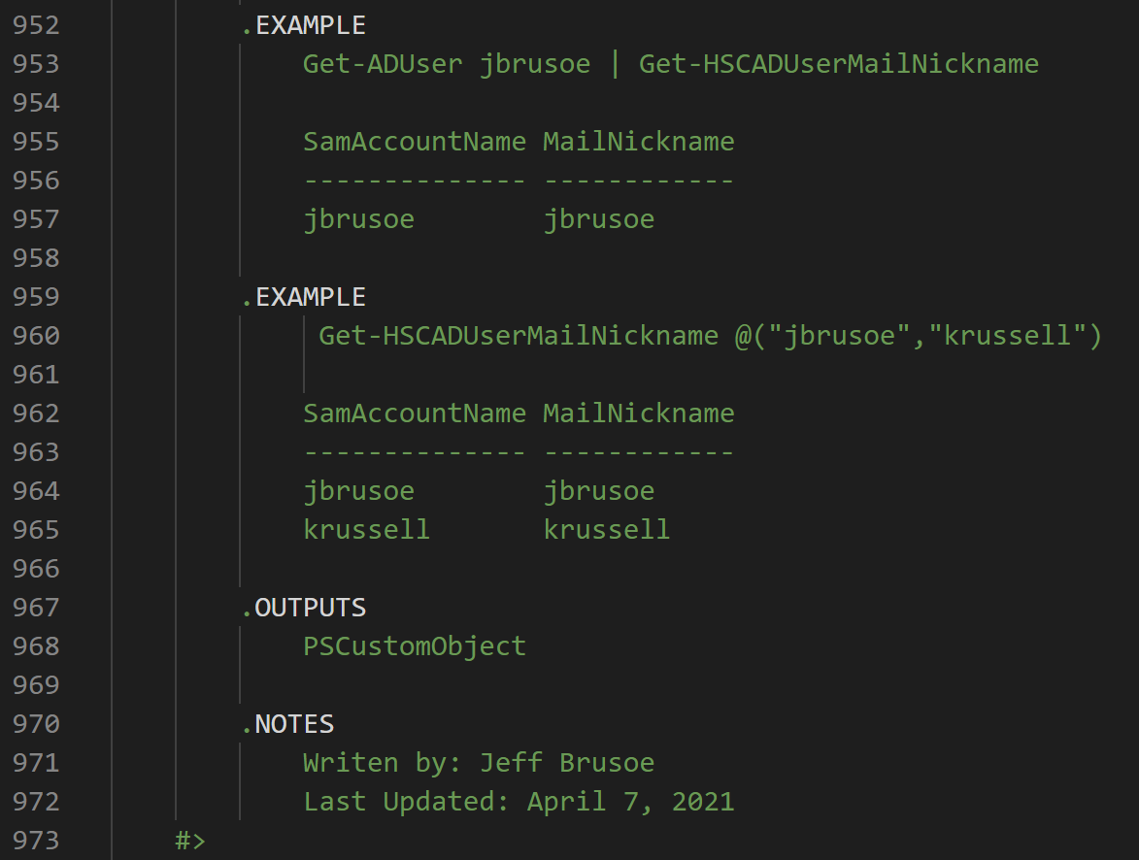

Slide 7
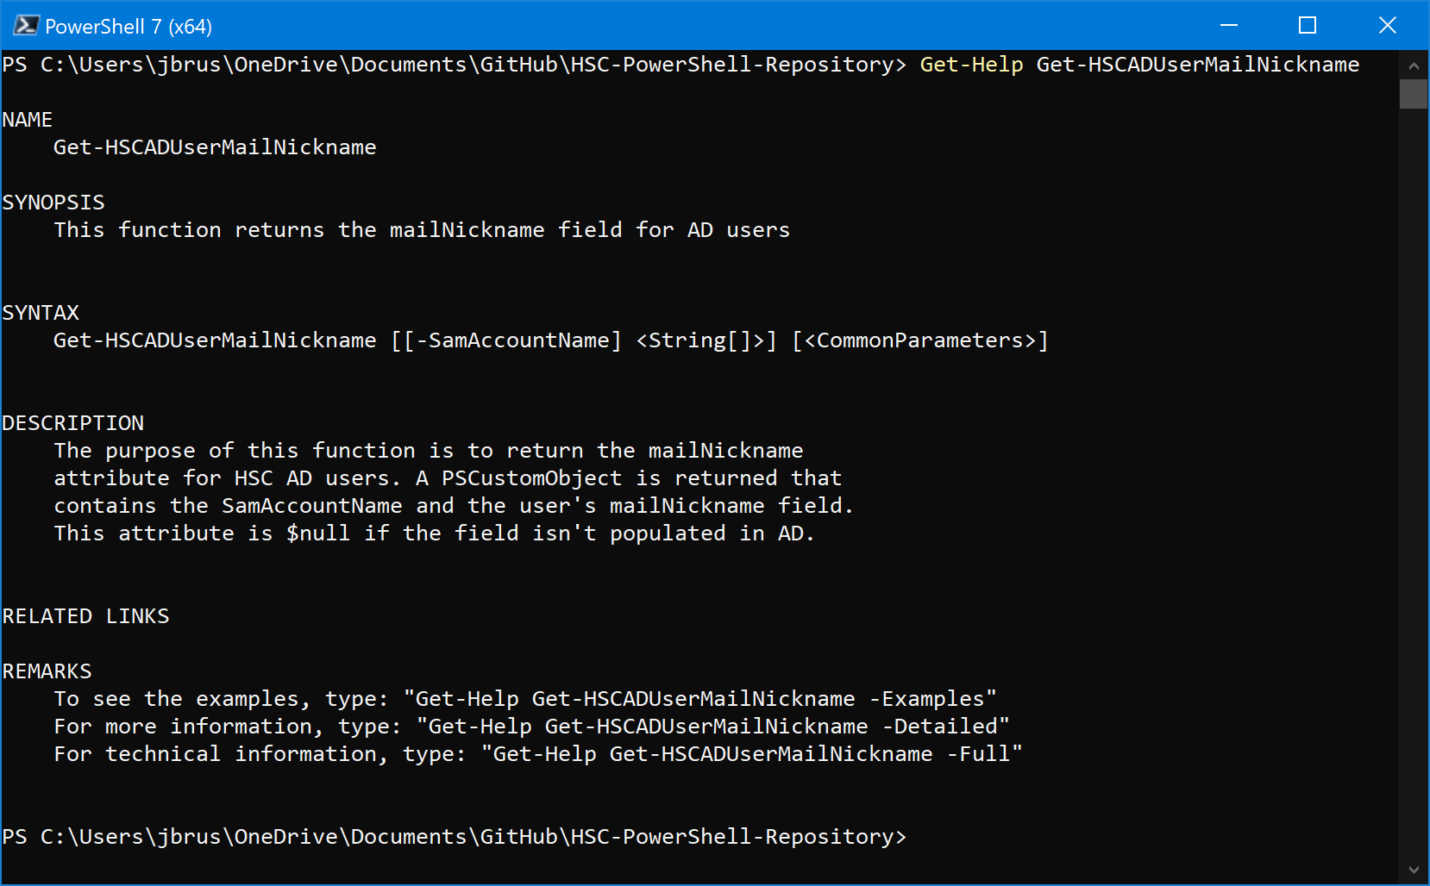

Slide 8
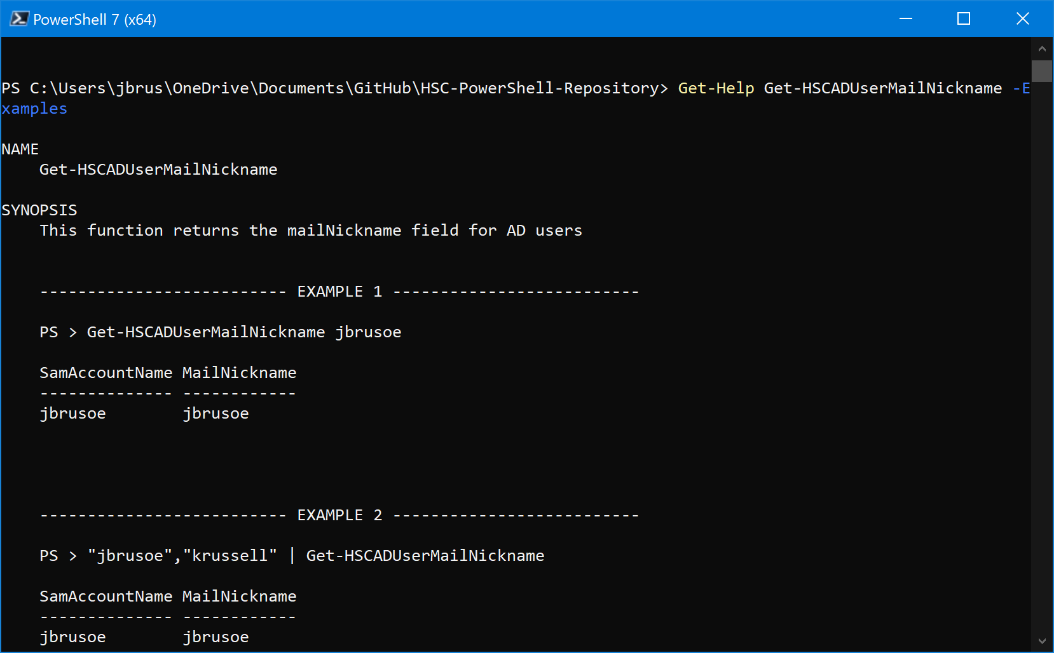

Slide 9
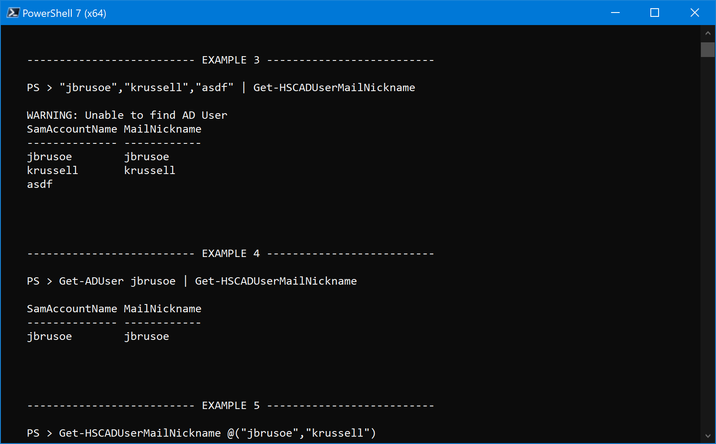

Slide 10
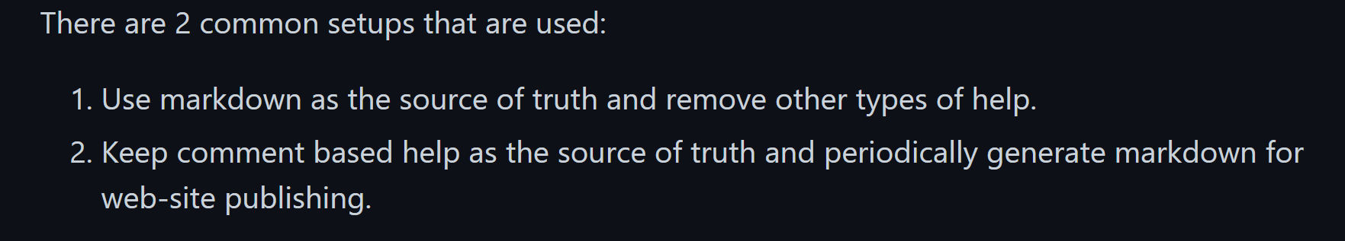

Slide 11
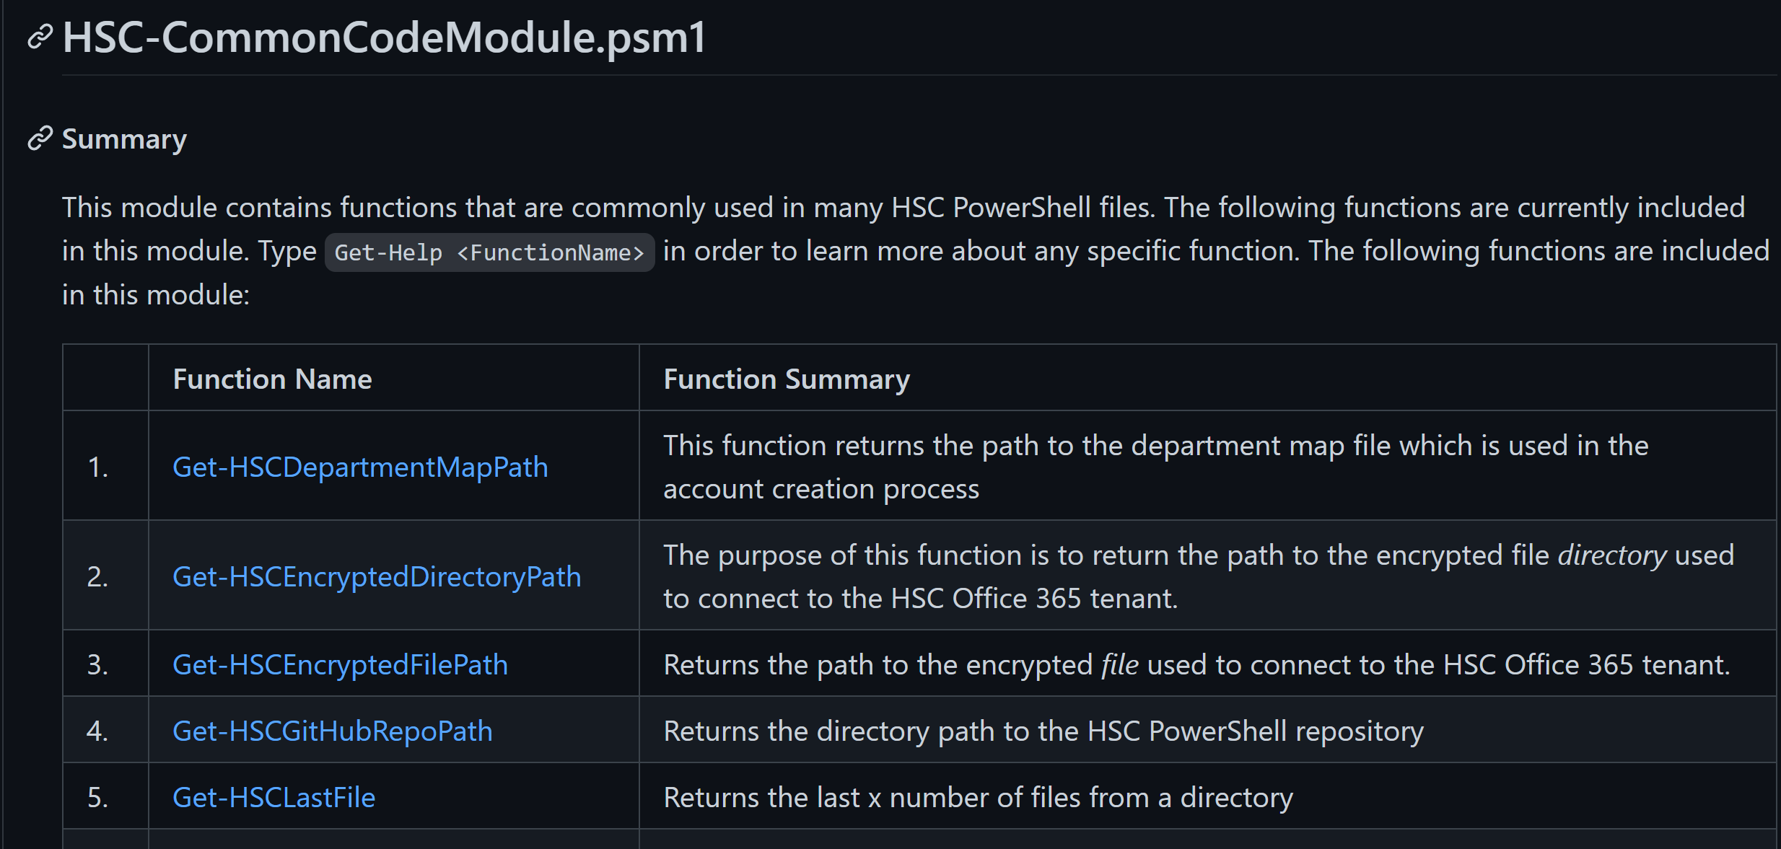

Slide 12
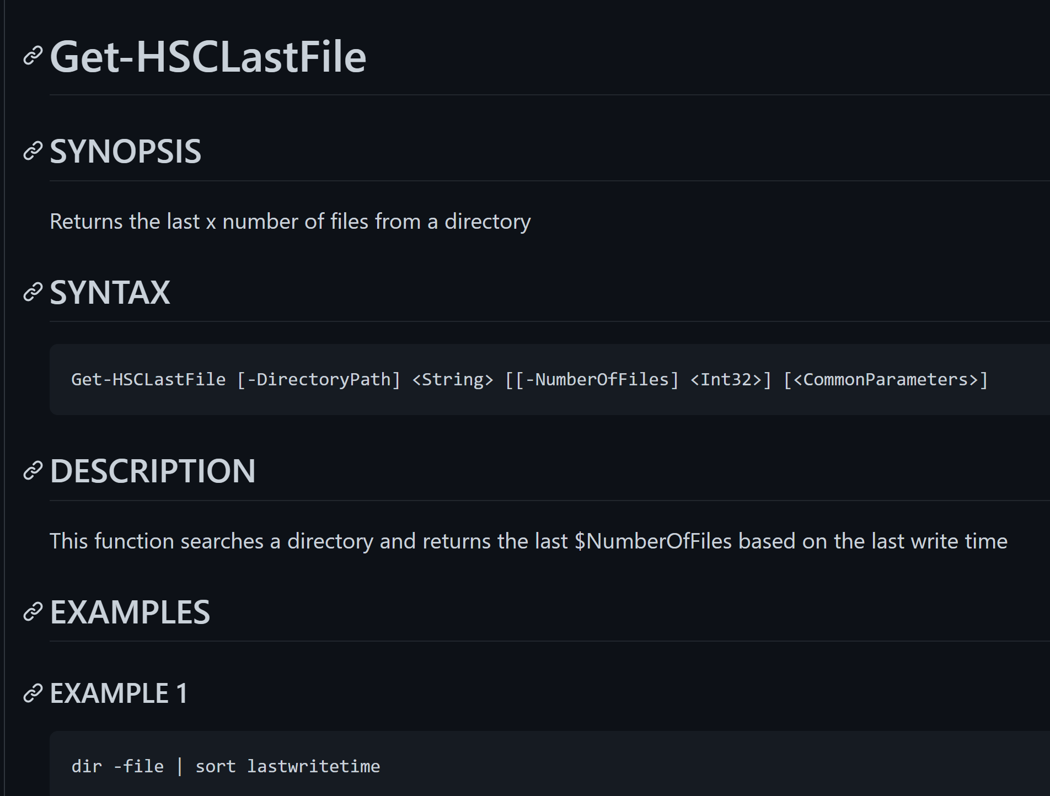

Slide 13
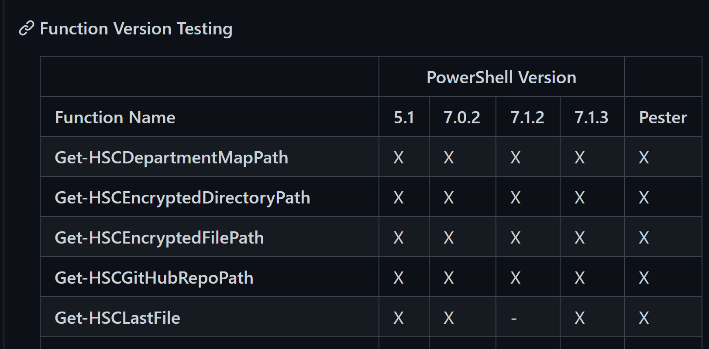

Slide 14
PowerShell Runspaces (PowerShell Multithreading)

Slide 15
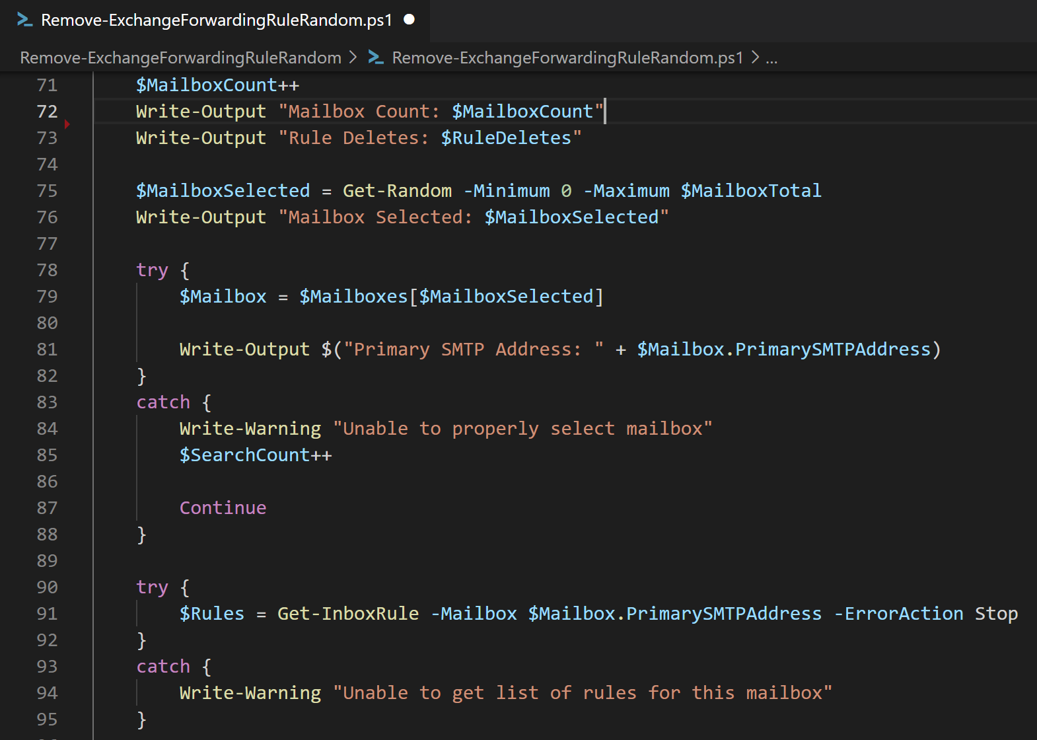

Slide 16
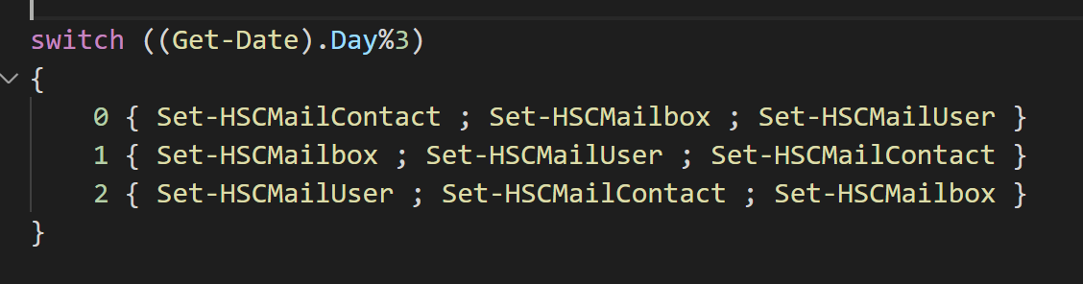

Slide 17
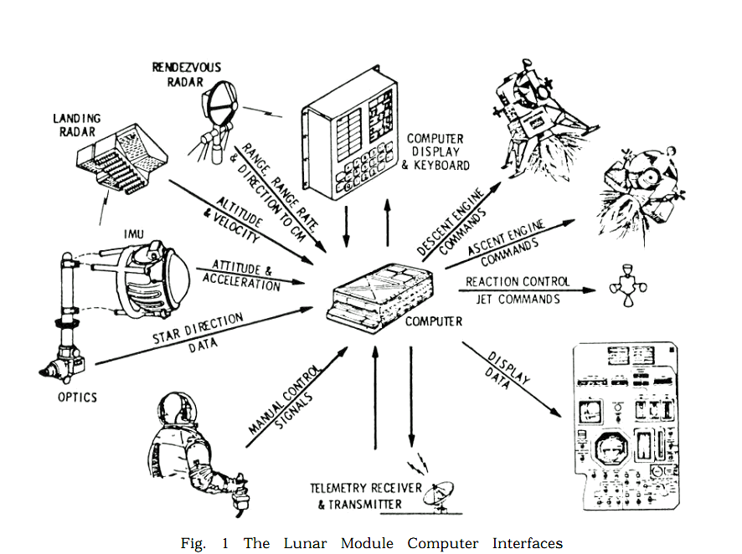

Slide 18
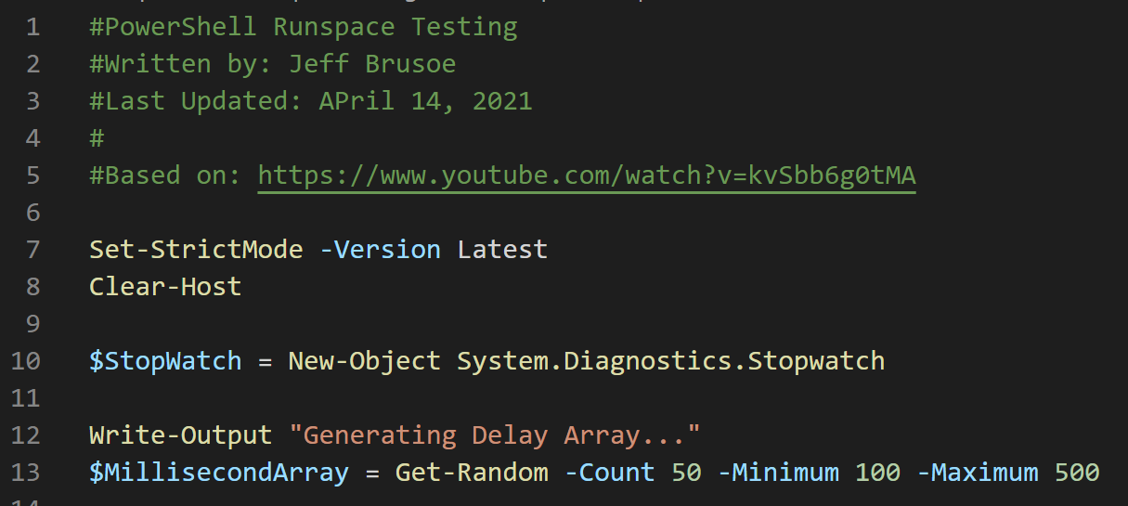

Slide 19
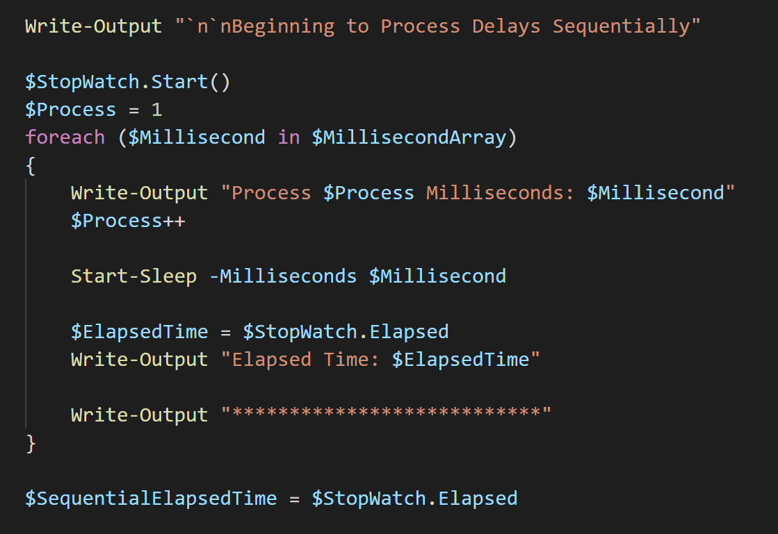

Slide 20
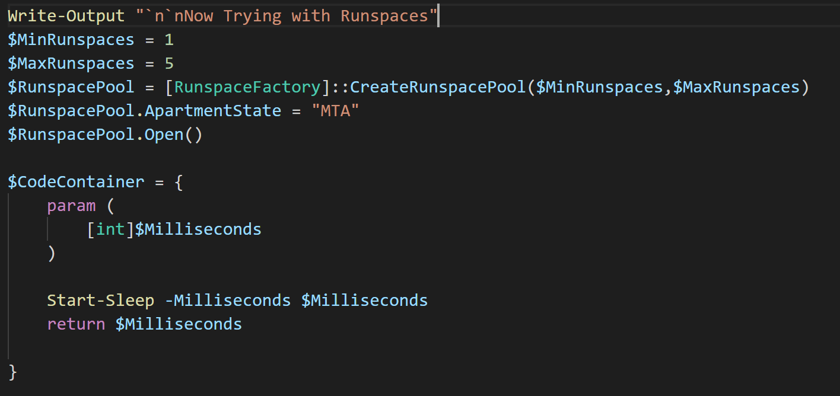

Slide 21
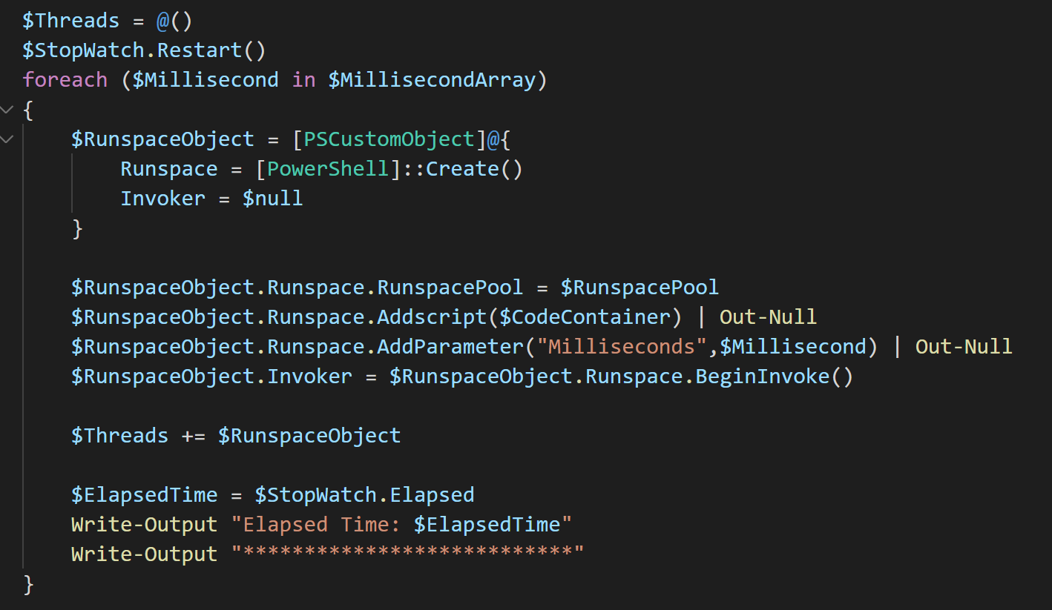

Slide 22
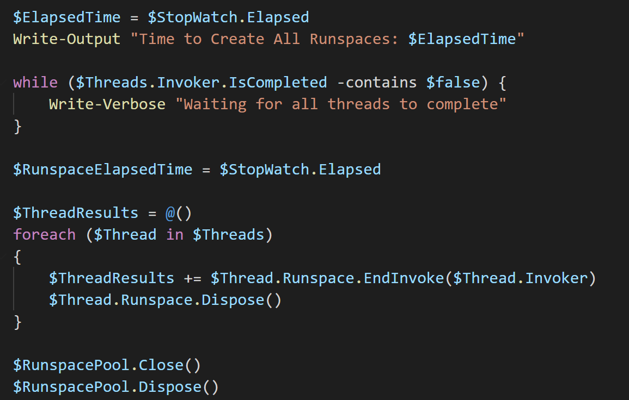

Slide 23
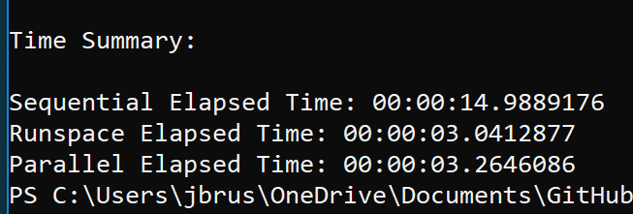
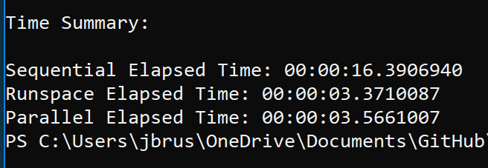
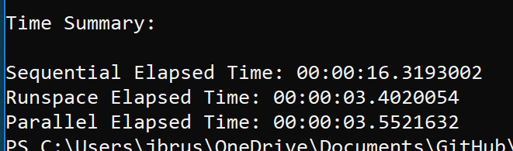

Slide 24
Update-CancerCenterDL.ps1

Slide 25
Main Problem: Keeping Input Data Sources Updated
HS AD Groups
WVUHS AD Groups
Manually updated .txt files
Manually updated .csv files
Non-standardized format for files
Directory.hsc.wvu.edu

Slide 26
Get-HSCADUserMailNickname

Slide 27
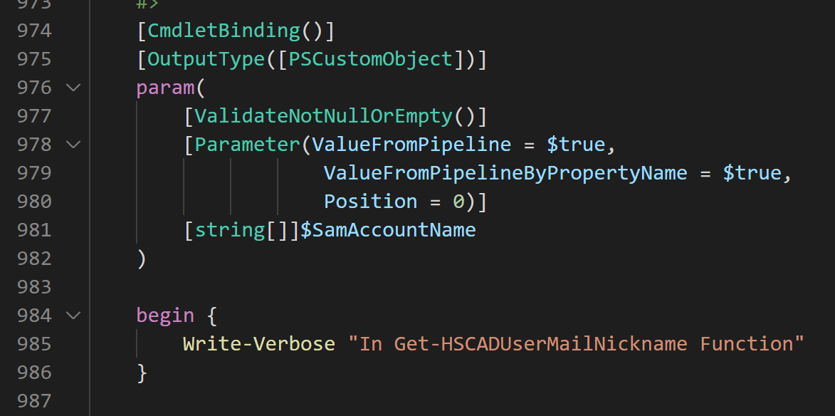

Slide 28
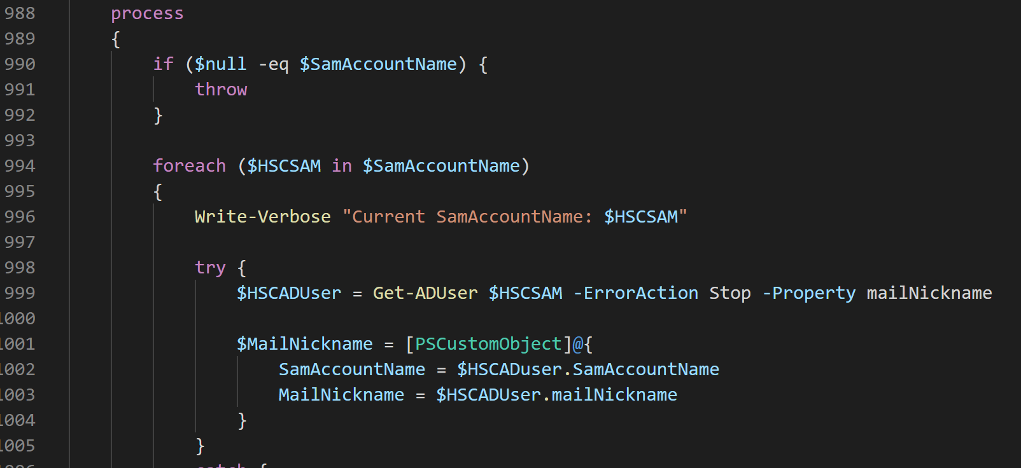

Slide 29
Set-HSCADUserMailNickname

