Slide 1
PowerShell Code Review April 28, 2021

Slide 2
Test-HSCDCConnection

Slide 3
Test-HSCDCConnection

Slide 4
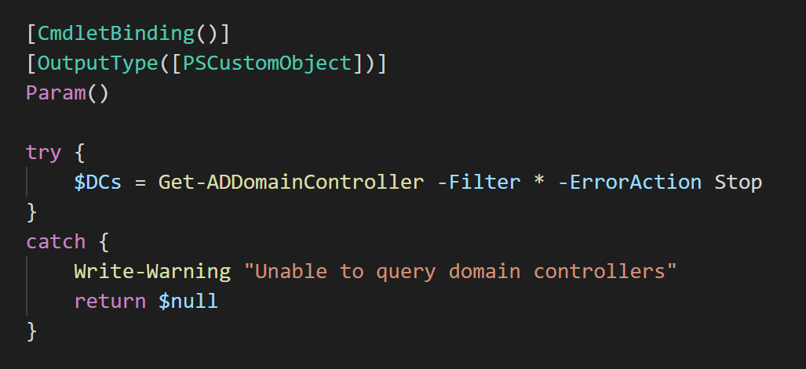

Slide 5
