Slide 1
PowerShell Code Review June 24, 2021

Slide 2
GitHub commit history
Set-HSCADUserExt7 (and similar type functions)
Create-NewAccount.ps1
Kevin’s file

Slide 3
GitHub Commit History

Slide 4
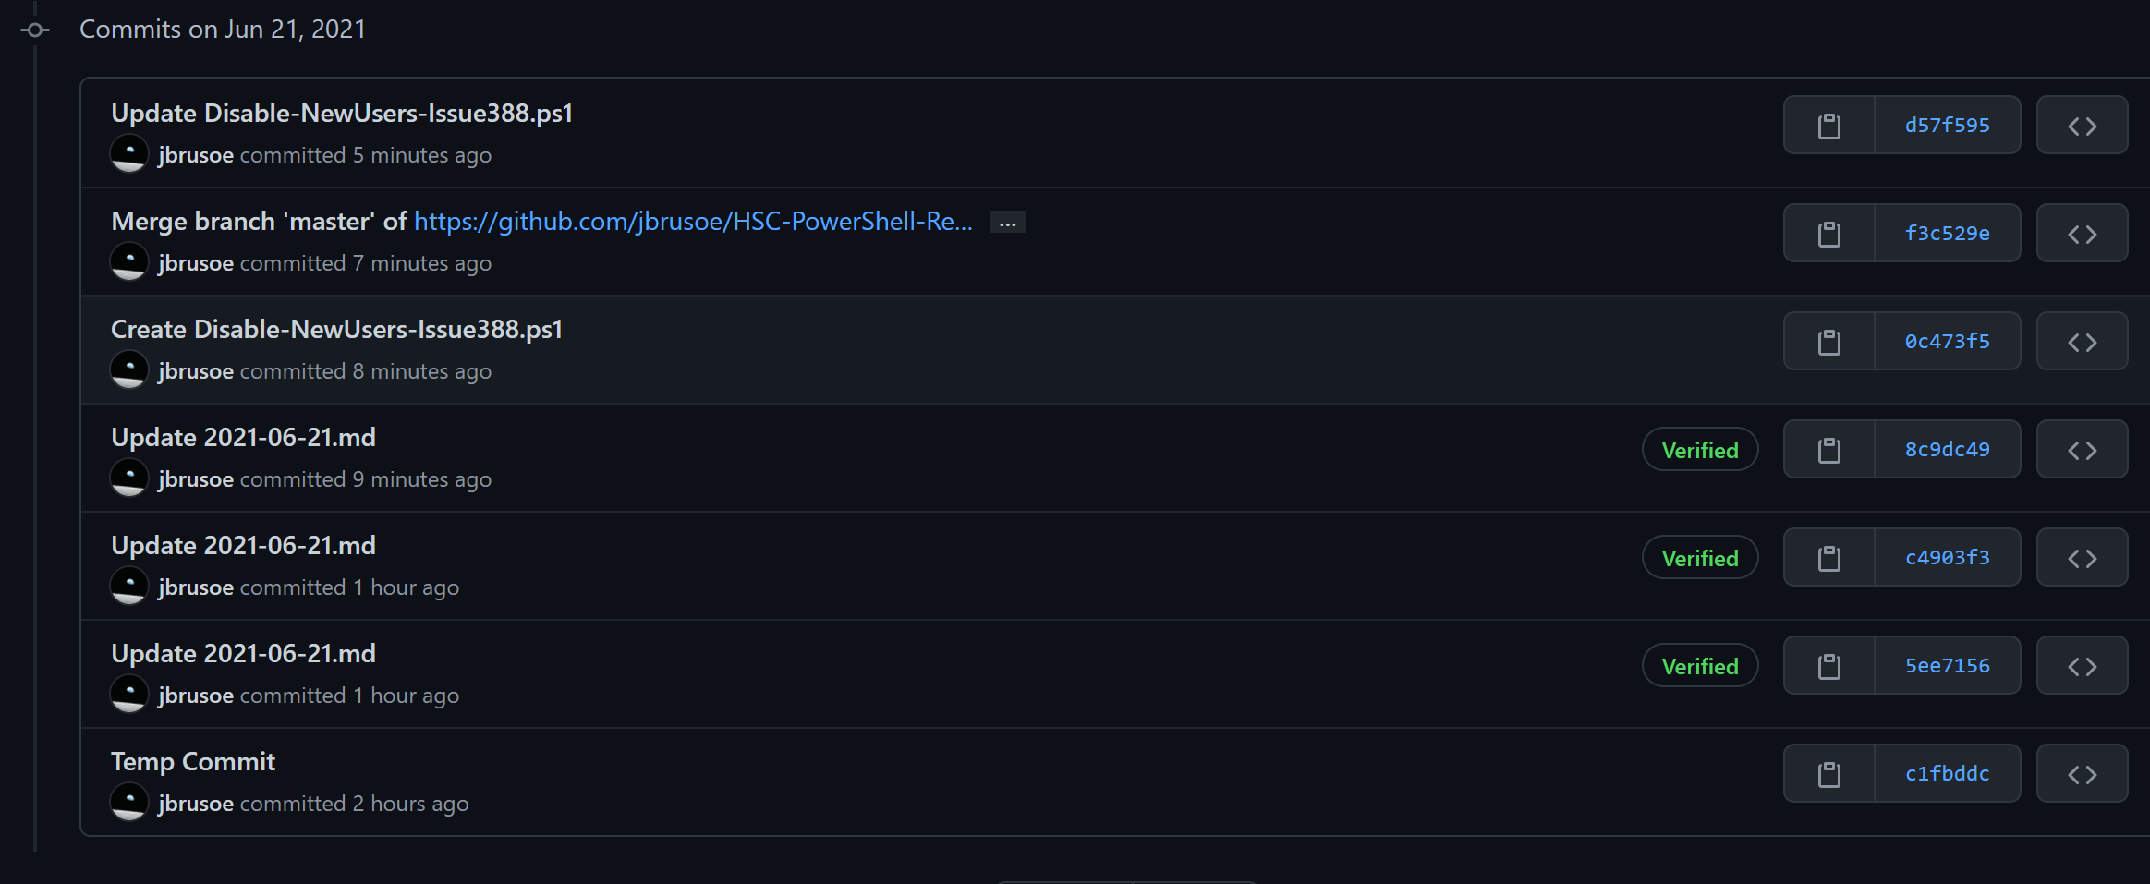

Slide 5
