Slide 1
PowerShell Code Review July 8, 2021

Slide 2
Get-NonADGroupUserLicense.ps1
Pester Testing

Slide 3
Get-NonADGroupUserLicense.ps1

Slide 4
PowerShell Pester Testing

Slide 5
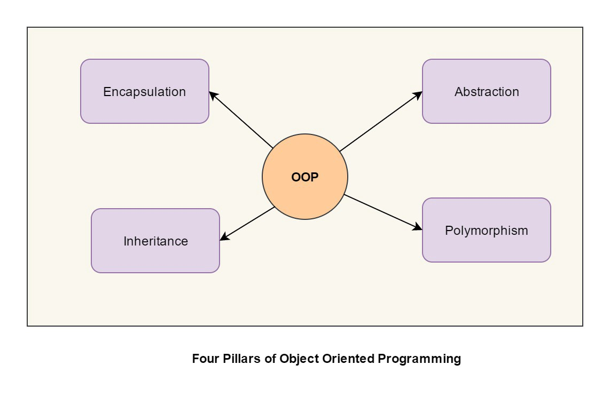

Slide 7
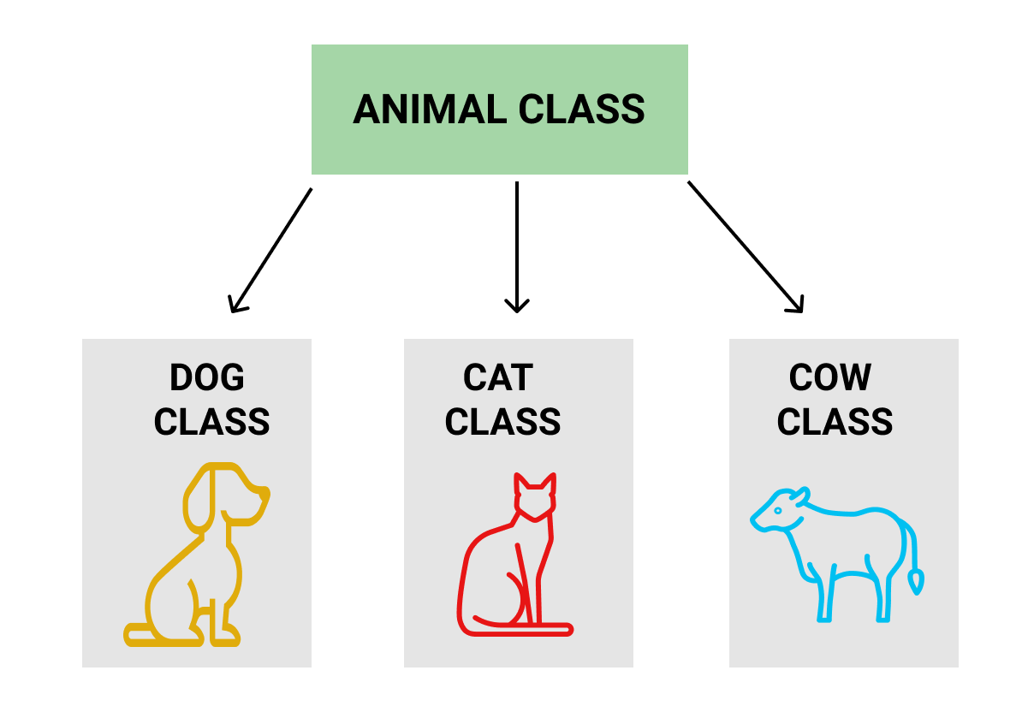

Slide 8
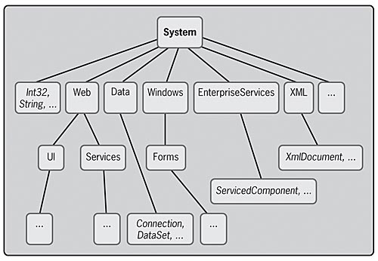

Slide 9
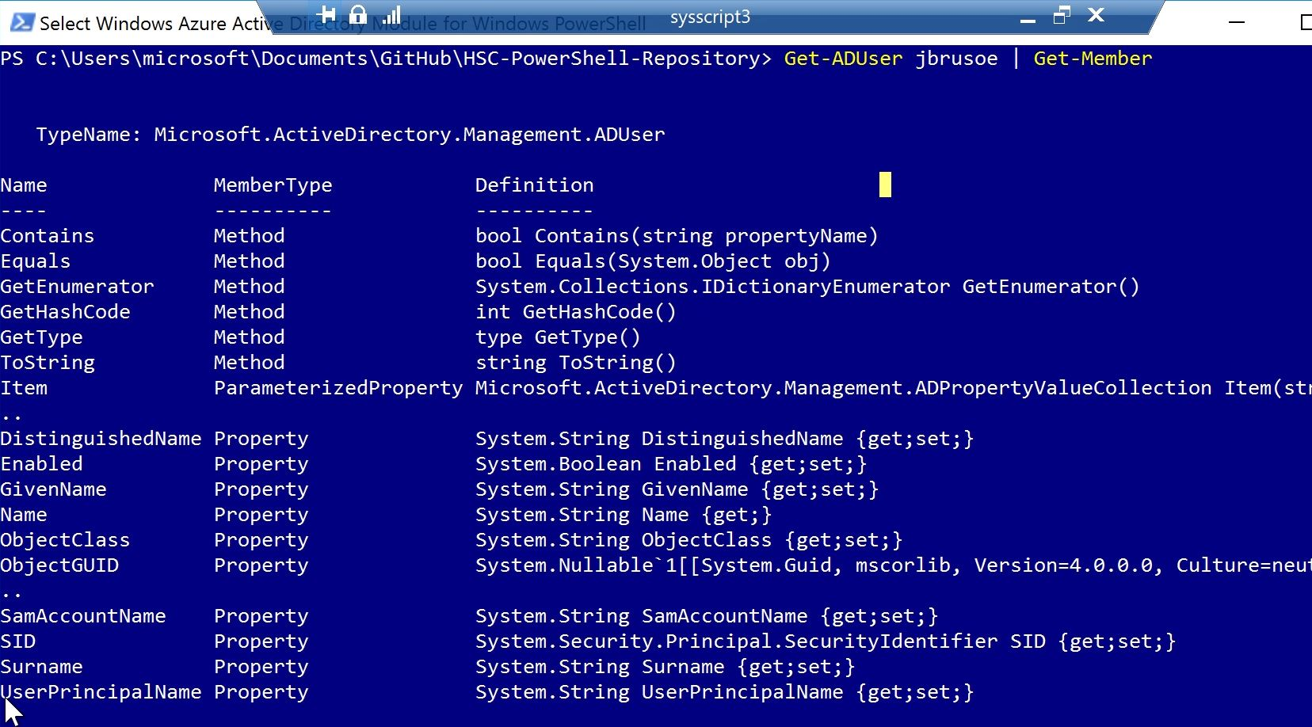

Slide 10
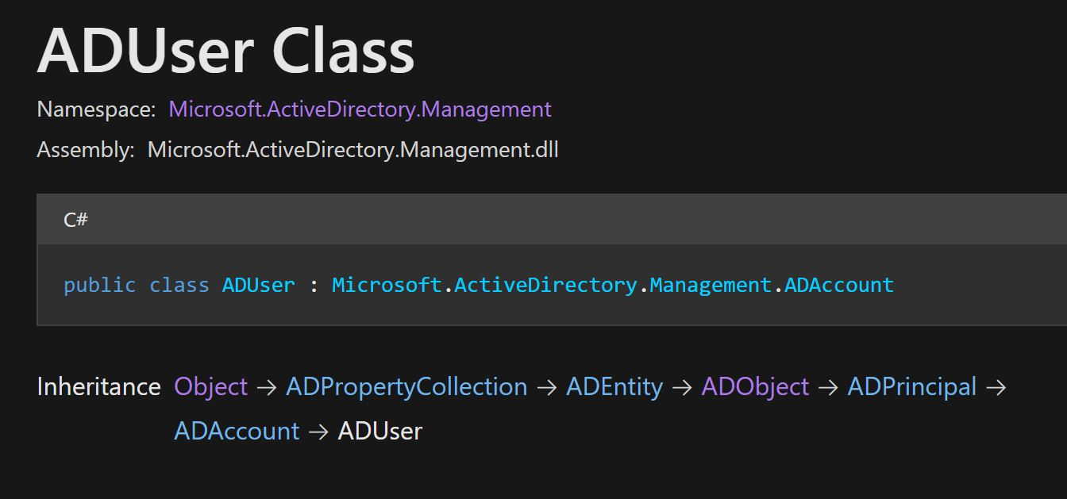

Slide 11


Slide 12
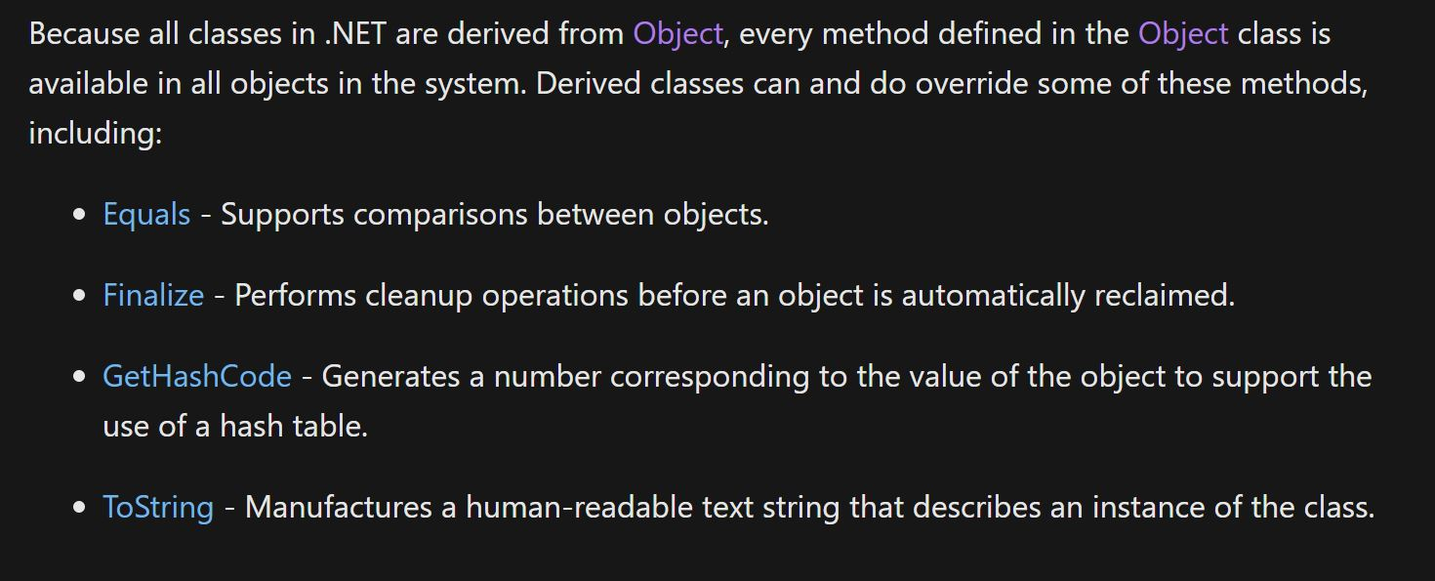

Slide 13
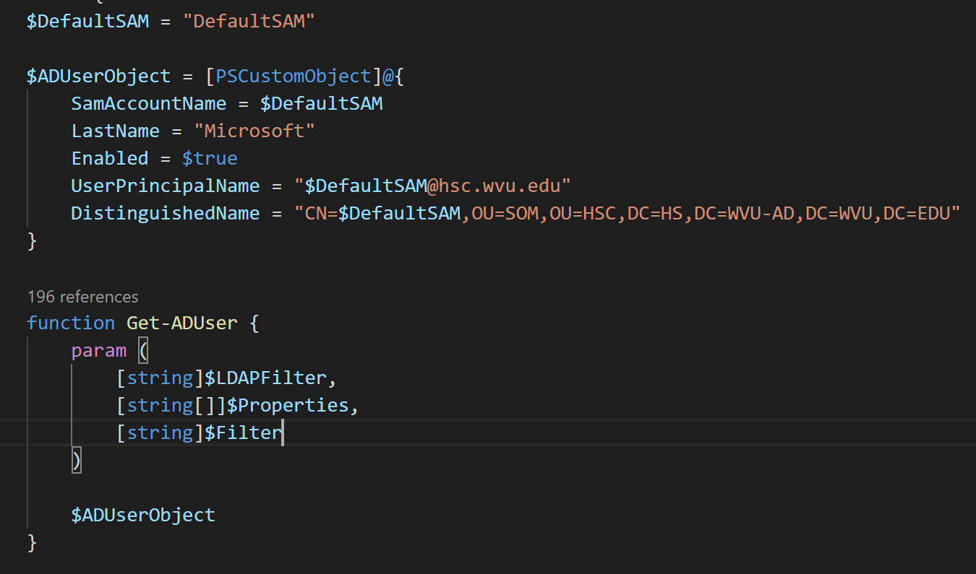

Slide 14
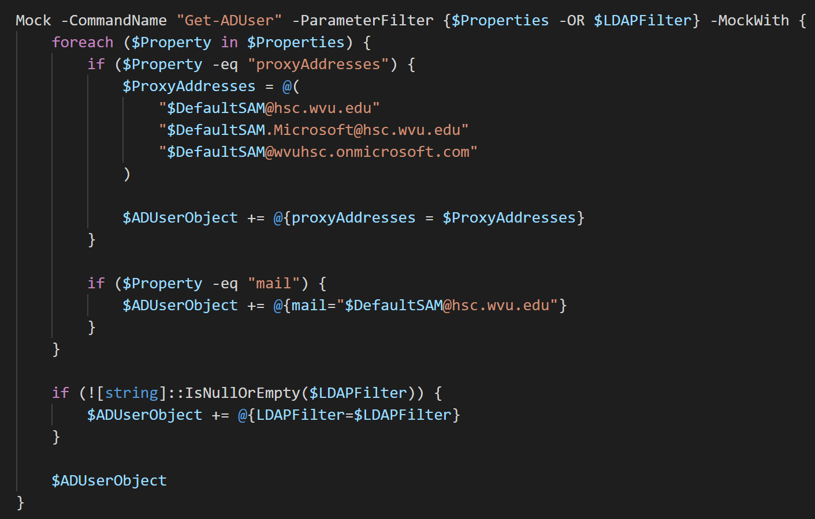

Slide 15
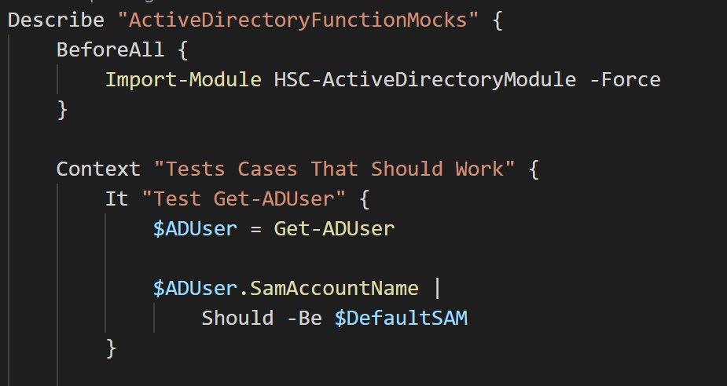

Slide 16
