Slide 1
PowerShell Code Review July 22, 2021

Slide 2
Backup-ADExtensionAttribute.ps1

Slide 3
Backup-ADExtensionAttribute.ps1

Slide 4
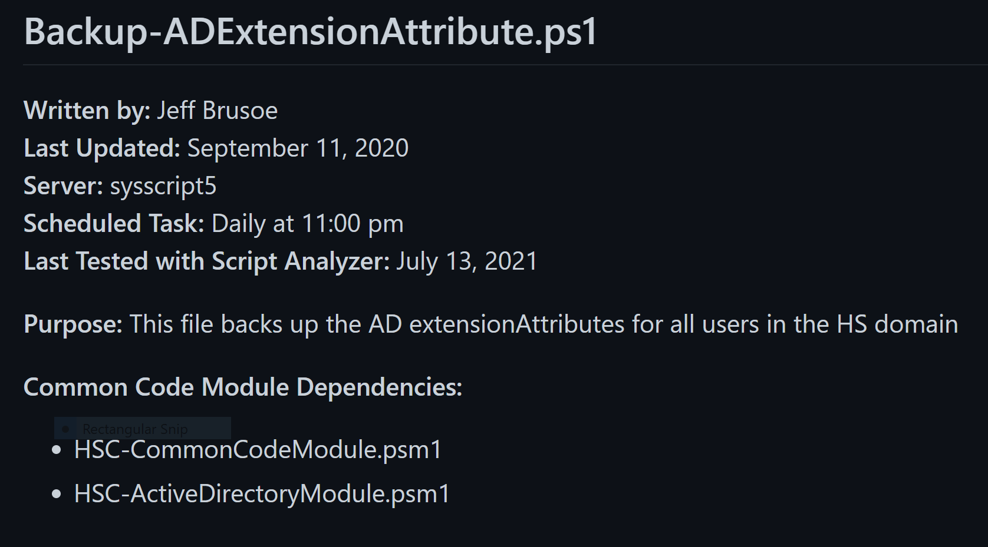

Slide 5
