Slide 1
PowerShell Code Review August 19, 2021

Slide 2
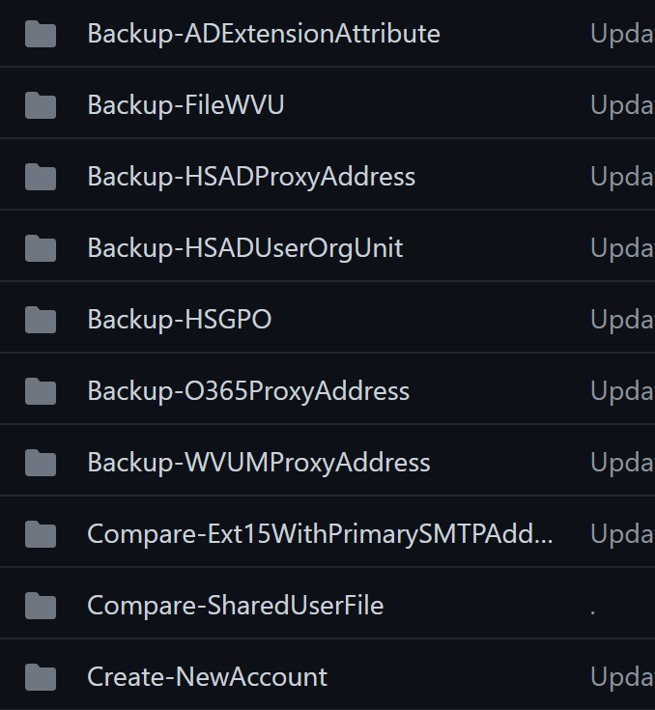

Slide 3
Compare-Ext15WithPrimarySMTPAddress.ps1

Slide 4
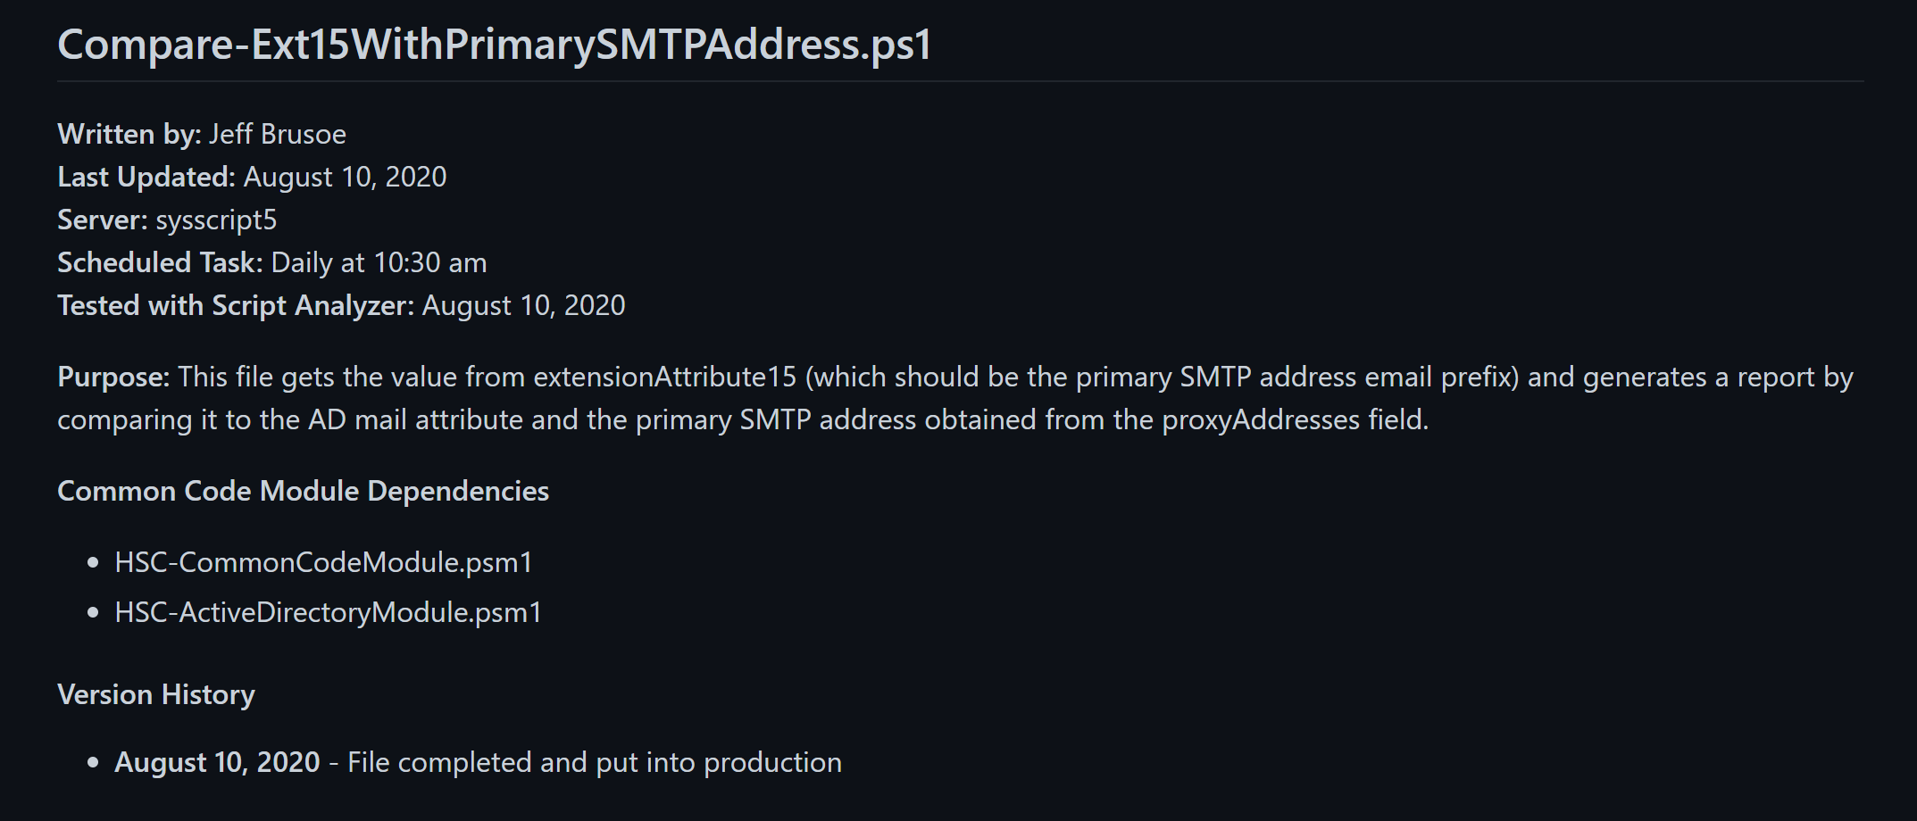

Slide 5


Slide 6


Slide 7
Compare-SharedUserFile.ps1

Slide 8
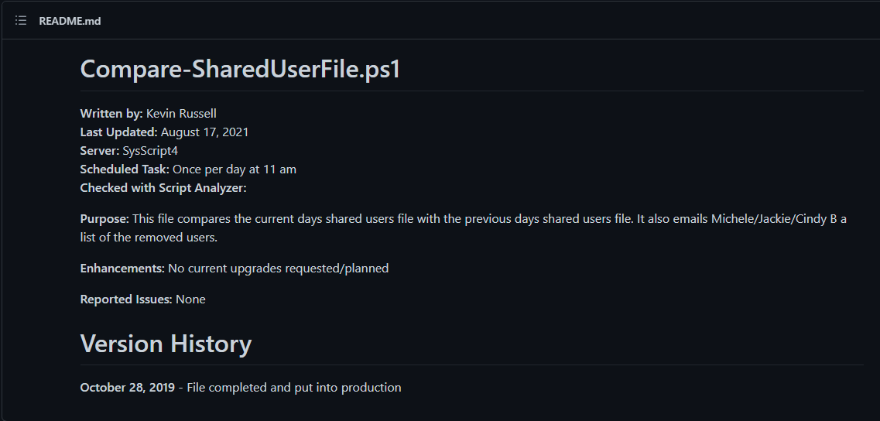

Slide 9


Slide 10
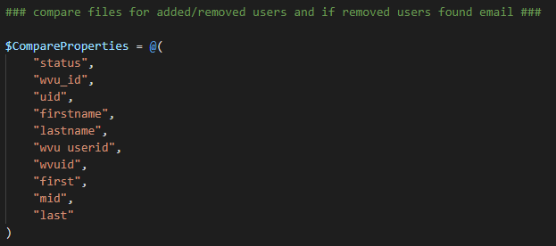

Slide 11
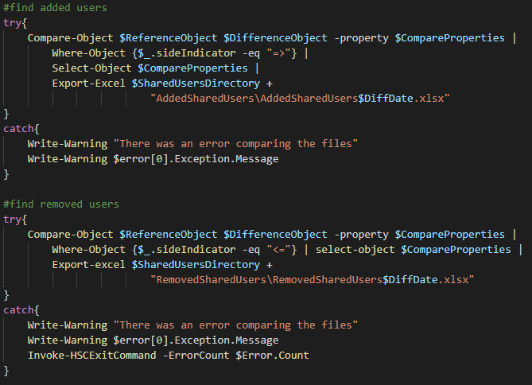

Slide 12
Create-NewAccount.ps1

Slide 13
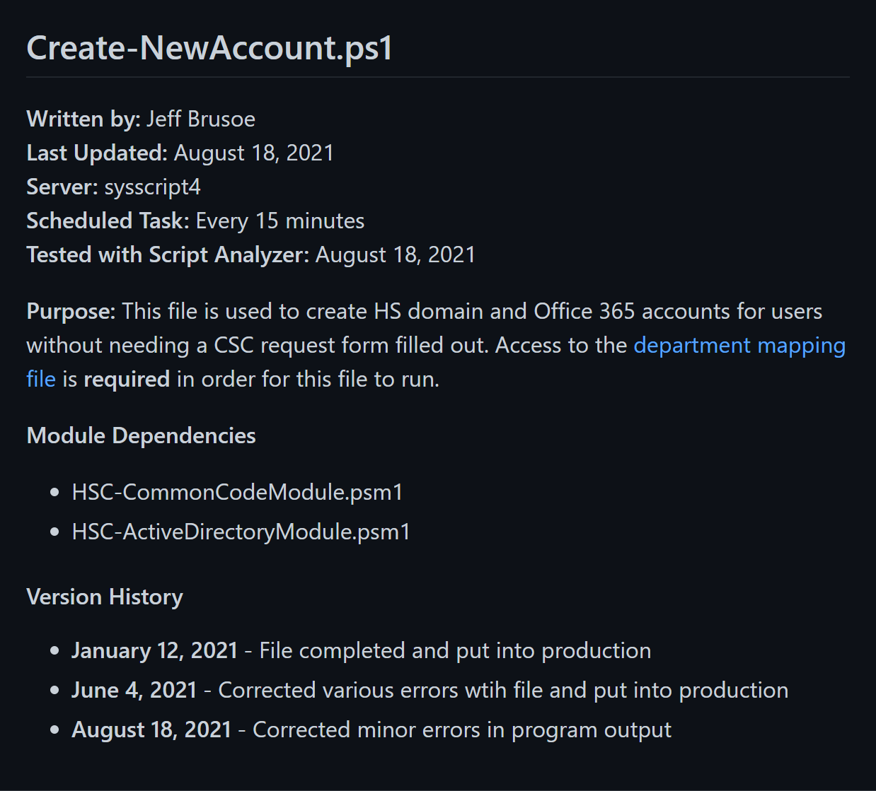

Slide 14


Slide 15
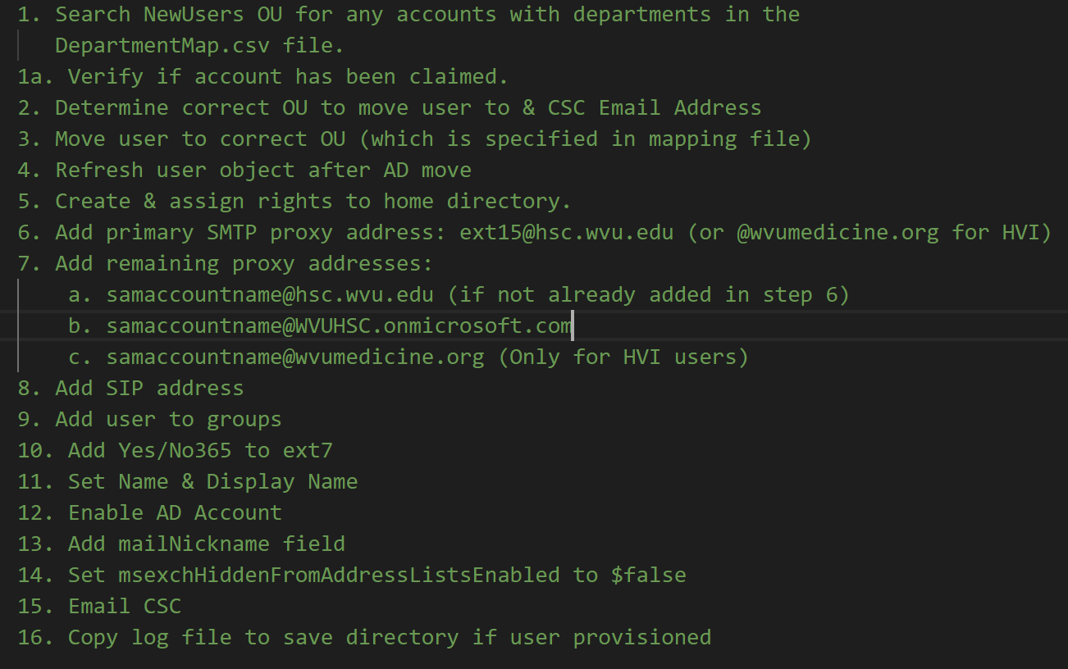

Slide 16
