Slide 1
PowerShell Code Review August 19, 2021

Slide 2
Disable-AccountSecurityCompliance.ps1

Slide 3
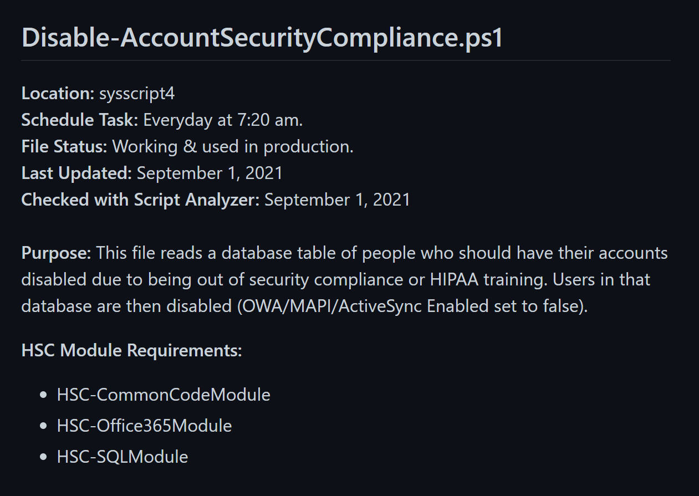

Slide 4
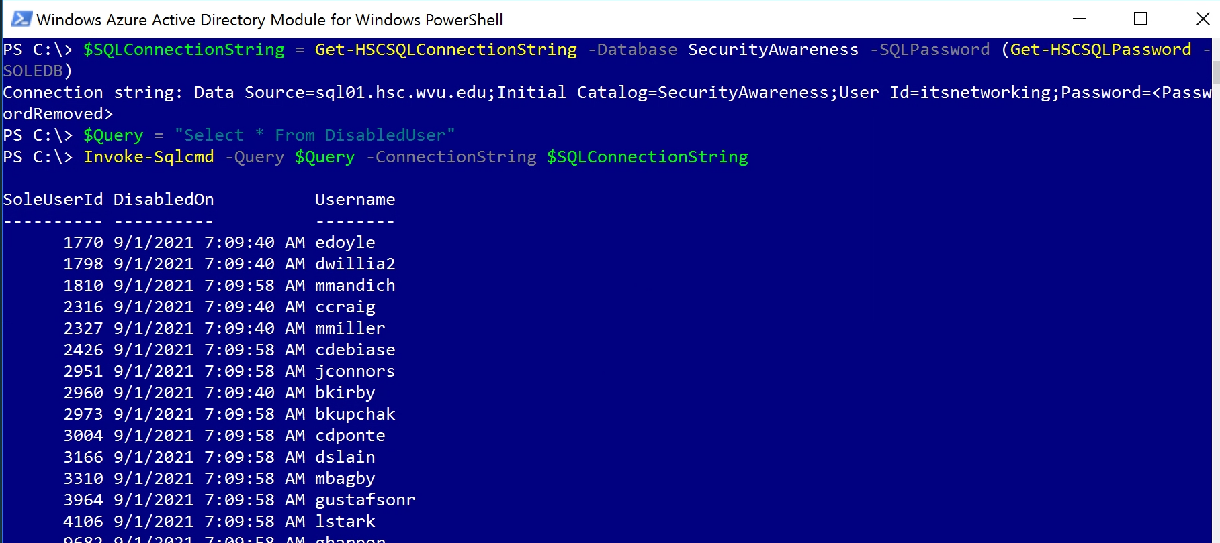

Slide 5
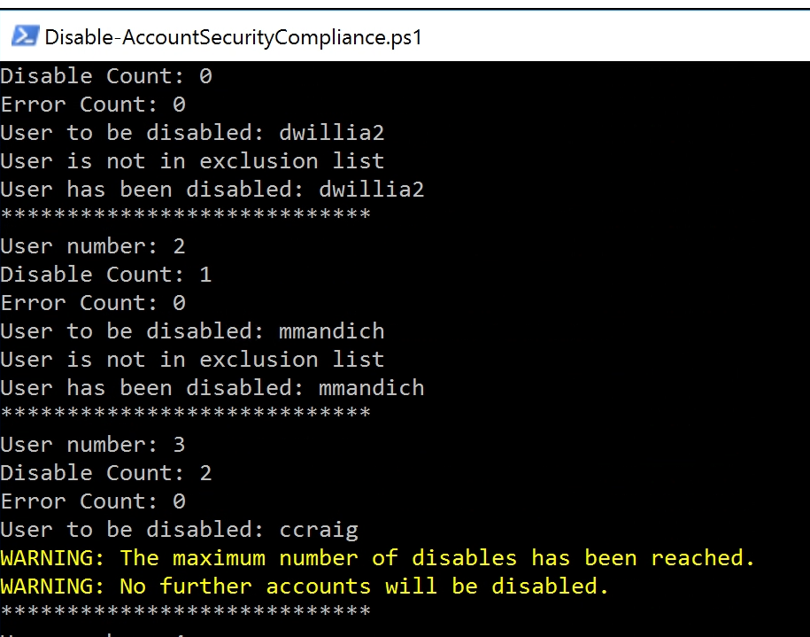

Slide 6
Disable-NewUsers.ps1

Slide 7
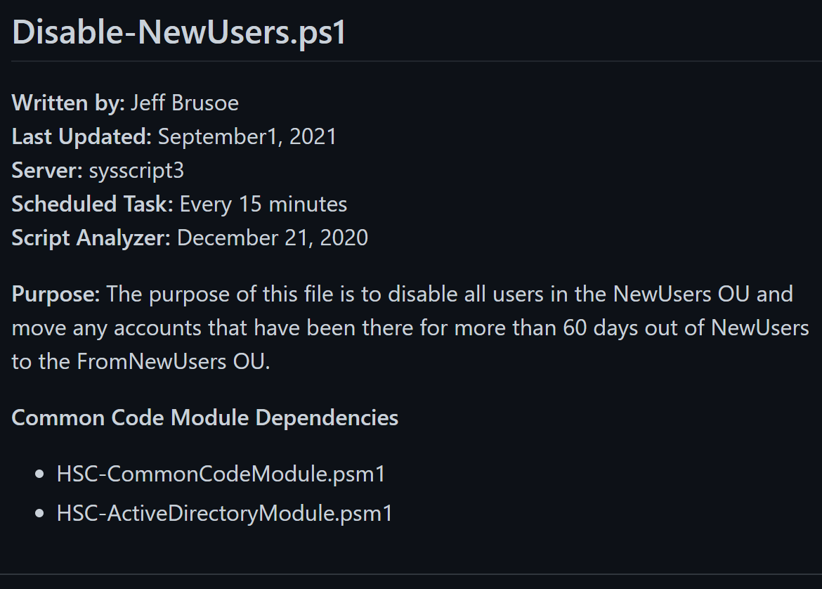

Slide 8
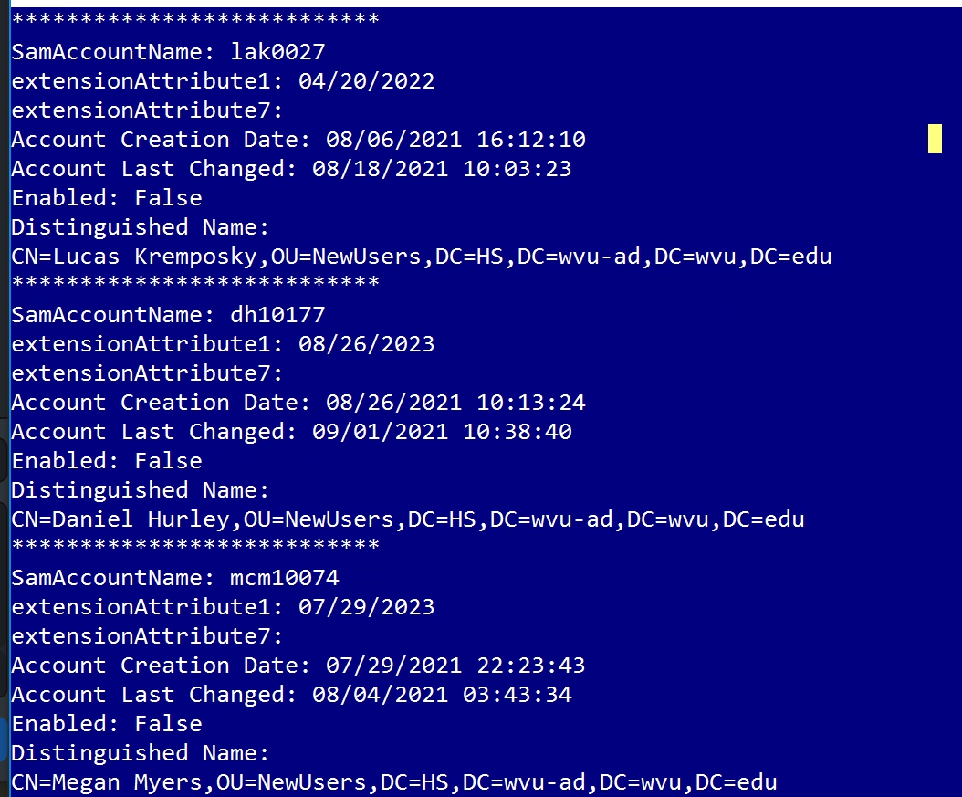

Slide 9
Disable-POPIMAP.ps1

Slide 10
