Slide 1
PowerShell Code Review October 14, 2021

Slide 2
Get-ADObjectCount.ps1
Backup-ADGroupMembershipByGroupName.ps1
Backup-ADGroupMembershipByUsername.ps1
Get-ADGroupmembershipNoRecursion.ps1

Slide 3
Get-ADObjectCount.ps1

Slide 4
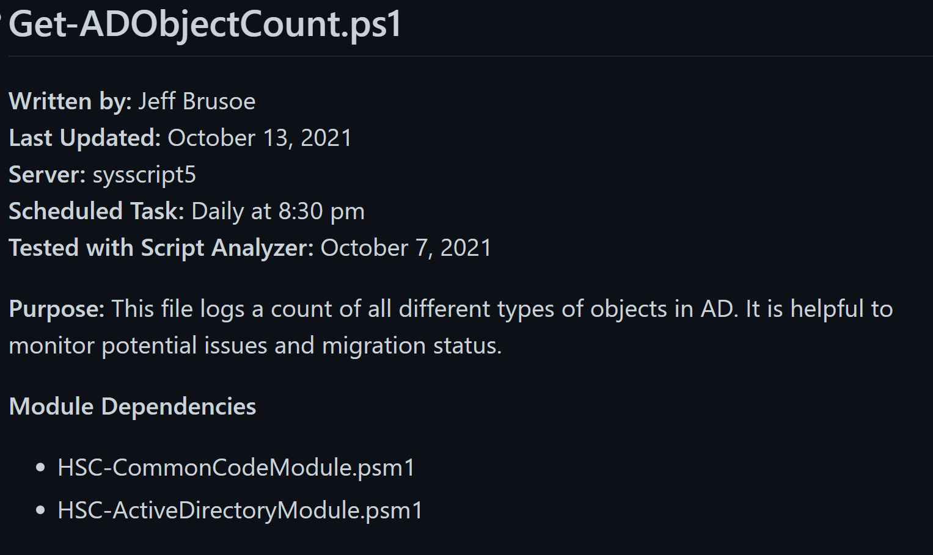

Slide 5
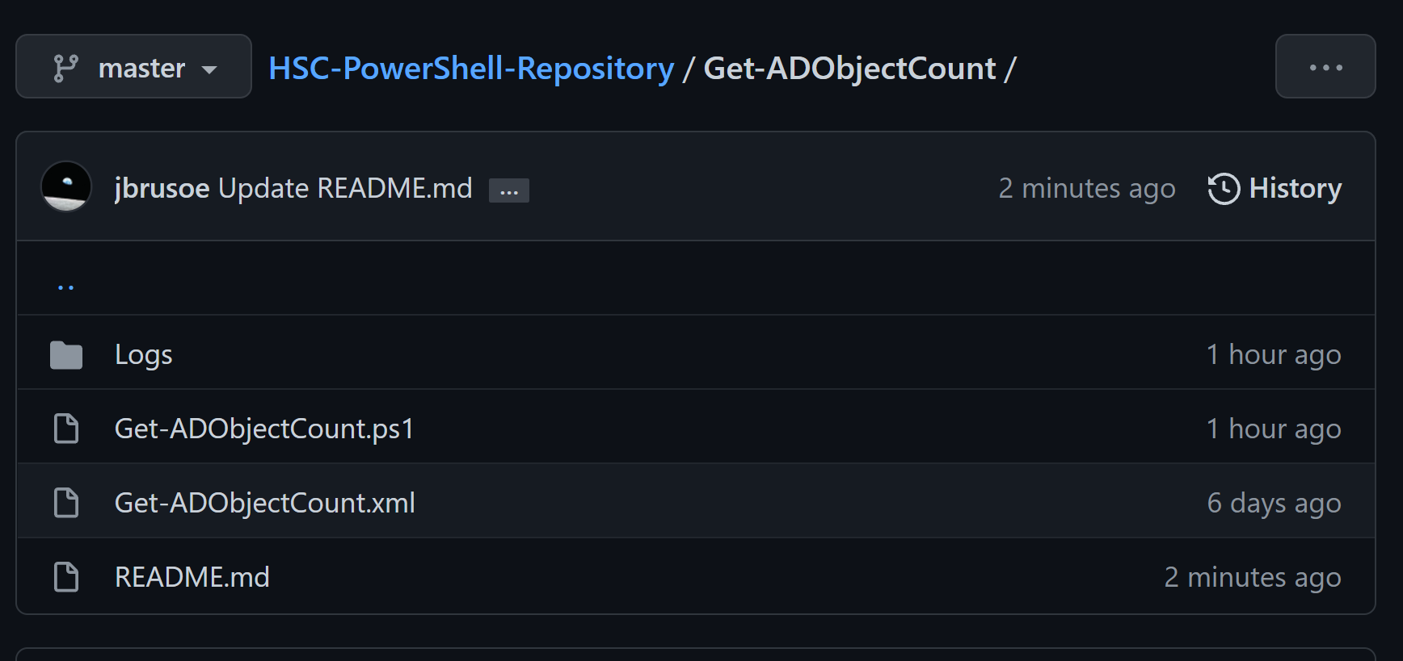

Slide 6
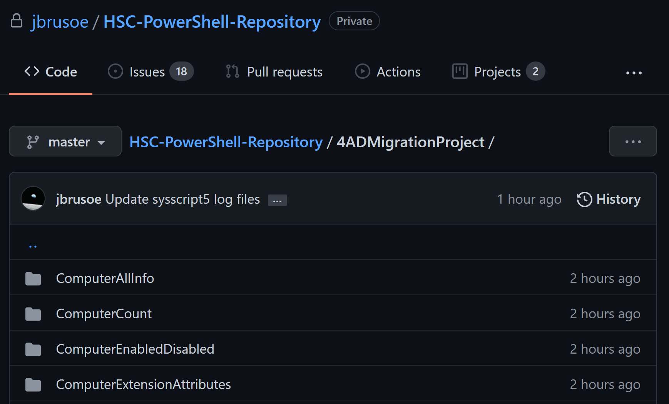

Slide 7
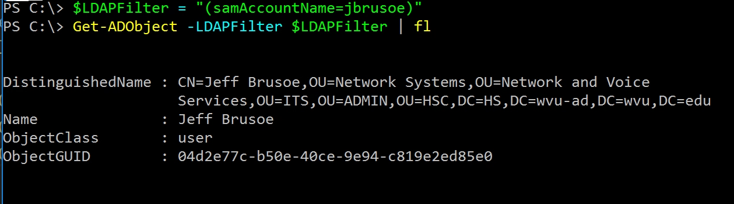

Slide 8
builtinDomain categoryRegistration classStore computer contact container dfsConfiguration dnsNode dnsZone domainDNS domainPolicy fileLinkTracking foreignSecurityPrincipal fTDfs | group groupPolicyContainer infrastructureUpdate intellimirrorSCP ipsecFilter ipsecISAKMPPolicy ipsecNegotiationPolicy ipsecNFA ipsecPolicy linkTrackObjectMoveTable linkTrackVolumeTable lostAndFound msDFS-Linkv2 msDFS-NamespaceAnchor

Slide 9
msDFS-Namespacev2 msDFSR-Connection msDFSR-Content msDFSR-ContentSet msDFSR-GlobalSettings msDFSR-LocalSettings msDFSR-Member msDFSR-ReplicationGroup msDFSR-Subscriber msDFSR-Subscription msDFSR-Topology msDS-PasswordSettings msDS-PasswordSettingsContainer msDS-QuotaContainer | msExchSystemMailbox msExchSystemObjectsContainer msFVE-RecoveryInformation msImaging-PSPs mSMQConfiguration ms-net-ieee-80211-GroupPolicy ms-net-ieee-8023-GroupPolicy msPrint-ConnectionPolicy mSSMSManagementPoint mSSMSRoamingBoundaryRange mSSMSSite msTPM-InformationObject msTPM-InformationObjectsContainer msWMI-Som

Slide 10
nTFRSReplicaSet nTFRSSettings organizationalUnit packageRegistration printQueue rIDManager rIDSet rpcContainer | rRASAdministrationConnectionPoint samServer secret serviceAdministrationPoint serviceConnectionPoint trustedDomain user volume

Slide 11
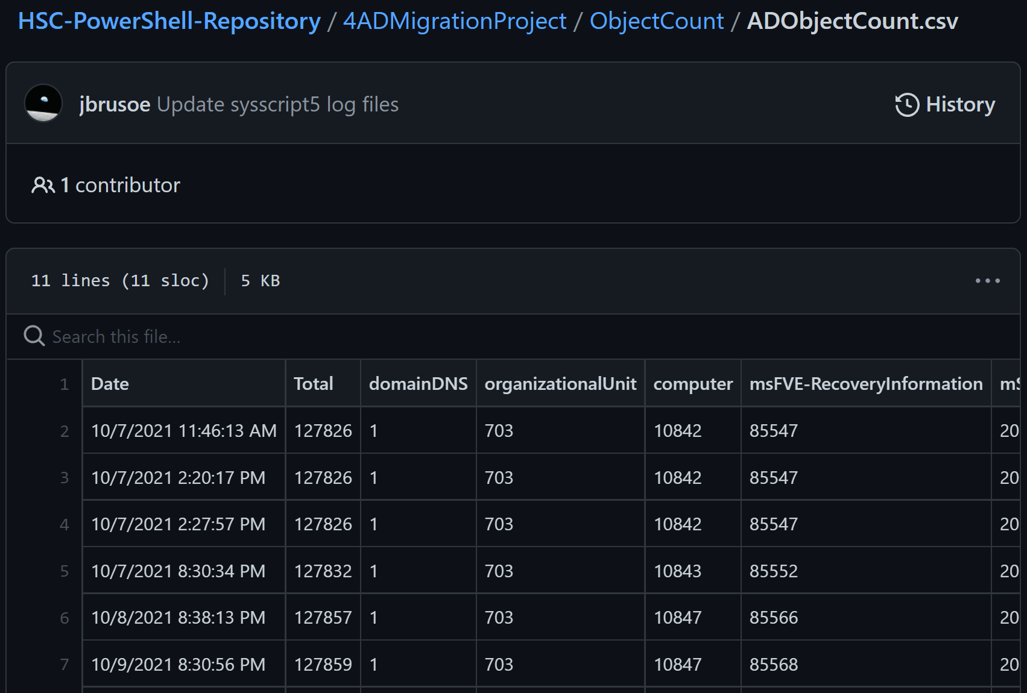

Slide 12
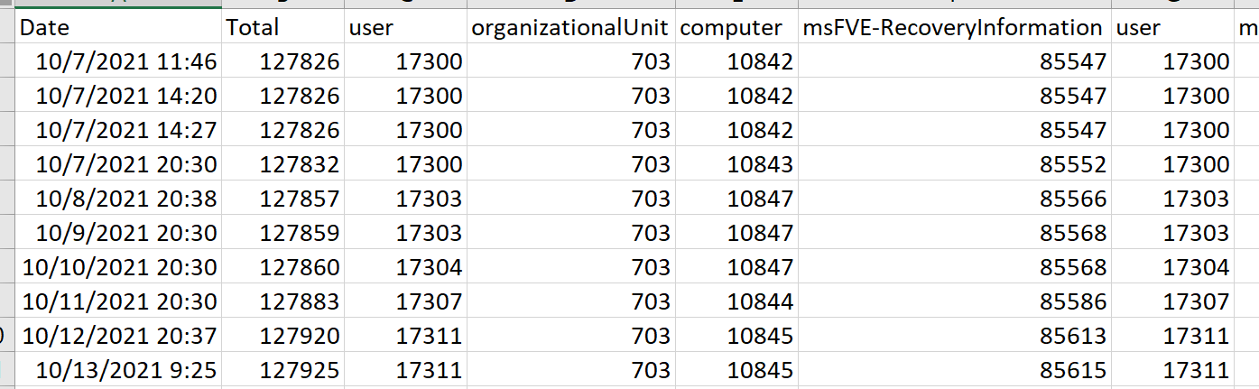

Slide 13
Backup-ADGroupMembershipByGroupName.ps1

Slide 14
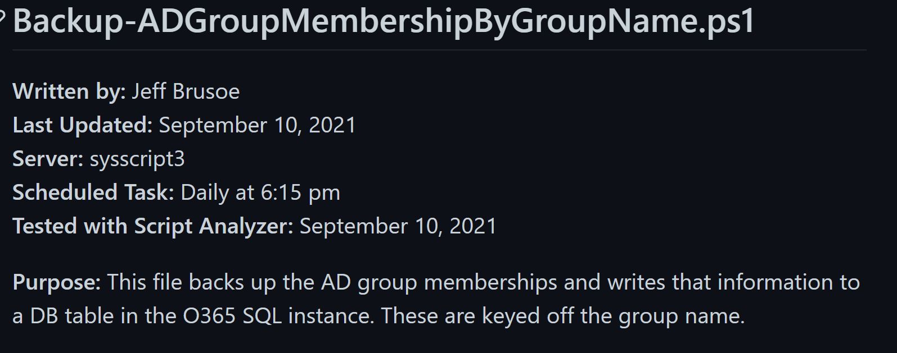

Slide 15
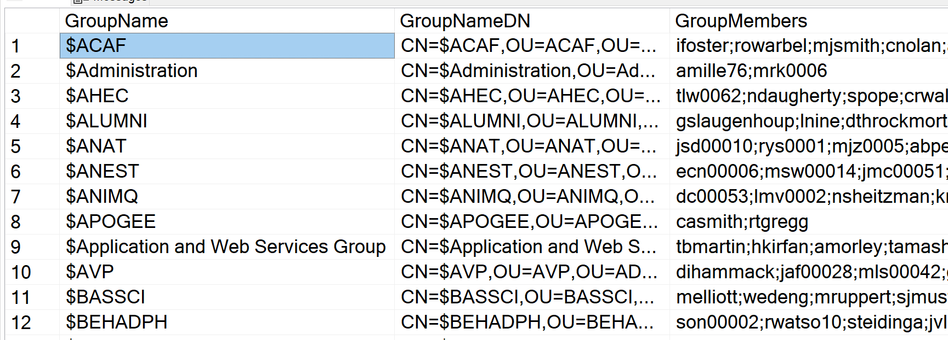

Slide 16
Backup-ADGroupMembershipByUser.ps1

Slide 17
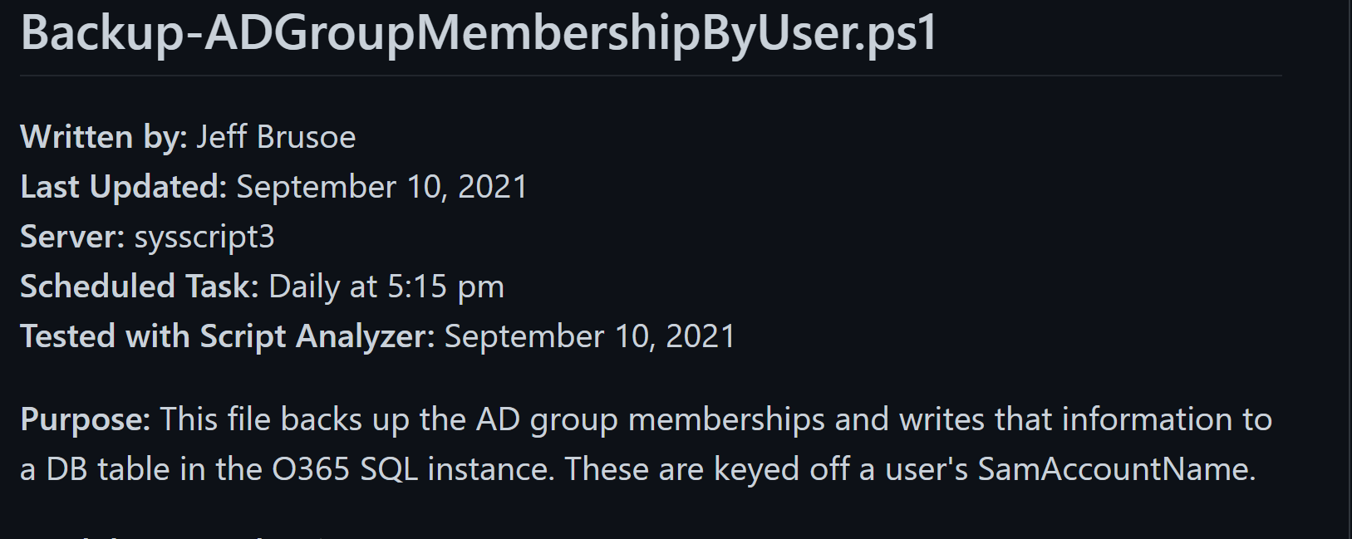

Slide 18
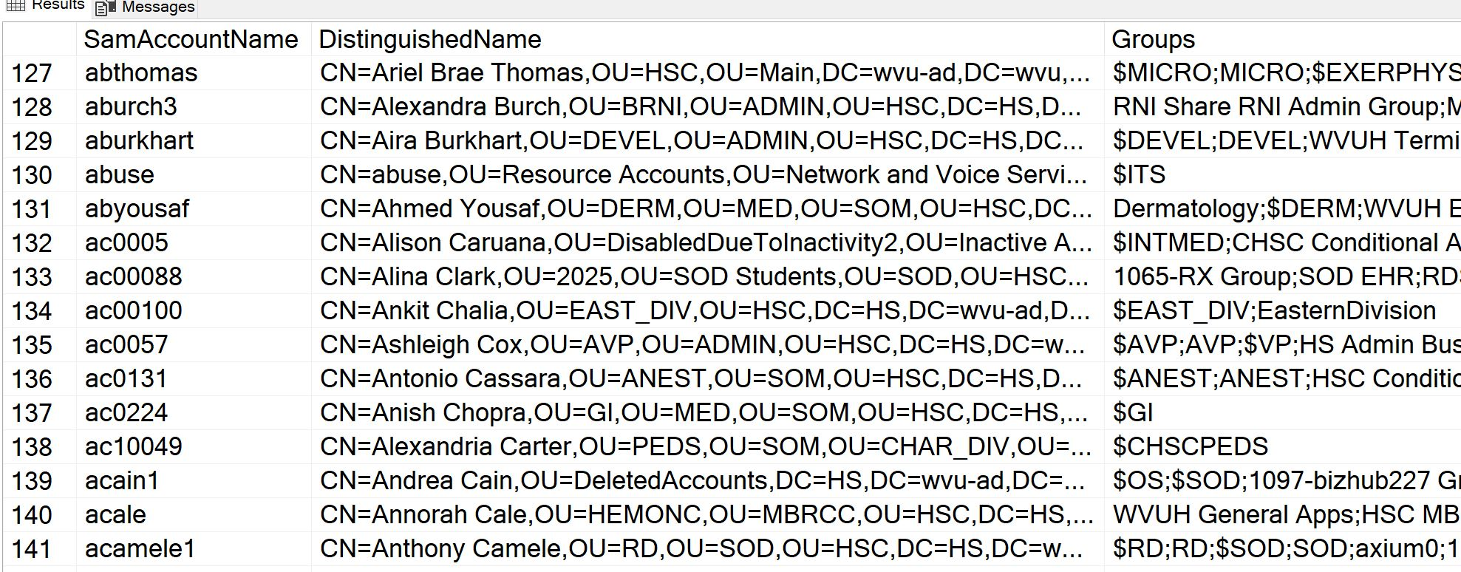

Slide 19
Get-ADGroupMembershipNoRecursion.ps1

Slide 20
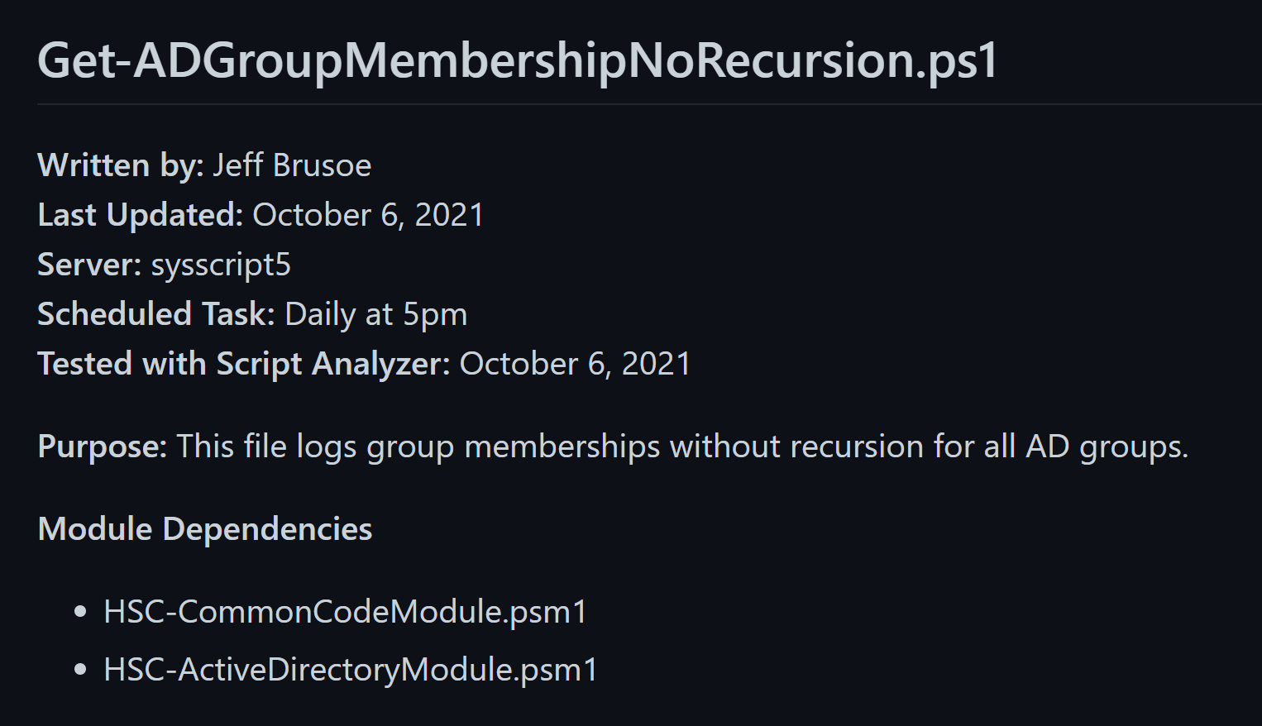

Slide 21
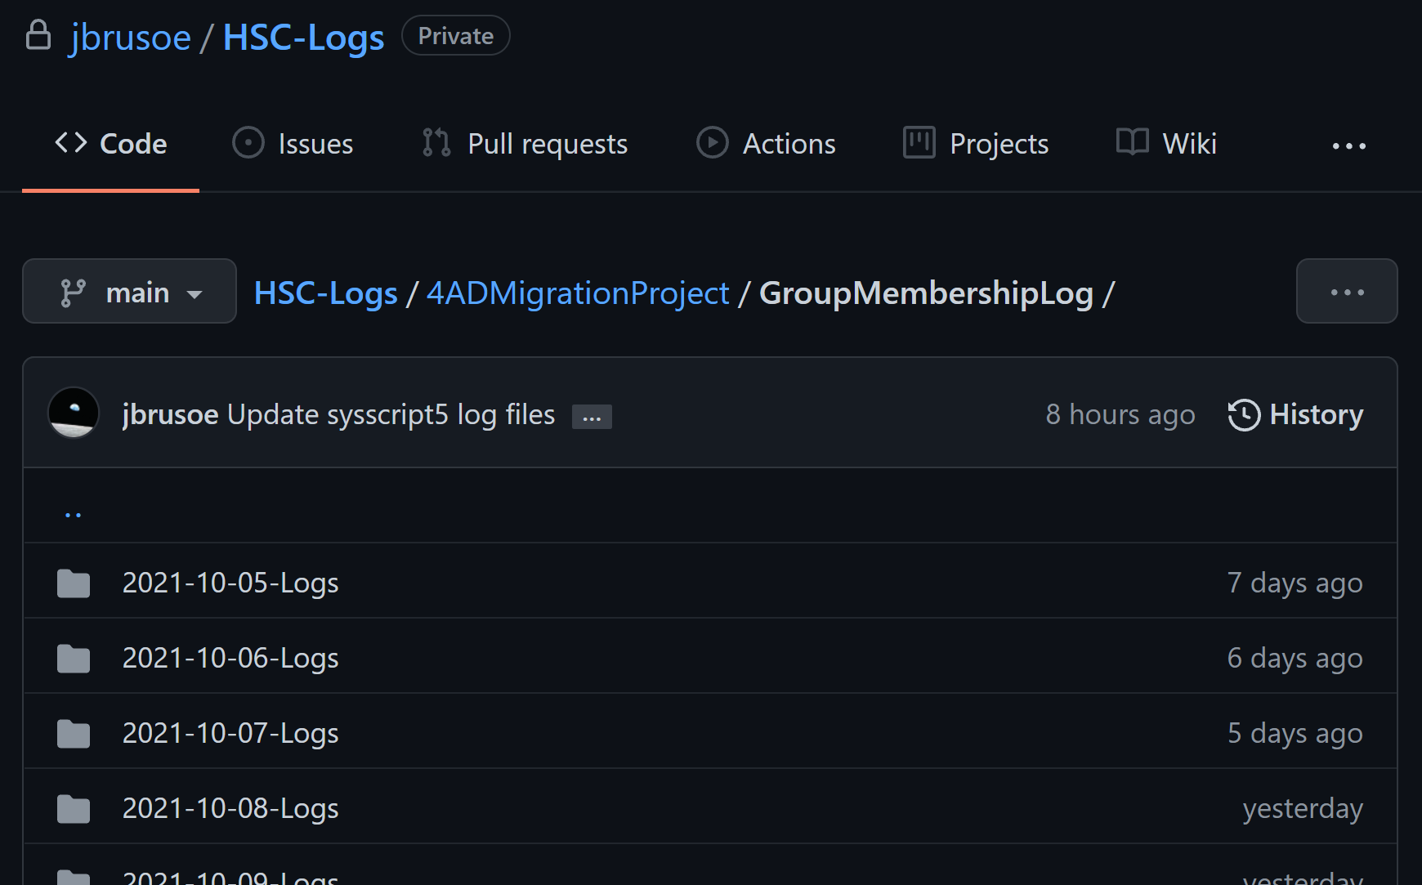

Slide 22
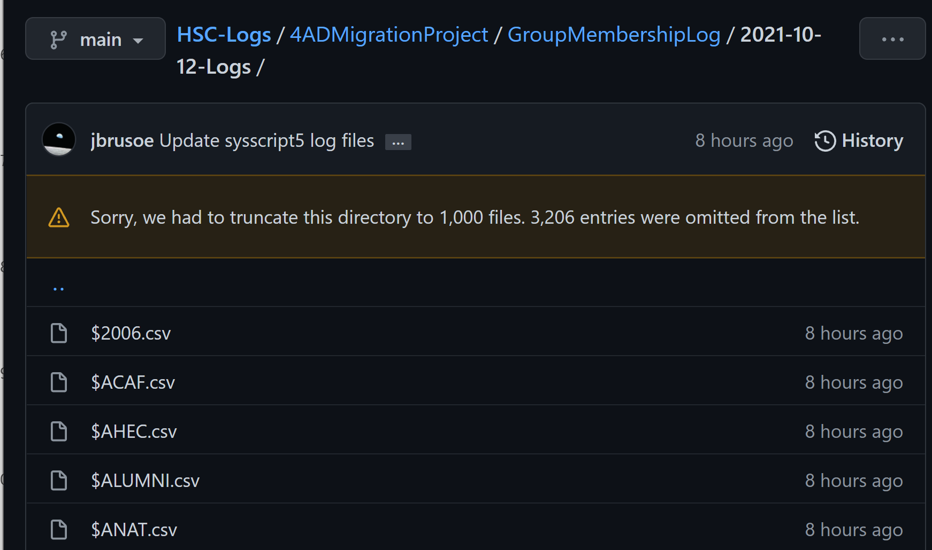

Slide 23
