Slide 1
Move-HSCStaleComputerObject.ps1

Slide 2
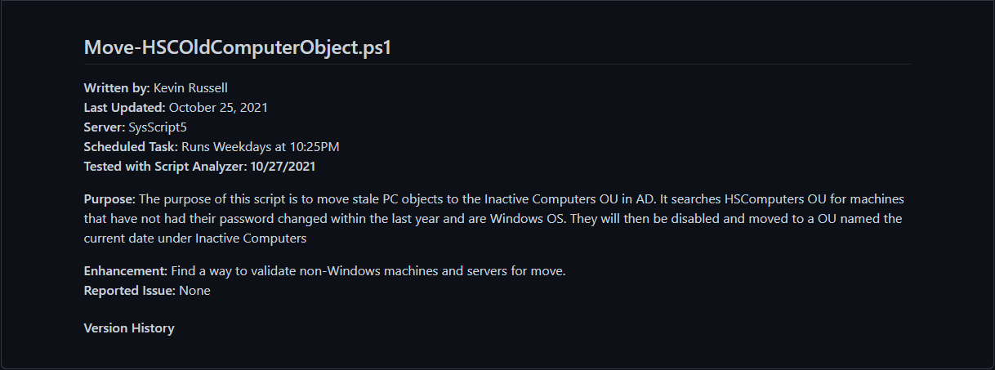

Slide 3
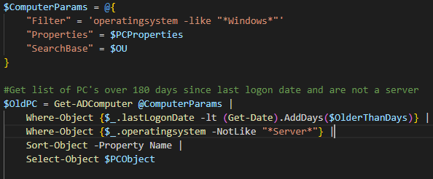

Slide 4
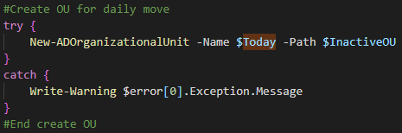
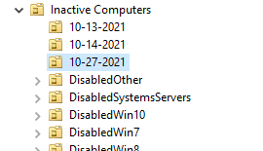

Slide 5
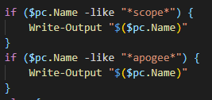

Slide 6
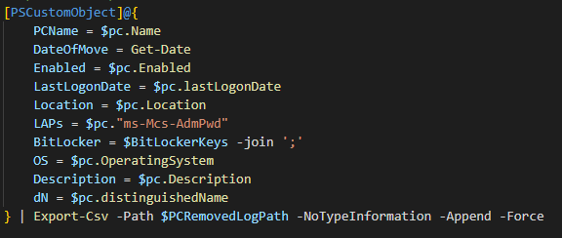
Name
Enabled Status
lastLogonDate
Location
LAPs
Bitlocker Keys
OS
Description
dN

Slide 7
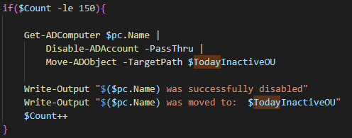

Slide 8
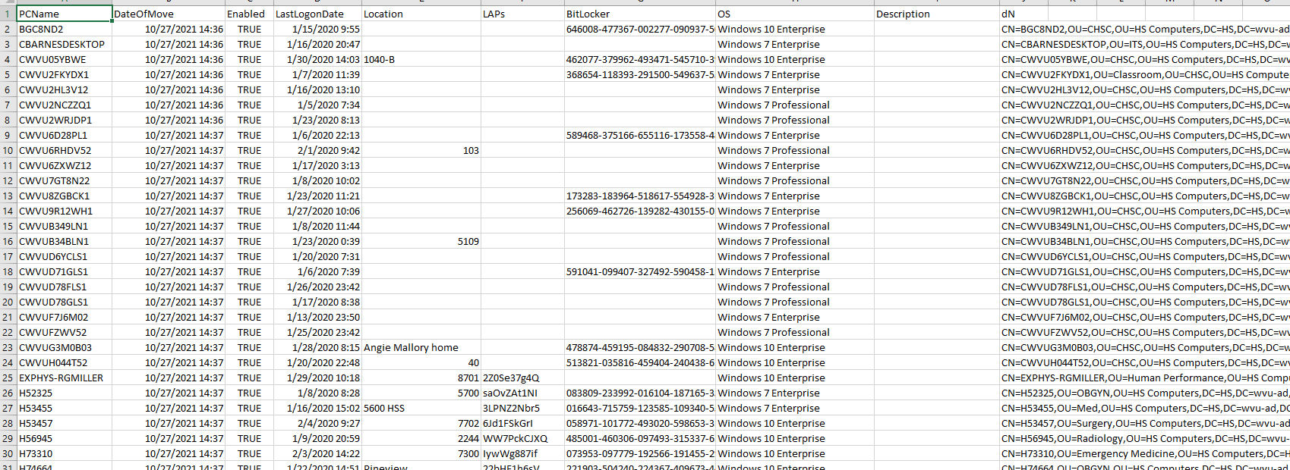

Slide 9
Remove-
HSCStaleComputerObject.ps1

Slide 10
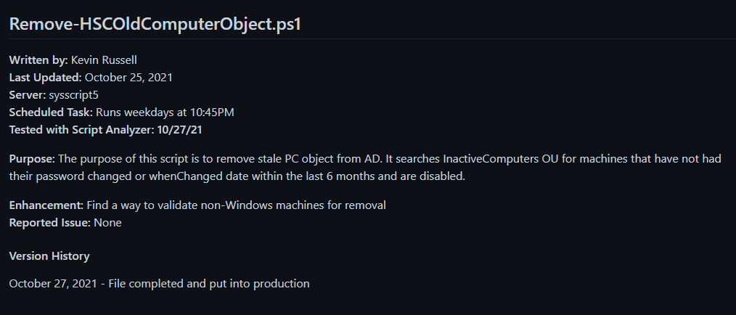

Slide 11
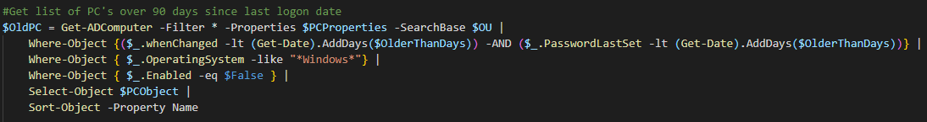

Slide 12
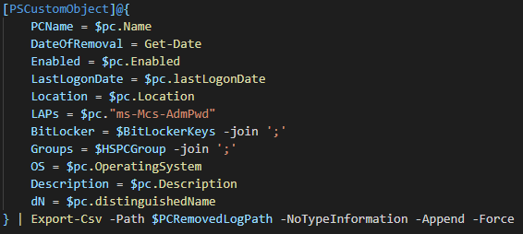
Filter out Server OS
Name
Enabled status
lastLogonDate
Location
LAPs
Bitlocker Key
Groups
OS
Description
dN

Slide 13
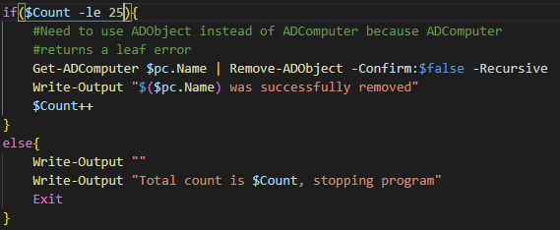

Slide 14
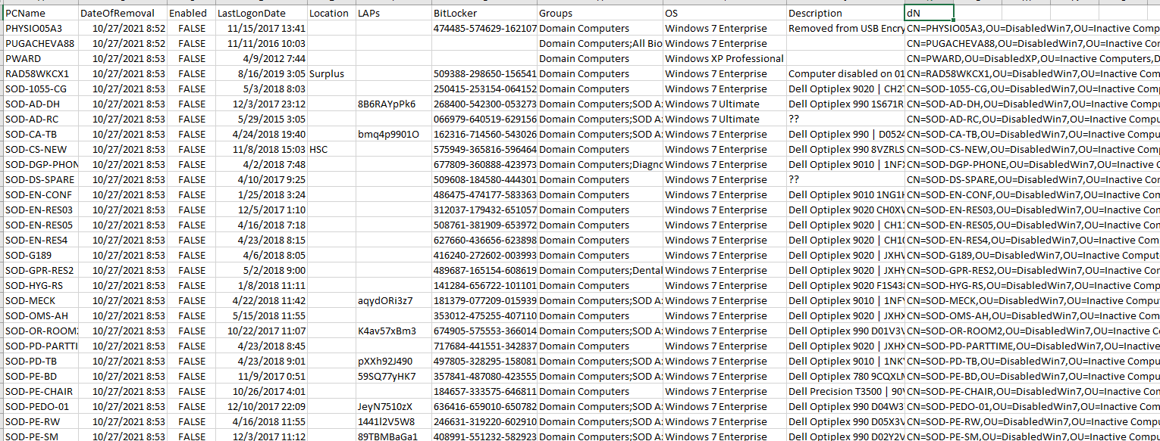

Slide 15
