Slide 1
PowerShell Code Review November 11, 2021

Slide 2
Get-FileShareDirectory.ps1
Get-ADComputerInfoForMigration.ps1
Get-SharedPrinterInfoForMigration.ps1

Slide 3
Get-FileShareDirectory.ps1

Slide 4
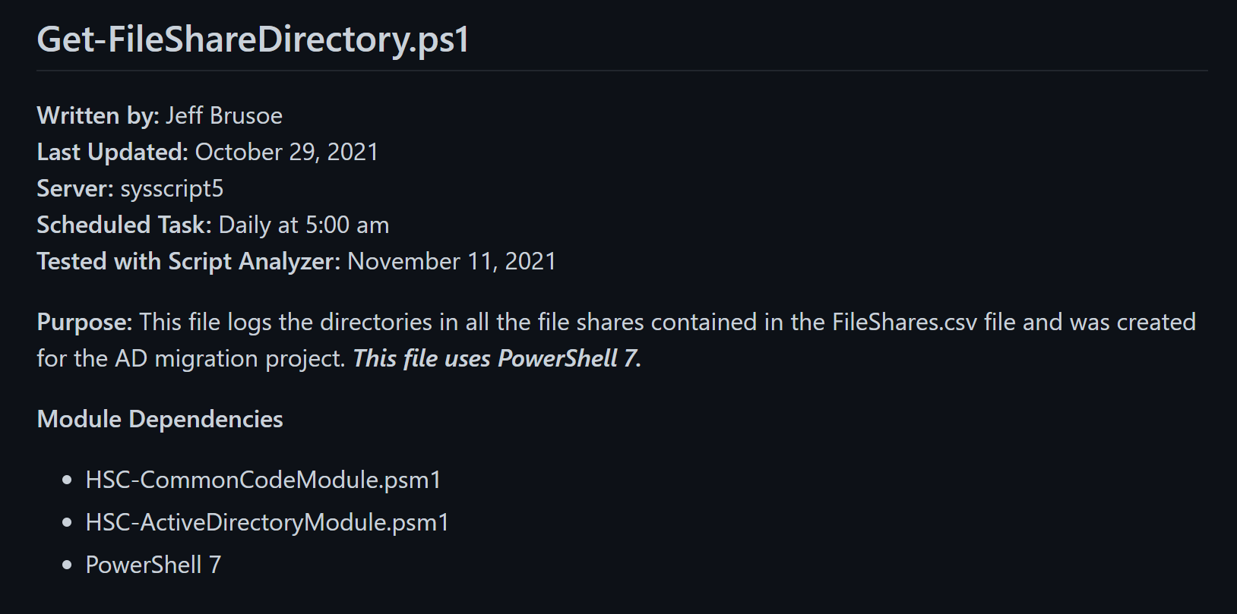

Slide 5
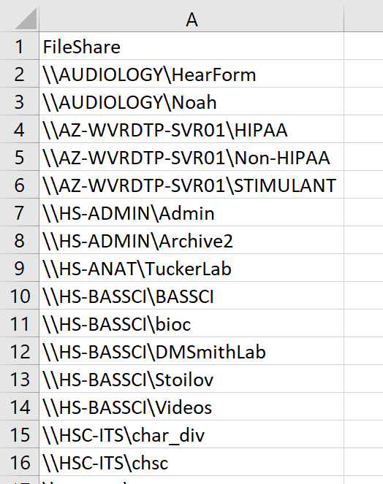

Slide 6
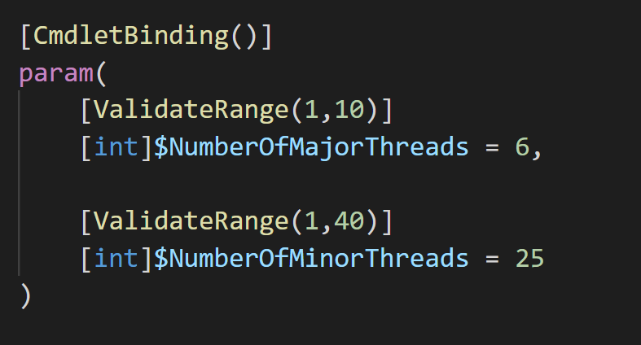

Slide 7
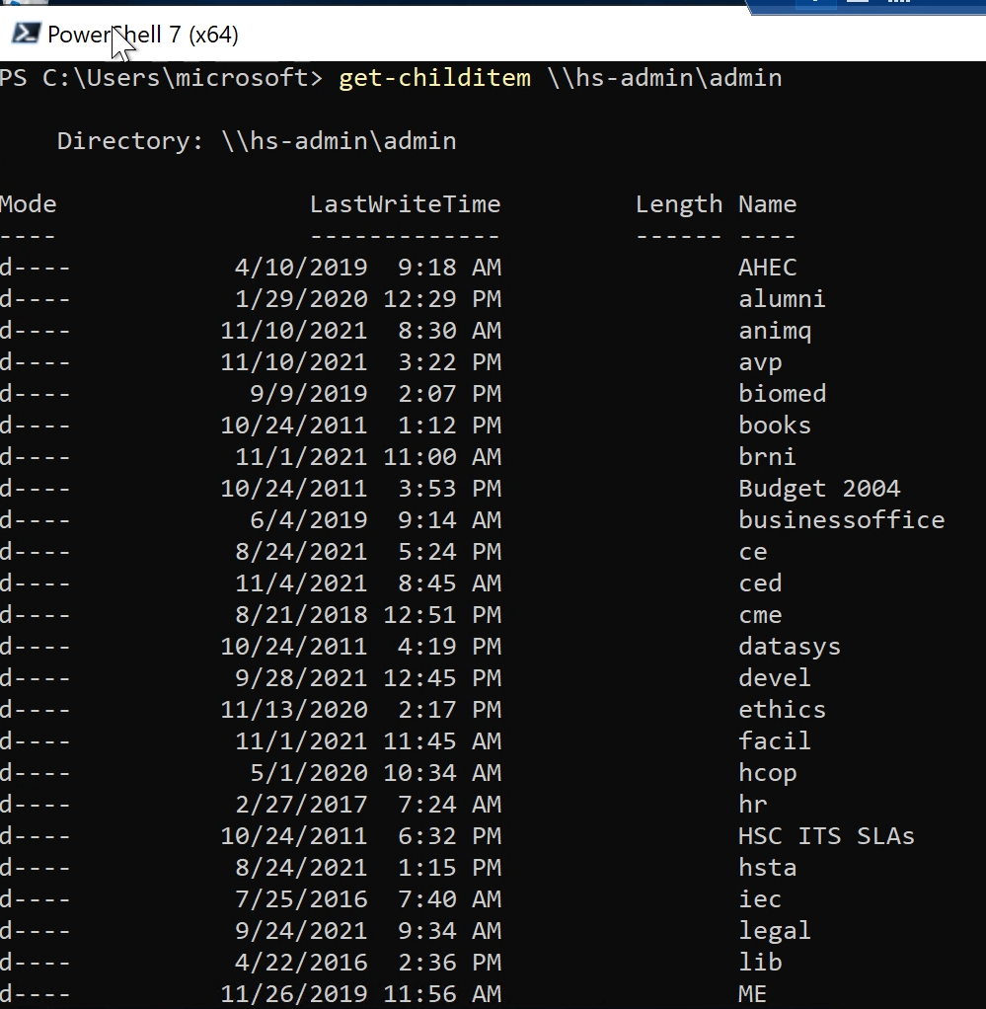

Slide 8
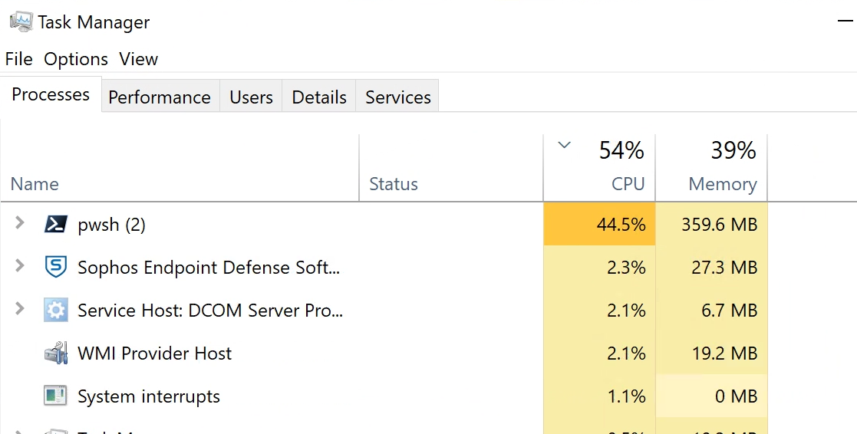

Slide 9
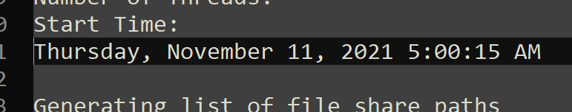
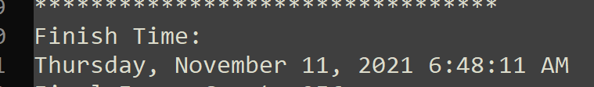

Slide 10
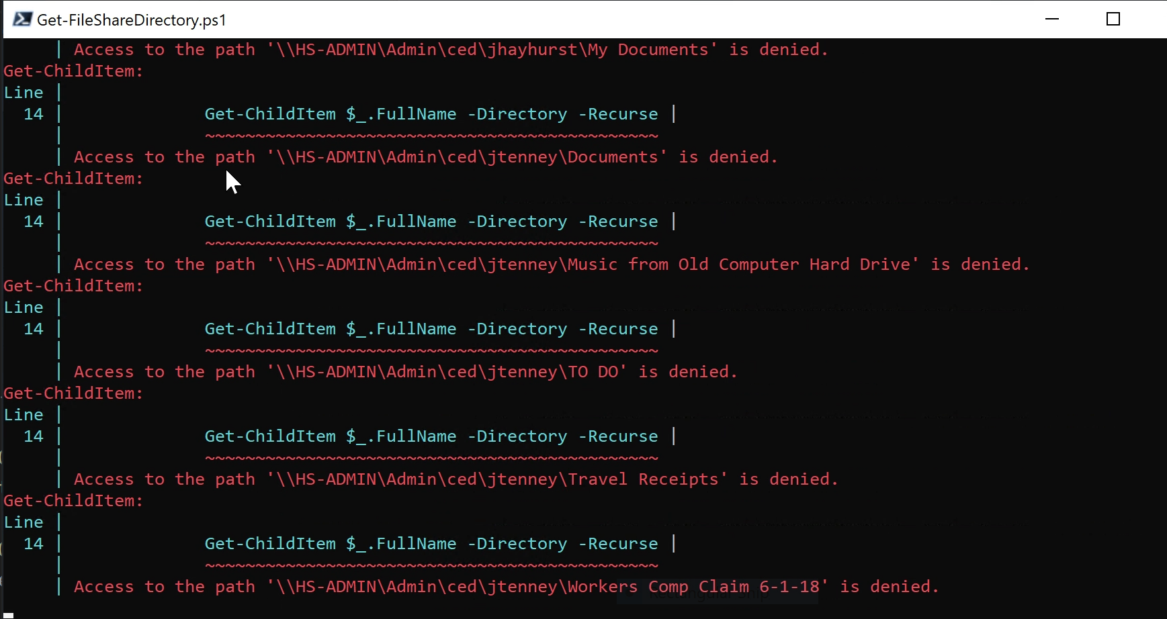

Slide 11
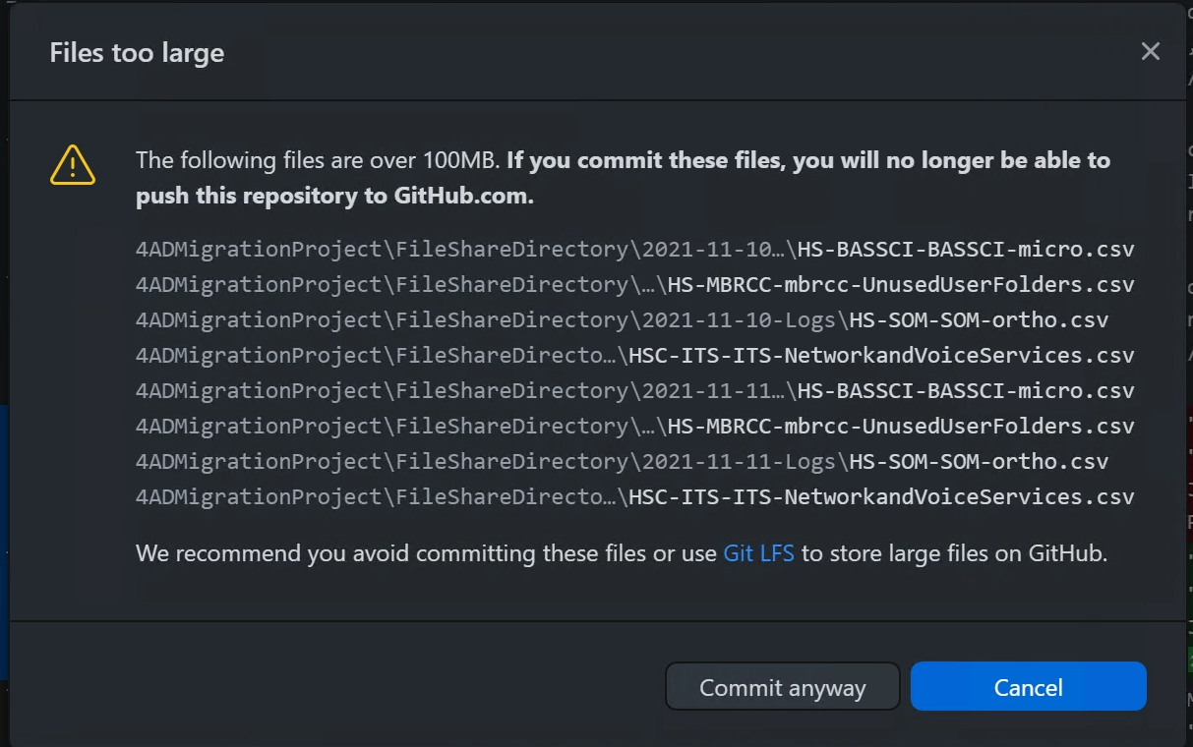

Slide 12
Get-ADComputerInfoForMigration.ps1

Slide 13
