Slide 1

Numerical Root-Finding Suite — Team Presentation
Web app for solving nonlinear equations using Bisection & Regula Falsi
Team Members
Junaeed Bin Saif - 242-15-475
Rafi - 242-15-451
Golam Rabby Miaze - 242-15-047
Sumiya Akter Nirjona - 242-15-875
Tahmina Akter - 242-15-117

Slide 2

Agenda
Intro & Problem
Bisection
Regula Falsi
Motivation, use-cases, input/output
Algorithm + simulation
Algorithm + simulation
Python + Flask
Live Demo
Implementation highlights
Website, animation, PDF report

Slide 3
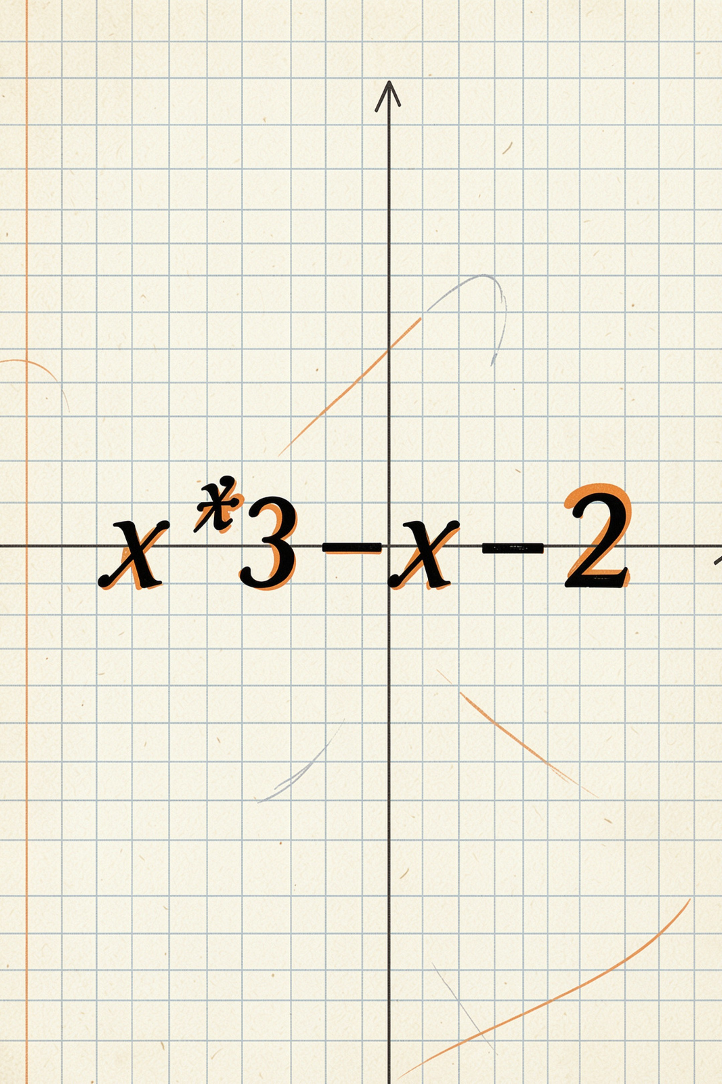
Problem Statement
Find roots of nonlinear equations (e.g., x³ − x − 2 = 0)
No closed-form solution in general
Need reliable numerical approximation
Interactive tool: input equation, interval, tol, max iter

Slide 4
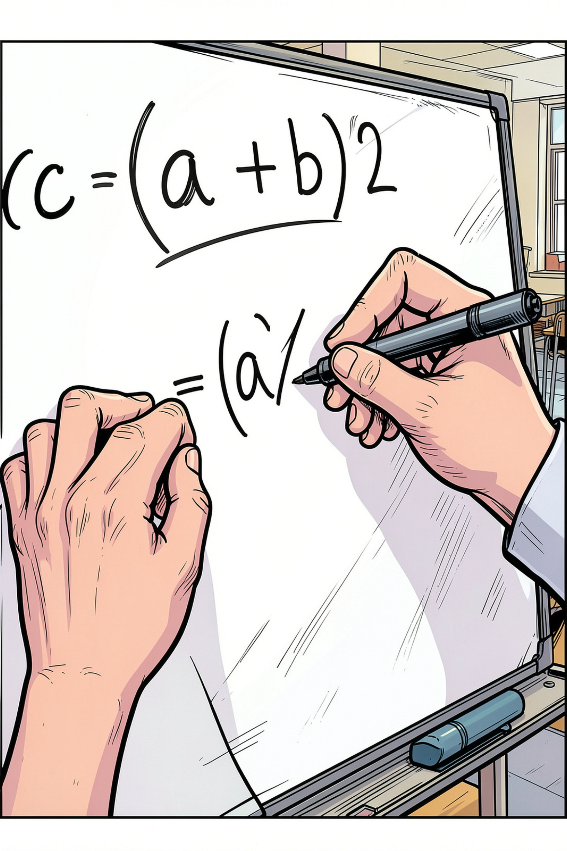
Bisection Method — Key Idea
Use Intermediate Value Theorem: if f(a)·f(b) < 0 → root in [a,b]
01
Step 1
Check sign: f(a)·f(b) < 0
02
Step 2
c = (a + b) / 2 → evaluate f(c)
03
Step 3
Replace a or b by c depending on sign(f(c))
04
Stop
When |f(c)| < tol or interval < tol or max iter

Slide 5
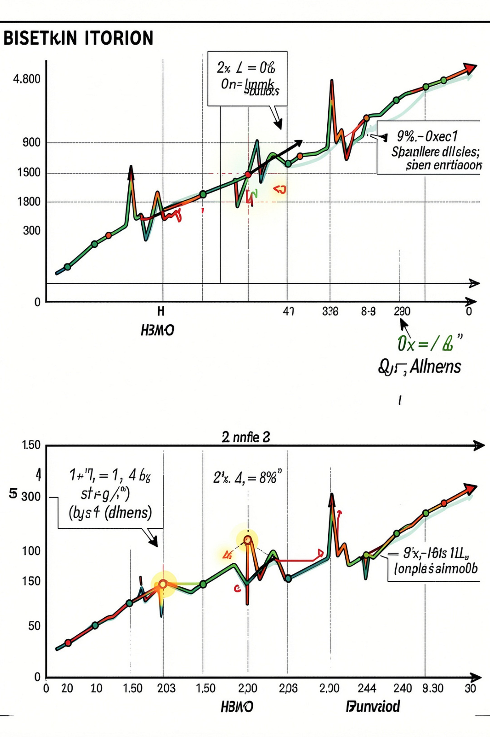
Bisection Simulation — Example
f(x)=x³−x−2, a=1, b=2
f(1)=-2, f(2)=4 → sign change OK
Iter 1: c=1.5 → update interval → [1.5,2]
Iterative halving → monotone convergence

Slide 6
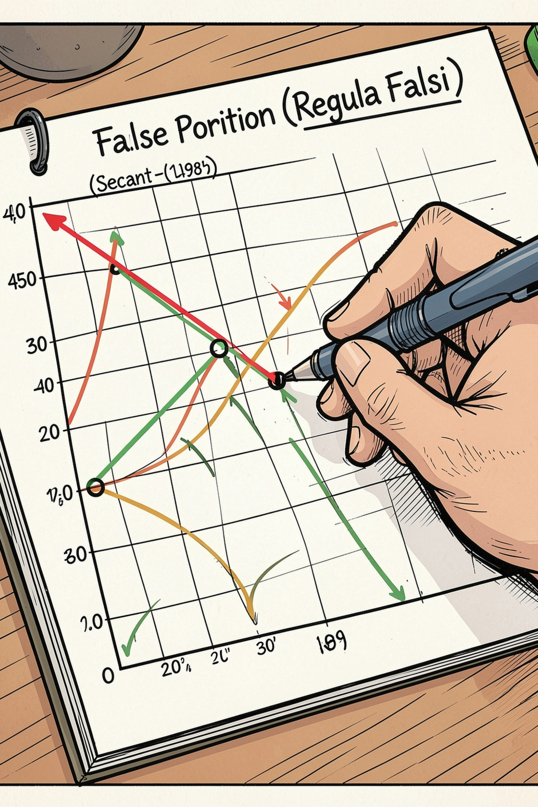

Regula Falsi (False Position)
Linear interpolation between (a,f(a)) and (b,f(b))
Formula
c = b − [f(b)·(a−b)] / [f(a)−f(b)]
Update
Replace endpoint with same-sign as f(c)
Advantage
Often faster than bisection (uses function values)

Slide 7
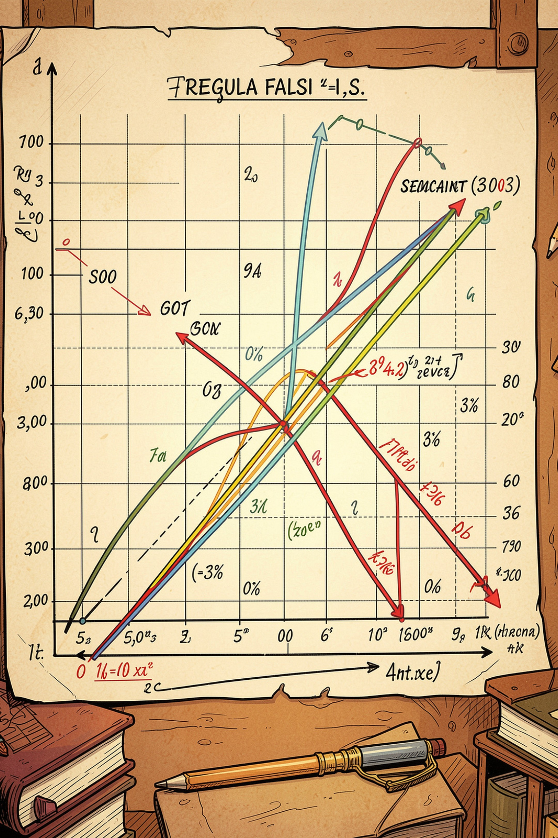
Regula Falsi — Simulation
Same example: f(x)=x³−x−2, a=1, b=2
Compute c by secant intersection
Evaluate f(c), update interval
Converges faster in many cases; watch for slow endpoint movement

Slide 8

Python Implementation (Highlights)
Flask: routes for Bisection, Regula Falsi, PDF
SymPy: parse_equation() → sympify() + lambdify()
Store iterations as list of dicts → JSON → frontend
Matplotlib → Base64 image for inline graph
ReportLab → automatic PDF export

Slide 9

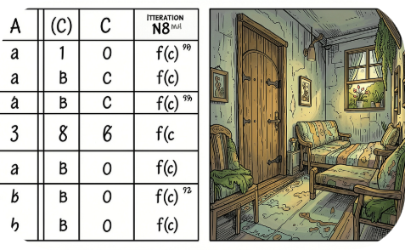
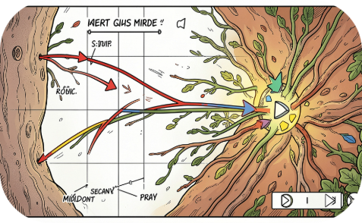
Website Demo — Features
Interactive Input
Iteration Table
Visual Animation
Equation text, a, b, tol, max iter, method selector
Step-by-step values; downloadable CSV/PDF
Step animation of convergence for teaching

Slide 10

Conclusion & Next Steps
Suite offers reliable numerics + visual learning
Extensions: Newton-Raphson, secant, error analysis, adaptive tol
Evaluation: compare iterations, runtime, robustness
Questions?

