Slide 1
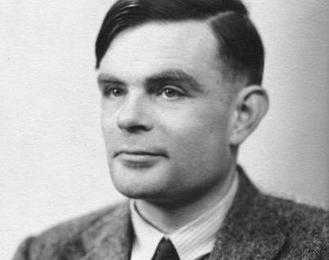
Turing Machines
A theoretic basis for computing
By Dr. Jason Shepherd

Slide 2
1936: Before Computers…
Alan Turing was not trying to “invent computers.”
He was trying to envision what they would be like.

Slide 3
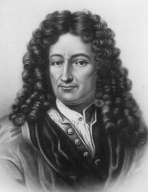
1936: Before Computers…
Alan Turing was not trying to “invent computers.”
He was trying to envision what they would be like.
Why does everyone always forget about me?

Slide 4
Turing asked two questions about computing machines:
Does a machine exist that can determine whether a given task will produce a specific output?
Does a machine exist that can determine whether a given task will ever complete at all?
These are reformulations of David Hilbert’s Entscheidungsproblem which has to do with “decision problems.”

Slide 5
Turing Machines
Turing never called them “Turing machines.”
His term: “automatic machine” or “a-machine”
Turing’s doctoral advisor Alonzo Church called them Turing machines.
Models what we call CPU’s.

Slide 6
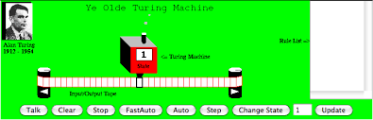
BVU’s Sun/Oracle Java World Cup winning Java applet,
circa 1996

Slide 7
BVU’s Sun/Oracle Java World Cup winning Java applet,
circa 1996
Control Unit
q_{k}
␣ | ␣ | ␣ | ␣ | 0 | 1 | 1 | 1 | 0 | 1 | 0 | ␣ | ␣ | ␣ | ␣
Read/write head

Slide 8
CU
q_{k}
␣ | ␣ | ␣ | ␣ | 0 | 1 | 1 | 1 | 0 | 1 | 0 | ␣ | ␣ | ␣ | ␣
M = (Q, Γ, ␣, 𝛅, q₀, Q_{F})
Q: CU states
Γ: tape alphabet
␣: the blank symbol ␣ ∊ Γ
𝛅: CU transition partial function
Q x Γ ↦ Q x Γ x {L,R,N}
q₀: initial CU state q₀ ∊ Q
Q_{F}: acceptable final states Q_{F} ⊆ Q

Slide 9
How Transition Functions Work
q₀
␣ | ␣ | a | b | c | ␣

Slide 10
How Transition Functions Work
q₁
Switch state!
␣ | ␣ | a | b | c | ␣

Slide 11
How Transition Functions Work
q₁
␣ | ␣ | x | b | c | ␣
Write!

Slide 12
How Transition Functions Work
q₁
␣ | x | b | c | ␣ | ␣
Head moves right!

Slide 13
How Transition Functions Work
q₀
q₁
␣ | ␣ | a | b | c | ␣
␣ | ␣ | x | b | c | ␣
𝛅(q₀, a) = (q₁, x, R)
In this example:
Q = {q₀, q₁, …}
Γ = {a, b, c, x, ␣, …}
new state
move head right
new symbol

Slide 14
Turing Machine Execution
M halts whenever it reaches a configuration for which 𝛅 is undefined. (That is, it doesn’t have a rule for the state and symbol at the head.)
Remember, 𝛅 is a partial function.
Suppose M starts in state q₀ with head on leftmost char of input string ω ∊ Γ and eventually halts on q_{F} ∊ Q_{F}.
We then say M accepts the input string ω.

Slide 15
Turing Machine Execution
Is it possible to write programs that never halt?

Slide 16
Turing Machine Execution
Is it possible to write programs that never halt?
Q = {q₀, q₁}
Γ = {a, ␣}
𝛅(q₀, a) = (q₁, a, R)
𝛅(q₁, a) = (q₀, a, L)

Slide 17
Notation
Often write 5-tuples for rules instead of transition function definitions.
𝛅(q₀, a) = (q₁, a, R)
(q₀, a, q₁, a, R)

Slide 18
Notation
Instantaneous description
Transition
q₀
␣ | a | b | c | ␣ | ␣
would be written as aq₀bc
aq₀bc├ abq₁c
aq₀bcd├* abcq₂d

Slide 19
Examples
Write a program that will make a copy of string of 1’s next to the input leaving a blank space.

Slide 20
Examples
Write a program that will make a copy of string of 1’s next to the input leaving a blank space.
initial head position
1 | 1 | 1 | 1 | ␣ | ␣ | ␣ | ␣ | ␣
1 | 1 | 1 | 1 | ␣ | 1 | 1 | 1 | 1

Slide 21
Examples
Write a program that will make a copy of string of 1’s next to the input leaving a blank space.
q₁
1 | 1 | 1 | ␣ | ␣ | ␣ | ␣ | ␣ | ␣

Slide 22
Examples
Write a program that will make a copy of string of 1’s next to the input leaving a blank space.
q₂
$ | 1 | 1 | ␣ | ␣ | ␣ | ␣ | ␣ | ␣

Slide 23
Examples
Write a program that will make a copy of string of 1’s next to the input leaving a blank space.
q₂
$ | 1 | 1 | ␣ | ␣ | ␣ | ␣ | ␣ | ␣

Slide 24
Examples
Write a program that will make a copy of string of 1’s next to the input leaving a blank space.
q₂
$ | 1 | 1 | ␣ | ␣ | ␣ | ␣ | ␣ | ␣

Slide 25
Examples
Write a program that will make a copy of string of 1’s next to the input leaving a blank space.
q₃
$ | 1 | 1 | ␣ | ␣ | ␣ | ␣ | ␣ | ␣

Slide 26
Examples
Write a program that will make a copy of string of 1’s next to the input leaving a blank space.
q₄
$ | 1 | 1 | ␣ | 1 | ␣ | ␣ | ␣ | ␣

Slide 27
Examples
Write a program that will make a copy of string of 1’s next to the input leaving a blank space.
q₄
$ | 1 | 1 | ␣ | 1 | ␣ | ␣ | ␣ | ␣

Slide 28
Examples
Write a program that will make a copy of string of 1’s next to the input leaving a blank space.
q₄
$ | 1 | 1 | ␣ | 1 | ␣ | ␣ | ␣ | ␣

Slide 29
Examples
Write a program that will make a copy of string of 1’s next to the input leaving a blank space.
q₄
$ | 1 | 1 | ␣ | 1 | ␣ | ␣ | ␣ | ␣

Slide 30
Examples
Write a program that will make a copy of string of 1’s next to the input leaving a blank space.
q₁
1 | 1 | 1 | ␣ | 1 | ␣ | ␣ | ␣ | ␣

Slide 31
Examples
Write a program that will make a copy of string of 1’s next to the input leaving a blank space.
q₂
1 | $ | 1 | ␣ | 1 | ␣ | ␣ | ␣ | ␣

Slide 32
Examples
Write a program that will make a copy of string of 1’s next to the input leaving a blank space.
q₂
1 | $ | 1 | ␣ | 1 | ␣ | ␣ | ␣ | ␣

Slide 33
Examples
Write a program that will make a copy of string of 1’s next to the input leaving a blank space.
q₃
1 | $ | 1 | ␣ | 1 | ␣ | ␣ | ␣ | ␣

Slide 34
Examples
Write a program that will make a copy of string of 1’s next to the input leaving a blank space.
q₃
1 | $ | 1 | ␣ | 1 | ␣ | ␣ | ␣ | ␣

Slide 35
Examples
Write a program that will make a copy of string of 1’s next to the input leaving a blank space.
q₄
1 | $ | 1 | ␣ | 1 | 1 | ␣ | ␣ | ␣

Slide 36
Examples
Write a program that will make a copy of string of 1’s next to the input leaving a blank space.
q₄
1 | $ | 1 | ␣ | 1 | 1 | ␣ | ␣ | ␣

Slide 37
Examples
Write a program that will make a copy of string of 1’s next to the input leaving a blank space.
q₄
1 | $ | 1 | ␣ | 1 | 1 | ␣ | ␣ | ␣

Slide 38
Examples
Write a program that will make a copy of string of 1’s next to the input leaving a blank space.
q₄
1 | $ | 1 | ␣ | 1 | 1 | ␣ | ␣ | ␣

Slide 39
Examples
Write a program that will make a copy of string of 1’s next to the input leaving a blank space.
q₁
1 | 1 | 1 | ␣ | 1 | 1 | ␣ | ␣ | ␣

Slide 40
Examples
Write a program that will make a copy of string of 1’s next to the input leaving a blank space.
q₂
1 | 1 | $ | ␣ | 1 | 1 | ␣ | ␣ | ␣

Slide 41
Examples
Write a program that will make a copy of string of 1’s next to the input leaving a blank space.
q₃
1 | 1 | $ | ␣ | 1 | 1 | ␣ | ␣ | ␣

Slide 42
Examples
Write a program that will make a copy of string of 1’s next to the input leaving a blank space.
q₃
1 | 1 | $ | ␣ | 1 | 1 | ␣ | ␣ | ␣

Slide 43
Examples
Write a program that will make a copy of string of 1’s next to the input leaving a blank space.
q₃
1 | 1 | $ | ␣ | 1 | 1 | ␣ | ␣ | ␣

Slide 44
Examples
Write a program that will make a copy of string of 1’s next to the input leaving a blank space.
q₄
1 | 1 | $ | ␣ | 1 | 1 | 1 | ␣ | ␣

Slide 45
Examples
Write a program that will make a copy of string of 1’s next to the input leaving a blank space.
q₄
1 | 1 | $ | ␣ | 1 | 1 | 1 | ␣ | ␣

Slide 46
Examples
Write a program that will make a copy of string of 1’s next to the input leaving a blank space.
q₄
1 | 1 | $ | ␣ | 1 | 1 | 1 | ␣ | ␣

Slide 47
Examples
Write a program that will make a copy of string of 1’s next to the input leaving a blank space.
q₄
1 | 1 | $ | ␣ | 1 | 1 | 1 | ␣ | ␣

Slide 48
Examples
Write a program that will make a copy of string of 1’s next to the input leaving a blank space.
q₁
1 | 1 | 1 | ␣ | 1 | 1 | 1 | ␣ | ␣

Slide 49
Examples
Write a program that will make a copy of string of 1’s next to the input leaving a blank space.
q_{F}
1 | 1 | 1 | ␣ | 1 | 1 | 1 | ␣ | ␣

Slide 50
Examples
Write a program that will make a copy of string of 1’s next to the input leaving a blank space.
q_{F}
q₁: look for 1, if ␣ then halt
q₂: leave a $ and look for ␣
q₃: found ␣, look for next ␣ to write a 1
q₄: found next ␣, write 1 and go back L
q_{F}: look for 1 but found ␣, so halt
1 | 1 | 1 | ␣ | 1 | 1 | 1 | ␣ | ␣

Slide 51
Examples
Write a program that will make a copy of string of 1’s next to the input leaving a blank space.
q_{F}
q₁: look for 1, if ␣ then halt
q₂: leave a $ and look for ␣
q₃: found ␣, look for next ␣ to write a 1
q₄: found next ␣, write 1 and go back L
q_{F}: look for 1 but found ␣, so halt
1 | 1 | 1 | ␣ | 1 | 1 | 1 | ␣ | ␣
M = (Q, Γ, ␣, 𝛅, q₀, Q_{F}) 𝛅:
Q = {q₁, q₂, q₃, q₄, q_{F}}
Γ = {1, $, ␣}
Q_{F} = {q_{F}}
(q₁, 1, q₂, $, R)
(q₁, ␣, q_{F}, ␣, N)
(q₂, 1, q₂, 1, R)
(q₂, ␣, q₃, ␣, R)
(q₃, 1, q₃, 1, R)
(q₃, ␣, q₄, 1, L)
(q₄, 1, q₄, 1, L)
(q₄, ␣, q₄, ␣, L)
(q₄, $, q₁, 1, R)

Slide 52
You Try It
Make a program that determines whether an input string consisting only of 1’s contains an even or odd number of 1’s. If even, the program should leave a blank space followed by a 0. If odd, the program should leave a 1 instead of a 0.
Do the previous problem, but replace the input string with a single 0 or 1.
Make a program that accepts strings in the regular expression language L = { a^{m}b^{n} : m ≥ 1, n ≥ 1 }.
Make a program that accepts strings in the regular expression language L = { (ab)^{n} : n ≥ 1 }.

Slide 53
Possible Answer for #1
Make a program that determines whether an input string consisting only of 1’s contains an even or odd number of 1’s. If even, the program should leave a blank space followed by a 0. If odd, the program should leave a 1 instead of a 0.
M = (Q, Γ, ␣, 𝛅, q₀, Q_{F}) 𝛅:
Q = {q₀, q₁, q₂, q₃}
Γ = {0, 1, ␣}
Q_{F} = {q₂, q₃}
(q₀, 1, q₁, 1, R)
(q₁, 1, q₀, 1, R)
(q₀, ␣, q₂, ␣, R)
(q₁, ␣, q₃, ␣, R)
(q₂, ␣, q₂, 0, N)
(q₃, ␣, q₃, 1, N)

Slide 54
Possible Answer for #2
Do the previous problem, but replace the input string with a single 0 or 1.
→ Let’s assume we don’t need to replace the input string at the exact same place on the tape.
M = (Q, Γ, ␣, 𝛅, q₀, Q_{F}) 𝛅:
Q = {q₀, q₁, q_{F}}
Γ = {0, 1, ␣}
Q_{F} = {q_{F}}
(q₀, 1, q₁, ␣, R)
(q₁, 1, q₀, ␣, R)
(q₀, ␣, q_{F}, 0, N)
(q₁, ␣, q_{F}, 1, N)

Slide 55
Possible Answer for #3
Make a program that accepts strings in the regular expression language L = { a^{m}b^{n} : m ≥ 1, n ≥ 1 }.
Examples: ab, abb, aaaabb
M = (Q, Γ, ␣, 𝛅, q_{S}, Q_{F}) 𝛅:
Q = {q_{S}, q_{a}, q_{b}, q_{F}}
Γ = {a, b, ␣}
Q_{F} = {q_{F}}
(q_{S}, a, q_{a}, a, R)
(q_{a}, a, q_{a}, a, R)
(q_{a}, b, q_{b}, b, R)
(q_{b}, ␣, q_{F}, ␣, N)

Slide 56
Possible Answer for #4
Make a program that accepts strings in the regular expression language L = { (ab)^{n} : n ≥ 1 }.
Examples: ab, abab, ababab
M = (Q, Γ, ␣, 𝛅, q_{S}, Q_{F}) 𝛅:
Q = {q_{S}, q_{a}, q_{b}, q_{F}}
Γ = {a, b, ␣}
Q_{F} = {q_{F}}
(q_{S}, a, q_{a}, a, R)
(q_{a}, b, q_{b}, b, R)
(q_{b}, a, q_{a}, a, R)
(q_{b}, ␣, q_{F}, ␣, N)

Slide 57
A Purely Mathematical Representation of a Computer
M = (Q, Γ, ␣, 𝛅, q_{S}, Q_{F}) 𝛅:
Q = {q_{S}, q_{a}, q_{b}, q_{F}}
Γ = {a, b, ␣}
Q_{F} = {q_{F}}
(q_{S}, a, q_{a}, a, R)
(q_{a}, b, q_{b}, b, R)
(q_{b}, a, q_{a}, a, R)
(q_{b}, ␣, q_{F}, ␣, N)

Slide 58
A Purely Mathematical Representation of a Computer
M = (Q, Γ, ␣, 𝛅, q_{S}, Q_{F}) 𝛅:
Q = {q_{S}, q_{a}, q_{b}, q_{F}}
Γ = {a, b, ␣}
Q_{F} = {q_{F}}
(q_{S}, a, q_{a}, a, R)
(q_{a}, b, q_{b}, b, R)
(q_{b}, a, q_{a}, a, R)
(q_{b}, ␣, q_{F}, ␣, N)

Slide 59
A Purely Mathematical Representation of a Computer
M = ({q_{S}, q_{a}, q_{b}, q_{F}},
{a, b, ␣},
␣,
{ (q_{S}, a, q_{a}, a, R),
(q_{a}, b, q_{b}, b, R),
(q_{b}, a, q_{a}, a, R),
(q_{b}, ␣, q_{F}, ␣, N) },
q_{S},
{q_{F}})

Slide 60
Important Results
The Church-Turing Thesis: Any function that can be computed can be computed by a Turing machine
Turing completeness: The ability of a programming language to simulate a Turing machine, i.e., to express all tasks that can be completed by computers.
Data description languages are often not Turing complete, like HTML, JSON, XML, and Markdown
At a minimum: while, if, variables

Slide 61
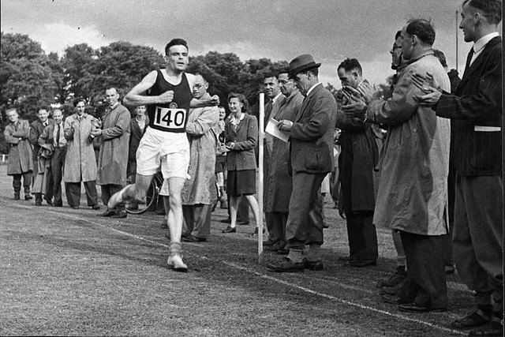
Important Results
Answers to Turing’s questions:
Does a machine exist that can determine whether a given task will produce a specific output?
Does a machine exist that can determine whether a given task will ever complete at all?
https://growingbolder.com/stories/running-history/

Slide 62
Important Results
Answers to Turing’s questions:
Does a machine exist that can determine whether a given task will produce a specific output?
→ No.
Does a machine exist that can determine whether a given task will ever complete at all?
https://growingbolder.com/stories/running-history/

Slide 63
Important Results
Answers to Turing’s questions:
Does a machine exist that can determine whether a given task will produce a specific output?
→ No.
Does a machine exist that can determine whether a given task will ever complete at all?
→ No.
https://growingbolder.com/stories/running-history/

Slide 64
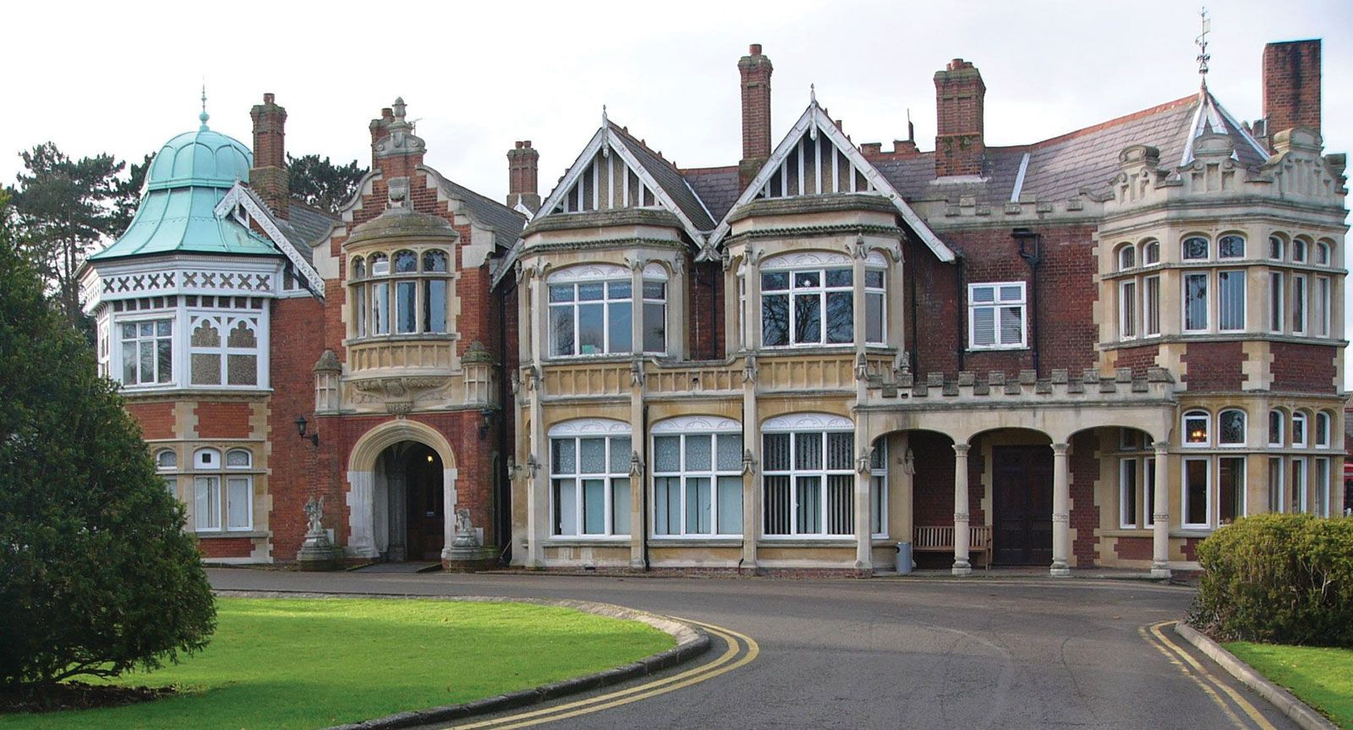
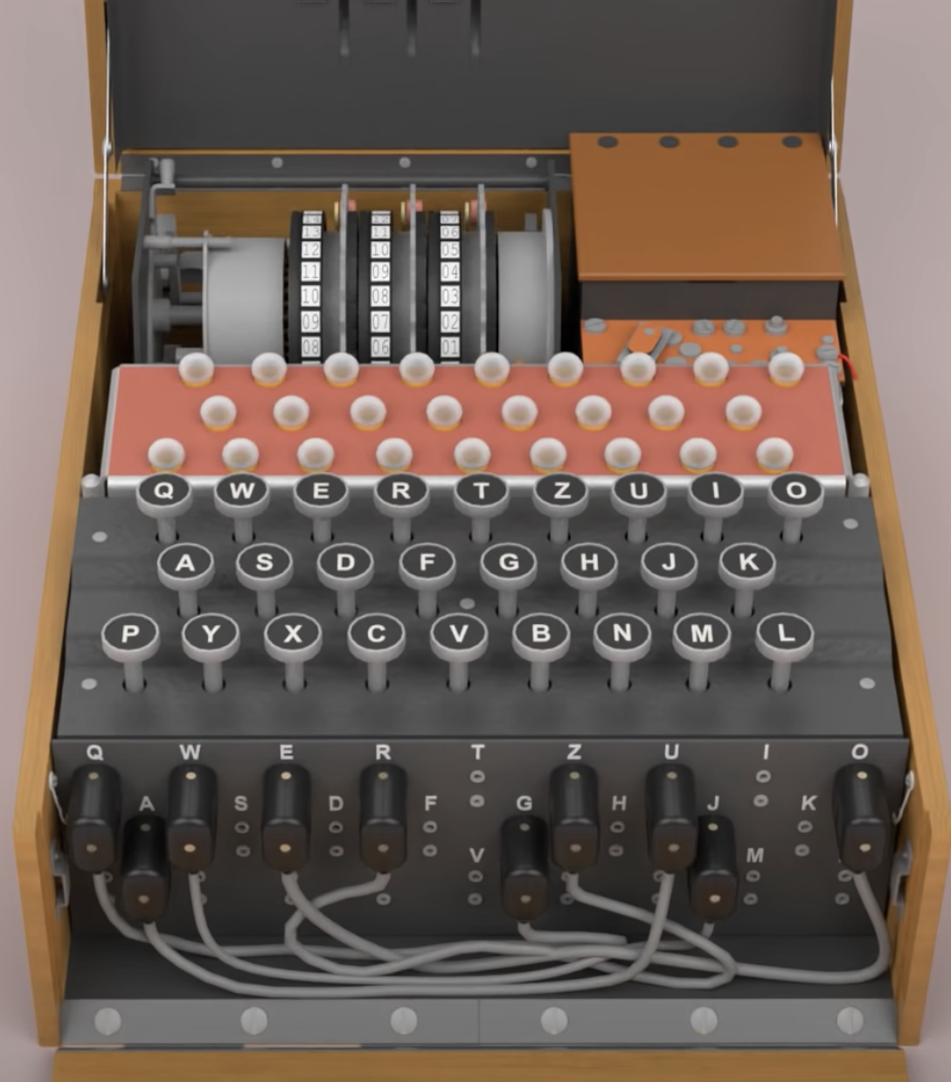
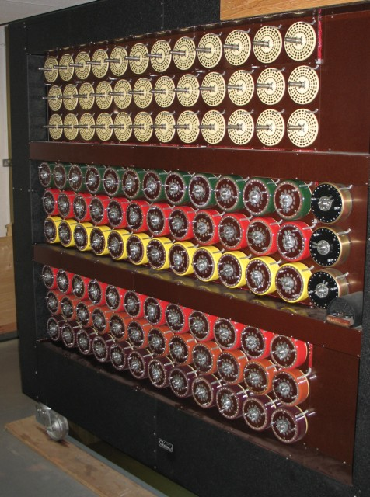
What about codebreaking and stuff…?
Alan Turing was a codebreaker during WWII at Bletchley Park
Turing invented Turing machines
What do Turing machines have to do with codebreaking?
Nothing!
Coming soon in a future presentation by Dr. Shepherd!

Slide 65
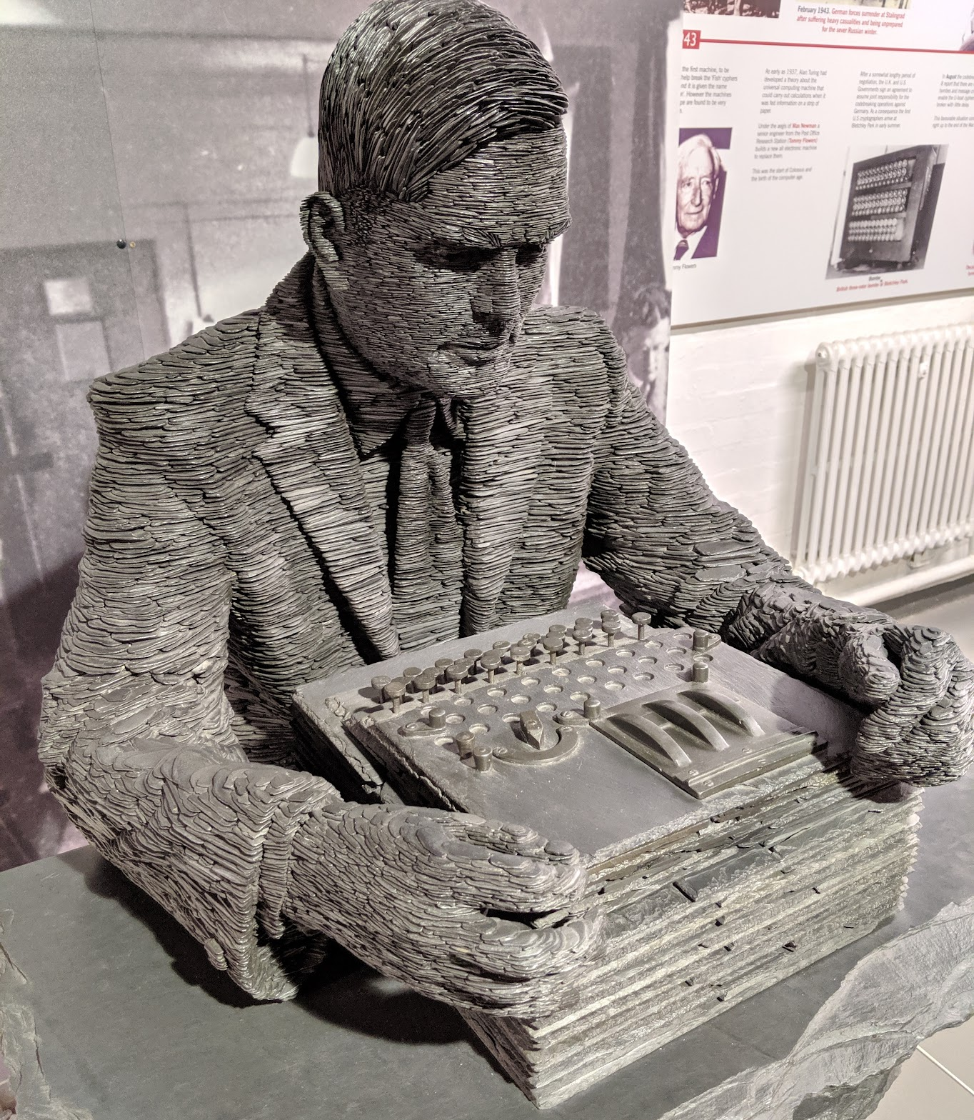
Turing: An Epilogue
After Bletchley, returned to academic life at Cambridge
1946: Paper with first design of stored-program computer
Early work in AI: the Turing Test
Mathematical biology
1952: Charges of “gross indecency” and chemical castration
1954: Death
2013: Pardon from Queen Elizabeth II
2021: Face on the £50 note

Slide 66
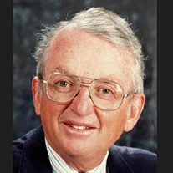
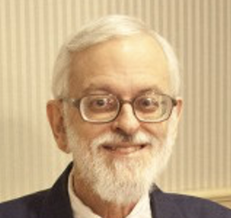
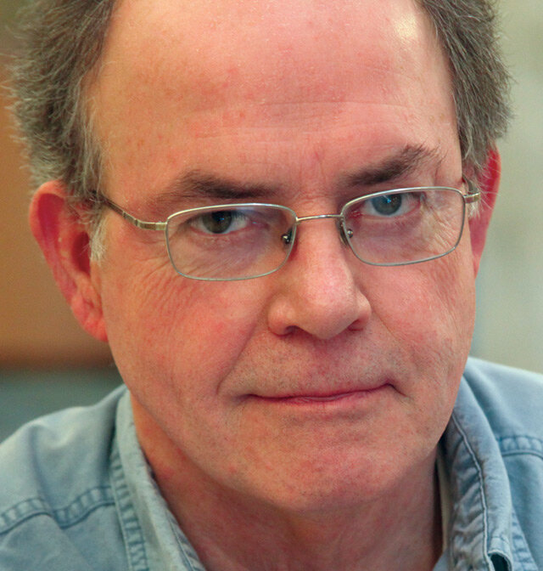
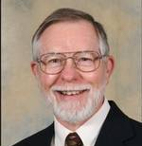
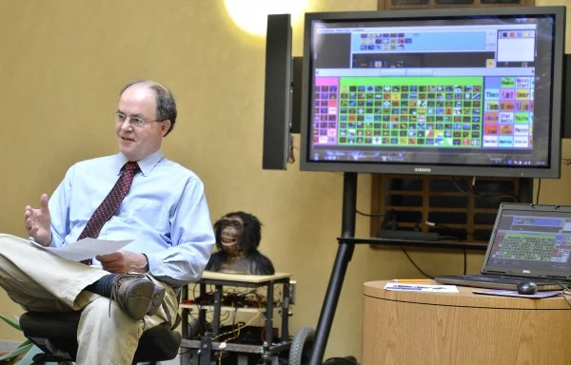
An aside: the “basis” of BVU Computing
Dr. Charles Slagle
Prof. of Chemistry
Dean of Science
Prof. Ben Donath
Prof. of Mathematics
Dean of Science
Assoc. Dean of Faculty
Dr. Ken Schweller
Prof. of Computer Science
and Psychology
Dean of Science
Dr. Joe Traylor
Prof. of Physics
and Computer Science
Director of the
Computer Center

