Slide 1
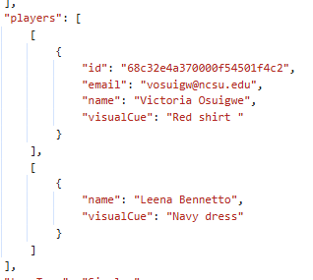
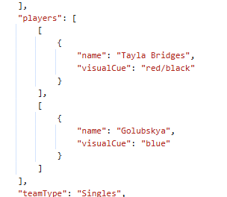
JSON data from CIZR
Match: 69c9cb6c3c0000da69d8f49c
Match: 5ae08b841a0000f894c84d14
Curl command retrieves data
Curl command does not retrieve data

Slide 2
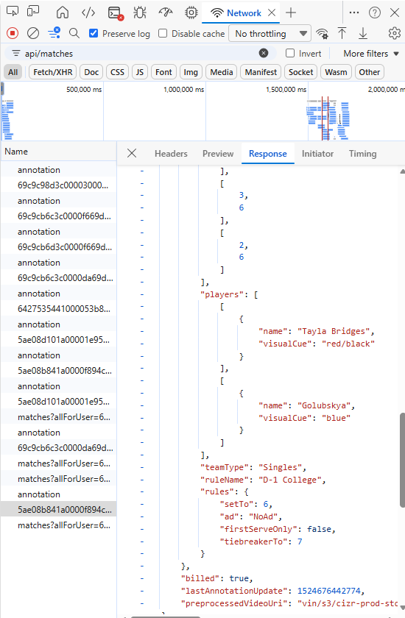
One way to see this:
Login to CIZR
Find a match (like this one)
Press “F12” or “Function+F12” to see DevTools
Click the Network icon
Write “api/matches” in the text box for filter
Refresh the page
Click the match name you’ve chosen.
Scroll “response” to find the array for “players”.
Some players have an ID. Others don’t.

