Slide 1


PLEDGE TO PROGRESS Sustainability Hackathon
Sponsored By
Your Team Name : IoT Solution
Your team bio : Jnaneshwar B.T.
+91-6362847265
Date :25/04/2023

Slide 2
Problem Statement?
Carbon dioxide (CO2) is a greenhouse gas that plays a significant role in shaping ecosystems and has various impacts on natural systems.
Here are some potential impacts of CO2 on ecosystems:
Climate change: CO2 is a major contributor to global warming and climate change. The increasing concentration of CO2 in the atmosphere is causing changes
in average temperatures, precipitation patterns, and extreme weather events, which can have profound effects on ecosystems.
For example, changes in temperature and precipitation can affect the distribution and abundance of plant and animal species, alter ecosystem dynamics,
and influence ecological processes such as nutrient cycling and energy flow.
Vegetation dynamics: CO2 can affect the growth and composition of vegetation in ecosystems. Higher concentrations of CO2 can stimulate photosynthesis, resulting in
increased plant productivity and growth. This can lead to changes in plant communities, such as shifts in species composition, changes in plant phenology
(e.g., timing of flowering or leaf senescence), and alterations in plant-microbe interactions.
Carbon sequestration: CO2 is a crucial component of the global carbon cycle, and changes in atmospheric CO2 concentrations can impact carbon sequestration in ecosystems.
Some studies suggest that elevated CO2 levels may stimulate plant growth and enhance carbon uptake by ecosystems, potentially leading to increased carbon
sequestration in soils and vegetation. However, the response of ecosystems to elevated CO2 can be complex and depends on factors such as nutrient availability,
water availability, and ecosystem dynamics.
Biodiversity: Changes in CO2 concentrations and associated climate impacts.
Human Health : CO2 is going to impact on human health.
Global Warming : In the atmosphere, CO2 is major factor to increase the global warming and makes holes in ozone layer.

Slide 3
User Segment & Pain Points
Individuals: households, consumers, and individuals who contribute to CO2 emissions through various activities such as energy usage, transportation, and consumption patterns.
Businesses: Across various industries contribute to CO2 emissions through their operations, including energy consumption, transportation of goods and services, manufacturing processes, and waste management.
Different sectors, such as educational Institutions, government buildings, hospitals, transportation, Industries, energy production, manufacturing, and agriculture, may have distinct CO2 emission profiles.
Municipalities: Cities and municipalities contribute to CO2 emissions through various activities such as energy usage in public buildings, transportation infrastructure (public transit, street lighting), waste management, and urban planning decisions.
Transportation: This includes individuals and businesses that contribute to CO2 emissions through various transportation modes such as cars, trucks, airplanes, trains, ships, and other forms of transportation.
Agriculture and Forestry: Agricultural and forestry practices, such as deforestation, livestock farming, and use of fertilizers, contribute to CO2 emissions through land-use changes and agricultural activities.
Energy production: Power plants, refineries, and other energy production facilities are significant sources of CO2 emissions due to the burning of fossil fuels for electricity and heat generation.

Slide 4
Pre-Requisite
Familiarity with Azure: Developers should have a good understanding of Azure and its various tools and services. This can be achieved through training, online resources, and practical experience.
Knowledge of programming languages: Developers should be proficient in at least one programming language, such as C#, Java, or Python,C,C++. Depending on the specific tools and services being used, knowledge of additional programming languages may be required.
Understanding of cloud computing: Developers should have a good understanding of cloud computing concepts and architectures, such as Infrastructure as a Service (IaaS), Platform as a Service (PaaS), and Software as a Service (SaaS).
Environmental sustainability knowledge: Developers should have an understanding of environmental sustainability and the impact of software on the environment. This can be achieved through research, training, and practical experience.
Access to Azure resources: Developers will need access to Azure resources, such as Azure subscription, to develop and deploy green software using Azure.
Collaboration tools: If working as a team, developers should have access to collaboration tools, such as Azure DevOps, to manage the software development process and collaborate with other team members
Electronic hardware platform required
CO2 Density Detecting Sensors.
CO2 production detection sensors.
Software tools: Compiler, Interpreter, Web Server, SQL Database.

Slide 5
Tools or resources
Azure Energy Efficiency Calculator: This tool can be used to estimate the energy consumption of virtual machines in Azure and recommend ways to optimize energy usage. Azure Kubernetes Service (AKS): AKS is a managed Kubernetes service provided by Azure that can be used to deploy and manage containerized applications. It is designed to be highly scalable and energy-efficient. Azure Functions: Azure Functions is a serverless compute service provided by Azure that allows developers to run code in response to events. This service can help reduce energy consumption and carbon footprint by automatically scaling resources based on demand. Azure Logic Apps: Azure Logic Apps is a cloud-based integration service that allows developers to create workflows to automate business processes. It is a serverless computing service that can help reduce energy consumption by automatically scaling resources. Azure DevOps: Azure DevOps is a set of development tools provided by Azure that can be used to manage the software development lifecycle, including version control, continuous integration, and deployment. Azure Advisor: Azure Advisor is a free service provided by Azure that can be used to optimize Azure resources for performance, security, and cost. It provides recommendations for improving resource utilization, which can help reduce energy consumption and carbon footprint. Azure Sustainable Energy Toolkit: This toolkit provides guidance on how to design and deploy sustainable cloud solutions using Azure. It includes best practices, case studies, and design patterns for developing energy-efficient solutions.

Slide 6
Methodology & Architecture
Infrastructure optimization: Azure provides a range of infrastructure optimization tools that can be used to reduce energy consumption and carbon footprint. For example, the Azure Energy Efficiency calculator can be used to calculate the energy consumption of Azure virtual machines and recommend ways to optimize energy consumption.
Cloud-native architecture: Cloud-native architecture refers to the design and deployment of software applications that are optimized for cloud computing environments. This involves using services and tools that are designed specifically for the cloud, such as Azure Kubernetes Service (AKS) and Azure Functions. Cloud-native architecture can help reduce energy consumption and carbon footprint by optimizing resource utilization and scaling.
Serverless computing: Serverless computing is a cloud computing model in which the cloud provider manages the infrastructure and automatically allocates resources as needed. This can help reduce energy consumption and carbon footprint by eliminating the need for dedicated server infrastructure. Azure Functions and Azure Logic Apps are examples of serverless computing services provided by Azure.
Sustainable data centers: Azure has made significant investments in building sustainable data centers that are designed to minimize energy consumption and carbon footprint. These data centers are powered by renewable energy sources and are equipped with energy-efficient hardware and cooling systems.
Green software development practices: Adopting green software development practices can help reduce the environmental impact of software development. These practices include optimizing code for energy efficiency, minimizing resource usage, and reducing waste generation. Azure provides a range of tools and services that can be used to implement these practices, such as Azure DevOps and Azure Advisor.

Slide 7
Key Differentiators
Azure Sustainability: Microsoft has made significant investments in building sustainable data centers and improving energy efficiency, making Azure a leading cloud provider for green computing.
Comprehensive Tools: Azure provides a range of tools and services that can be used to develop and deploy green software, including serverless computing, Kubernetes, and DevOps tools.
Integration with Other Microsoft Products: Azure integrates well with other Microsoft products, such as Power BI, Dynamics 365, and SharePoint, providing a seamless user experience for developing and deploying green software.
Flexibility and Scalability: Azure offers a flexible and scalable infrastructure that can be customized to meet the unique needs of green software applications.
Security and Compliance: Azure provides a range of security and compliance features, such as encryption, access controls, and compliance certifications, ensuring that green software applications are secure and compliant with regulations.

Slide 8
Adaptation Plan
To adopt Azure for developing green software, organizations can follow these steps:
Assess Current Infrastructure: Organizations should assess their current infrastructure to determine areas where energy consumption can be reduced and waste generation minimized.
Set Green Computing Goals: Organizations should set goals for green computing, such as reducing energy consumption, carbon footprint, and waste generation.
Identify Green Software Applications: Organizations should identify software applications that can be developed or optimized to be more environmentally sustainable.
Plan Migration to Azure: Organizations should plan the migration of green software applications to Azure, taking into account the specific tools and services that will be required.
Train Developers: Developers should be trained on the use of Azure and the specific tools and services required for developing green software.
Develop and Deploy Green Software: Developers can use Azure to develop and deploy green software applications, optimizing energy consumption, reducing carbon footprint, and minimizing waste generation.
Monitor and Optimize: Organizations should continuously monitor and optimize their green software applications, using tools like Azure Advisor to improve resource utilization and reduce energy consumption.

Slide 9
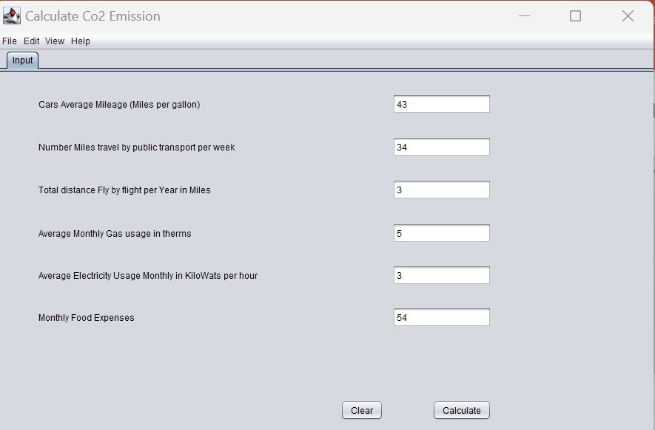
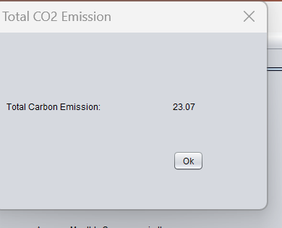
GitHub Repository Link & supporting diagrams, screenshots
https://github.com/jbt1607/Sustainability-Hack/tree/main/Idea/sources/GreenSoftware

Slide 10
Thank You
Jnaneshwar B.T. +91-6362847265

