Slide 1
Video Classification and Analysis for Travel Content
Presented By:
1. Manikanta Kodandapani Naidu (k11@iu.edu)
2. Charan Chowdary Pothumarthi (chpothu@iu.edu)
3. Jayanth Budigini (jbudigin@iu.edu)

Slide 2
Project Overview
This project uses machine learning techniques to classify and analyze travel-related video content.
Utilizes machine learning models which includes Sequential LSTM.
Employs Scikit-learn and Tensorflow keras libraries for model development and training.
Focuses on temporal data analysis and textual feature processing for robust predictions.

Slide 3
Pre Processing
Dataset Overview: Rows and Columns: Contains 10333 rows and 4 columns (Video ID, Title, Description, Category).
Handling Missing Values: Null Values: Found 334 missing values in the 'Description' column (approximately 3.3% of the data).
Approach: Dropped rows with unknown values to ensure clean input for the models. Ensured critical columns like 'Title' and 'Category' had no missing entries.
Adjustments: Removed malformed entries to maintain data integrity. Validated categories to align with predefined labels (e.g., "art and music," "travel").
Stopwords and Lemmatization: Eliminating common words that do not carry significant meaning and reduced words to their base or dictionary form.
Notes:
Not removing the outliers because time series is continuous data. We shouldn’t make it discontinous by removing values.

Slide 4
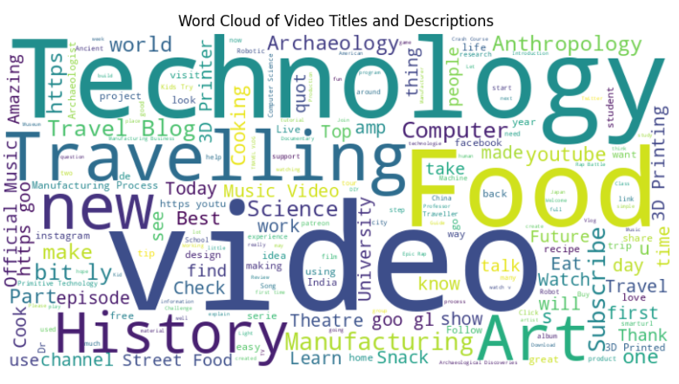
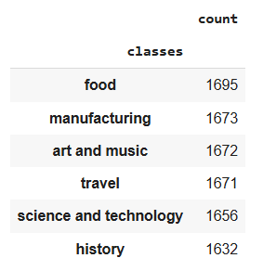
Notes:
Not removing it because, time series is continuous data. We shouldn’t make it discontinous by removing values.

Slide 5
Why SEQUENTIAL LSTM !
Captures Temporal Dependencies: Videos have a sequential structure, and LSTM learns patterns over time.
Processes Variable-Length Sequences: Handles videos of different durations without needing fixed-size inputs.
Extracts Sequential Features: Identifies frame-level patterns and transitions critical for classification.
Addresses Vanishing Gradients: Ensures stable learning for long sequences compared to traditional RNNs.
Enhances Classification Accuracy: Effectively distinguishes between categories by analyzing temporal relationships.

Slide 6
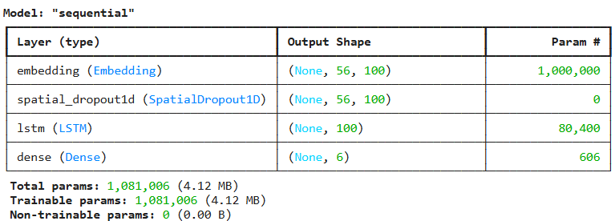
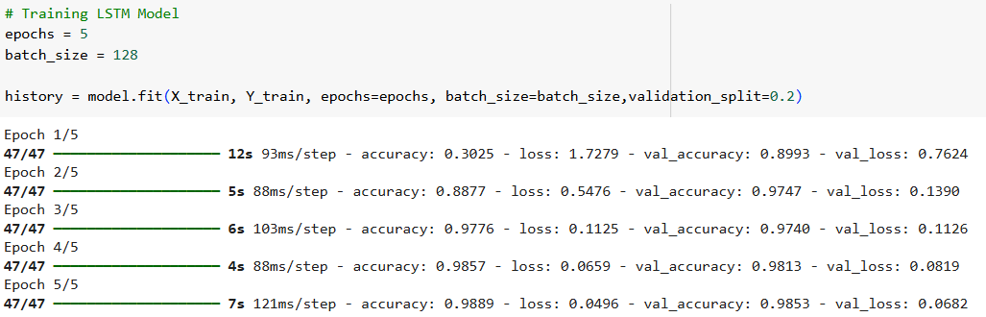
LSTM Summary
Notes:
Not removing it because, time series is continuous data. We shouldn’t make it discontinous by removing values.

Slide 7
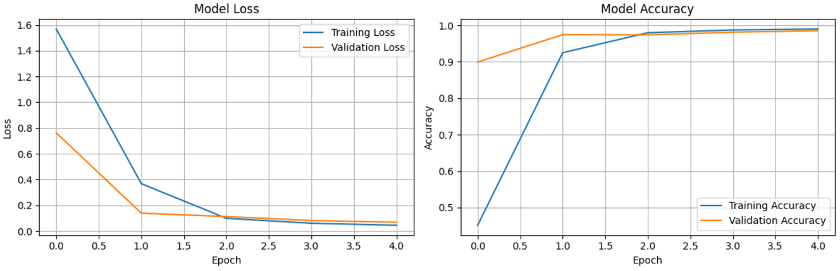
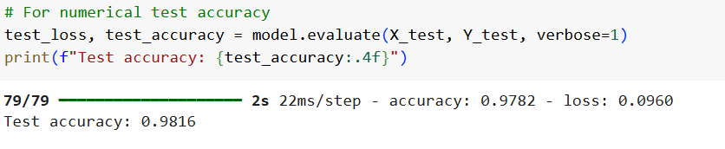
LSTM Model Results :Loss and Accuracy

Slide 8
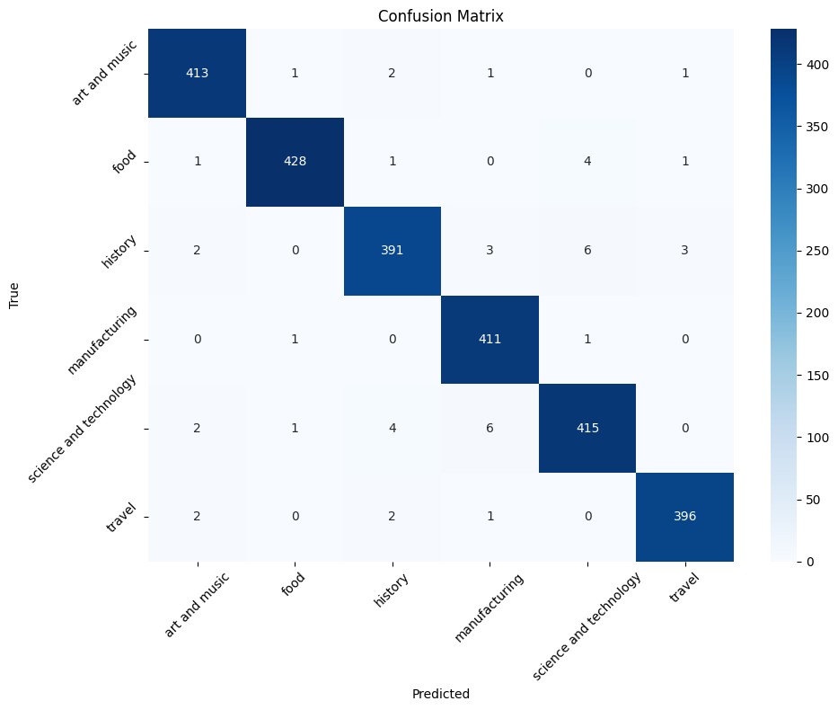
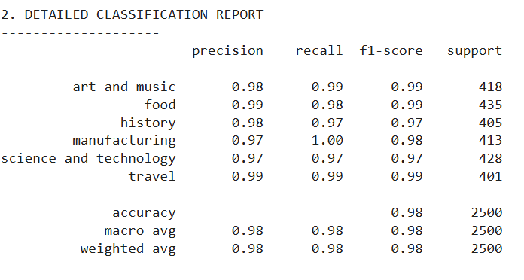
LSTM Model Results

Slide 9
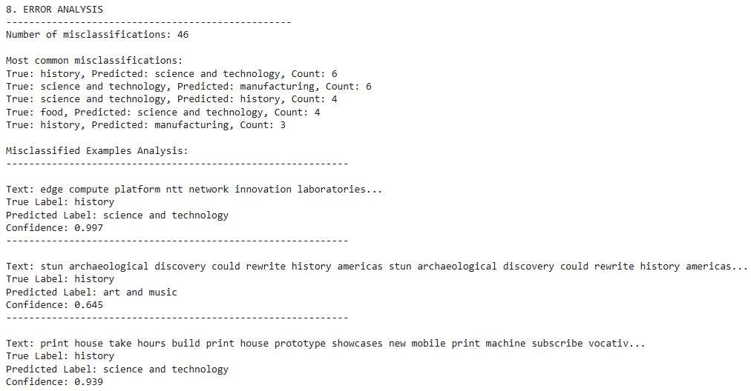
Error Analysis

Slide 10
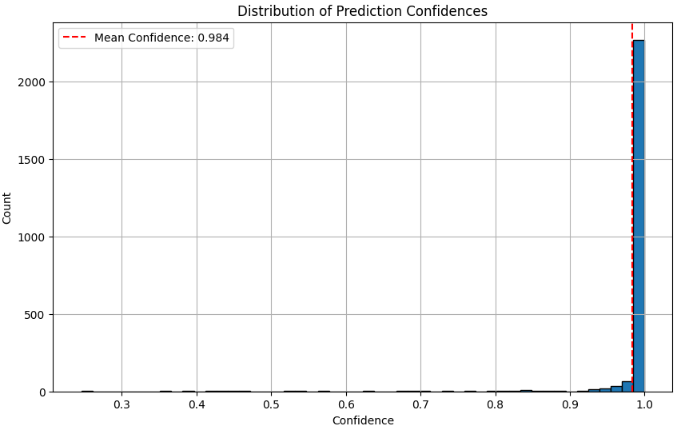
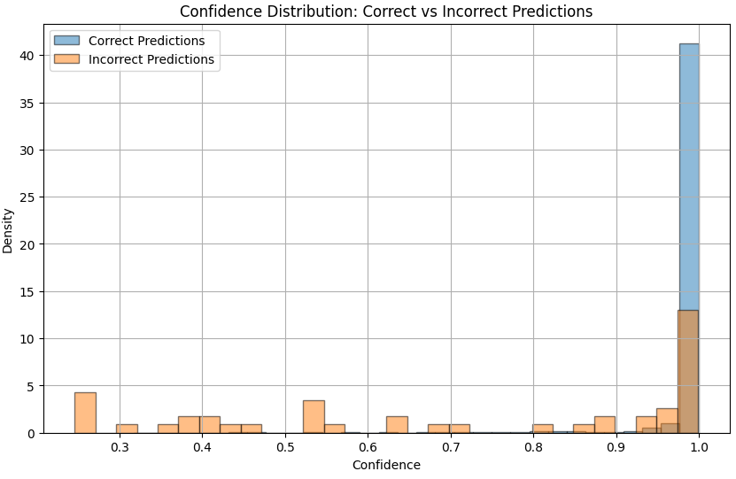
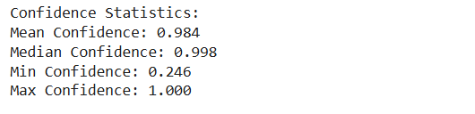

Confidence Statistics: Correct vs Incorrect

Slide 11
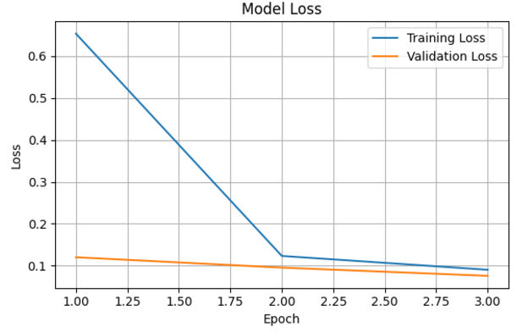

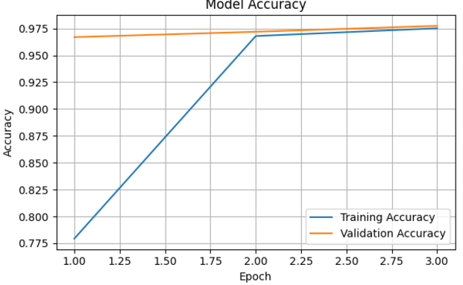
RoBERTa Model Results

Slide 12
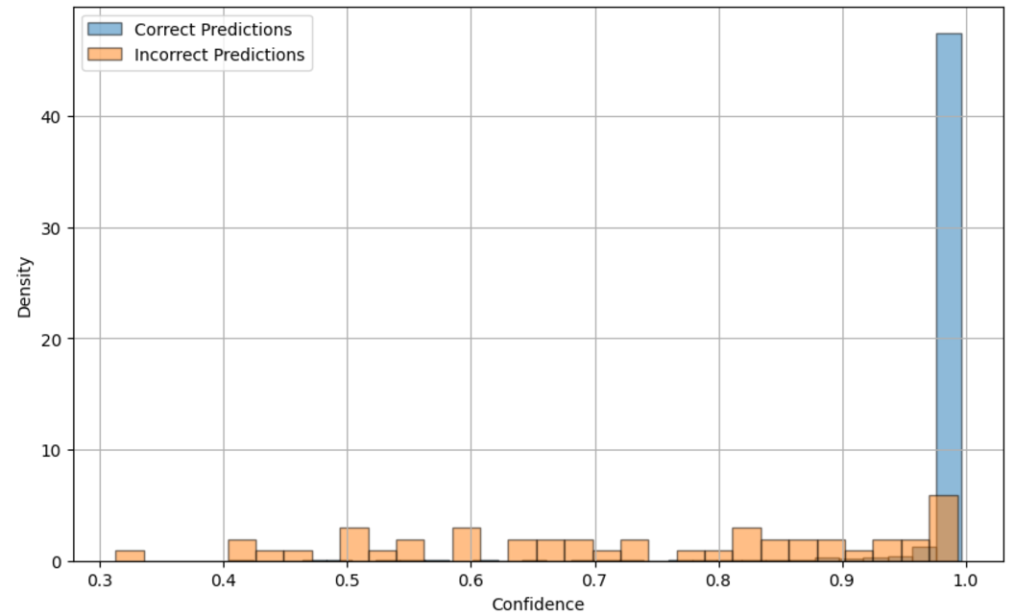
Confidence Statistics: Correct Vs Incorrect

Slide 13
Thank You!

