Slide 1

WildFly Swarm服务构建实战
Building MicroServices with WildFly Swarm
Jim Ma ema@redhat.com

Slide 2
Who is Jim
Redhat JBoss senior engineer
Wildfly/JBoss webservice core developer
Apache CXF PMC/Commitor
Contributors:
jBPM, JAXB, WSS4j, Xerces...
weibo.com/jimmacn

Slide 3
Microservices
Decoupled Components.
系统解耦，拆分成多个服务
Independent release cycles (continuous deployment).
服务开发拥有独立的周期
HTTP, REST or otherwise networked.
服务之间通常采用Http, Rest通讯方式
No limit on size, really.
服务不局限于开发语言和大小
Micro functionality, not micro lines-of-code.
服务具有通常具有简单小巧的功能，但不是说一个服务只有几行代码
Preferably self-contained.
服务通常不需要容器运行
But not just Docker-izing everything.
不只是Docker-izing现有的东西

Slide 4
WildFly
Java-EE application-server
Java-EE应用服务器
ALL OF JAVA-EE
是包含JavaEE规范所规定的所有组件
So, it’s big but it's faster
160.7 M～2s启动

Slide 5
WildFly Swarm
WildFly, broken apart
将wildfly拆分，自由组合
Maven-addressable components
提供maven plugin来组织服务
Fat-jarrable fat-jar方式启动服务
You can provide your own main(...)
支持用户创建的main函数
Programatic configuration (instead of standalone.xml)
通过程序来配置运行时组件

Slide 6
WildFly Swarm
Automatic configuration 自动进行配置
Convention over Configuration约定优于配置
Beyond Java-EE 不只是Java EE
- Netflix Ribbon
- Logstash

Slide 7
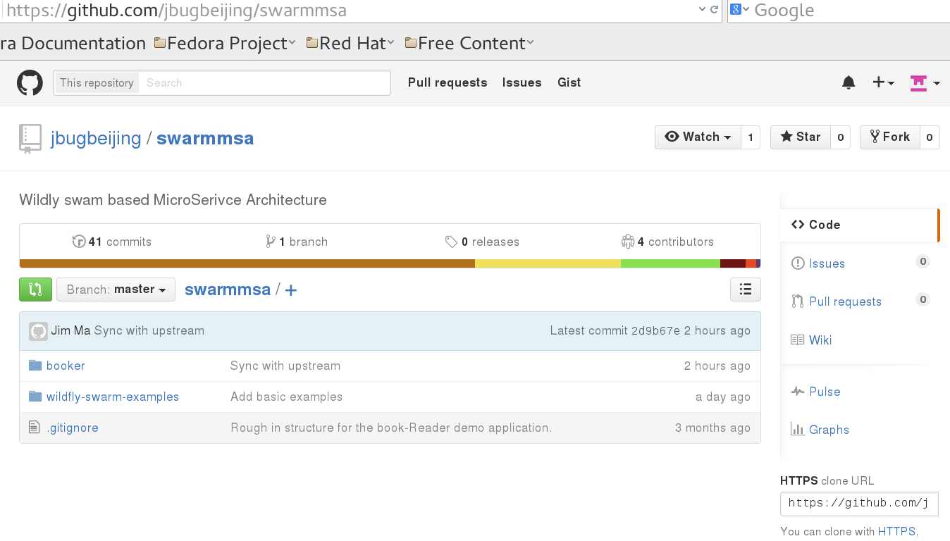
Let's get started
git clone https://github.com/jbugbeijing/swarmmsa.git
advanced
basic

Slide 8
Login to laptop:
Fedora22
username/pwd: jboss/jboss
java/maven/ant are ready
Eclipse4 : /home/jboss/java/eclipse4
All demo code already cloned under: /home/jboss/code

Slide 9
Example1: Create Service with Servlet

Slide 10
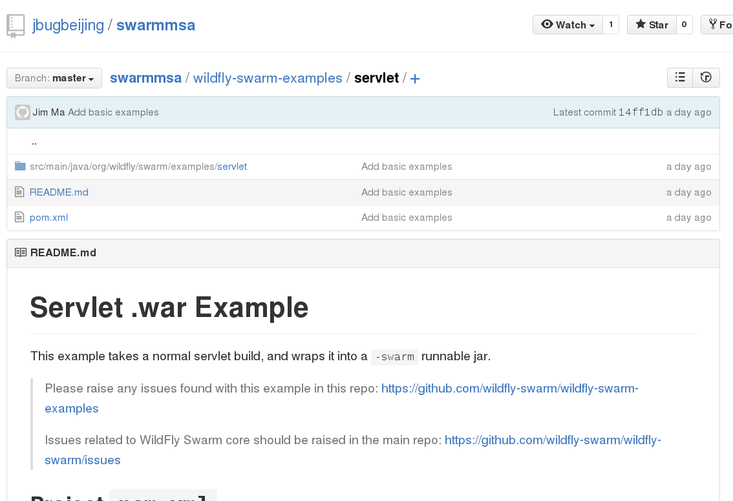
Code is here

Slide 11
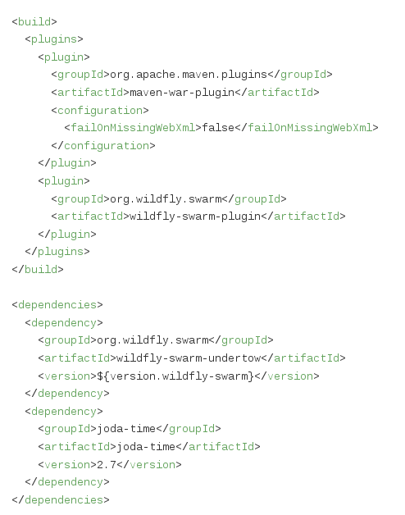
2 plugins and 2 dependencies

Slide 12
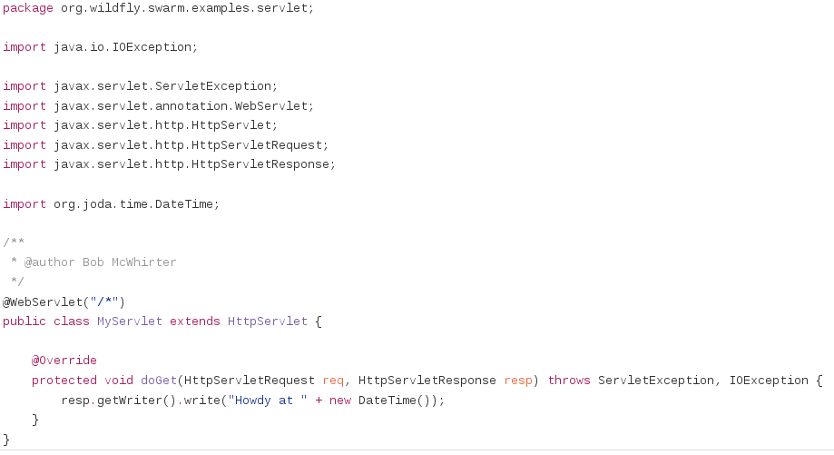
Just A Servlet3 !

Slide 13
Example2: Create service with jax-rs/restful code

Slide 14
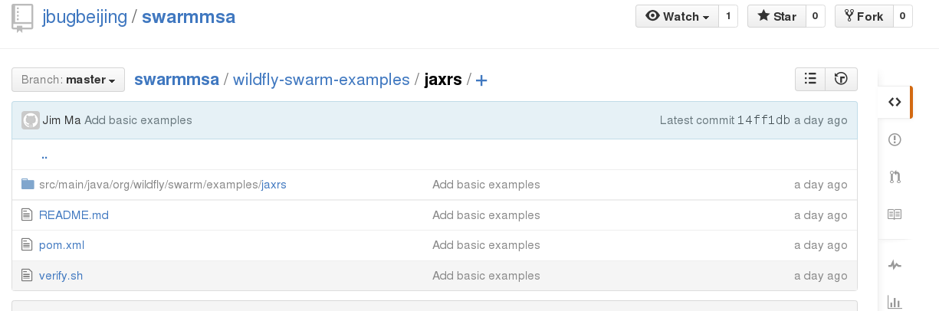
Code is here

Slide 15
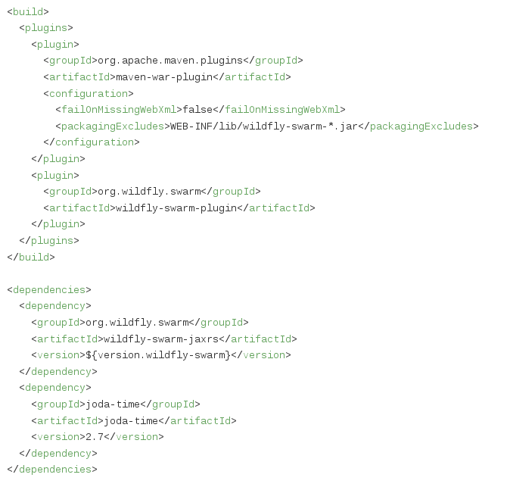
Still 2 plugins and 2 dependencies

Slide 16
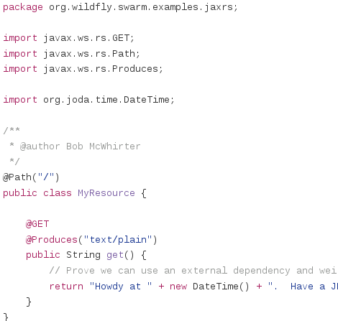
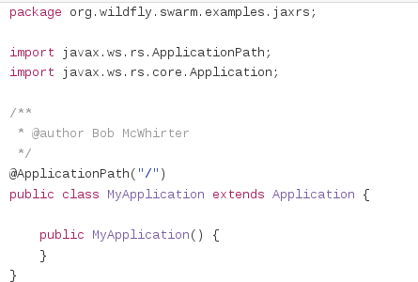
Two classes

Slide 17
Example3:Create service with jaxrs,cdi and jpa

Slide 18
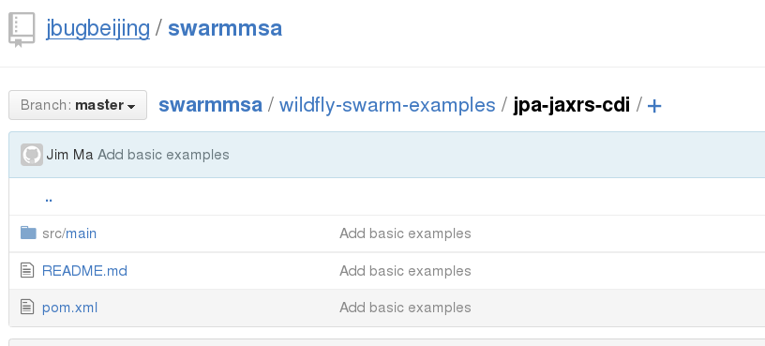
Code

Slide 19
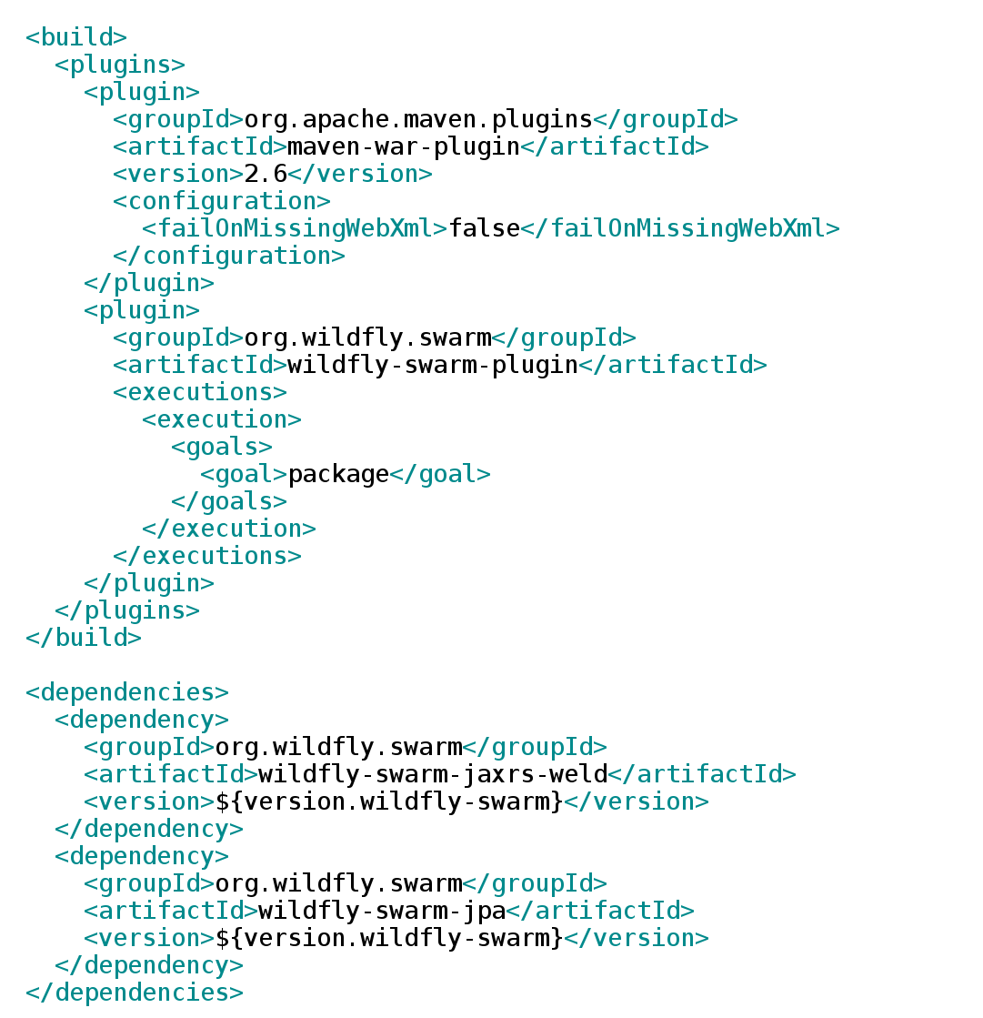
Simple plugins dependencies
Focus on code, not package and deploy

Slide 20
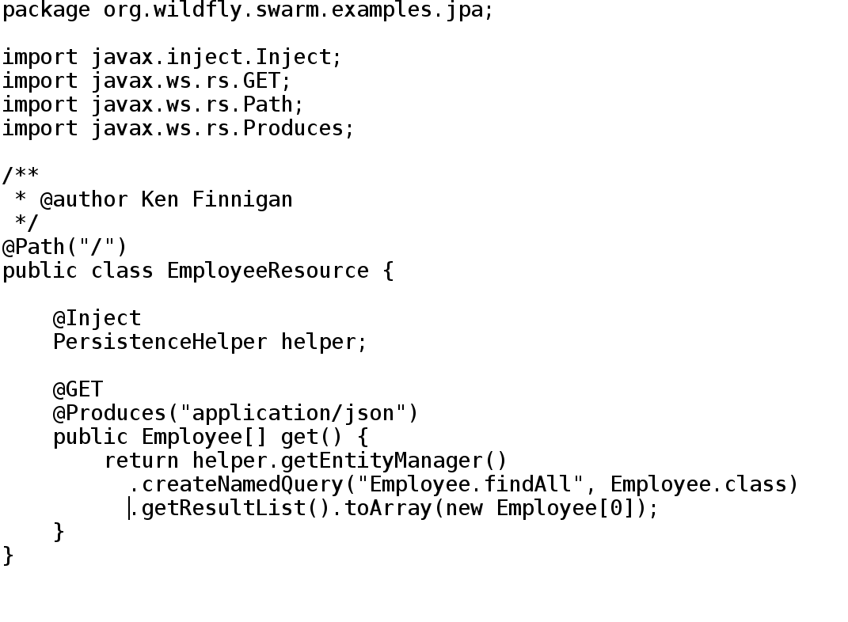
JPA,JAX-RS And CDI

Slide 21
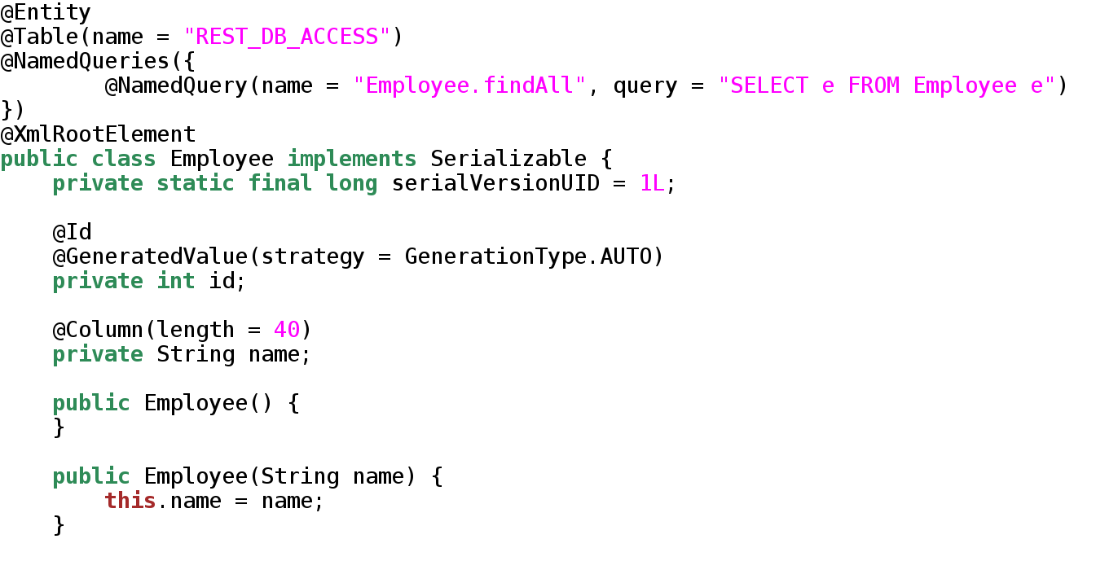
JPA,JAX-RS And CDI

Slide 22
Question
Can you add an employ register rest api and write some test code to check it works ?

Slide 23
Advanced Example: Booker

Slide 24
What is Booker ?
• Akin to the Amazon Kindle Store
• Search for books
• Get price for books
• Buy books
• Keep your library of purchased books

Slide 25
What is Booker ?
Authentication using Keycloak
Logging using Logstash
React.js single-page-app Web UI
Inter-service communication using Ribbon

Slide 26
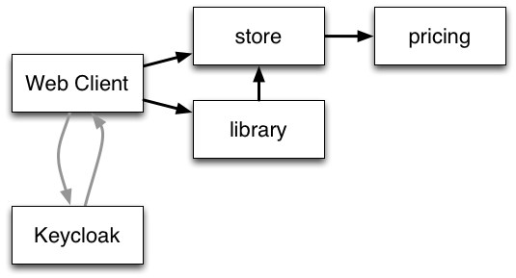
What is Booker ?
Authentication using Keycloak
Logging using Logstash
React.js single-page-app Web UI
Inter-service communication using Ribbon

Slide 27
Keycloak
Single-sign-on with JSON Web Token(JWT)
Supports social login
Bearer tokens for automated access
Token propagation for chained service invocations
$BOOKER_HOME/extra/keycloak/README.md
http://downloads.jboss.org/keycloak/1.5.0.Final/keycloak-1.5.0.Final.zip
Unzip
cd keycloak-1.5.0.Final/
./bin/standalone.sh -Djboss.http.port=9090

Slide 28
Keycloak
http://localhost:9090/
admin / admin

Slide 29
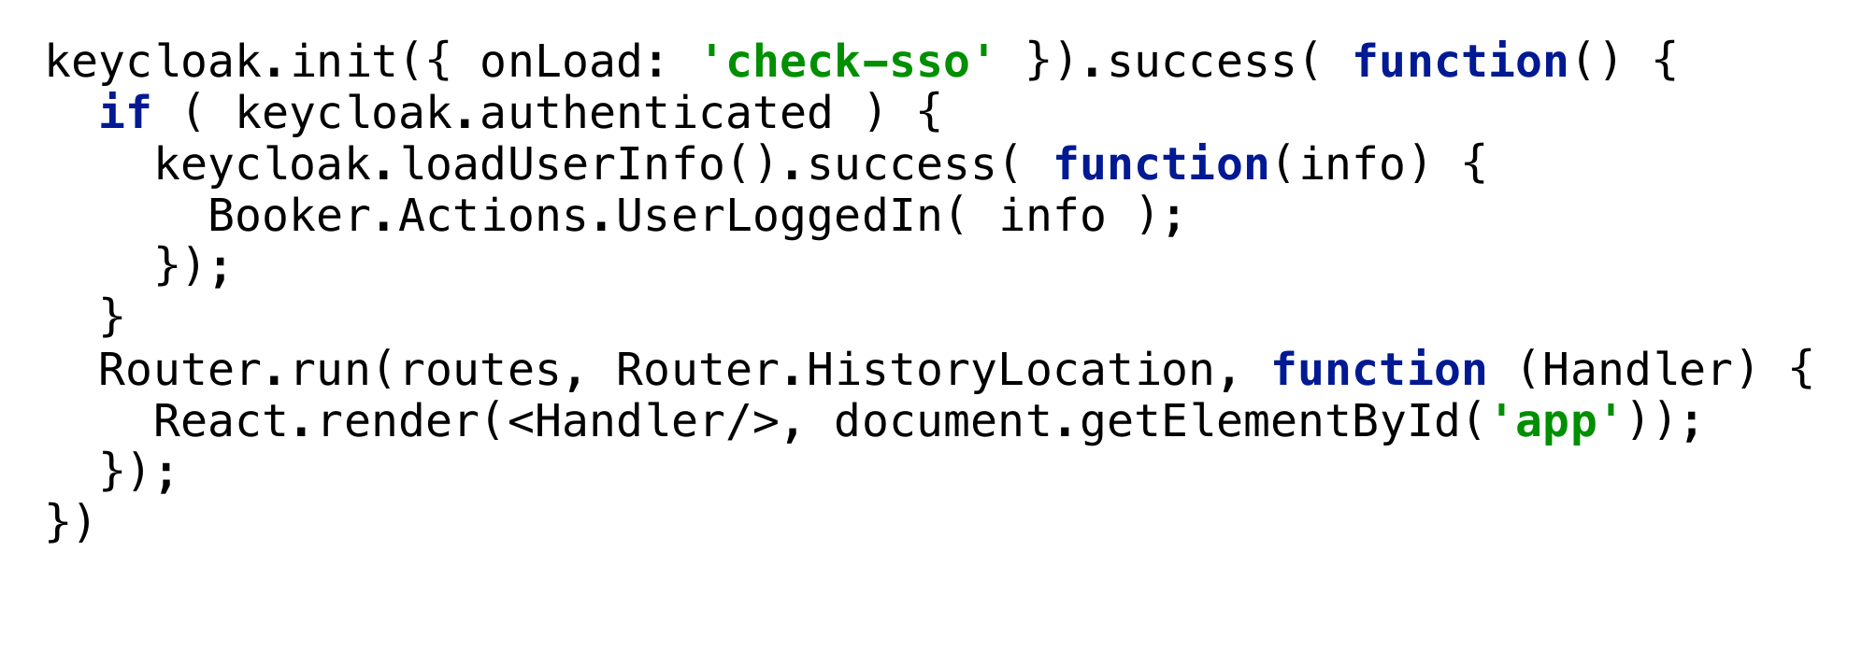
Securing from .js

Slide 30
Ribbon
Ribbon is a client side IPC library that is battle-tested in cloud. It provides the following features
Load balancing
Fault tolerance
Multiple protocol (HTTP, TCP, UDP) support in an asynchronous and reactive model
Caching and batching
Ribbon in Java uses WildFly Clustering to wire
together services.

Slide 31
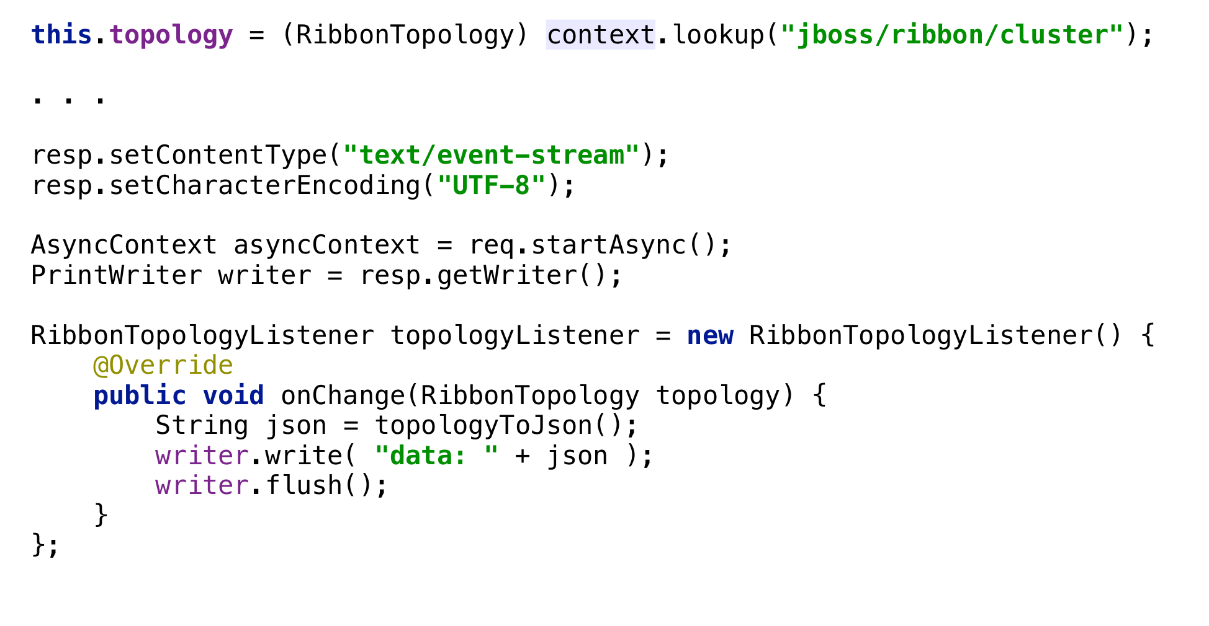
Ribbon

Slide 32
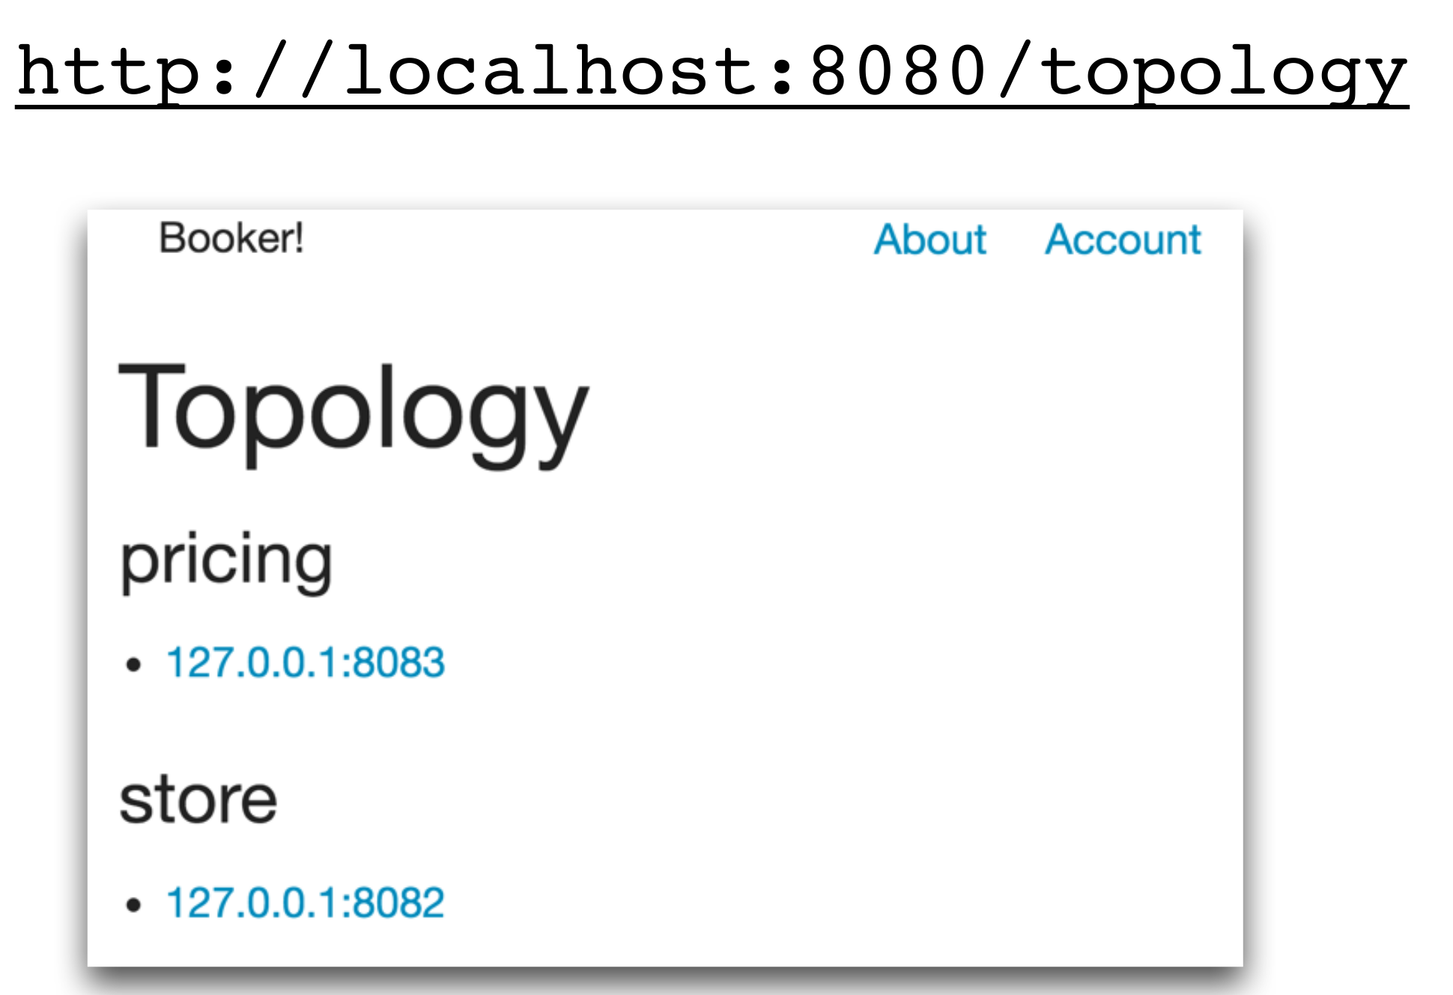
Ribbon

Slide 33
Logstash
If you deploy a lot of services, that’s a lot of logs to keep up with
Logstash + Kibana lets you log to a central
location, and search them in aggregate

Slide 34
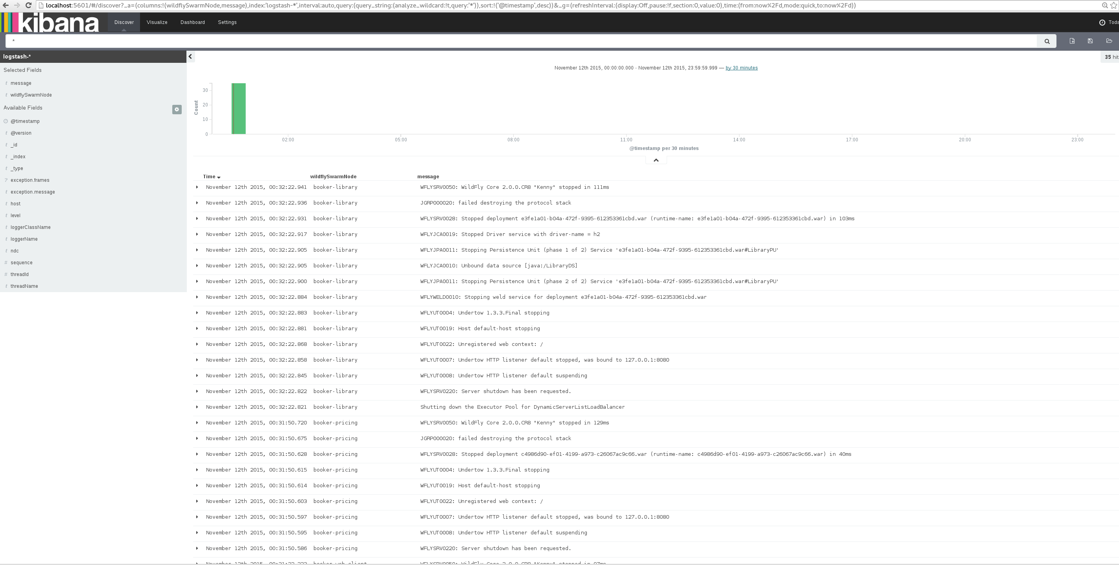
Kibana

Slide 35
Demo
BOOKER_HOME/bin/run_all.sh
http://localhost:8080

Slide 36
Q&A

