Slide 1
Tagging policy areas for federal legislation
By: Jehan Bugli

Slide 2

The number of introduced bills is reaching record highs
Average bill processing time has tripled from 4 to 12 days across the last 4 sessions
Sources: Congress.gov, Roll Call
Notes:
https://www.congress.gov/search
https://rollcall.com/2025/03/05/publishing-pileup-congressional-bills-slow-to-reach-public/

Slide 3





Policy area tags are a prime target for NLP investigation
Policy area tags are static and mutually exclusive
Legislative text is structured and formal
Taxation
Labor and Employment
Legislative text uses precise, consistent language due to statutory definitions and implications
Foreign Trade and International Finance
Health
Bills dealing with the same subject matter will often cite similar code excerpts
Law
Language is frequently recycled across bills that amend others, move in parallel, etc.
Agriculture and Food
Armed Forces and National Security
Legislation has no casual or undefined terms, unlike less regulated information sources
Education

Slide 4








Classical NLP methods have significant implementation benefits relative to SOTA neural networks
The CRS must be able to justify label choices for various stakeholders
Implementation is easier and cost-effective
Congressional offices
Policy analysts
No LLM API expenses, elaborate setup, etc.
Inexpensive to train or retrain on new data
Faster inference
Public affairs professionals
Other public stakeholders

Slide 5




The dataset includes all bills from 2013-present, downloaded from the GovInfo bulk data repository
Dataset 1: Bill text
Dataset 2: Processed bill data
Download a zipped collection of text versions
Download a zipped collection of bill data files
Extract into a flattened folder of XML files
Extract into a flattened folder of XML files
Input data with tagged bill contents
Isolate the content body for each bill text file
Isolate the policy area and the text version IDs for each data file

Slide 6

TF-IDF transformed “raw” bill text into feature vectors
Term Frequency: how often a term appears within a document
Inverse Document Frequency: how rare a term is over the document collection

Slide 7



3 different models were tested on extracted feature vectors
Relative model performance (macro recall) on a test dataset
Models were tested using a grid search, modulating parameters like C (regularization)
Recall is the rate of true positives over all actual positive class instances (true positives + false negatives); macro recall averages recall values across all classes without considering imbalance
Metric choice was based on practical implications, where catching relevant (potentially niche) legislation is critical

Slide 8
Performance differed significantly by policy area
LinearSVC performance on a test dataset by policy area (first 10)
“(#)” represents available instances in the test dataset

Slide 9
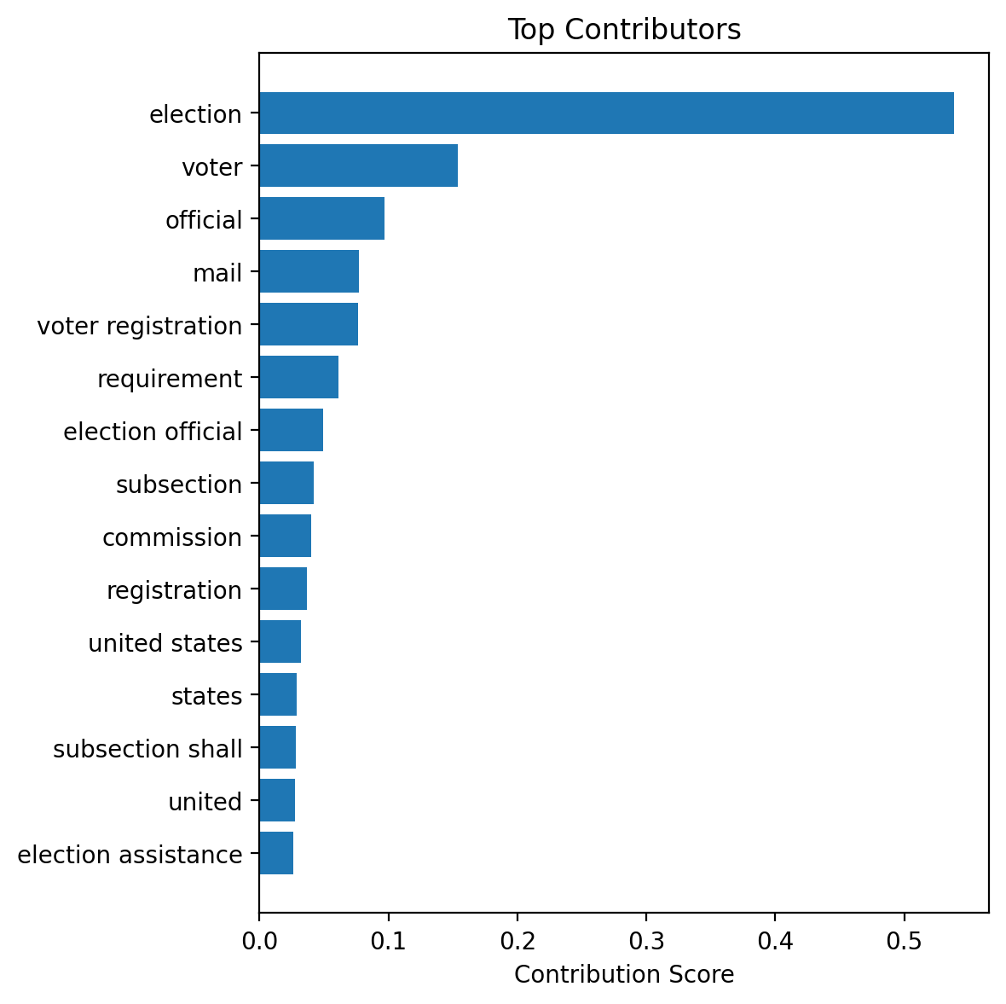
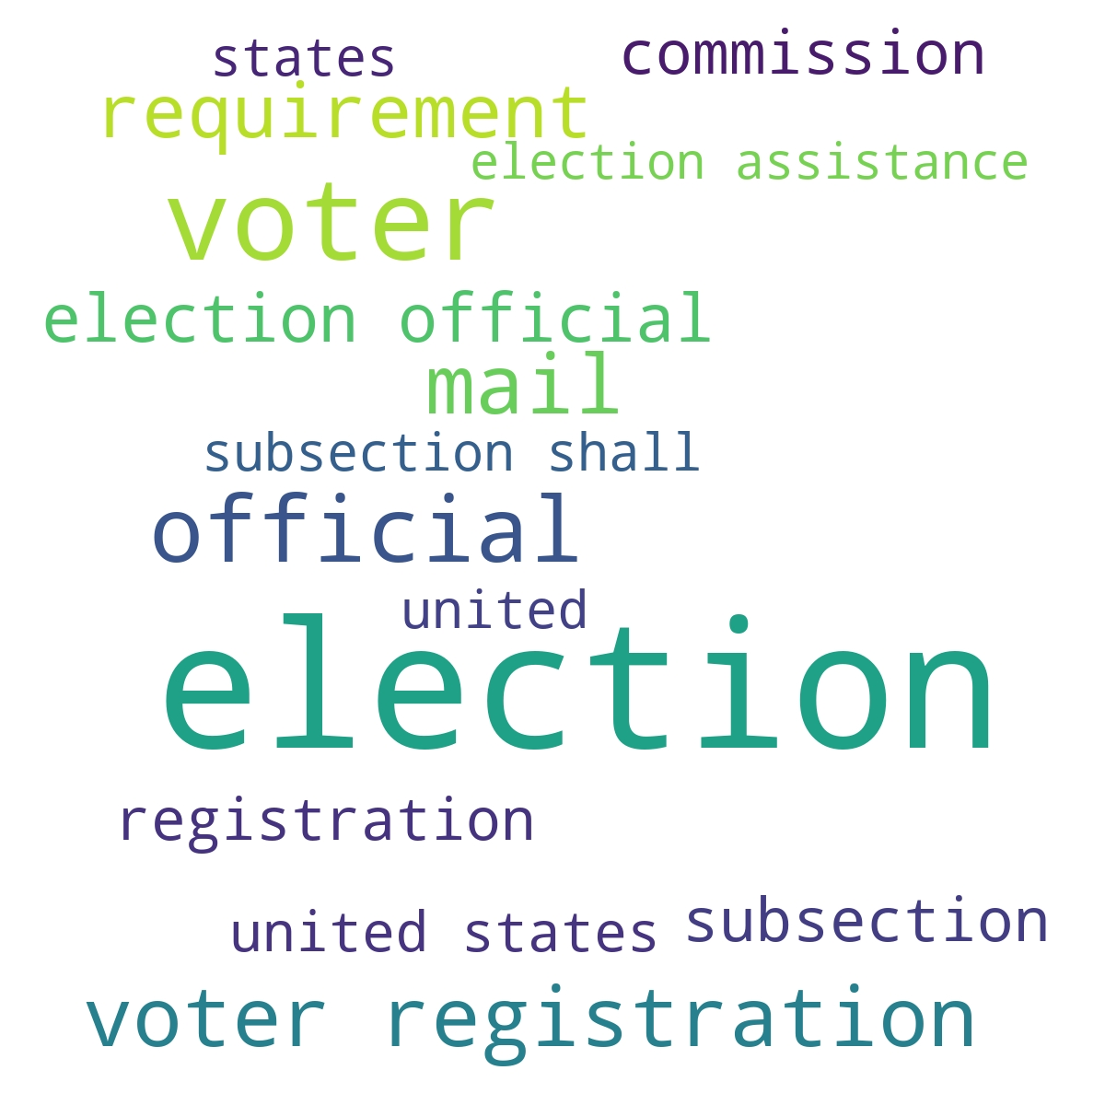


App implementation involves entering text and returning responses + interpretation
Notification of requirement.--Upon receiving an otherwise completed mail voter registration application form prescribed by the Election Assistance Commission pursuant to section 9(a)(2) or a form described in paragraph (1) or (2) of subsection (a), the appropriate election official shall transmit a notice to the applicant of the requirement to present documentary proof of United States citizenship under this subsection, and shall include in the notice instructions to enable the applicant to meet the requirement.
Prediction: Government Operations and Politics

Slide 10

Results indicate that classical approaches can form a robust policy area classification mechanism
Avenues for further investigation
Refining stop-word implementation
More robust metrics taking class overlap into account
Investigating legislative attitudes and biases
Testing against similar text corpora to generalize

