Slide 1
Exploring applications for the Montandon Global Crisis Data Bank
Jeongmin An, Jehan Bugli, and Aidan Carlisle

Slide 2
The Montandon Data Bank collects disaster data from disparate sources, exposing it under a unified system
Key research question: how can the data bank be used to understand disasters and respond to them more effectively?
EM-DAT
Montandon record fields include:
Unstructured text (title, description, keywords)
General event metadata (dates, countries, etc.)
Universal codes (e.g. hazards) and source-specific IDs
Geometry (coordinate points, polygons, etc. by source)
GDACS
Montandon
IFRC

Slide 3
We built a network connecting Montandon records and external data to serve as an LLM query layer
Montandon records are connected to each other, external articles, and the IFRC GO API
Temperature data is collected from the NASA POWER API and integrated with relevant Montandon records
Nodes and edges are saved in a local Neo4j instance
LLMs receive tools that execute templated Cypher queries
Disaster 2
Disaster 1
Same country
Article 1
Similar embeddings for text fields
Disaster 3
Article retrieved from an external source (e.g. NewsAPI) describing the event
Potentially matching IFRC GO API ID
Matching IFRC GO API ID
Red Cross Event 1
Red Cross Appeal 1
Associated operation responding to the same disaster from the GO API
Appeals associated with events from the GO API

Slide 4
Historical disaster coverage requires a searchable news archive
NewsAPI.org Developer access searches only recent articles.
Media Cloud provides historical article discovery for our event dates.
We search by event date, hazard, and country; matches are candidates, not confirmed evidence.
Pilot: 2025 Texas flash flood
July 3-10, 2025
“Flash Flooding” AND “United States” AND language:en
Article Candidate
search query
search results
Article Candidate
Montandon Event
Media Cloud API
Article Candidate
title , date, URL
Observed pilot: 100 article candidates returned in the initial API request; relevance not yet verified.

Slide 5
Article candidates must be checked before linking them to disaster
Search results mix signal and noise
Media Cloud supplies title, date, and URL - not downloadable article text.
We fetch publisher HTML when accessible and extract the body
A four-way decision compares article evidence with the event.
Looks relevant
Texas flash flood is a preview of chaos to come
Looks unrelated
EPA article about contrails
Both appeared in the first 100 results for the same event query.
VERIFIED_FOR
Same event
Disaster node
Article Candidate
Publisher body extraction
Event relevance decision
Related context
Uncertain/ body unavailable
Different event

Slide 6
Local LLM performance was benchmarked against a set of fact retrieval questions
We created question banks with known answers from the network
LLMs were given these questions and graded on performance (% correct)
Answers were requested in specific formats supporting substring checks
Testing centered around Qwen3-1.7B, Qwen3-5-4B, and Qwen3.5-9B
“Which disaster (by starting date) had the highest wind speed?
<answer>2025-10-01</answer>
Disasters on 2025-10-01 and 2025-10-09 had equivalent wind speed.
“How many people were affected by X disaster”?
X disaster affected 12,050 people.
X disaster affected 20 people.

Slide 7
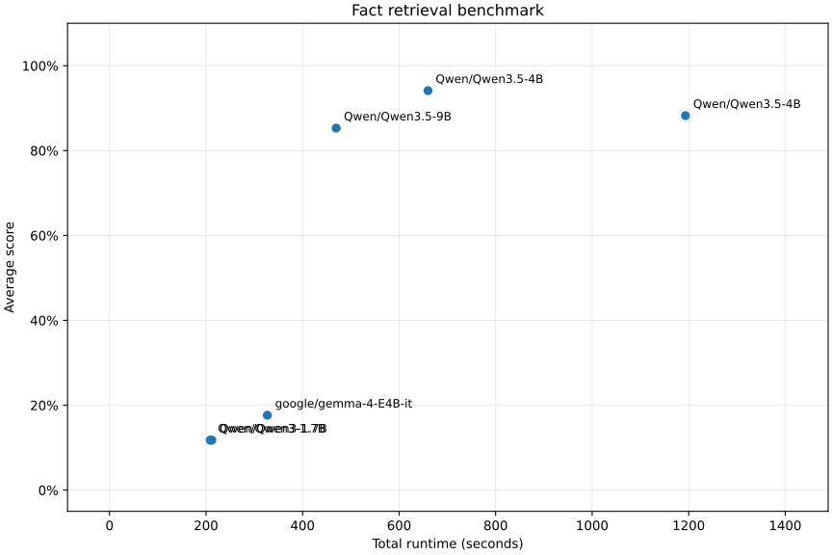
Qwen3.5-4B performed the best in evaluations, making that our local LLM of choice for an initial demo (1/2)
Benchmark 1: General fact retrieval
Interestingly, Qwen3.5-4B performed better than its 9B counterpart
All models had some difficulty following instructions well
Benchmarks informed the templated tool approach due to difficulties with raw Cypher
General fact retrieval was tested alongside historical weather data (latter with/without tools) to investigate innate world knowledge

Slide 8
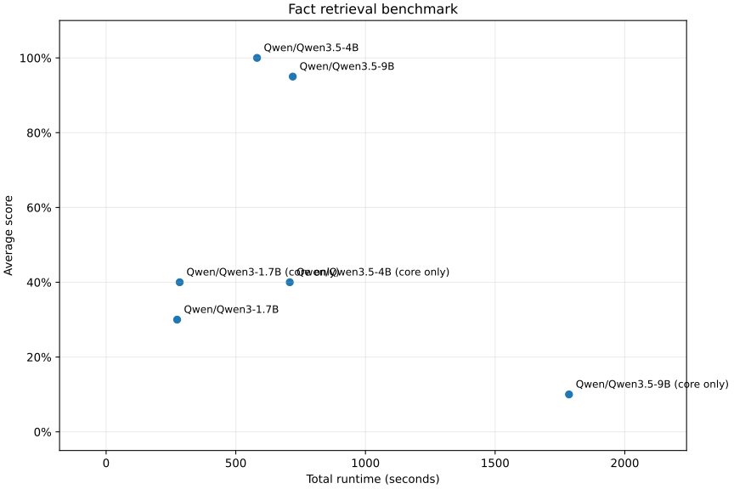
Qwen3.5-4B performed the best in evaluations, making that our local LLM of choice for an initial demo (2/2)
Benchmark 2: Historical weather data
Interestingly, Qwen3.5-4B performed better than its 9B counterpart
All models had some difficulty following instructions well
Benchmarks informed the templated tool approach due to difficulties with raw Cypher
General fact retrieval was tested alongside historical weather data (latter with/without tools) to investigate innate world knowledge

Slide 9
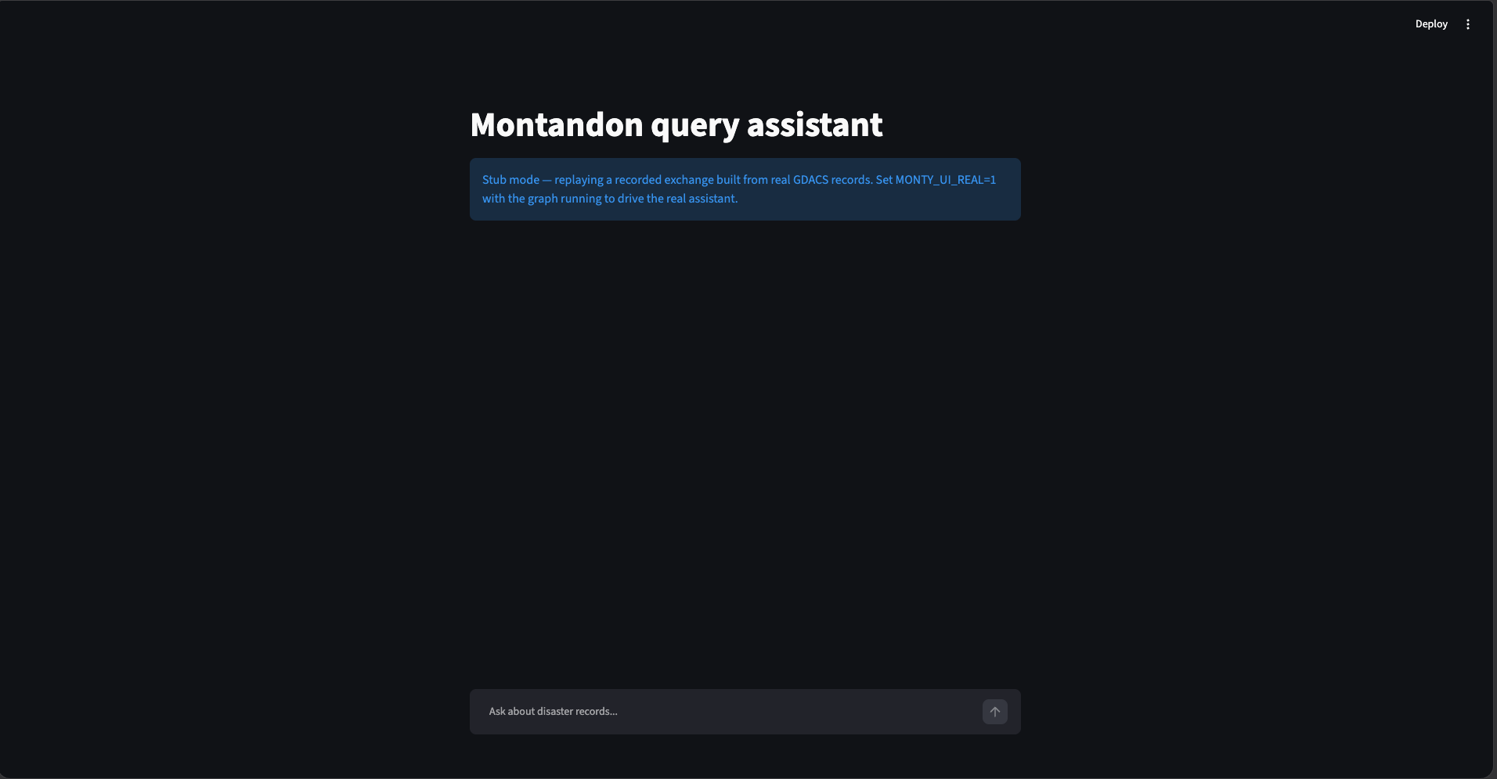
User Interface
Built a Streamlit app that wraps the QueryAssistant and shows its output
Shows conversation history and a list of specific disaster records that contributed to the answer

Slide 10
