Slide 1
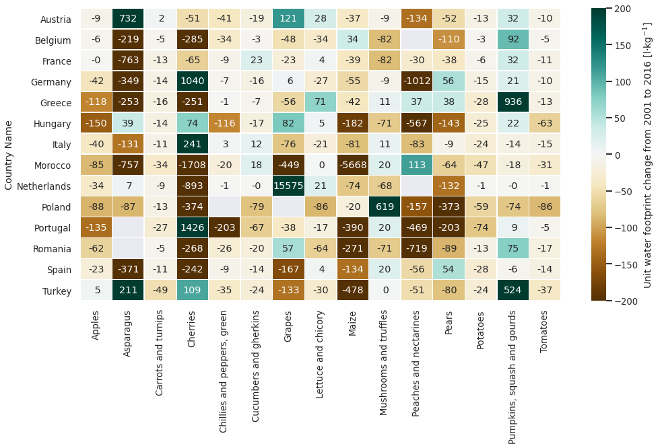
Results of Jörg (Questions 4 and 9) Q4: How did the unit water footprint (uWF) change within the last 15 years of data (2001-2016)?
+ uWF decreases in most cases (76%) of all 15 products in all 15 countries considered within the last 15 years. + uWF of potatoes, tomatoes, maize, carrots, chilies and apples decrease most consistently in almost all countries while pumpkins, mushrooms and lettuce increase in at least half of the countries considered.

Slide 2
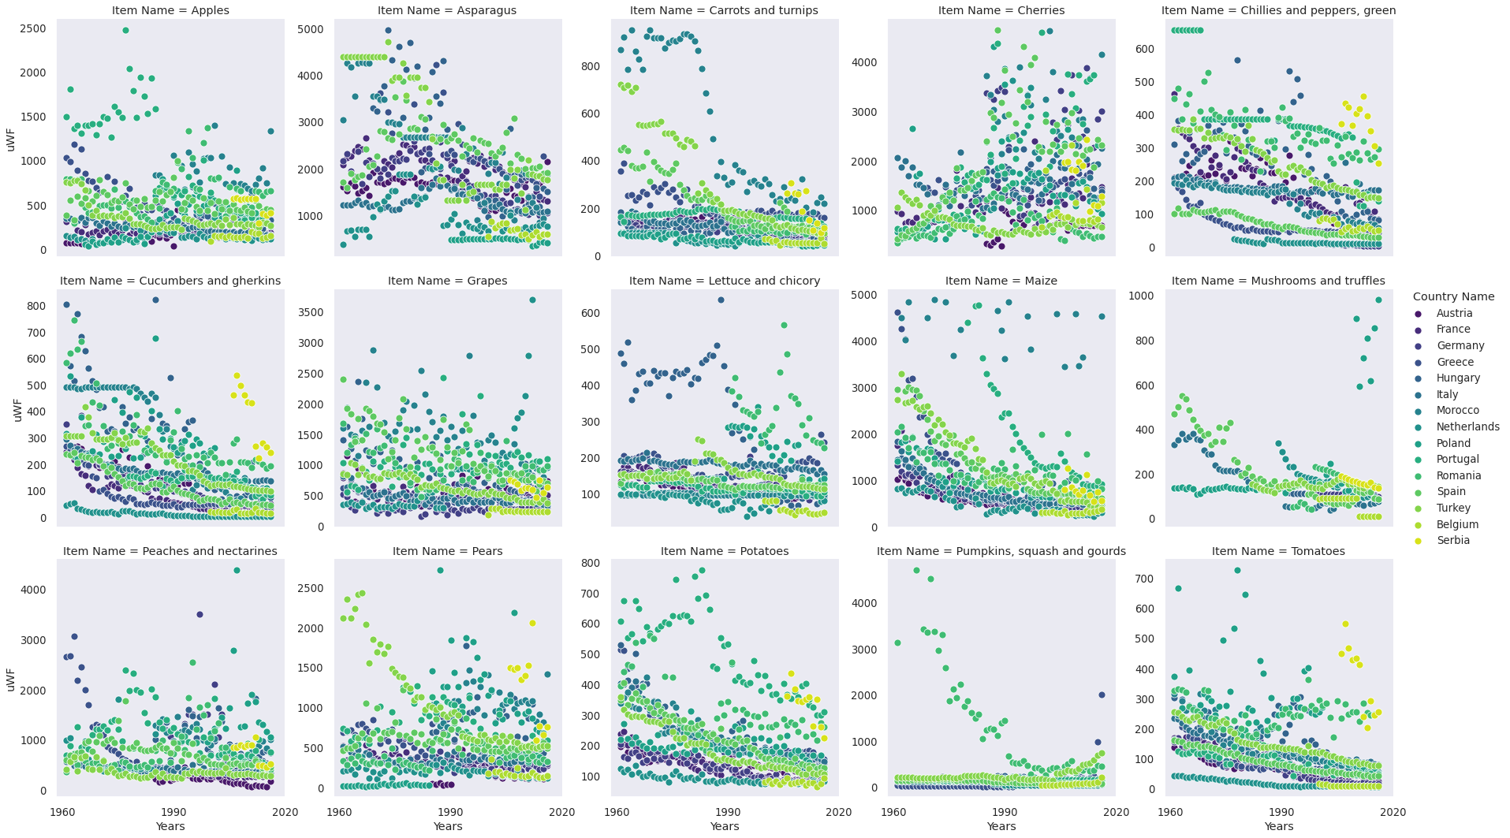
+ From 1960-2016, uWF changes vary dramatically among countries and products. Nevertheless, a few typical patterns can be observed: (1) exponential decay over time, converging toward constant uWF; (2) strongly fluctuating uWF (unknown reasons); (3) constant uWF over many years, some decline suddenly; (4) a seemingly random behavior. + Few extremely high uWFs (> 10,000 l/kg) occur for few products/countries (e.g., grapes in Netherlands, maize in Marocco) that could be considered outliers/erroneous data; but: lack of knowledge!
+ Except for cherries, we find at least an average trend of a decreasing uWF over time for most countries.

Slide 3
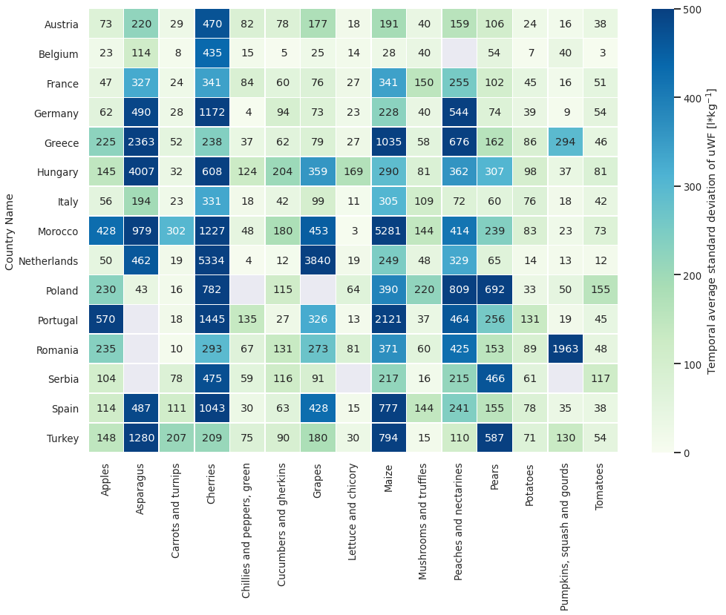
Q9: How is the unit water footprint (uWF) distributed among the different products/countries over time?
+ Indepent of some extreme values, uWF varies more among products than among countries.
+ uWF varies strongly (sdev > 500 l/kg) for some products, such as cherries, asparagus, maize while other products hardly vary in their uWF (sdev < 100 l/kg) such as potatoes, lettuce, chilies (see below).
+

Slide 4
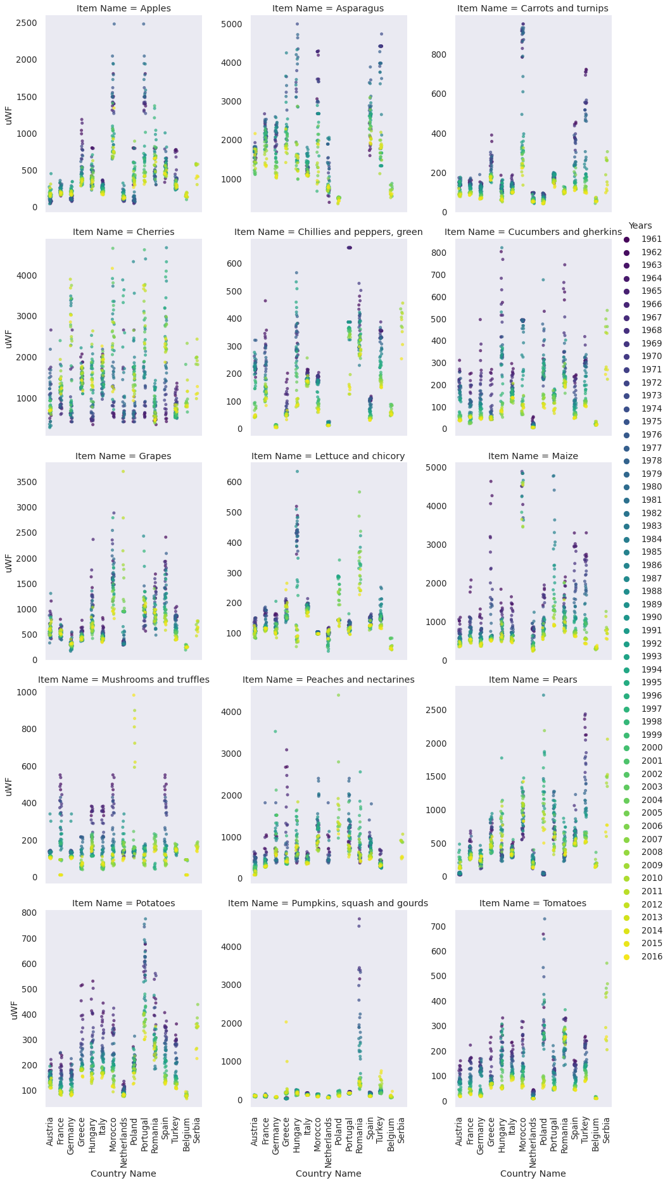

Slide 5
