Slide 1
Natural Language Processing
Jonathan Burge

Slide 2
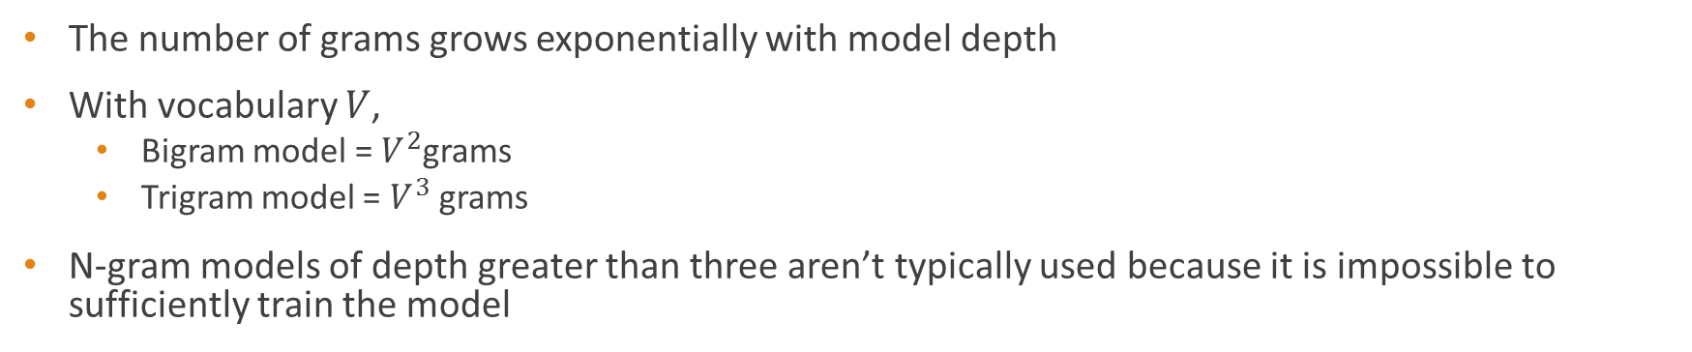
N-gram model
Simple probabilistic model
Computes a probability distribution for n based upon the previous observed n-1 word
once
upon
a
?
n-3
n-2
n-1
n
The number of grams grows exponentially with model depth
With vocabulary $V$,
Bigram model = $V^{2}$grams
Trigram model = $V^{3}$grams
N-gram models of depth greater than three aren’t typically used because it is impossible to sufficiently train the model

Slide 3

Example: Trigram Model
once
upon
a
?
n-3
n-2
n-1
n
Accesses each chain of length three
$$P\left(current word \right| Predicate)$$
Predicate | Current word | Probability
upon a | time | .4
upon a | new | .01
upon a | train | .005
… | … | …

Slide 4

MLE Estimate
Easily computed:
$$P\left(w_{n} | w_{n−1}w_{n−2}…\right)=\frac{C({w_{n}w}_{n−1}w_{n−2}…)}{C(w_{n−1}w_{n−2}…)}$$
MLE model attributes 0 probability to events not observed in the training data
Overfit
Need a way to make it more general

Slide 5
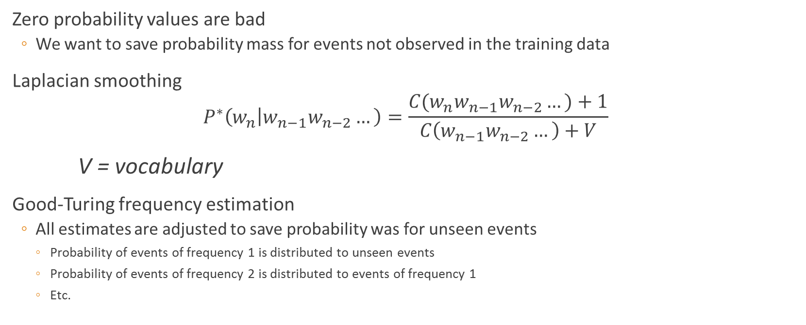
Smoothing
Zero probability values are bad
We want to save probability mass for events not observed in the training data
Laplacian smoothing
$$P^{∗}\left(w_{n} | w_{n−1}w_{n−2}…\right)=\frac{C(w_{n}w_{n−1}w_{n−2}…)+1}{C\left(w_{n−1}w_{n−2}…\right)+V}$$
V = vocabulary
Good-Turing frequency estimation
All estimates are adjusted to save probability was for unseen events
Probability of events of frequency 1 is distributed to unseen events
Probability of events of frequency 2 is distributed to events of frequency 1
Etc.

Slide 6
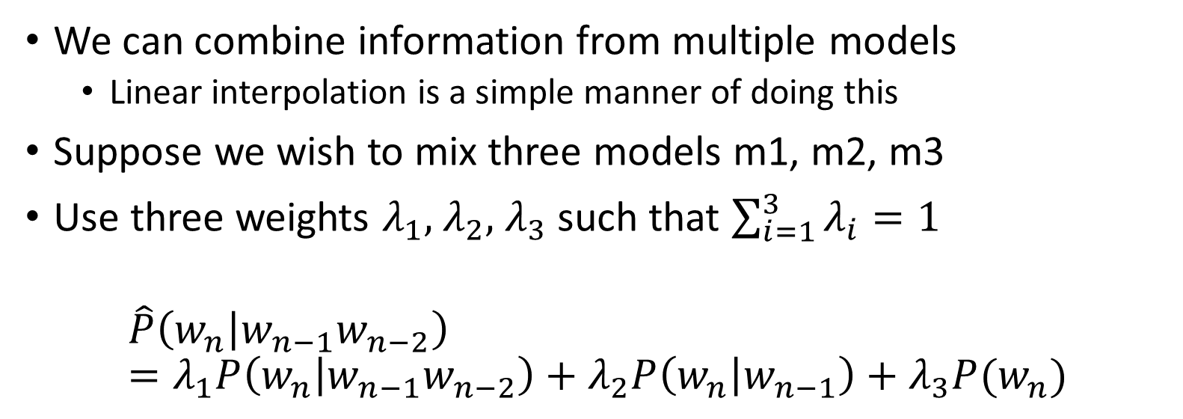
Interpolation
We can combine information from multiple models
Linear interpolation is a simple manner of doing this
Suppose we wish to mix three models m1, m2, m3
Use three weights $λ_{1},$ $λ_{2},$ $λ_{3}$ such that $\sum_{i=1}^{3}{λ_{i}}=1$
$$\hat{P}\left(w_{n} | w_{n−1}w_{n−2}\right) =λ_{1}P\left(w_{n} | w_{n−1}w_{n−2}\right)+λ_{2}P\left(w_{n} | w_{n−1}\right)+λ_{3}P{(w}_{n})$$

Slide 7
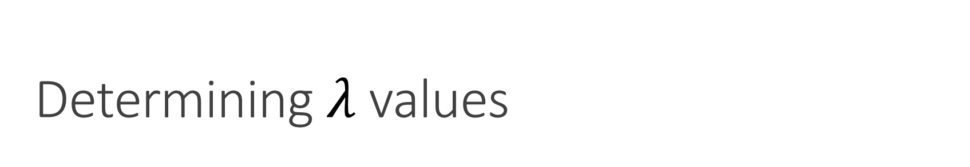
Determining $λ$ values
Typically this is done using held-out corpus

Slide 8





Evaluation of Model Ability to Predict
$$λ=(.01, .345, .645)$$
$$λ=(.01, .495, .495)$$
$$λ=(.01, .645, .345)$$
$$λ=(.33, .34, .33)$$
$$λ=(.3, .7, 0)$$
Austen Model
Dickens Model
Twain Model

Slide 9
Breakdown of Correct Predictions
Graph of each models correct predications on A Tale of Two Cities.
All models used linear interpolation (unigram = .01, bigram = .345, trigram = .645) and Laplace smoothing.
Honestly, I find this form of model evaluation very interesting: the model can predict the word the a lot…

Slide 10
Second Form of Evaluation

Slide 11

Autocorrect
New problem:
$$P^{∗}\left(w_{n} | w_{n−1}w_{n−2}, w′\right)$$
Given:
$w′$ is the word the user provides
$w_{n−1}w_{n−2}$ are the preceding words
Predict:
Best candidate for $w_{n}$

Slide 12
Levenshtein Distance (aka Edit Distance)
We need a way to determine how similar two word are
Mutate one word into the other and sum costs of operations
Substitution, removal, insertion
Basic examples
LD(“test”, “text”) = 1 one substitution
LD(“Sunday”, “Saturday”) = 3 two removals, one substitution

Slide 13
How to Implement
Dynamic programming
LD(“test”, “text”)
 |  | t | e | s | t
 | 0 | 1 | 2 | 3 | 4
t | 1 | 0 | 1 | 2 | 3
e | 2 | 1 | 0 | 1 | 2
x | 3 | 2 | 1 | 1 | 2
t | 4 | 3 | 2 | 2 | 1

Slide 14
Future Features
Implement a more sophisticated method of for computing edit distance
Use Good-Turing Estimation instead of Laplacian Smoothing
Allow a model to be saved between program sessions
Finish text editor functionality

