Slide 1
>_ Dotnet new webapi
ASPNET CORE BASICS

Slide 2

same, but different
ASPNET CORE IS KIND OF LIKE ASPNET MVC…
Notes:
ASPNET CORE is very similar to the previous incarnations. It can do most of the same things, but it is also very different. Let’s dive in to what is new

Slide 3
DEPLOY ANYWHERE
>_ WHY, ASPNET CORE?
ALIGNED STACK
LIGHTWEIGHT
MODULARITY FIRST
SELF HOSTable
CONTAINER FRIENDLY
Notes:
Firstly, it is designed to be deployed just about anywhere. You can find aspnet core driving IoT devices, to massively load balanced cloud workloads.
MS decided that having two different ways to make Controllers (Webapi vs MVC) was a bit silly, so they consolidated both stacks, taking the best ideas from each and merged them together.
It is lightweight by design. You can avoid taking a dependency on a great many libraries, making it ideal to fit onto small platforms, like Raspberry Pi, for instance. This has benefits on large scale applications too, more room to scale!
MS seperated a lot of libraries into smaller dependencies, and went with a middleware architecture, allowing us to be more choosy with how we compose various capabilities of our applications.
It can be self hosted, meaning no hard dependency on IIS. Using the provided Kestrel web application host. It is pretty quick too. Typically though, production deployments would not expose these to the web directly, although it is now supported (but not entirely recommended, wait for the security issues to get ironed out). The usual method is to use IIS or Ngenix to handle incoming requests and act as a reverse proxy to your application.
Since it can be self hosted, this makes it possible to use containerisation technologies to make deployment a lot simpler and more reliable.

Slide 4
SETUP YOUR ENVIRONMENT

Slide 5
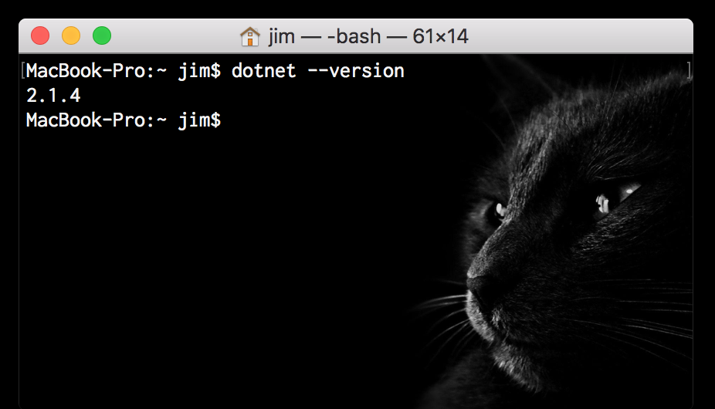
Environment SETUP
Install the .NET SDK 2.1.4
Check you can run the dotnet CLI
Notes:
What I want to do is show you how to build software from first principles, with minimal support for tools. I have a few reasons for this:
If you ever get stuck with a IDE or tool that is misbehaving, you’ll have an effective strategy to troubleshoot and isolate issues
If you ever find yourself in a scenario where downloading an 8Gb installation of visual studio is out of the question, you’ll be able to be productive.
Understanding what a ‘power tool’ actually gets you, and what it doesn’t get you, before using said power tool, is an important part of situational awareness as a developer.
If you want to follow along, you can use the README.md in the git repository of this slide deck to guide you through building. If not, I’ll just show what things look like. Feel free to ask questions at any point.

Slide 6
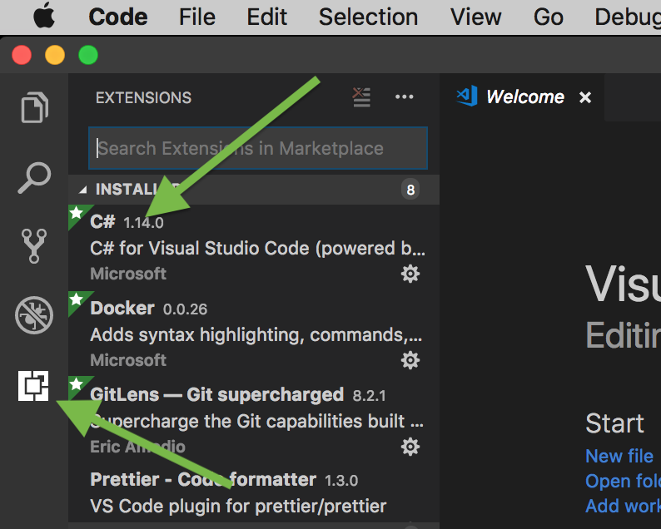
Environment SETUP
Install the VS Code
Add the C# and Docker extensions

Slide 7
WHY A SOLUTION File?
Not strictly needed in dotnet core, but there are upsides!
Allows you to build everything from a single asset
Some IDE’s like Visual Studio rely on a solution file. Its good to share…
Notes:
Solution files are no longer a mandatory part of .NET development, but that doesn’t mean they are useless…

Slide 8
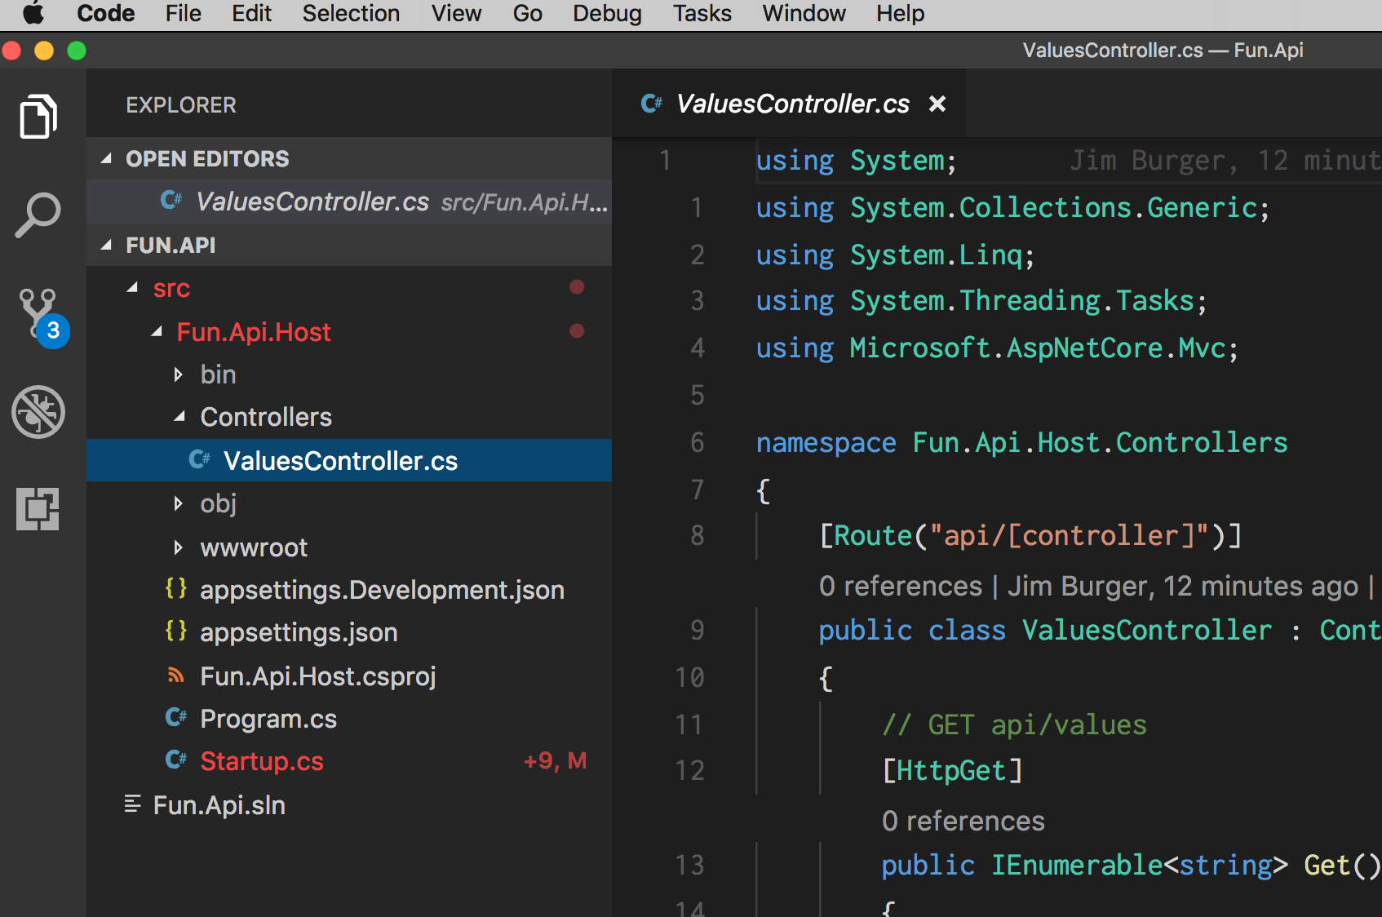
Create a SOLUTION
dotnet new sln
dotnet new webapi
dotnet sln add foo.csproj

Slide 9
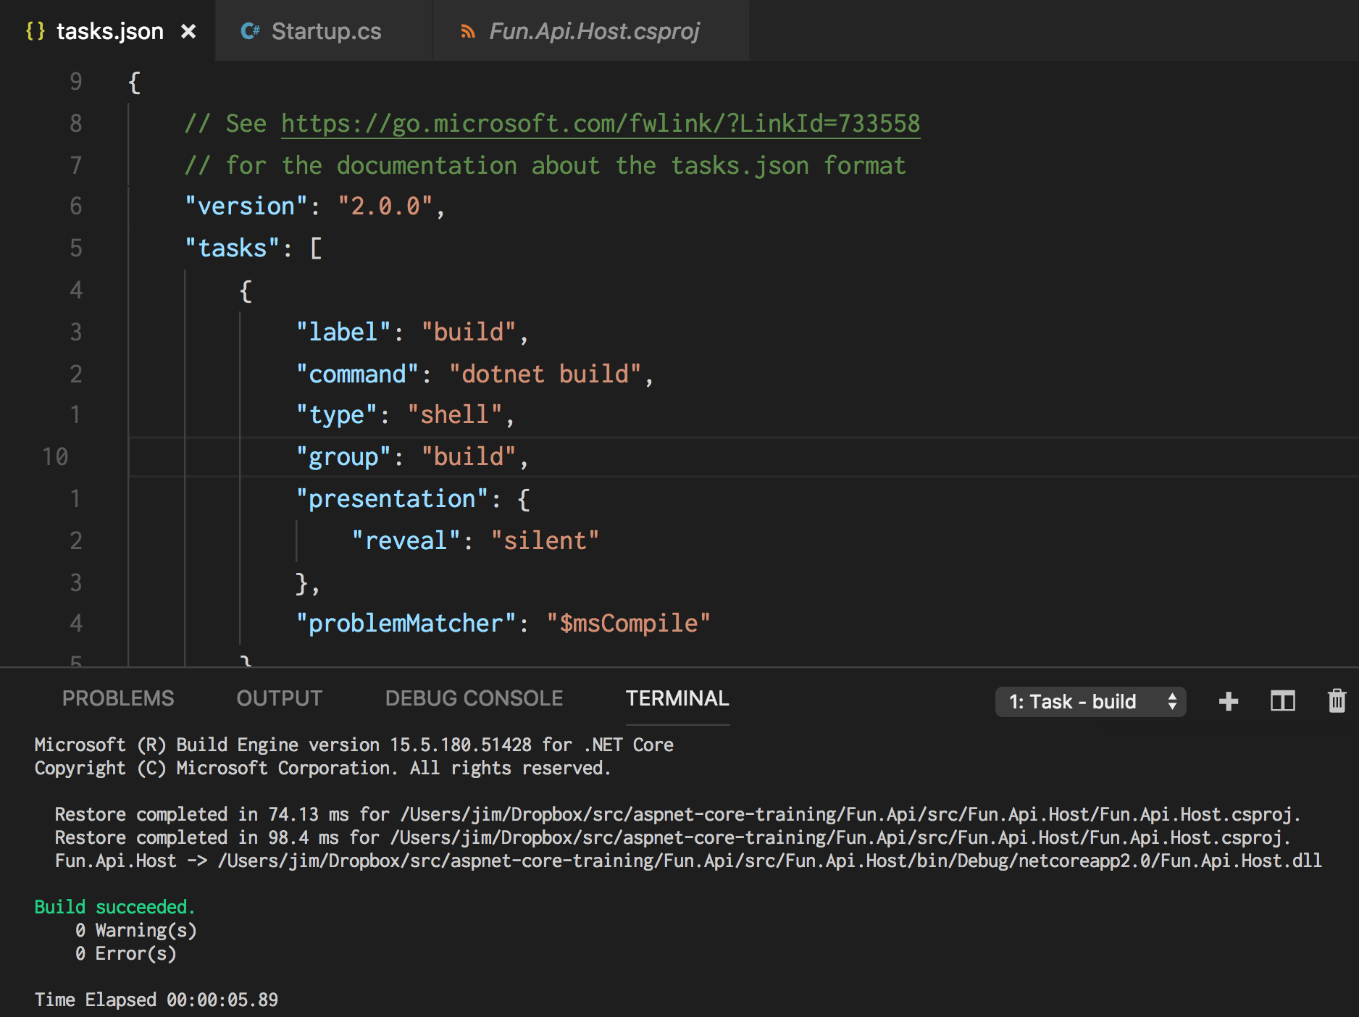
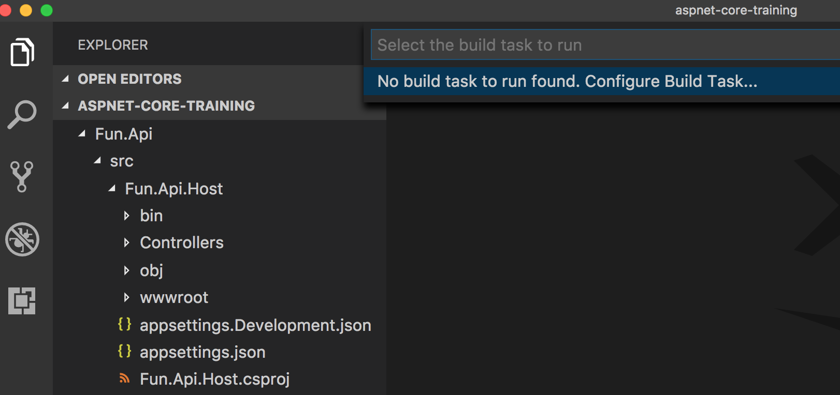
Build a SOLUTION

Slide 10
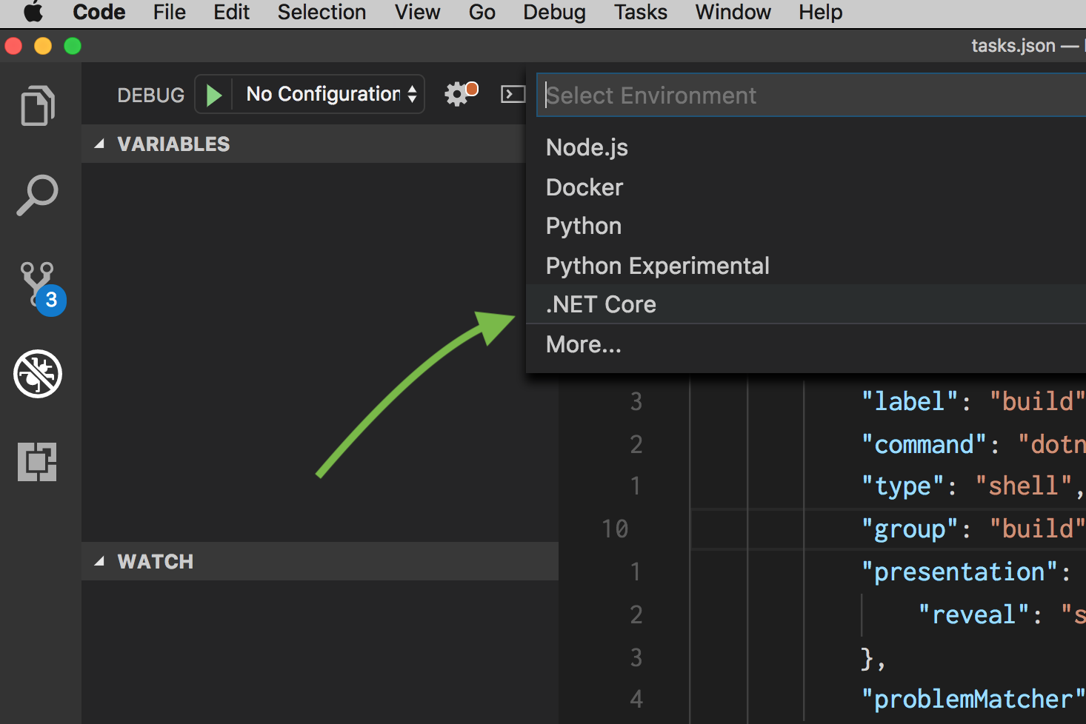
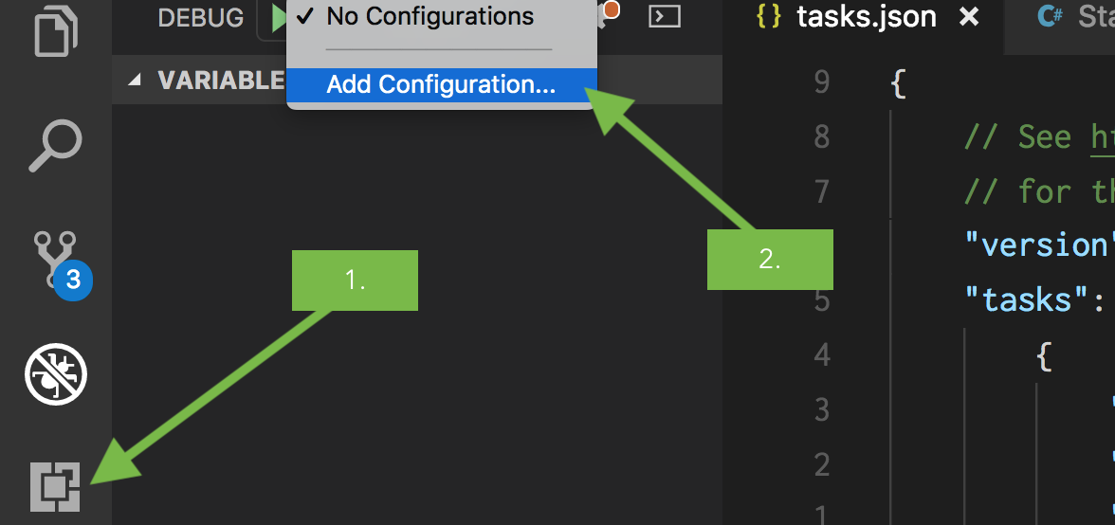
DEBUG a SOLUTION

Slide 11
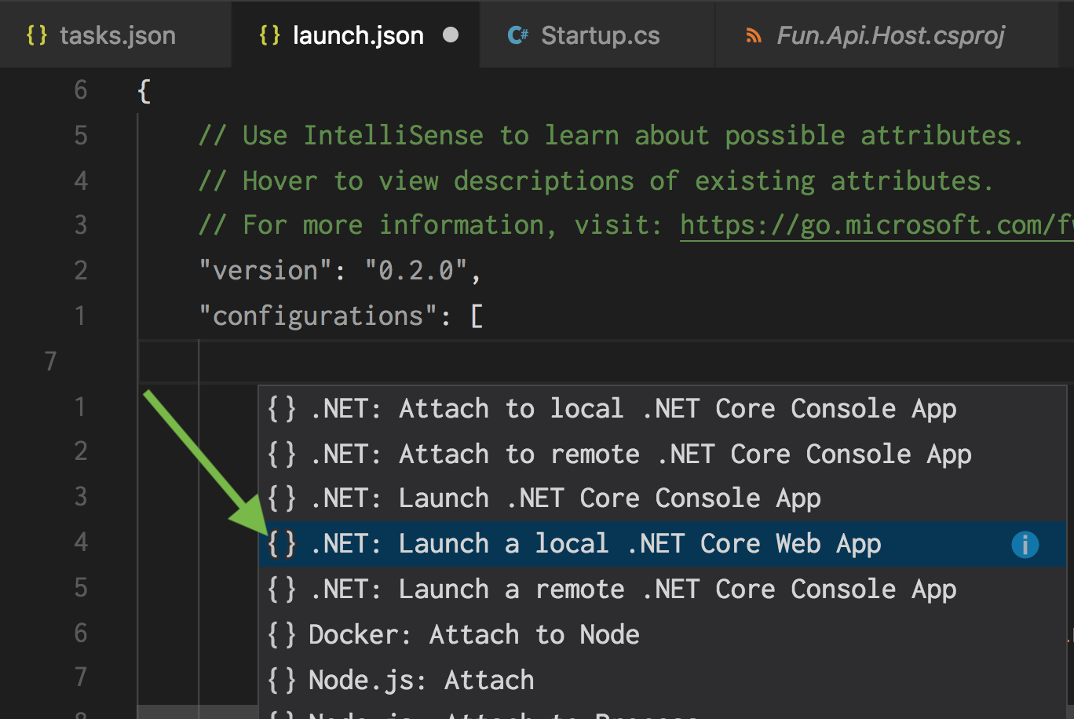
DEBUG a SOLUTION

Slide 12
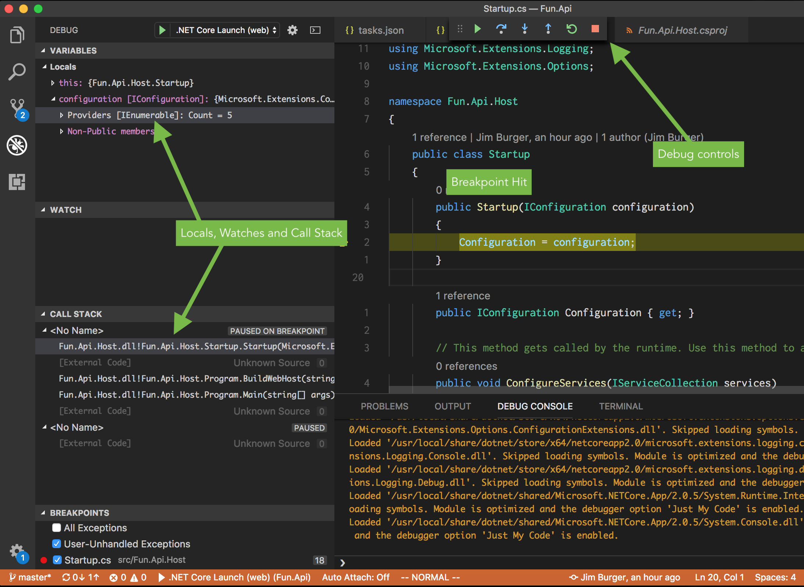
DEBUG a SOLUTION

Slide 13
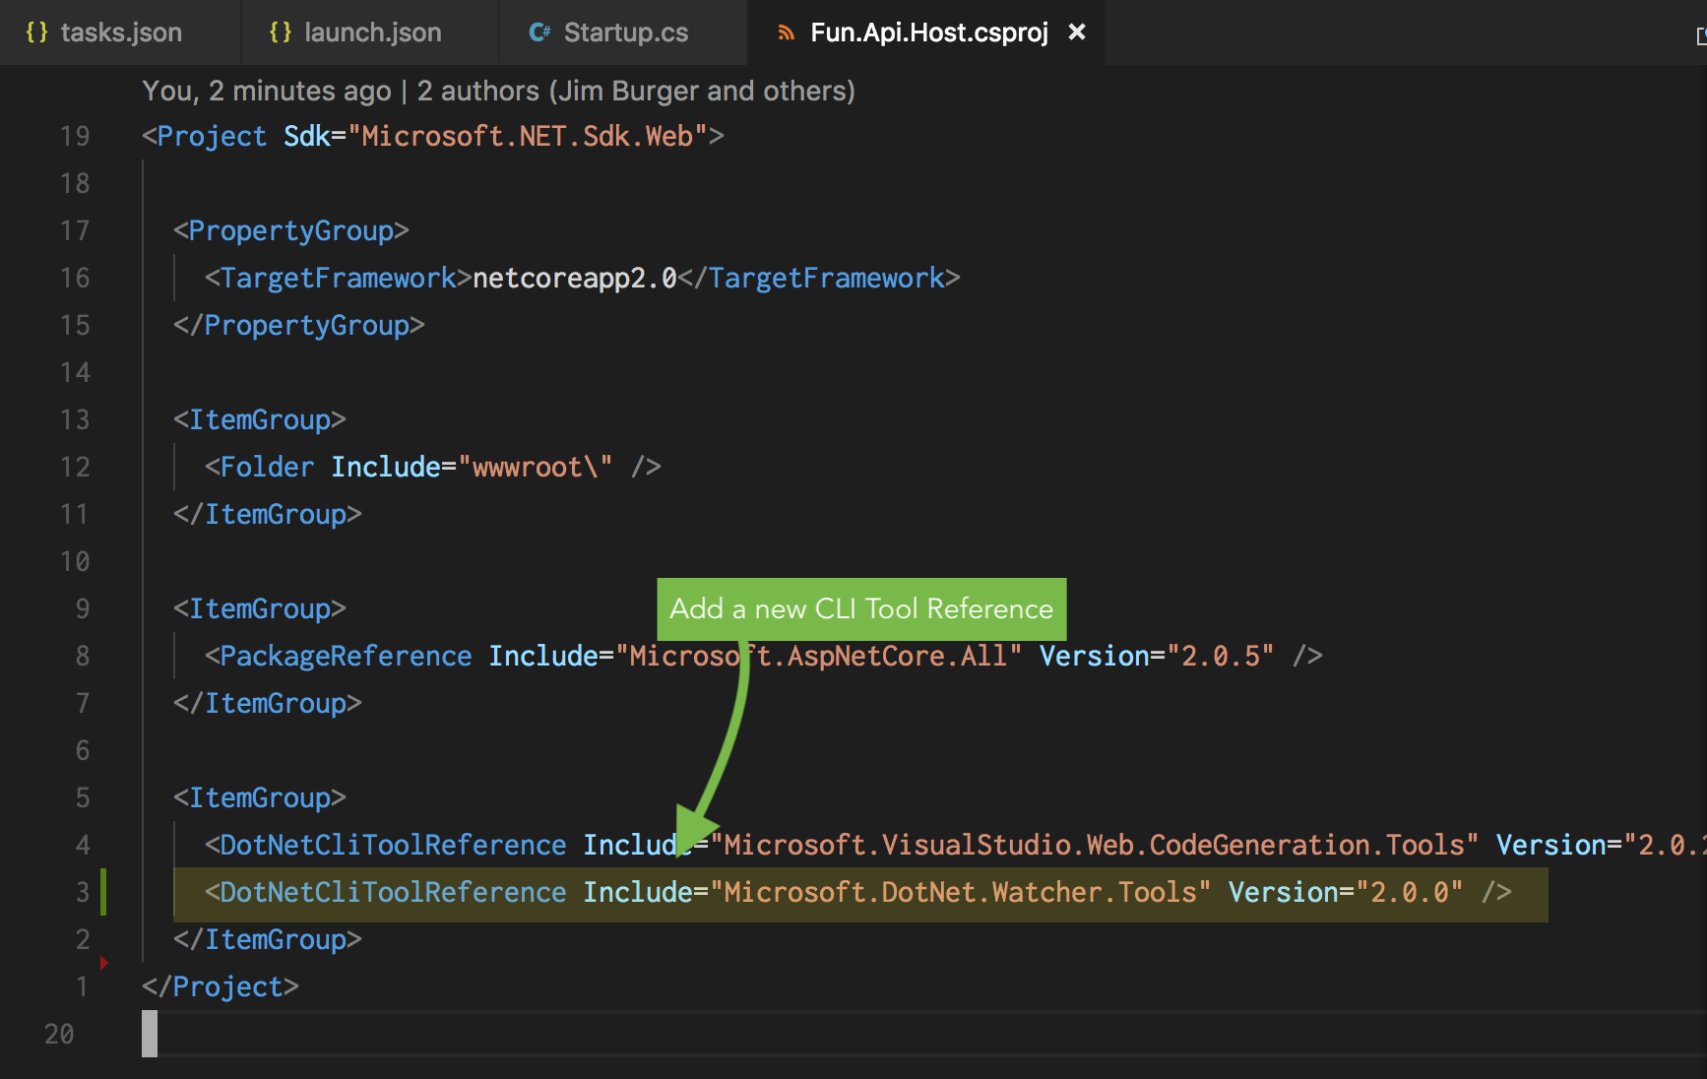
SET a ‘WATCH’

Slide 14
ADDING OUR OWN CODE

Slide 15
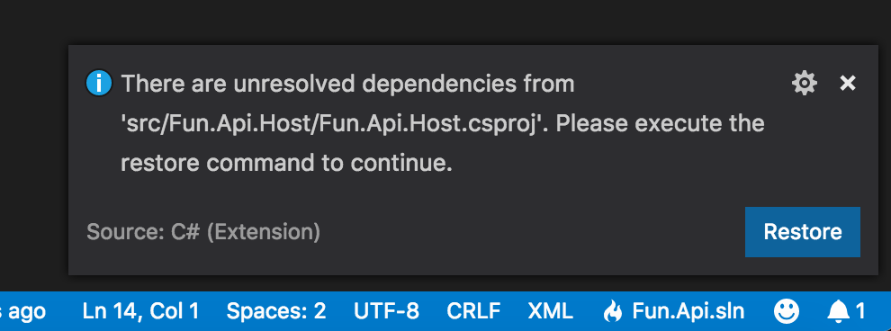
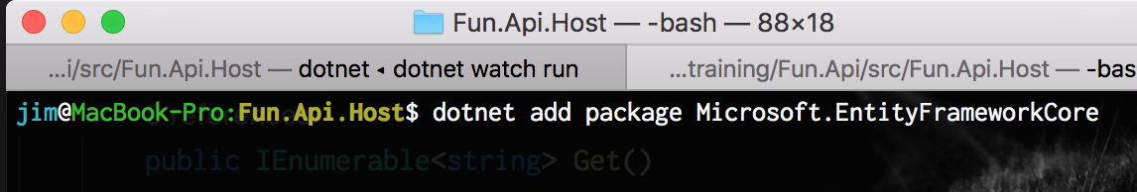
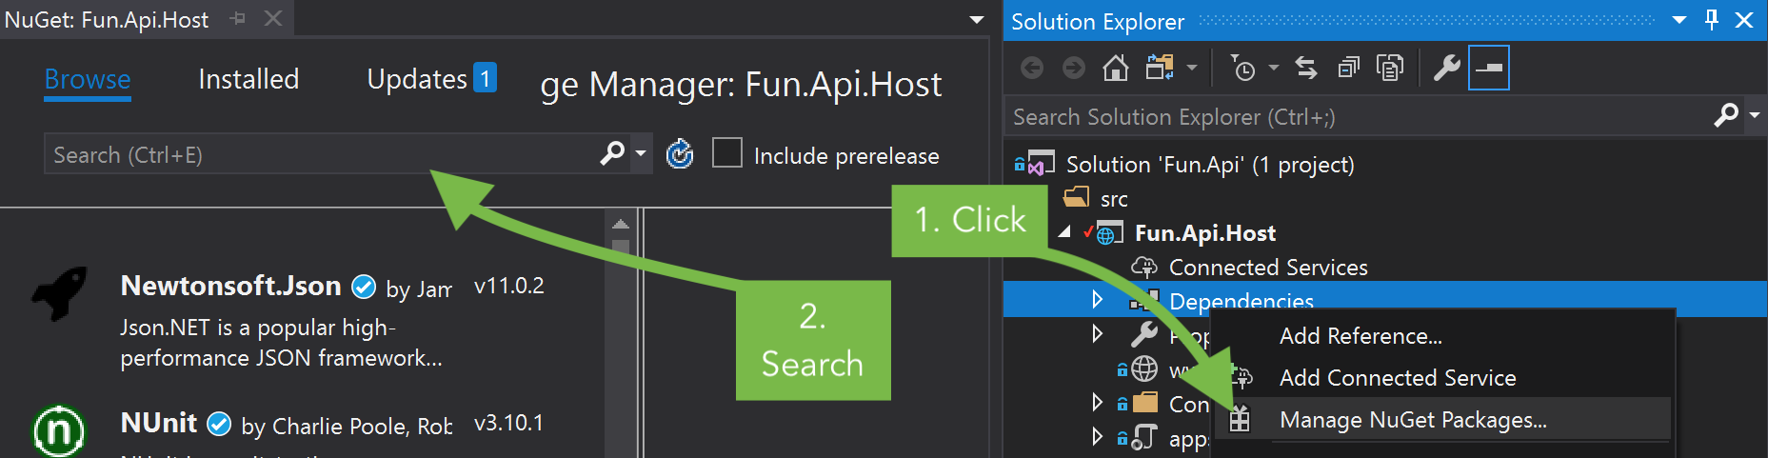
Add REFERENCES
Add references directly to csproj files
Use dotnet CLI to find and add references for you
IDE’s can do button click friendly versions of this

Slide 16
AdDING CONVENTIONAL ROUTES
The call to UseMvc() in Startup.Configure can be rewritten to use an overload that allows us to define a convention based routing template
Notes:
You'll notice that the ValuesController class that was generated in the Controlles folder of our source code, amkes use of meta-programming (Attributes) to designate the routing. This approach is fine for small jobs.
For bigger things it can really help to have a single place to go to, to inspect the way your application performs routing.
Attribute routing can give you fine grained control over things like parameters though, so it definitely has its place, and shouldn’t be discounted from design discussion.
So let's take a look at ASPNET Cores conventional routing approach to building the routes for our API.

Slide 17
Fuzzy UNITED BOARDING KENNELS
customers
Pets
bookings
Notes:
Fuzzy United (or FUN for short) is a boarding kennel in need of an API.
To keep things simple, we’ll tackle 3 entities: Customers, Pets & Bookings

