Slide 1
Cleaning, Structuring and Grounding Historical Data
One dataset, start to finish, with a coding agent
Jim Clifford, University of Saskatchewan

Slide 2
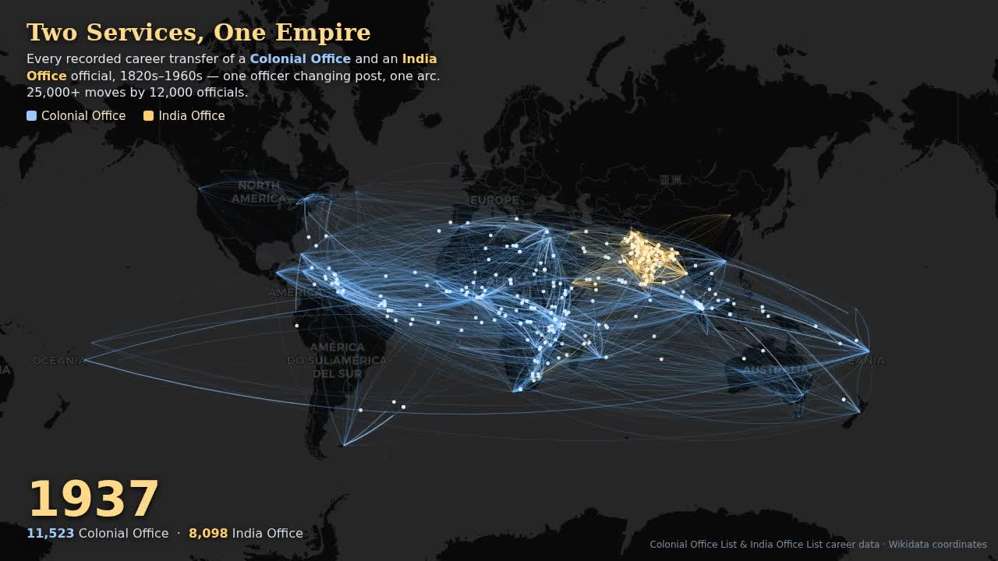
The atlas
Notes:
Let it run. 56 seconds. Every arc is one official moving between colonies, 1815 to 1966. Say nothing until the arcs reach Africa. If the network is down, play the downloaded mp4 instead; the still behind this slide is a frame from it.

Slide 3
What that was
46,926 officials
305,164 career events
211,581 of them on the map
Two printed reference books. One historian, a coding agent, a few months.
Ten years ago
Notes:
CO 27,526 people / 180,470 events / 131,343 placed. IOL 19,400 / 124,694 / 80,238. 36,431 arcs. 186 people in both services; Wodehouse.

Slide 4
Trading Consequences, 2013
Five institutions. A grant. A pipeline built by computational linguists. F-scores of 0.6.
Imperial Careers, 2026
One historian. A coding agent. A cheap model reading overnight. The same three problems.
Notes:
Clifford, Alex, Coates, Klein, Watson, Historical Methods 2016. “Italy” in Texas. What changed is who writes the pipeline and how fast the loop runs.

Slide 5
 | The question | You decide
Structure | What is a record here? | What counts as an event
Clean | One person or two? | Merge, keep apart, review
Ground | Which place, which person? | Supported, unresolved, wrong
Three questions

Slide 6
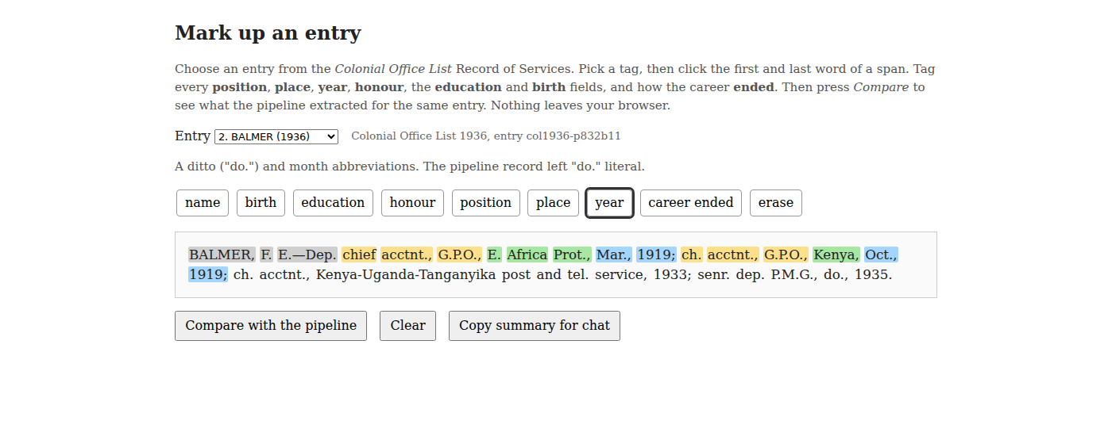
The model does everything around the decision, a hundred thousand times.
The second half of the method
Build. Extract. Visualise. See. Fix. Rerun.
The atlas was built to answer a question. It turned out to be the best error detector the project had.
The source
BALMER, F. E.—Dep. chief acctnt., G.P.O., E. Africa Prot., Mar., 1919; ch. acctnt., G.P.O., Kenya, Oct., 1919; ch. acctnt., Kenya-Uganda-Tanganyika post and tel. service, 1933; senr. dep. P.M.G., do., 1935.
85 volumes, 1883 to 1966. 1,400 to 2,900 entries in each. The same man in forty of them.
Mark one up
Notes:
Record of the Public Services of Officers. Cumulative. OCR’d with olmOCR; we begin after OCR.

Slide 7
jimclifford.ca/imperial-careers-workshop/annotate/ or the paper. Three minutes.

Slide 8
Structure
1. Python | a grammar for the entry shape | refuses anything it cannot fully parse
2. Qwen3.6-35B | one entry in, one JSON object out | run-on, ditto and concurrent clauses
3. Python | every place and year checked against the source | systematic errors fixed by rule
What is a record here?
Python, a cheap model, Python

Slide 9
Source | Record
“senr. dep. P.M.G., do., 1935” | place: “do.”
“BLAKELY … atty.-gen.’s off., B. Honduras, Apl., 1898.” | birth_year: 1898
“KT. BACH. (1920)” | two honours: KT; BACH
30,496 entries · 8.2 hours · 1 a second · 55 failures
The prompt is the decisions
Extract ONLY what is printed; never invent or infer facts.
events: one object per distinct posting. EXPLODE compound clauses.
place: as printed. No place in the clause? Carry the previous one and say so.
birth_year: only if printed. NEVER infer from the earliest career date.
Every rule is there because a run broke it.
Every tenth record, read against the source
186 sampled · 69% clean · 3% major
Notes:
IOL run, overnight 25–26 June, 16 workers, reasoning off, temp 0. Reasoning on: 67% failures. COL: 34,743, about a day including setup.

Slide 10
Not a bigger model
The errors are systematic, so the fixes are rules:
merge KT + BACH into Knight Bachelor
forward-fill a “do.” place, and say it was inherited
“officer in chief” back to “officer in charge”
stop pre-expanding “off.” at all
Every change logged on the record. Zero cost per entry.

Slide 11
Clean
One person or two?
Forty editions, one person
A missed link is recoverable. A false merge is not. Ties resolve to no merge.
Deterministic passes first: zero false merges on 543 hand-checked careers. Then a model argues each leftover cluster from a dossier. 917 so far, each with its reason.
Two clusters

Slide 12
ABERY, Joseph
M.B.C.M. · 1867 Ceylon, asst. colonial surgeon · one edition
CARBERY, Joseph
M.B.C.M. · 1867 Ceylon, asst. colonial surgeon · six editions
Merge. An OCR garble with one identical event.
A’BECKETT, Thomas, b. 1836
Lincoln’s Inn · Victorian puisne judge · knighted 1909
BECKETT, Thomas Rumbold, b. 1898
Judd School · Nigeria, telegraph engineer
Keep apart. Sixty-two years and nothing shared.

Slide 13
Ground
 | No tools | Pipeline | Opus, retrieval | Astra, retrieval
People right | 0 of 16 | 12 of 12 given | 16 of 16 | 16 of 16
Places | 38 of 104, modern | 3,207 surfaces | 17 of 138, stopped | 104, period entities
Time | 5 min | overnight, corpus | 20 min | 27 min
Which place, which person?
Why ground
Every arc needs coordinates for “the Central Provinces”, “British Guiana”, “Jodhpur”.
Wikidata has the item, or the capital that has the coordinates. One query.
And: a historian of the Cape and a historian of Bombay who both ground to Q1800510 have joined their data without meeting.
Live: the lookup
“Henry Trimen botanist Ceylon Peradeniya” → read the statements → supported
“Ferdinando Hamlyn Price” → Q123279571, b. 1855, Tamil description only → supported, and the pipeline’s gate had rejected it
“Elwood D’Arcy Tibbits Antigua” → nothing → unresolved, record the search
Ask a chatbot instead
0 of 16
Gemini 3.8 Flash, no tools, the same twenty entries.
Alfred Sharpe → a species of orchid. Richard Wilkinson → Thoth. Nyasaland → a disambiguation page. Joseph Chamberlain → a Swiss footballer.
It knew who. It did not know the number.
Four ways to get the number
Notes:
WikidataMCP vector search. Saved results in outputs/ground-test/ if the network fails.

Slide 14
27 minutes for 20 entries is 25 days for one List. The retrieval columns are the review queue, not the corpus.
Notes:
George V from memory: Q269 is Tashkent; Opus caught it by reading the page. Gorges has two items. Harris b. 1858 vs item 1855.

Slide 15
The map finds the errors
Seen on the map | Cause | Fix
A premier of British Columbia with a seat in Melbourne | “Victoria” grounded once, by string | Resolve per person
The Union of South Africa at Harare: 960 events | “South Africa” matched inside “British South Africa Company” | Five cache rows; a guard on the join
Two Baluchistans | One under Q843, Pakistan | One canonical row
Three errors

Slide 16
Fix the rule, re-emit both corpora, look at everyone the rule touched.
What the map cannot find
76%
of the judge’s “different” verdicts were wrong in the rare-surname, overlapping-era stratum.
No map shows a missed merge. For that: 200 hand-labelled cases, risky strata oversampled.
Exercise

Slide 17
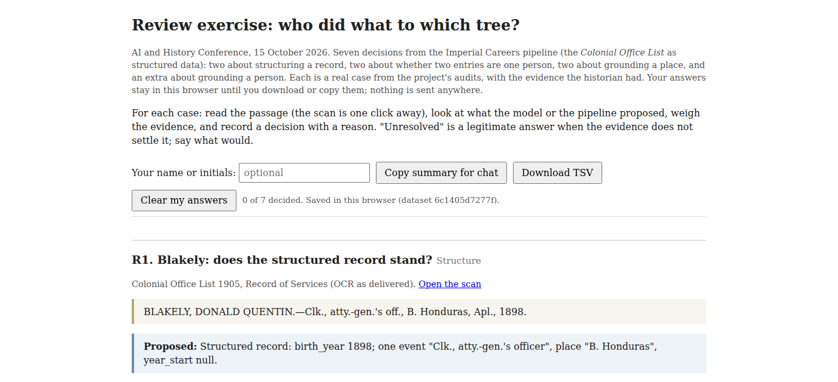
jimclifford.ca/imperial-careers-workshop/review/
Structure Blakely, Balmer
Clean Abery, A’Beckett
Ground South Africa, Brewster
Extra Price
Write the reason.
Zoom: Copy summary for chat.

Slide 18
 |  | You decide
Structure | What is a record here? | What counts as an event
Clean | One person or two? | Merge, keep apart, review
Ground | Which place, which person? | Supported, unresolved, wrong
Your own data
One question, one small sample, the page reachable
Build the view early. It is your error detector
Local identifiers first. None from memory
Ground to the historical entity, per person
Ties resolve to no merge
Fix the rule, not the record. Make the correction a test
A frontier model writes the pipeline; a cheap one reads the collection
Three questions

Slide 19
jimclifford.ca/imperial-careers-workshop · data jimclifford.ca/col_matching

